Slide 1

Chapter
2
Global E-Business: How Businesses Use Information Systems

Slide 2
Management Information Systems
Chapter 2 Global E-Business: How Businesses Use Information Systems
LEARNING OBJECTIVES
Define and describe business processes and their relationship to information systems.
Describe the information systems supporting the major business functions: sales and marketing, manufacturing and production, finance and accounting, and human resources.
Evaluate the role played by systems serving the various levels of management in a business and their relationship to each other.

Slide 3
Management Information Systems
Chapter 2 Global E-Business: How Businesses Use Information Systems
LEARNING OBJECTIVES (Continued)
Explain how enterprise applications and intranets promote business process integration and improve organizational performance.
Assess the role of the information systems function in a business.

Slide 4
Management Information Systems
Chapter 2 Global E-Business: How Businesses Use Information Systems
Information Systems Join the Tupperware Party
Problem: Continuing expansion and transition to multilevel compensation structure.
Solutions: Revised ordering processes and monitoring service levels and sales increase sales.
Oracle Collaboration Suite and Portal enable order entry via Web interface, access to integrated corporate systems, and personal e-commerce sites.
Demonstrates IT’s role in designing compensation structure and system integration.
Illustrates the benefits of revising internal and customer-related business processes.

Slide 5
Management Information Systems
Chapter 2 Global E-Business: How Businesses Use Information Systems
Business Processes and Information Systems
Business processes
How information technology enhances business processes: efficiency and transformation

Slide 6
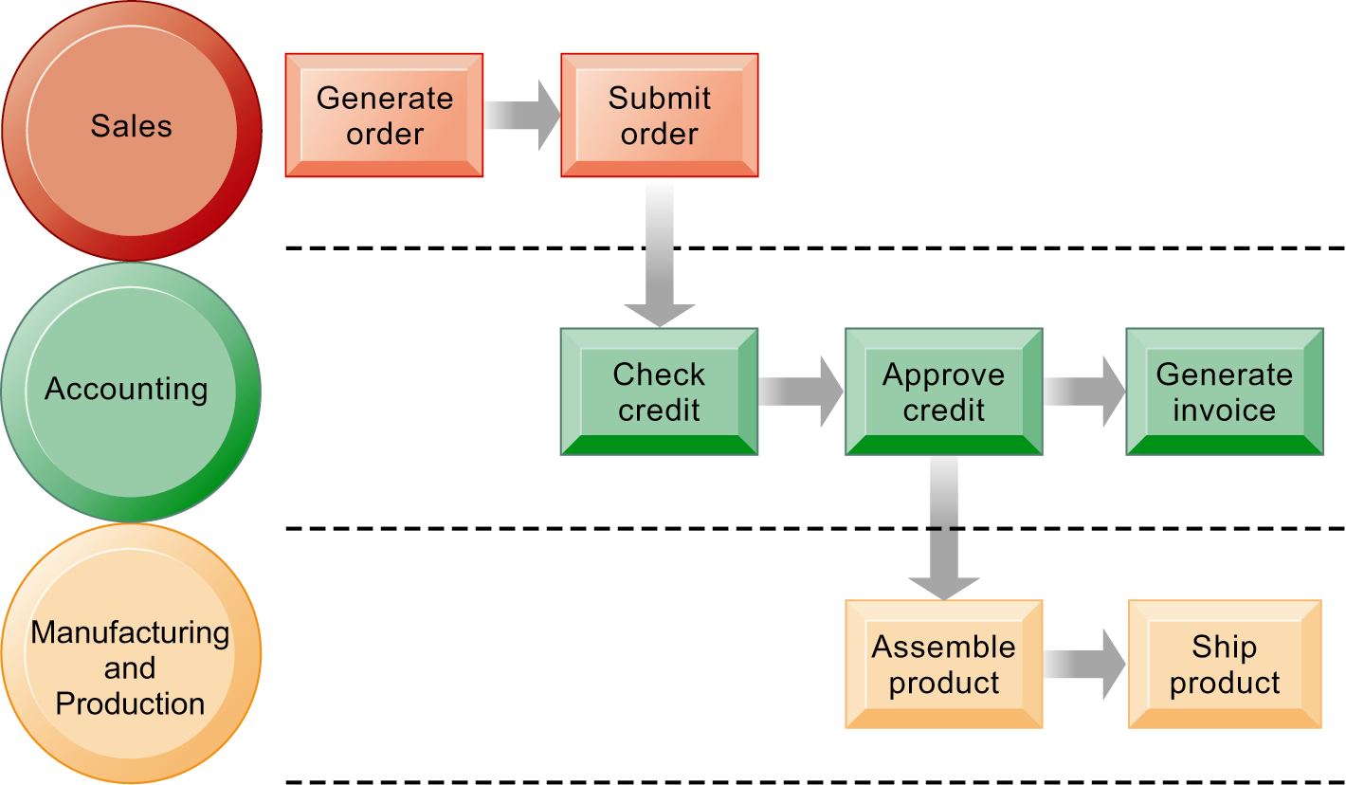
Management Information Systems
Chapter 2 Global E-Business: How Businesses Use Information Systems
Business Processes and Information Systems
The Order Fulfillment Process
Fulfilling a customer order involves a complex set of steps that requires the close coordination of the sales, accounting, and manufacturing functions.
Figure 2-1

Slide 7
Management Information Systems
Chapter 2 Global E-Business: How Businesses Use Information Systems
Types of Business Information Systems
Systems from a functional perspective
  Sales and marketing systems
  Manufacturing and production systems
  Finance and accounting systems
  Human resources systems
Systems from a constituency perspective
  Transaction processing systems
  Management information systems and decision-support systems
  Executive support systems
Relationship of systems to one another

Slide 8
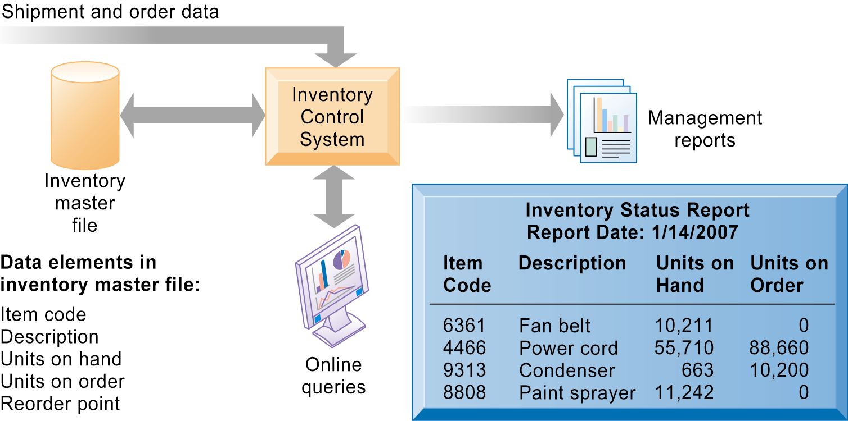
Management Information Systems
Chapter 2 Global E-Business: How Businesses Use Information Systems
Types of Business Information Systems
Overview of an Inventory System
This system provides information about the number of items available in inventory to support manufacturing and production activities.
Figure 2-3

Slide 9
Management Information Systems
Chapter 2 Global E-Business: How Businesses Use Information Systems
Types of Business Information Systems
Information Systems Help Kia Solve Its Quality Problems
Read the Interactive Session: Organizations, and then discuss the following questions:
  Why was it so difficult for Kia to identify sources of defects in the cars it produced?
  What was the business impact of Kia not having an information system to track defects? What other business processes besides manufacturing and production were affected?
  How did Kia’s new defect-reporting system improve the way it ran its business?
  What management, organization, and technology issues did Kia have to address when it adopted its new quality control system?
  What new business processes were enabled by Kia’s new quality control system?

Slide 10
Management Information Systems
Chapter 2 Global E-Business: How Businesses Use Information Systems
Types of Business Information Systems
Managing Travel Expenses: New Tools, New Savings
Read the Interactive Session: Management, and then discuss the following questions:
  What kinds of systems are described here? What valuable information do they provide for employees and managers? What decisions do they support?
  What problems do automated expense reporting systems solve for companies? How do they provide value for companies that use them?
  Compare MarketStar’s manual process for travel and entertainment expense reporting with its new process based on Concur Expense Service. Diagram the two processes.
  What management, organization, and technology issues did MarketStar have to address when adopting Concur Expense Service?
  Are there any disadvantages to using computerized expense processing systems? Explain your answer.

Slide 11
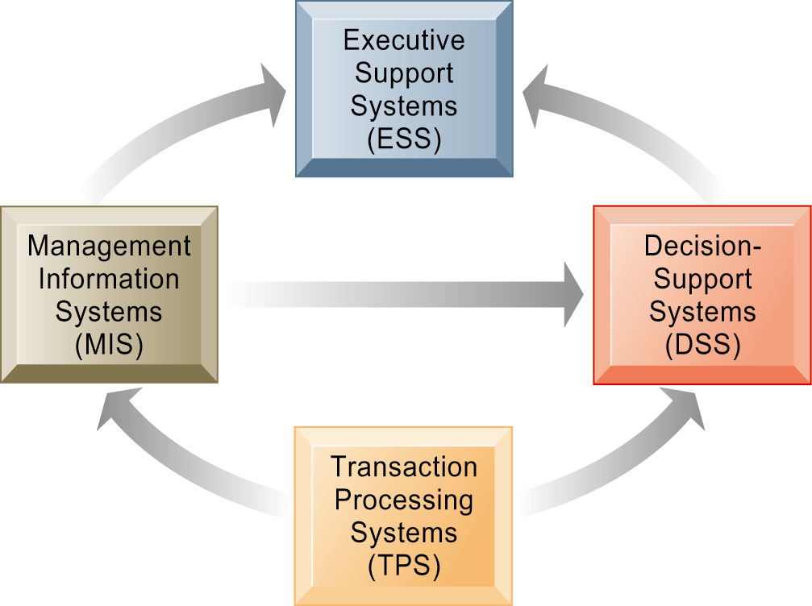
Management Information Systems
Chapter 2 Global E-Business: How Businesses Use Information Systems
Types of Business Information Systems
Interrelationships Among Systems
The various types of systems in the organization have interdependencies. TPS are major producers of information that is required by many other systems in the firm, which, in turn, produce information for other systems. These different types of systems are loosely coupled in most business firms, but increasingly firms are using new technologies to integrate information that resides in many different systems.
Figure 2-10

Slide 12
Management Information Systems
Chapter 2 Global E-Business: How Businesses Use Information Systems
Systems That Span the Enterprise
Enterprise applications
  Enterprise systems
  Supply chain management systems
  Customer relationship management systems
  Knowledge management systems
Intranets and extranets
E-business, e-commerce, and e-government

Slide 13
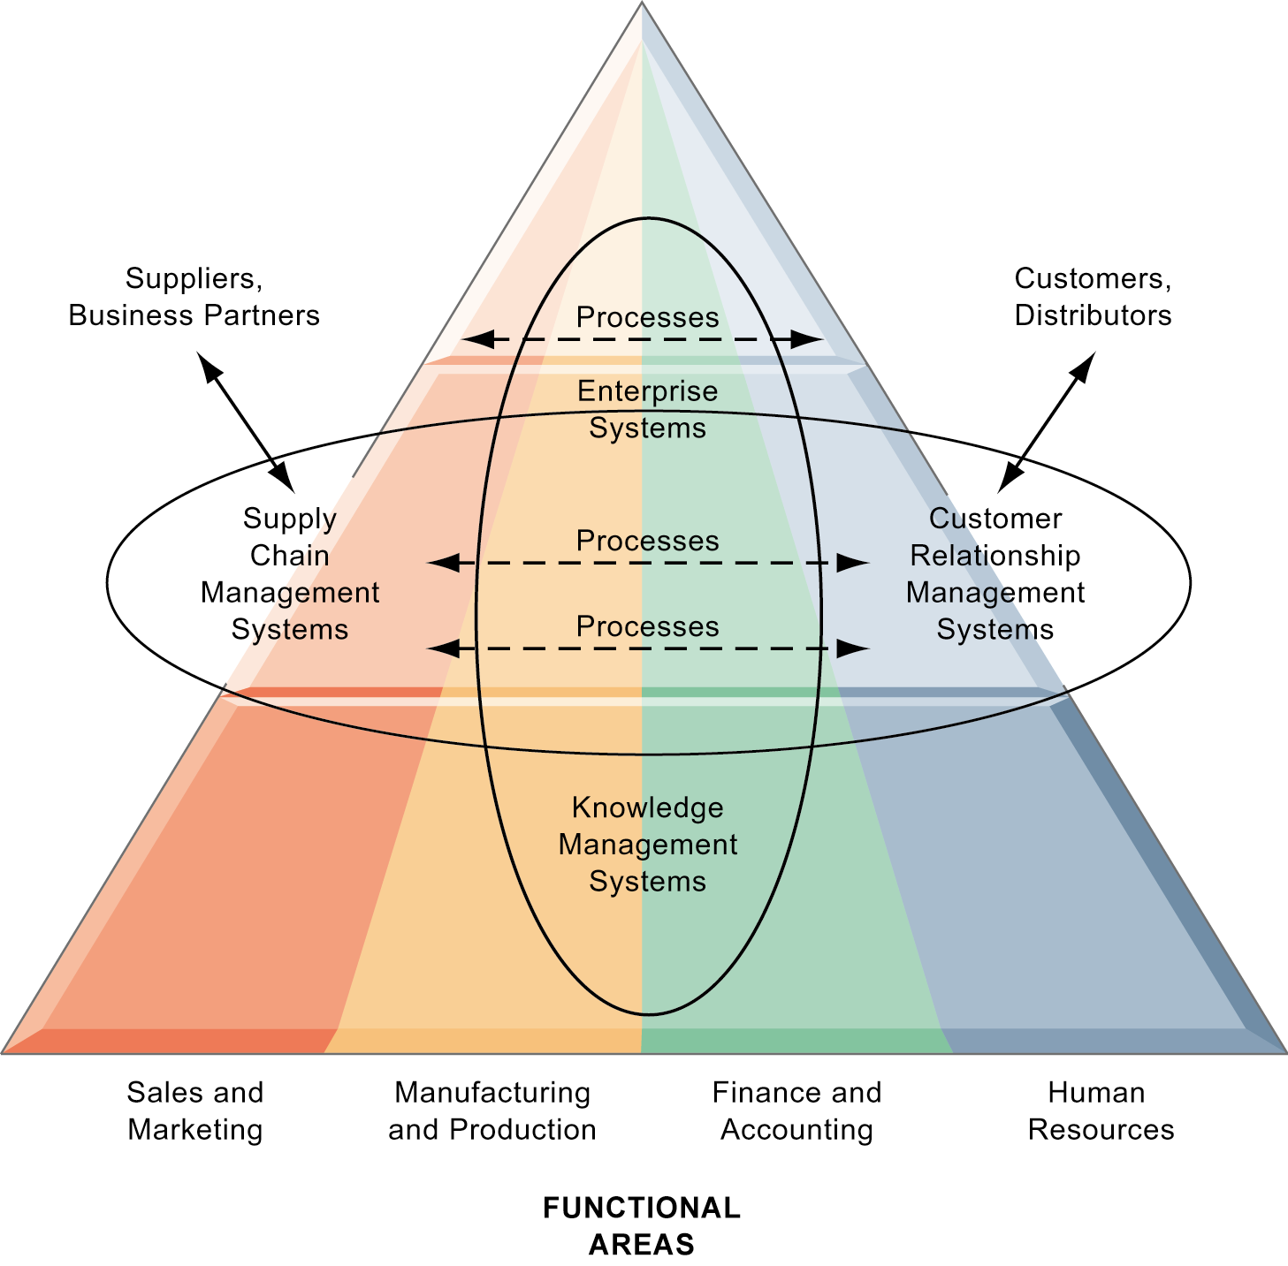
Management Information Systems
Chapter 2 Global E-Business: How Businesses Use Information Systems
Systems That Span the Enterprise
Enterprise Application Architecture
Enterprise applications automate processes that span multiple business functions and organizational levels and may extend outside the organization.
Figure 2-11

Slide 14
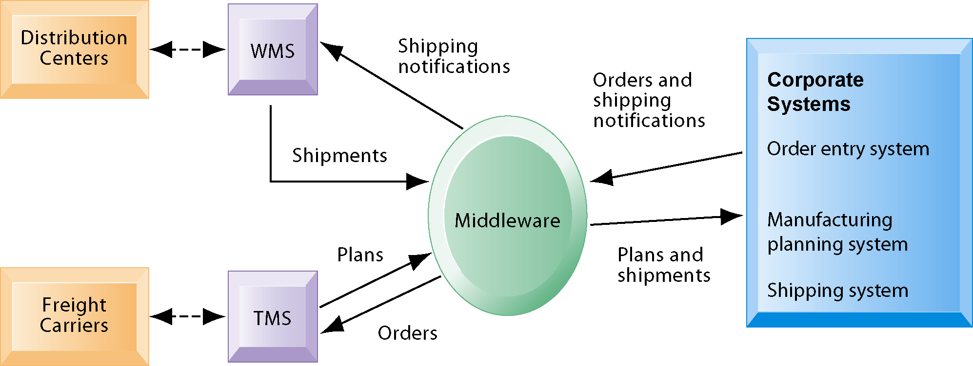
Management Information Systems
Chapter 2 Global E-Business: How Businesses Use Information Systems
Systems That Span the Enterprise
Example of Supply Chain Management System
Customer orders, shipping notifications, optimized shipping plans, and other supply chain information flow among Haworth’s Warehouse Management System (WMS), Transportation Management System (TMS), and its back-end corporate systems.
Figure 2-13

Slide 15
Management Information Systems
Chapter 2 Global E-Business: How Businesses Use Information Systems
The Information Systems Function in Business
The information systems department
Organizing the information systems function

