Slide 1

Chapter
10
E-Commerce: Digital Markets, Digital Goods

Slide 2
Management Information Systems
Chapter 10 E-Commerce: Digital Markets, Digital Goods
LEARNING OBJECTIVES
Describe the unique features of e-commerce, digital markets, and digital goods.
Analyze how Internet technology has changed value propositions and business models.
Describe the various types of e-commerce and how
e-commerce has changed consumer retailing and business-to-business transactions.

Slide 3
Management Information Systems
Chapter 10 E-Commerce: Digital Markets, Digital Goods
LEARNING OBJECTIVES (cont’d)
Evaluate the role of m-commerce in business and describe the most important m-commerce applications.
Compare the principal payment systems for electronic commerce.

Slide 4
Management Information Systems
Chapter 10 E-Commerce: Digital Markets, Digital Goods
Major League Baseball Hits a Home Run with Information Systems
Problem: Declining revenue from traditional sales channels, declining customer base, increasing costs.
Solutions: MLB Web sites and cell phone ticketing enable electronic ticketing and delivery of online information and games, which increase sales.
SAS customer analysis software and Web site tracking tools help identify good sales prospects.
Demonstrates IT’s role in reducing cost, opening new sales channels, and building community with customers.
Illustrates the emerging digital firm landscape where businesses can use tools to analyze critical data and leverage expertise in emerging technologies to offer services to other businesses.

Slide 5
Management Information Systems
Chapter 10 E-Commerce: Digital Markets, Digital Goods
Electronic Commerce and the Internet
E-Commerce today
Why e-commerce is different
  Ubiquity
  Global reach
  Universal standards
  Richness
  Interactivity
  Information density
  Personalization/customization

Slide 6
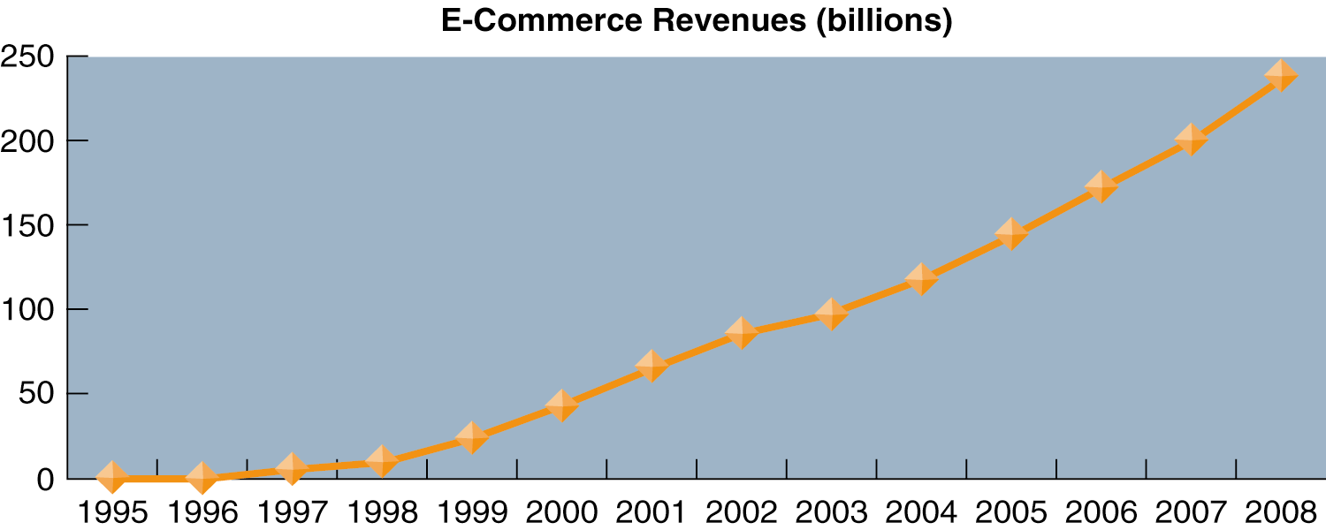
Management Information Systems
Chapter 10 E-Commerce: Digital Markets, Digital Goods
Electronic Commerce and the Internet
The Growth of E-Commerce
Retail e-commerce revenues have grown exponentially since 1995 and have only recently “slowed” to a very rapid 25 percent annual increase, which is projected to remain the same until 2008.
Source: Based on data from eMarketer, 2006; Shop.org and Forrester Research, 2005; and authors.
Figure 10-1

Slide 7
Management Information Systems
Chapter 10 E-Commerce: Digital Markets, Digital Goods
Electronic Commerce and the Internet
Key concepts in e-commerce: Digital markets and digital goods
Internet business models
  Communication and community
  Digital content, entertainment, and services

Slide 8
Management Information Systems
Chapter 10 E-Commerce: Digital Markets, Digital Goods
Electronic Commerce and the Internet
The Allure of MySpace
Read the Interactive Session: Management, and then discuss the following questions:
  How do businesses benefit from MySpace? How do MySpace members benefit?
  Does MySpace create an ethical dilemma? Why or why not?
  Do parent and schools’ objections to MySpace have any merit? Should a site like MySpace be allowed to operate? Why or why not?
  Is there anything that MySpace management can do to make the site less controversial?

Slide 9
Management Information Systems
Chapter 10 E-Commerce: Digital Markets, Digital Goods
Electronic Commerce
Types of electronic commerce
Achieving customer intimacy: Interactive marketing, personalization, and self-service
  Blogs
Business-to-business (B2B) electronic commerce: New efficiencies and relationships
  EDI
  Procurement
  Private industrial networks (private exchanges)
  Net marketplaces
  Exchanges

Slide 10
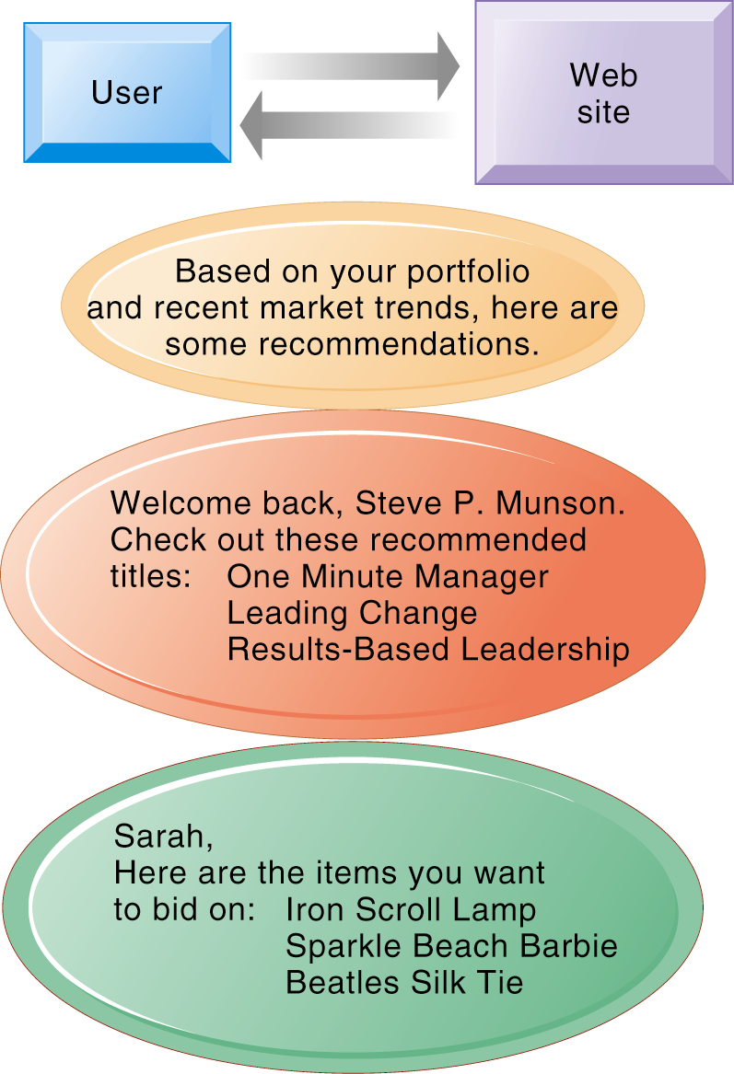
Management Information Systems
Chapter 10 E-Commerce: Digital Markets, Digital Goods
Electronic Commerce
Web Site Personalization
Firms can create unique personalized Web pages that display content or ads for products or services of special interest to individual users, improving the customer experience and creating additional value.
Figure 10-4

Slide 11
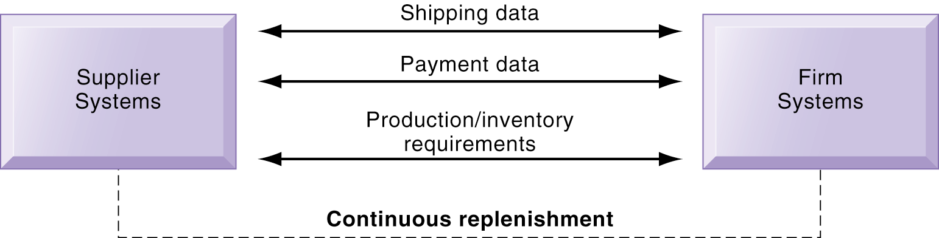
Management Information Systems
Chapter 10 E-Commerce: Digital Markets, Digital Goods
Electronic Commerce
Electronic Data Interchange (EDI)
Companies use EDI to automate transactions for B2B e-commerce and continuous inventory replenishment. Suppliers can automatically send data about shipments to purchasing firms. The purchasing firms can use EDI to provide production and inventory requirements and payment data to suppliers.
Figure 10-5

Slide 12
Management Information Systems
Chapter 10 E-Commerce: Digital Markets, Digital Goods
Electronic Commerce
Stonyfield Farm Blogs for Organic Communication
Read the Interactive Session: Organizations, and then discuss the following questions:
  How are Unilever executives’ wireless handhelds related to the company’s business performance?
  Discuss the potential impact of a security breach at Unilever.
  What management, organization, and technology factors had to be addressed in developing security policies and procedures for Unilever’s wireless handhelds?
  Is it a good idea to allow Unilever executives to use both BlackBerrys and cell phones? Why or why not?

Slide 13
Management Information Systems
Chapter 10 E-Commerce: Digital Markets, Digital Goods
M-Commerce
M-Commerce services and applications
  Content and location-based services
  Banking and financial services
  Wireless advertising
  Games and entertainment
Accessing information from the wireless Web
M-Commerce challenges

Slide 14
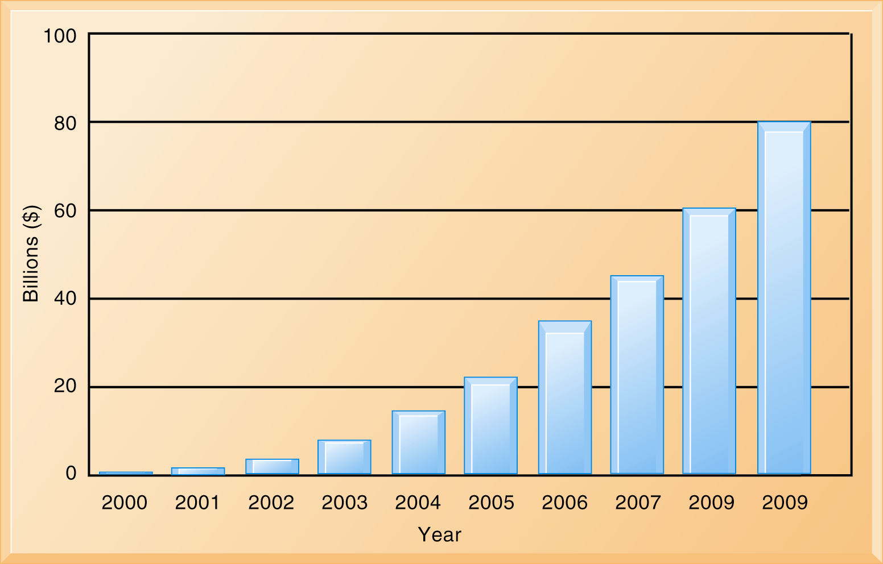
Management Information Systems
Chapter 10 E-Commerce: Digital Markets, Digital Goods
M-Commerce
Electronic Data Interchange (EDI)
Companies use EDI to automate transactions for B2B e-commerce and continuous inventory replenishment. Suppliers can automatically send data about shipments to purchasing firms. The purchasing firms can use EDI to provide production and inventory requirements and payment data to suppliers.
Figure 10-8

Slide 15
Management Information Systems
Chapter 10 E-Commerce: Digital Markets, Digital Goods
Electronic Commerce Payment Systems
Types of electronic payment systems
Digital payment systems for m-commerce

