Slide 1

Chapter
11
Managing Knowledge

Slide 2
Management Information Systems
Chapter 11 Managing Knowledge
LEARNING OBJECTIVES
Assess the role of knowledge management and knowledge management programs in business.
Describe the types of systems used for enterprise-wide knowledge management and demonstrate how they provide value for organizations.
Describe the major types of knowledge work systems and assess how they provide value for firms.
Evaluate the business benefits of using intelligent techniques for knowledge management.

Slide 3
Management Information Systems
Chapter 11 Managing Knowledge
Content Management Makes Southern Company a Top Utility Performer
Problem: Document-intensive business, fragmented information in legacy systems and manual processes.
Solutions: Document access rules and procedures reduce the time and cost of business processes by cutting delays in accessing design documents.
Documentum content management software and Oracle database coordinates design documents and maintenance data, and makes them immediately available.
Demonstrates IT’s role in reducing cost by making organizational knowledge more easily available.
Illustrates how an organization can become more efficient and profitable through content management.

Slide 4
Management Information Systems
Chapter 11 Managing Knowledge
The Knowledge Management Landscape
Important dimensions of knowledge
  Organizational learning and knowledge management
The knowledge management value chain
  Knowledge acquisition
  Knowledge storage
  Knowledge dissemination
  Knowledge application
  Building organizational and management capital: Collaboration, communities of practice, and office environments
Types of knowledge management systems

Slide 5
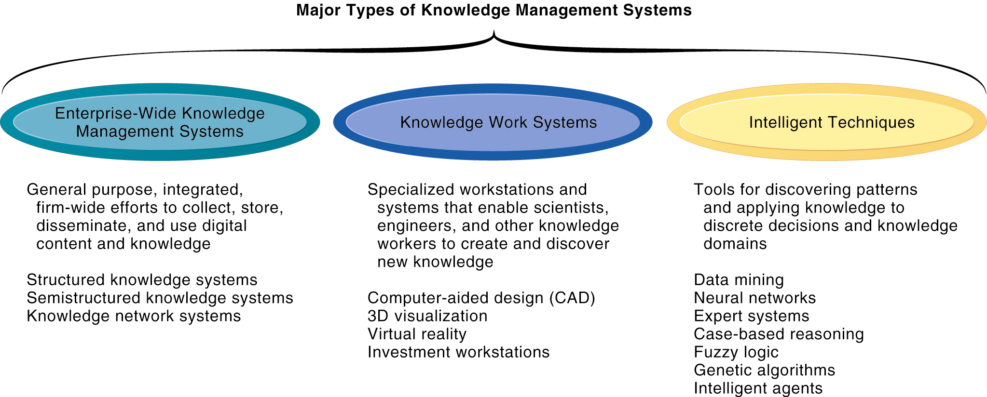
Management Information Systems
Chapter 11 Managing Knowledge
The Knowledge Management Landscape
Major Types of Knowledge Management Systems
There are three major categories of knowledge management systems, and each can be broken down further into more specialized types of knowledge management systems.
Figure 11-3

Slide 6
Management Information Systems
Chapter 11 Managing Knowledge
Enterprise-Wide Knowledge Management Systems
Structured knowledge systems
Semistructured knowledge systems
  Organizing knowledge: Taxonomies and tagging
Knowledge network systems
Supporting technologies: Portals, collaboration tools, and learning management systems

Slide 7
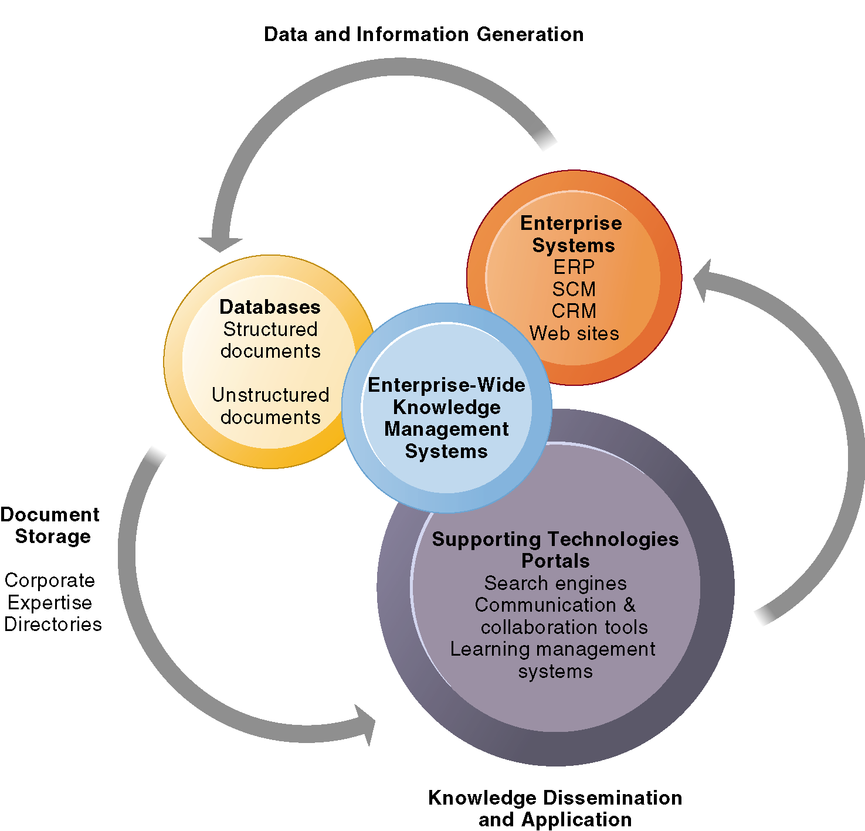
Management Information Systems
Chapter 11 Managing Knowledge
Enterprise-Wide Knowledge Management Systems
Enterprise-Wide Knowledge Management Systems
Enterprise-wide knowledge management systems use an array of technologies for storing structured and unstructured documents, locating employee expertise, searching for information, disseminating knowledge, and using data from enterprise applications and other key corporate systems.
Figure 11-4

Slide 8
Management Information Systems
Chapter 11 Managing Knowledge
Enterprise-Wide Knowledge Management Systems
Stikeman Elliott Computerizes Its Brainpower
Read the Interactive Session: Organizations, and then discuss the following questions:
  What are the problems and challenges that a law firm such as Stikeman Elliott faces?
  What solutions are available to solve these problems?
  How did implementing Hummingbird address these problems? How successful was the solution? Did Stikeman Elliott choose the best alternative?

Slide 9
Management Information Systems
Chapter 11 Managing Knowledge
Enterprise-Wide Knowledge Management Systems
Sharing Knowledge with Social Bookmarking
Read the Interactive Session: Technology, and then discuss the following questions:
  What are the advantages and disadvantages of using social bookmarking for knowledge management?
  What management, organization, and technology issues should be addressed when considering whether to use social bookmarking for knowledge management at a business?
  Should there be different standards for posting bookmarks to public Web pages at a public Web site and posting bookmarks to internal corporate Web pages on a corporate social bookmarking site?

Slide 10
Management Information Systems
Chapter 11 Managing Knowledge
Knowledge Work Systems
Knowledge workers and knowledge work
Requirements of knowledge work systems
Examples of knowledge work systems
  CAD
  Virtual reality
  VRML
  Investment workstations

Slide 11
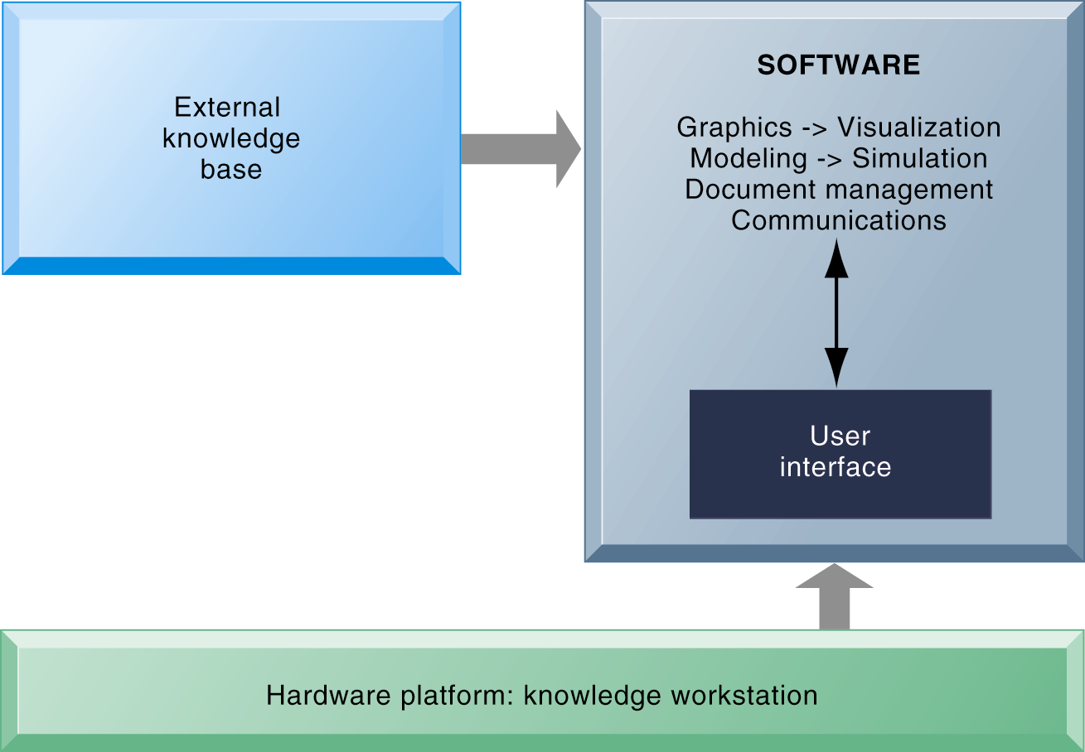
Management Information Systems
Chapter 11 Managing Knowledge
Knowledge Work Systems
Requirements of Knowledge Work Systems
Knowledge work systems require strong links to external knowledge bases in addition to specialized hardware and software.
Figure 11-8

Slide 12
Management Information Systems
Chapter 11 Managing Knowledge
Intelligent Techniques
Capturing knowledge: Expert systems
  How expert systems work
  Examples of successful expert systems
Organizational intelligence: Case-based reasoning
Fuzzy logic systems
Neural networks
Genetic algorithms
Hybrid AI systems
Intelligent agents

Slide 13
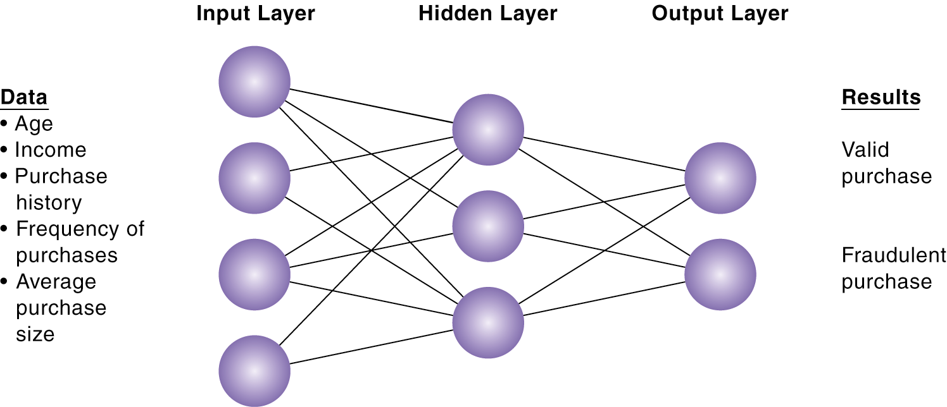
Management Information Systems
Chapter 11 Managing Knowledge
Intelligent Techniques
How a Neural Network Works
A neural network uses rules it “learns” from patterns in data to construct a hidden layer of logic. The hidden layer then processes inputs, classifying them based on the experience of the model. In this example, the neural network has been trained to distinguish between valid and fraudulent credit card purchases.
Figure 11-13

Slide 14
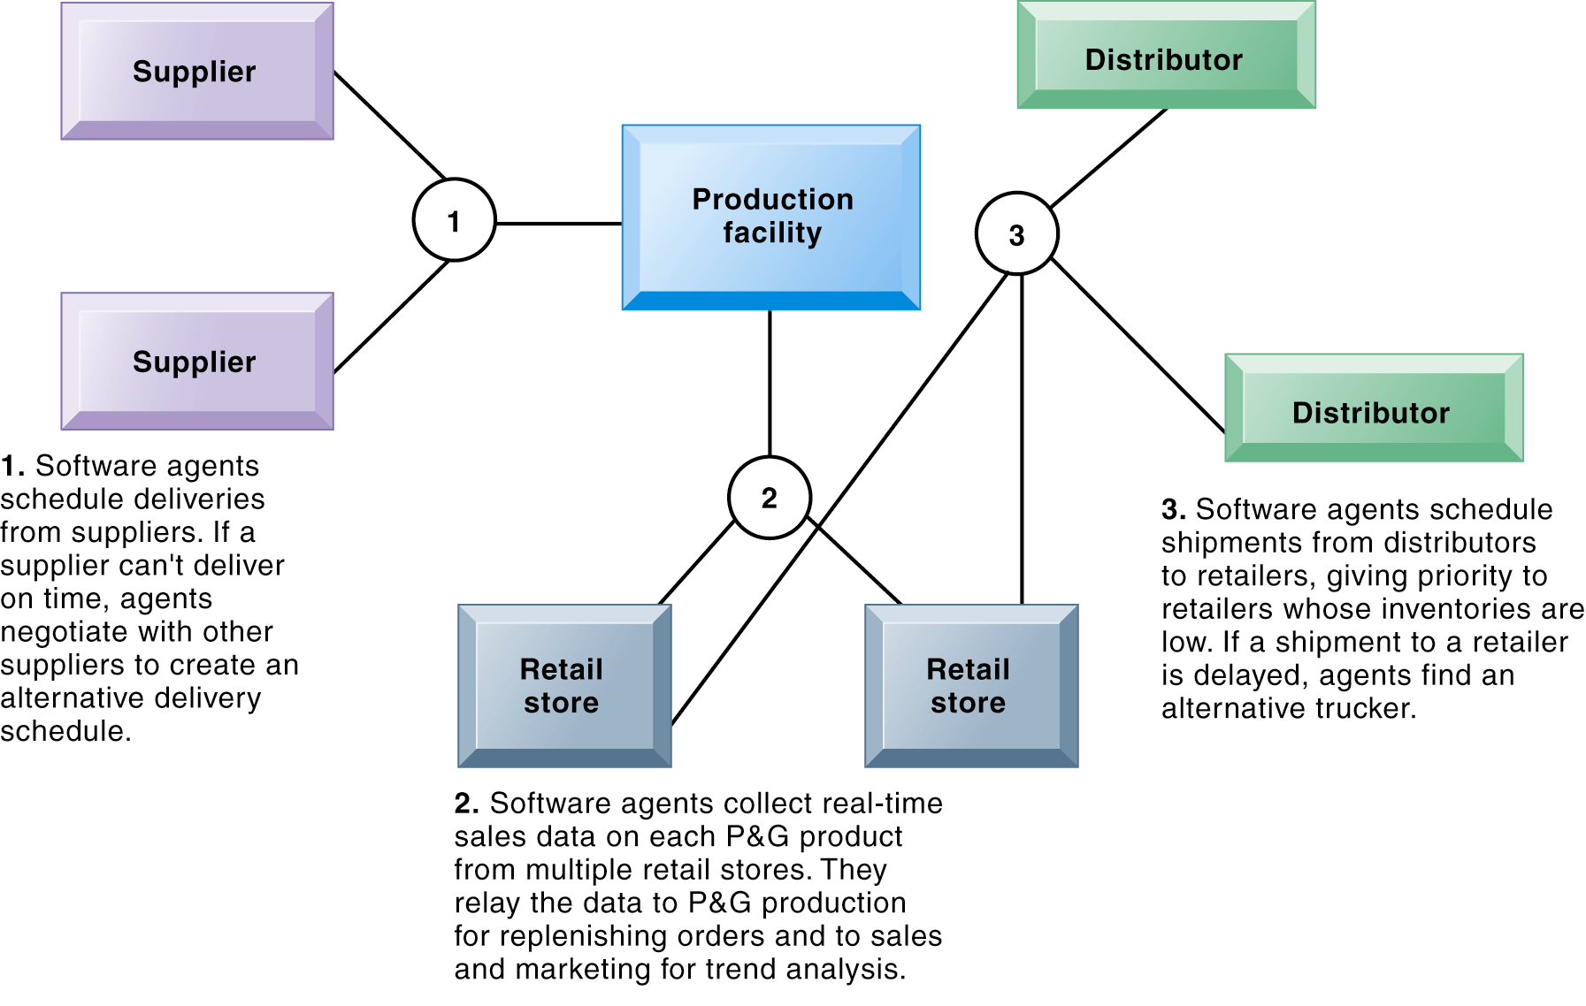
Management Information Systems
Chapter 11 Managing Knowledge
Intelligent Techniques
Intelligent Agents in P&G’s Supply Chain Network
Intelligent agents are helping Procter & Gamble shorten the replenishment cycles for products such as a box of Tide.
Figure 11-15

