Slide 1
UNIVERSITY DIGITAL LIBRARY
MANAGEMENT SYSTEM
CIA-3 PROJECT DEVELOPMENT
P05 • Education • 5th Semester
Node.js • Express.js • MongoDB • Mongoose • JWT • Bootstrap
CHRIST (Deemed to be University)

Slide 2
Project Overview
Purpose, scope and value
Centralized Operations
Role-Based Experience
Real Business Rules
Catalog, circulation, reservations, fines, inventory, notifications and reports.
Member, Librarian and Admin workflows with server-side authorization.
Loan limits, due dates, fine caps, FIFO holds and inventory accountability.
• Responsive landing page and authenticated dashboards.
• REST API connects the frontend with MongoDB-backed services.
• Designed for an academic-library CIA-3 demonstration.
• Postman supports functional and negative API testing.
P05 • University Digital Library Management System • CIA-3 2

Slide 3
Problem Statement
Challenges addressed by the system
• Manual registers make circulation history slow to search.
• Separate records can cause inconsistent book availability.
• Fine calculations become difficult when handled manually.
• Unavailable books need a fair, traceable reservation queue.
• Staff actions require accountability and role restrictions.
• Distributed information makes reporting difficult.
System Response
Centralize data and enforce library rules through the backend.
Operational Benefit
Maintain consistent transactions, inventory, holds and fine records.
Evaluation Benefit
Demonstrates authentication, business logic, security and auditability.
P05 • University Digital Library Management System • CIA-3 3

Slide 4
Objectives & Scope
What the implementation covers
• Model books, members and transactions in MongoDB.
• Implement borrowing and return with due-date and fine logic.
• Search by title, author, ISBN and category.
• Provide inventory and operational reporting.
• Enforce Member, Librarian and Admin permissions.
• Maintain copy-level availability and inventory logs.
• Support FIFO holds, fine payments and notifications.
In Scope
Authentication • Catalog • Circulation • Holds • Fines
Management
Inventory • Membership Plans • Notifications • Reports
Testing
Success cases plus 401 / 403 / validation / 404 scenarios
P05 • University Digital Library Management System • CIA-3 4

Slide 5
User Roles
Role-based access control
Member
Librarian
Search catalog, borrow, reserve, view history and fines.
Issue/return, manage holds, catalog, inventory, fines and reports.
Admin
Student / Faculty
Manage staff accounts, membership plans, institutional settings and oversight.
Membership categories with configurable loan limits, duration and fine policy.
• JWT identifies the authenticated user.
• RBAC middleware protects staff/admin APIs.
• Frontend navigation changes according to role.
P05 • University Digital Library Management System • CIA-3 5

Slide 6
Functional Modules
Integrated modules rather than isolated CRUD screens
Authentication & Registration
Book Catalog & Search
Book Issue / Return
Connected to the shared backend and database.
Connected to the shared backend and database.
Connected to the shared backend and database.
Reservations / FIFO Holds
Fine Calculation & Payment
Membership Plans
Connected to the shared backend and database.
Connected to the shared backend and database.
Connected to the shared backend and database.
Inventory & Copy Management
Notifications
Borrowing History & Reports
Connected to the shared backend and database.
Connected to the shared backend and database.
Connected to the shared backend and database.
Integration Principle
One operation can affect transactions, inventory, fines, reservations, notifications and history.
P05 • University Digital Library Management System • CIA-3 6

Slide 7
Tools & Technologies
Technology stack from the detailed report
Runtime
Backend
Node.js
Express.js
Database
Authentication
MongoDB + Mongoose
JWT + bcryptjs
Validation
Security
Joi / Express middleware
Helmet • CORS • Rate limiting
Frontend
Testing
HTML5 • Bootstrap 5 • CSS3 • JavaScript
Postman + Node.js test/integration workflows
P05 • University Digital Library Management System • CIA-3 7

Slide 8
System Architecture
Layered architecture
Presentation
Landing, login, member, staff and admin interfaces
API / Routing
Express routes for auth, books, transactions, holds, fines, inventory and reports
Middleware
JWT, RBAC, Joi validation, security and error handling
Controllers / Services
Request coordination and library business rules
Data Access
Mongoose schemas, references and indexes
Persistence
MongoDB operational records and audit history
P05 • University Digital Library Management System • CIA-3 8

Slide 9
End-to-End Workflow
Ordered for the final project demonstration
1
2
3
4
5
6
7
8
Landing
Login
Catalog
Borrow
Return
Hold
Payment
Reports
Key Principle
Every visible workflow has a backend state change. Issue affects transaction + availability; return can affect fine + holds; inventory actions create audit information.
Demo Narrative
Landing → Login → Member workflow → Staff/Admin workflow → Postman proof → Database explanation.
P05 • University Digital Library Management System • CIA-3 9

Slide 10
Database Design
MongoDB collections used by the system
users
books
Identity, password hash, role and member type
Catalog metadata and copy availability
transactions
holds
Issue/return lifecycle, dates, fine and status
Book/member reservation queue
finePayments
notifications
Fine settlement records
Overdue, availability and hold alerts
inventoryLogs
membershipPlans
Copy changes, reasons and responsible actor
Loan limits, duration, overdue rate and fine cap
Key Relationships
users ↔ transactions ↔ books, with holds, payments, notifications and inventory logs linked to the relevant entities.
P05 • University Digital Library Management System • CIA-3 10

Slide 11
Borrowing, Return & Fine Logic
Business rules that make the application realistic
Borrowing
Return
Reservation & Fine
1. Authenticate member
2. Check membership status
3. Check active-loan limit
4. Check available copy
5. Calculate due date
6. Create ACTIVE transaction
7. Reduce availability
1. Select active transaction
2. Compare dates
3. Calculate overdue days
4. Apply rate + cap
5. Mark returned
6. Restore availability
7. Advance hold if applicable
Unavailable title → FIFO hold queue
Fine is linked to the transaction
Payment records settlement
Authorized staff can process approved waivers
P05 • University Digital Library Management System • CIA-3 11

Slide 12
Security & Validation
Controls enforced at the backend boundary
• bcryptjs password hashing.
• JWT authentication for protected routes.
• Role-based authorization for Member, Librarian and Admin.
• Joi / Express validation before business logic.
• Environment variables for database URI and JWT secret.
• Helmet-style headers, CORS controls and rate limiting.
• Centralized error handling for consistent JSON responses.
401 Unauthorized
No valid authentication token.
403 Forbidden
Authenticated user lacks the required role.
400 / 409 / 404
Validation, business conflict or missing resource.
P05 • University Digital Library Management System • CIA-3 12

Slide 13
REST API & Postman Testing
Backend evidence for the evaluator
Authentication
Success Testing
POST /api/auth/register • POST /api/auth/login
Valid login, search, issue, return, hold, payment and reports.
Catalog / Circulation
Negative Testing
GET /api/books/search • POST /api/transactions/issue • PUT /api/transactions/:id/return
Missing token, wrong role, invalid input, unavailable copy and invalid ID.
Holds / Fines
Why Postman
POST /api/holds • POST /api/fines/:transactionId/pay
Backend can be verified independently of the browser.
P05 • University Digital Library Management System • CIA-3 13

Slide 14
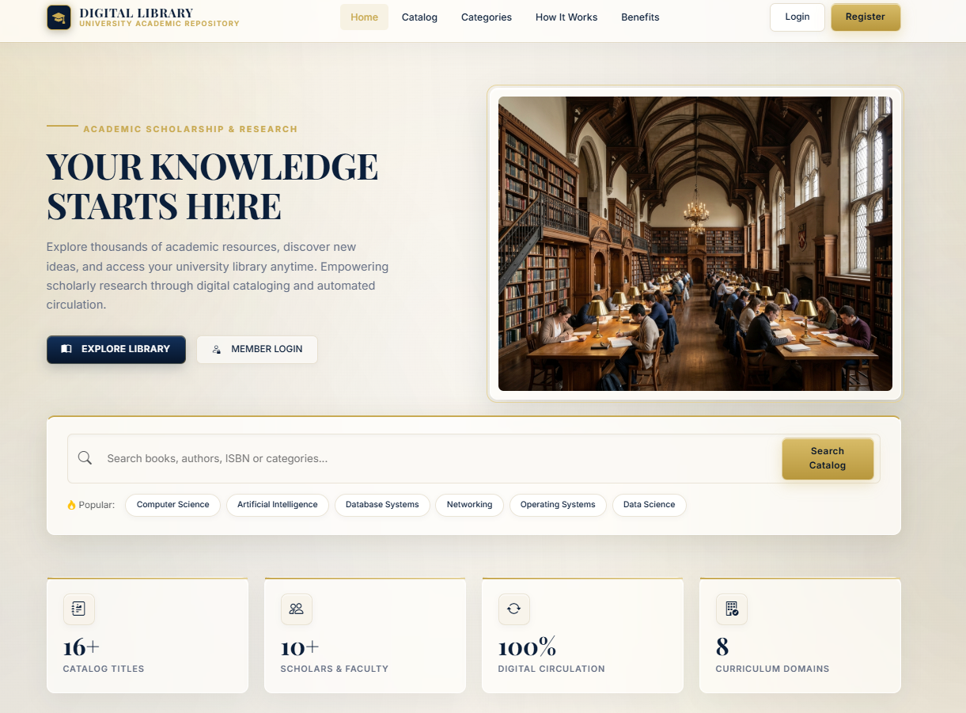
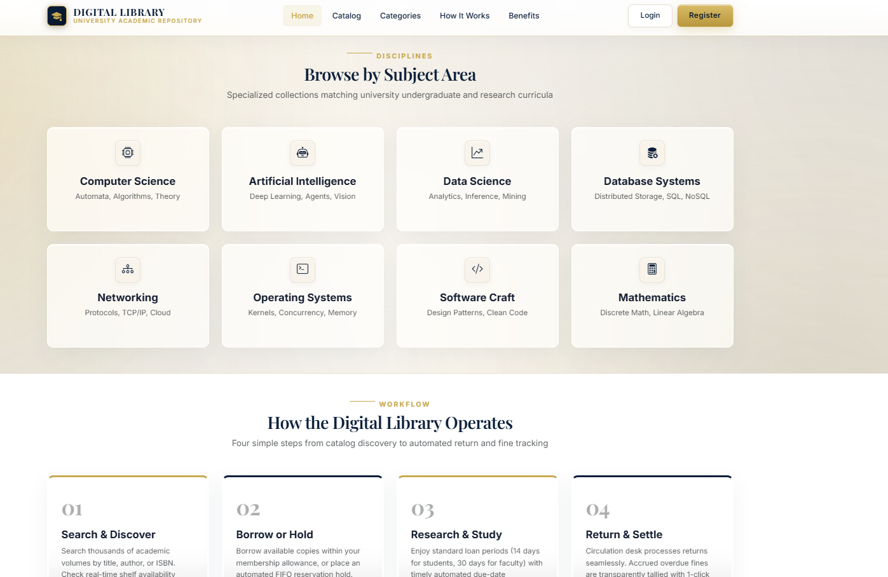
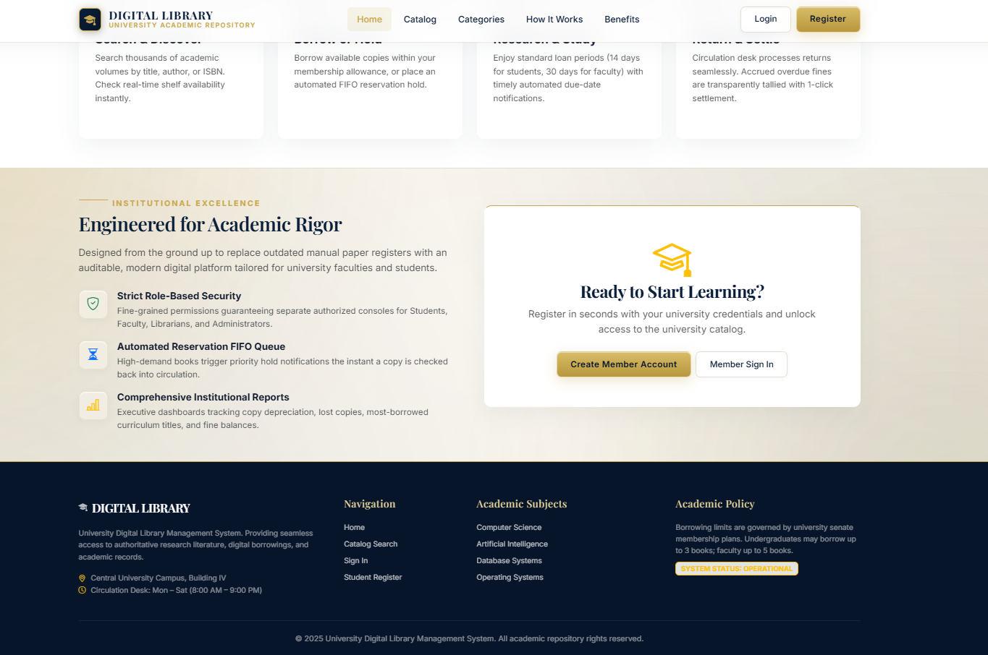
Implementation Evidence — Landing Page
First in the required screenshot sequence
P05 • University Digital Library Management System • CIA-3 14

Slide 15
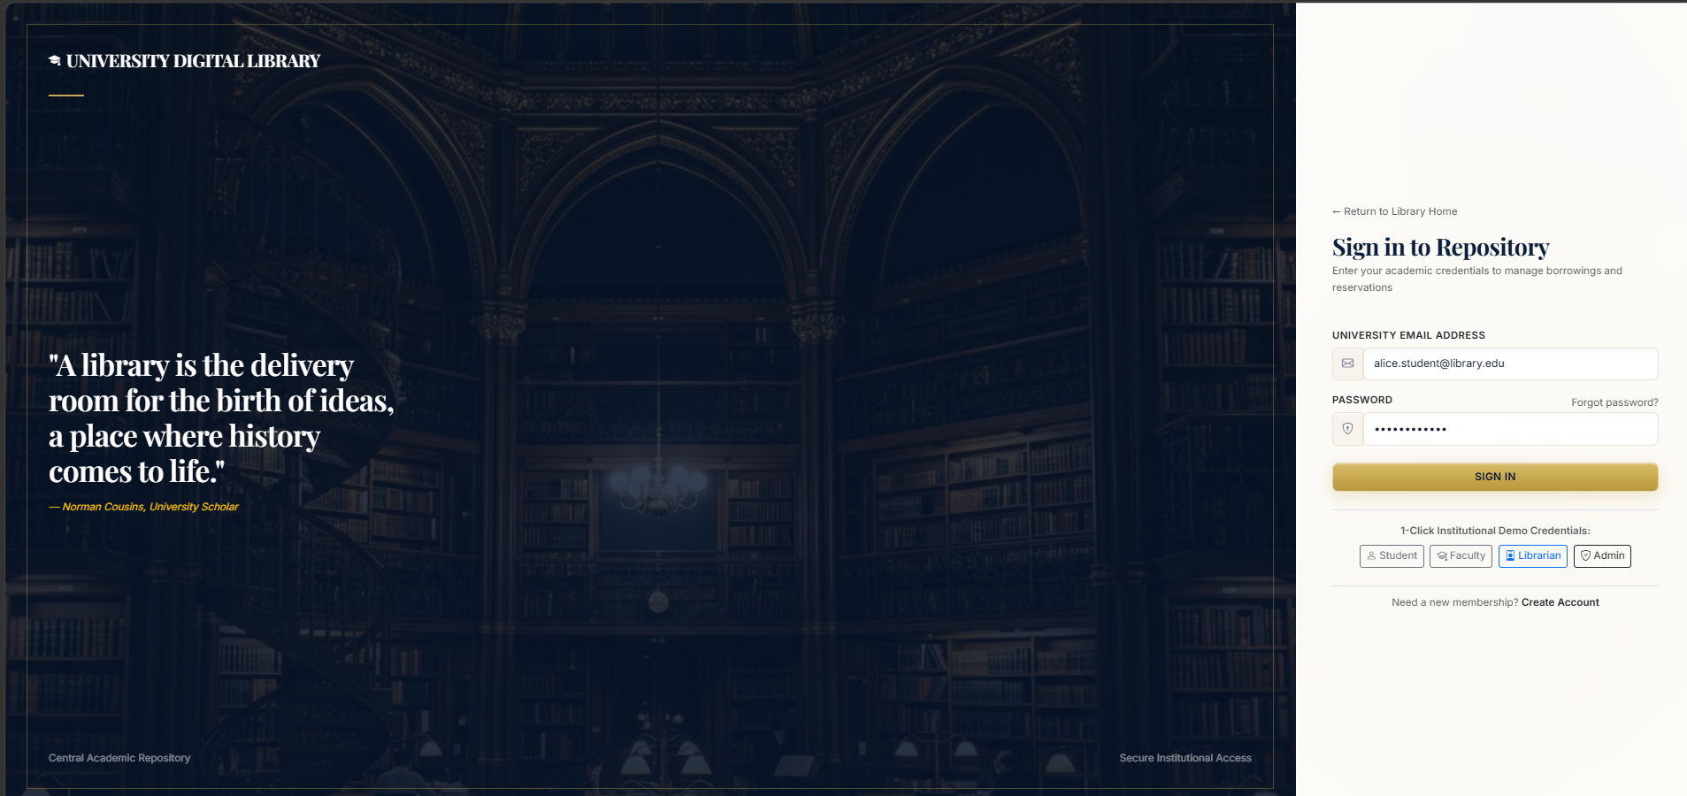
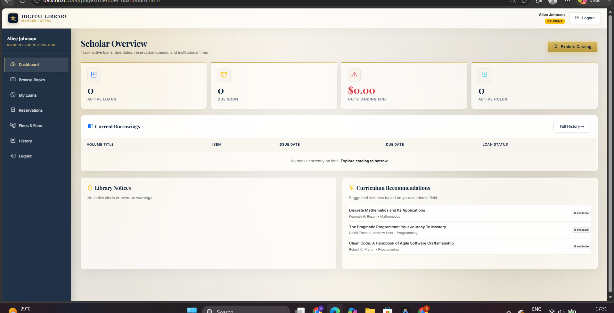
Implementation Evidence — Login & Student Dashboard
P05 • University Digital Library Management System • CIA-3 15

Slide 16
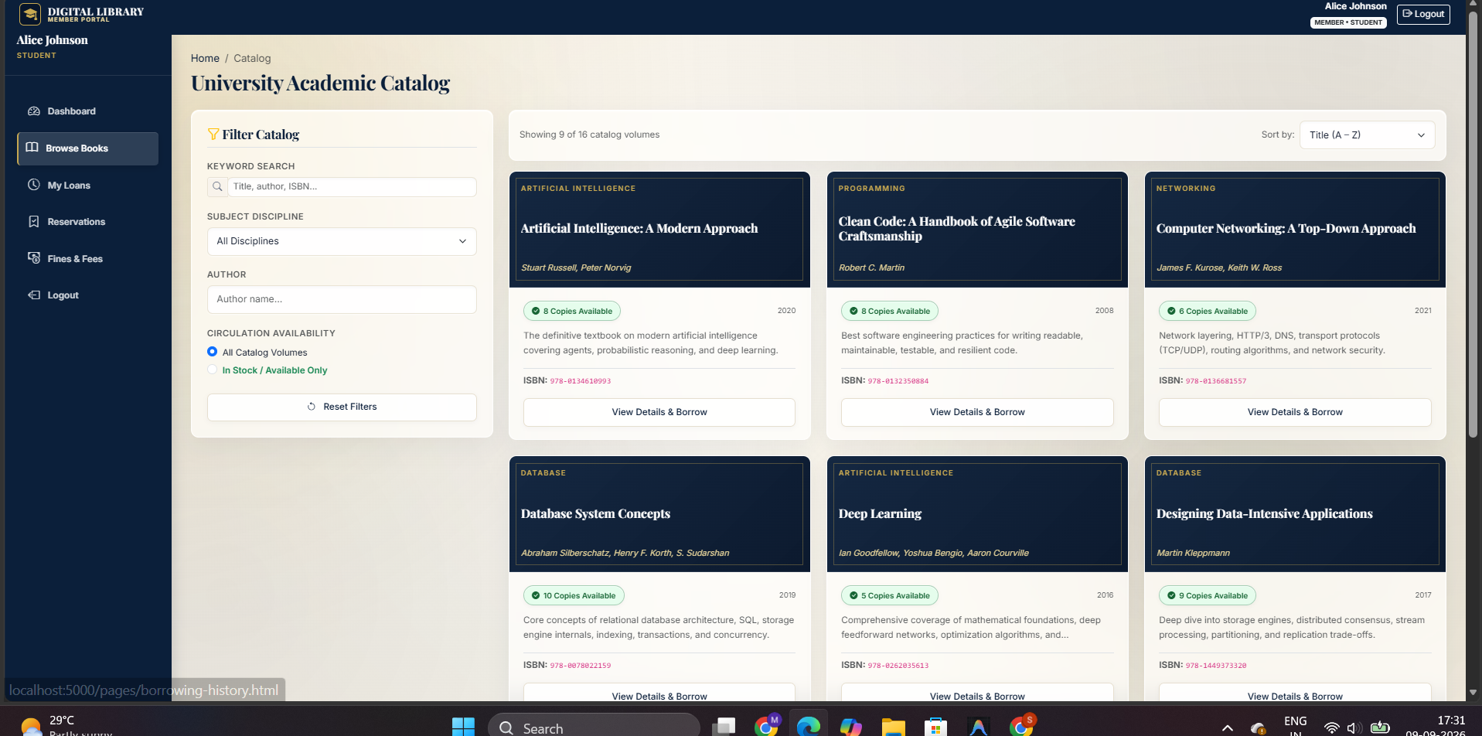
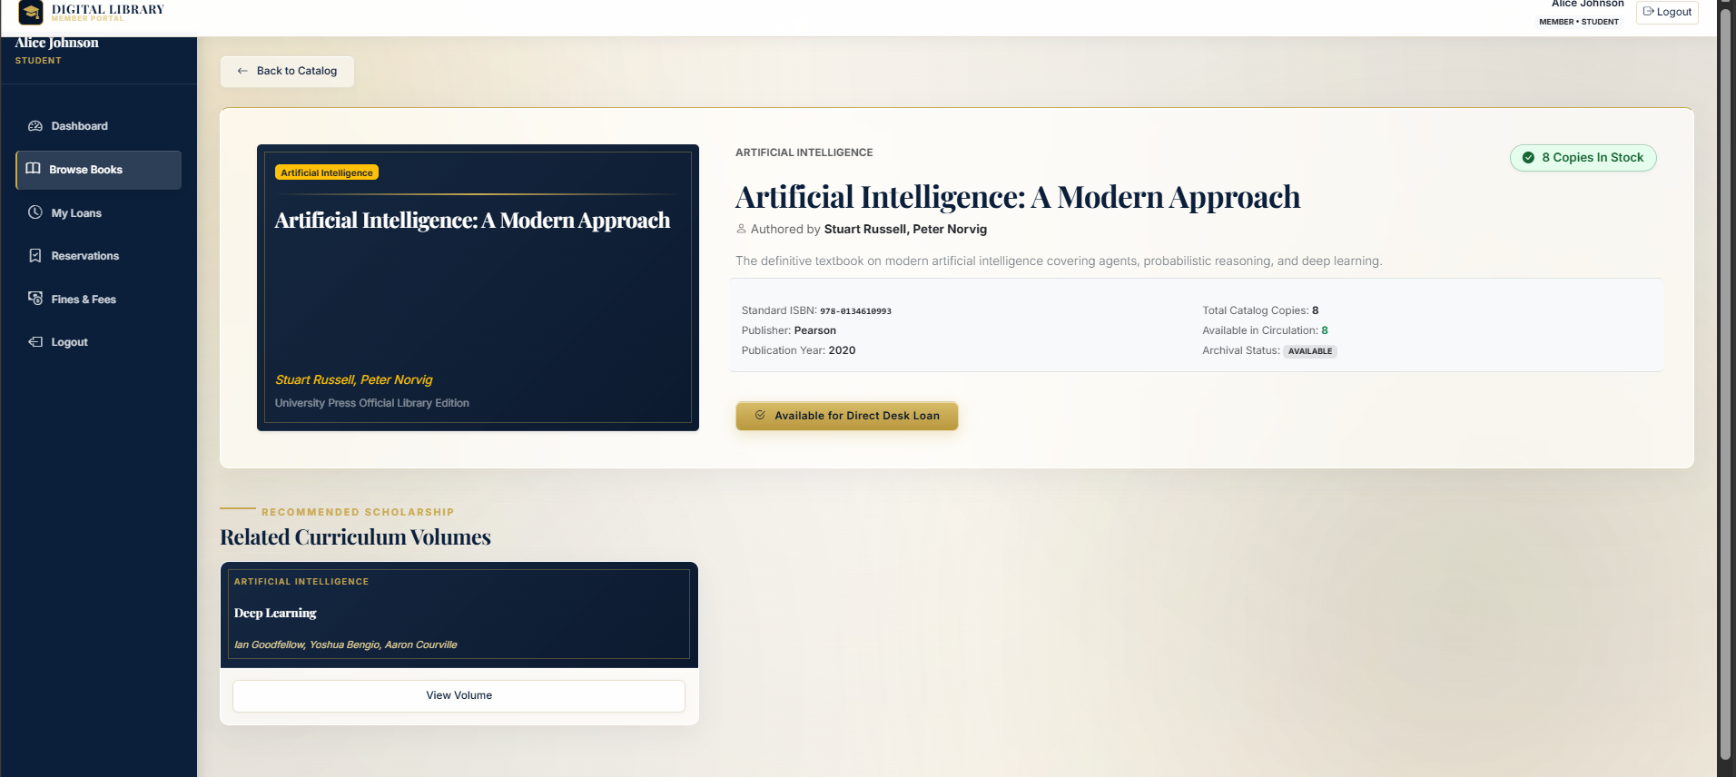
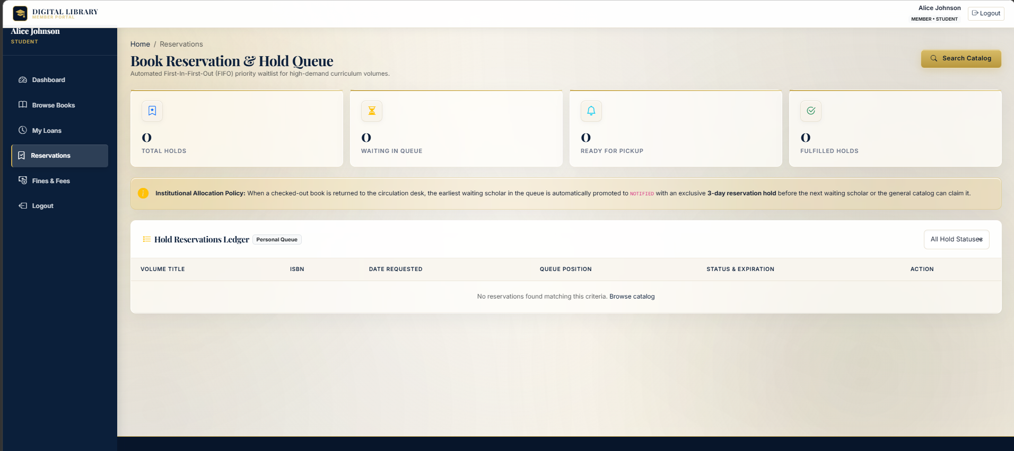
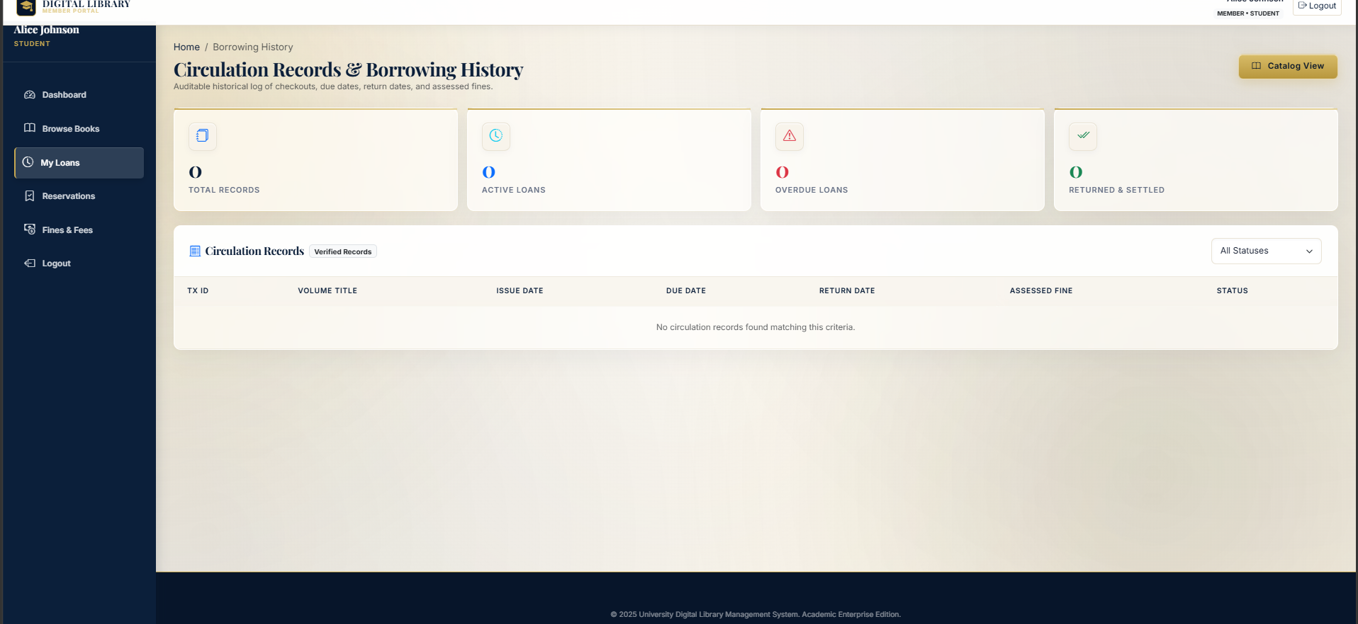
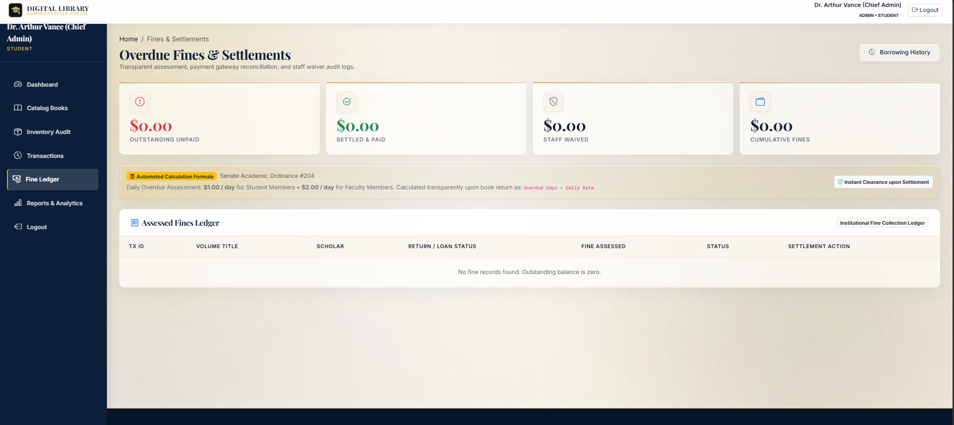
Implementation Evidence — Student / Member Components
P05 • University Digital Library Management System • CIA-3 16

Slide 17
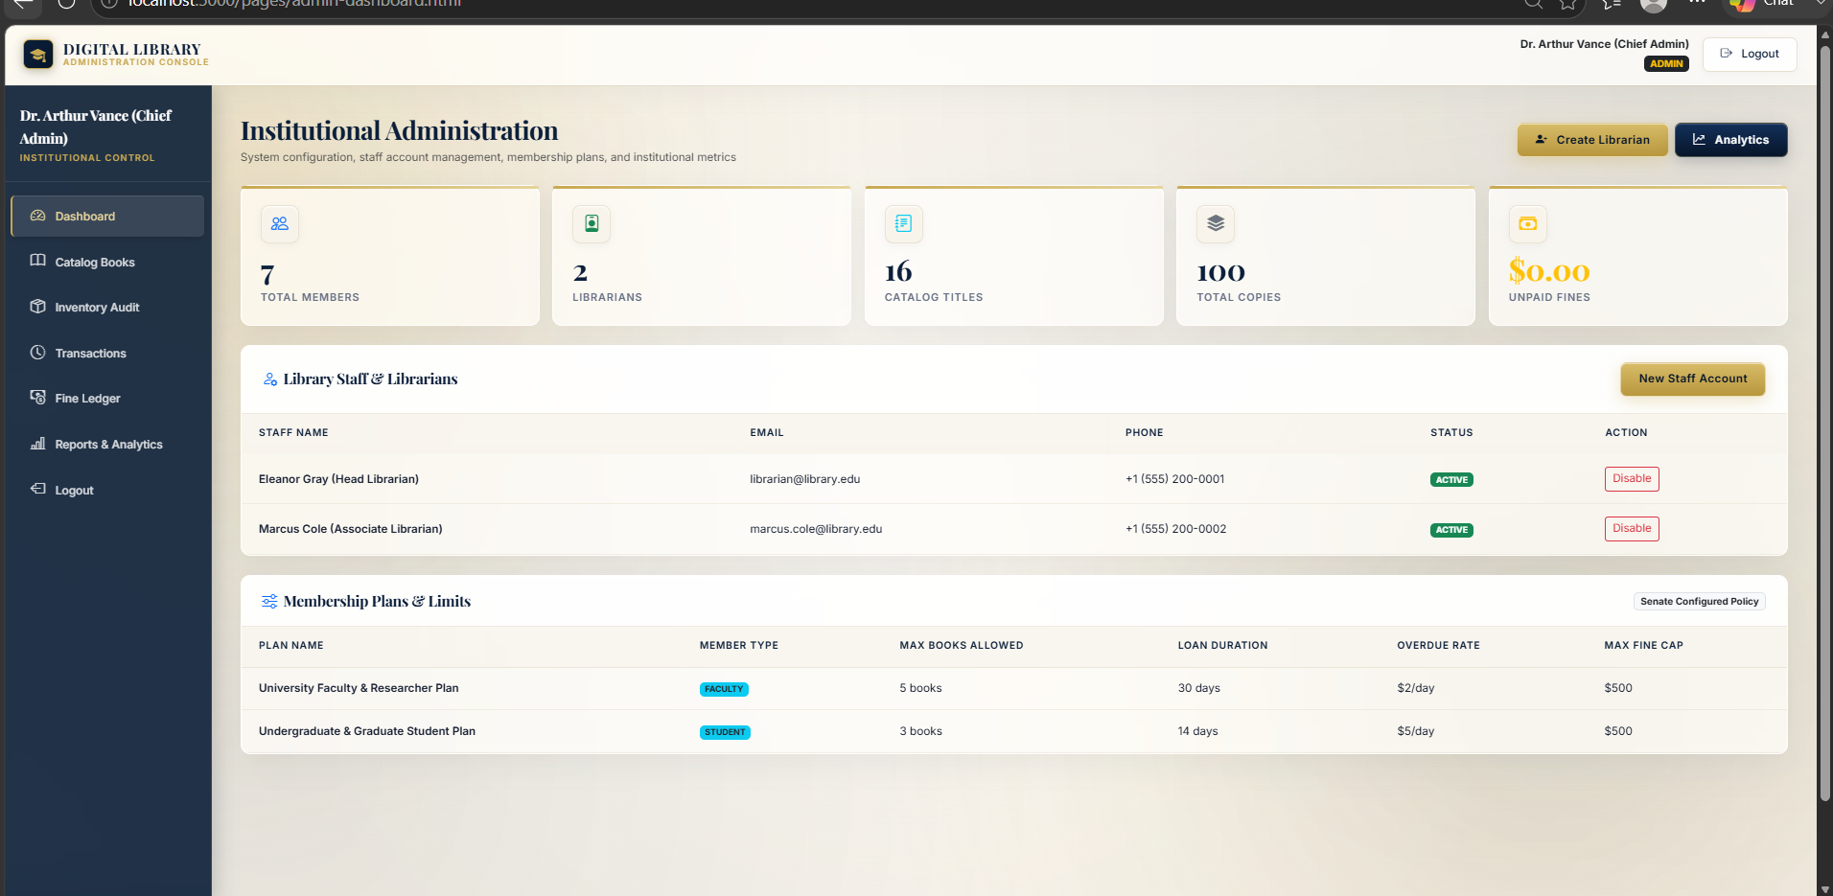
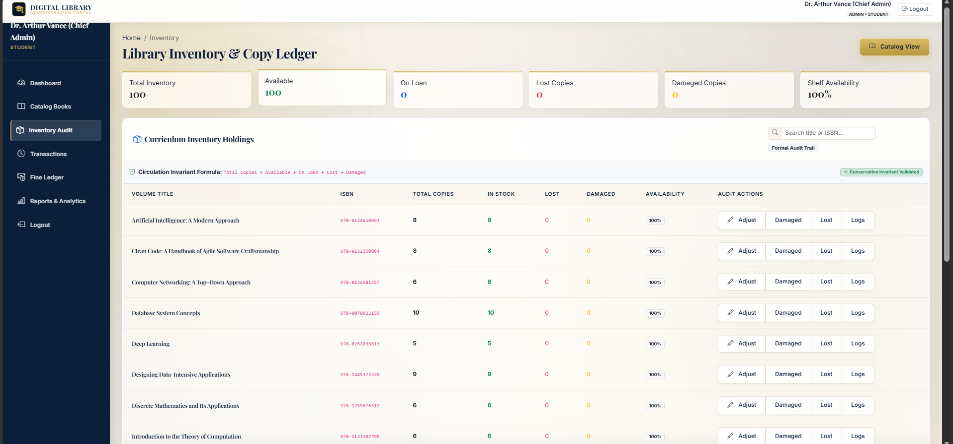
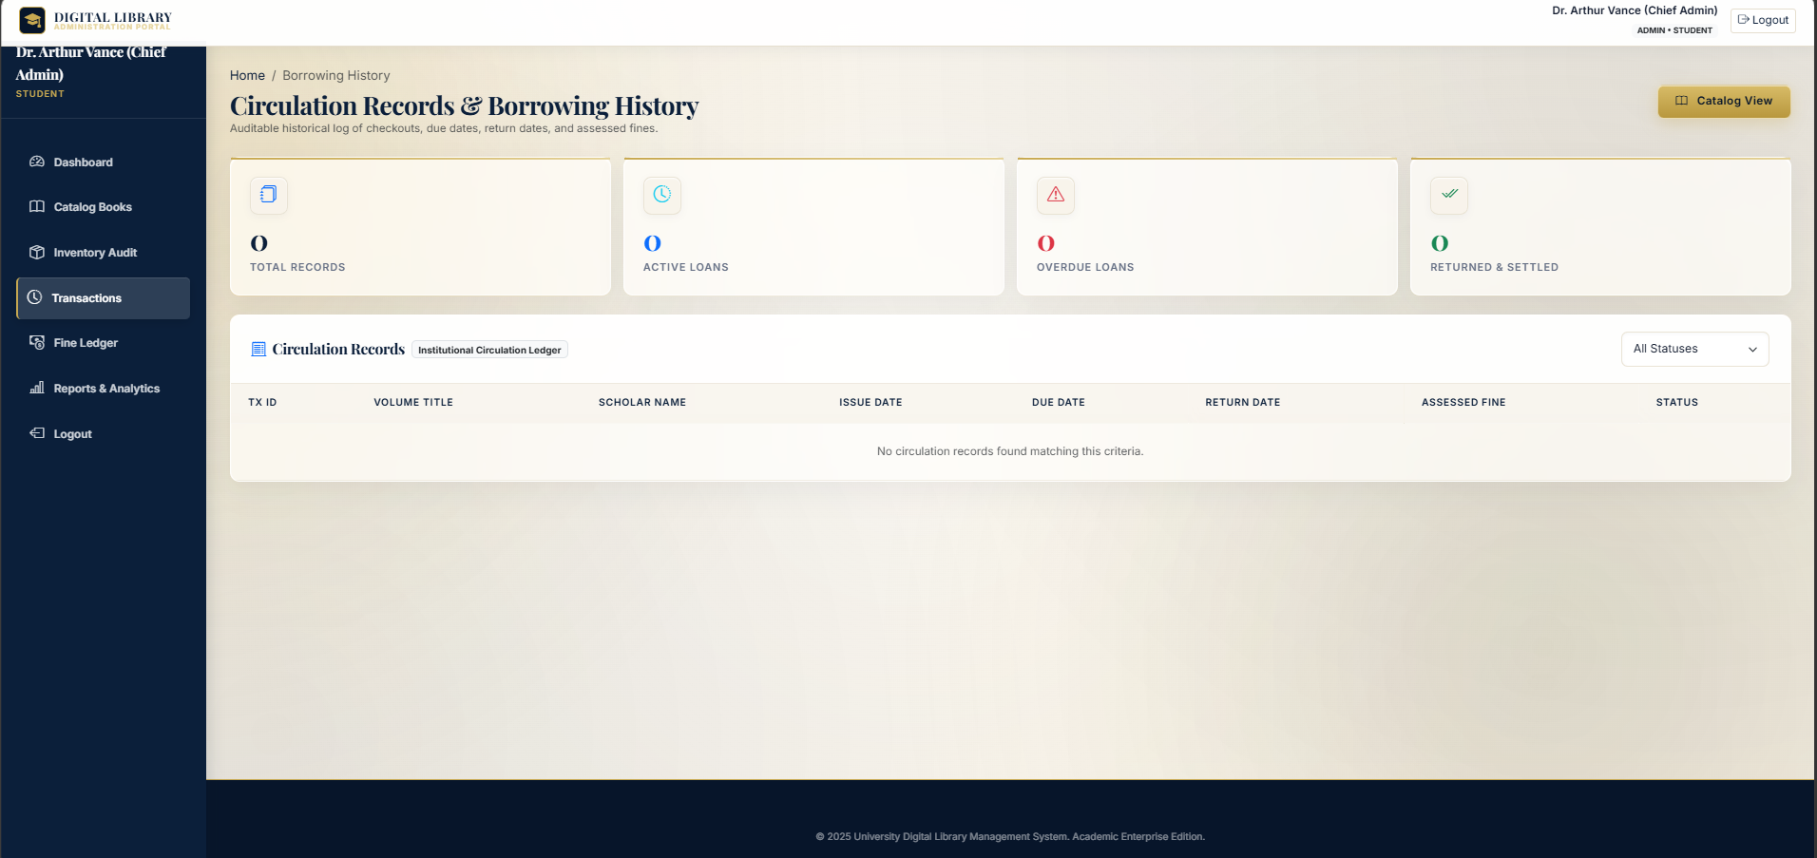
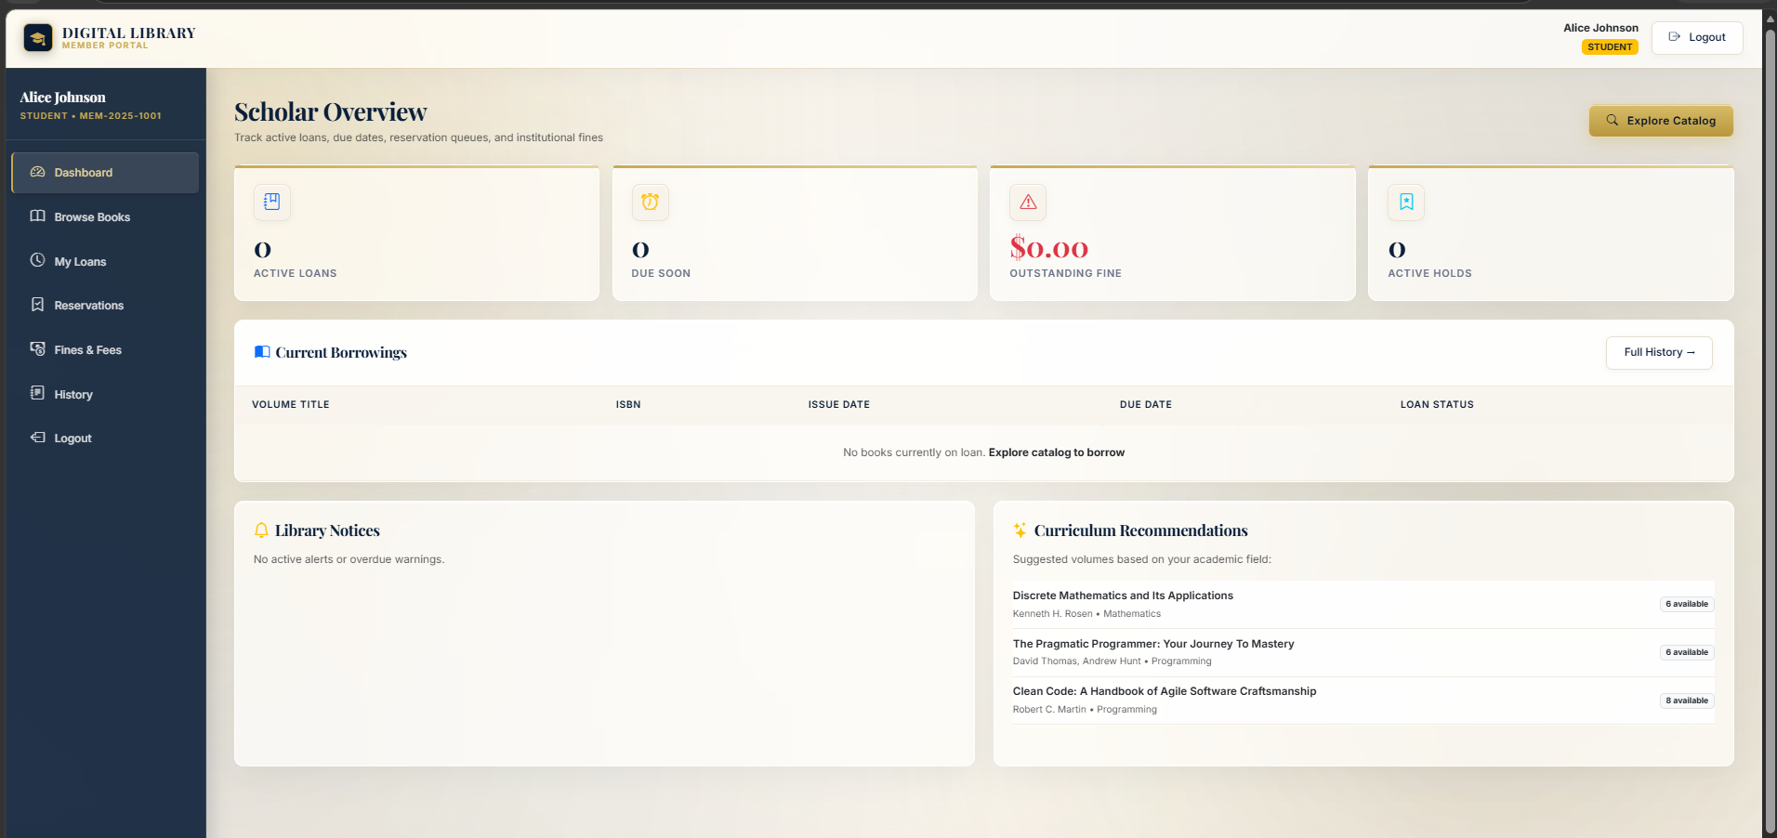
Implementation Evidence — Admin & Staff
P05 • University Digital Library Management System • CIA-3 17

Slide 18
Future Scope & Conclusion
Beyond the academic implementation
• Real payment gateway integration.
• Email/SMS notifications and scheduled jobs.
• Barcode/RFID issue and return.
• Multi-branch inventory and advanced search.
• Automated frontend testing and centralized logs.
• Production monitoring, token revocation and stronger backup/audit controls.
Conclusion
DLMS demonstrates a complete academic-library workflow with authentication, RBAC, MongoDB persistence, circulation, reservations, fines, inventory and reporting.
Key Learning
Backend enforcement matters because one operation can change multiple related states that must remain consistent.
Final Message
More than a catalogue — a role-aware library management system.
P05 • University Digital Library Management System • CIA-3 18

Slide 19
THANK YOU
University Digital Library Management System
P05 • CIA-3

