Slide 1

Bellabeat Leaf — Portfolio Case Study
Smart Device Usage Analysis → Marketing Strategy
(Mehar Fatima)

Slide 2
Executive Summary
Bellabeat aims to grow in women’s wellness wearables. Using Fitbit public data, we examined daily activity and sleep patterns to understand how people use smart devices. Key findings: strong focus on activity tracking (steps-calories correlation), limited sleep logging, and inconsistent long-term engagement. Recommendations center on sleep wellness campaigns, gamified habit loops, timely nudges, and community-led branding to increase retention and brand affinity.

Slide 3
Elevator Pitch
Position Leaf as a daily wellness companion that turns small routines into lasting habits. Use data-driven nudges for midday activity and bedtime consistency, reward streaks, and build community challenges. This will boost engagement, retention, and customer lifetime value in Bellabeat’s core audience.

Slide 4
1. Ask — Business Task
Goal: Identify smart device usage trends to guide Bellabeat Leaf marketing.
Questions: What trends exist? How do they apply to Bellabeat customers? How do they inform marketing?
Stakeholders: Urška Sršen (CCO), Sando Mur (Exec), Bellabeat Marketing Analytics.

Slide 5
2. Prepare — Data Sources
Primary: Fitbit Fitness Tracker data (Kaggle, CC0). ~30 users; activity, calories, sleep, intensities.
Strengths: Real-world usage; multiple wellness dimensions.
Limitations: Small sample; short duration; not fully representative of Bellabeat’s female user base.
Mitigation: Treat as directional; combine with Bellabeat app data where possible.

Slide 6
3. Process — Cleaning & Preparation
Consolidated daily activity, sleep (and weight if present) by user and date.
Removed duplicates, standardized dates, handled nulls, and filtered incomplete logs.
Created derived fields: active minutes, sleep efficiency, steps-to-calories ratio.
Outcome: Analysis-ready table linking activity and sleep per user-day.

Slide 7
4. Analyze — Findings
Activity & Engagement
Avg steps ≈ 7.6k (below 10k benchmark).
Strong steps ↔ calories correlation.
Peak device use: 12–6 pm; weekend dips.
Only ~1/3 users track daily (consistency gap).
Sleep Insights
Avg sleep ≈ 6.9 hours (below 7–9 guideline).
Sleep logs sparser than activity logs.
Users who log sleep often show higher overall engagement.

Slide 8
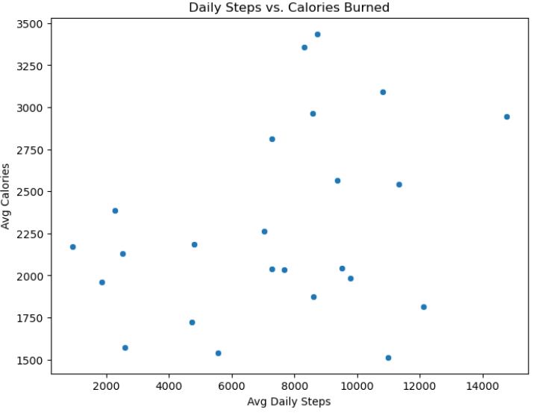
Steps vs Calories

Slide 9
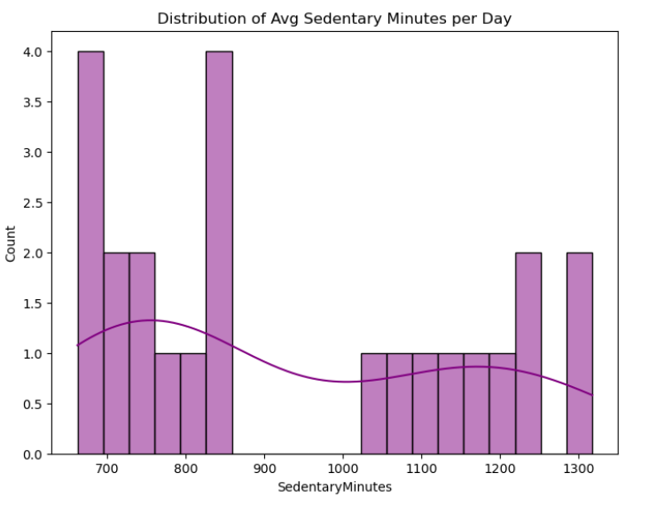
Sleep Duration Distribution

Slide 10
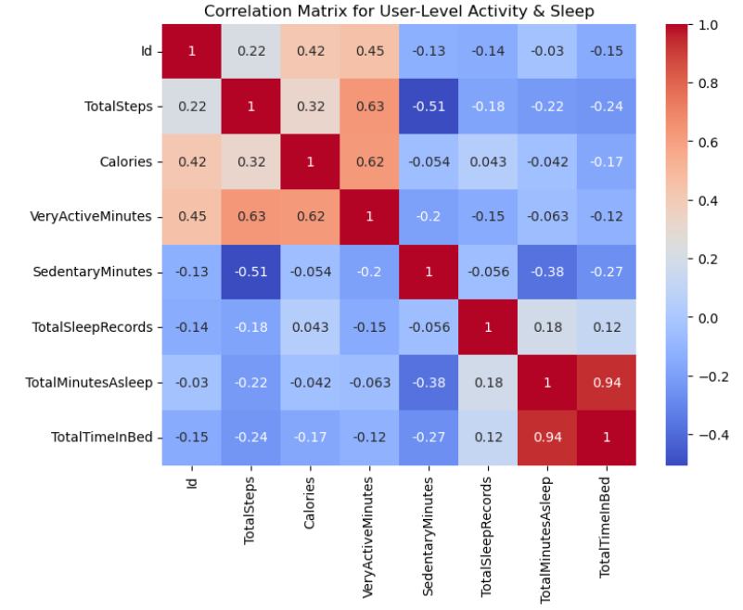
Activity Heatmap (Hourly)

Slide 11
5. Share — Insights Story
Users prioritize activity tracking; sleep tracking lags.
Engagement intensity aligns with daily routines (afternoons).
Marketing should reinforce consistent habits and celebrate progress.
Clear visuals connect trends to actions stakeholders can back.

Slide 12
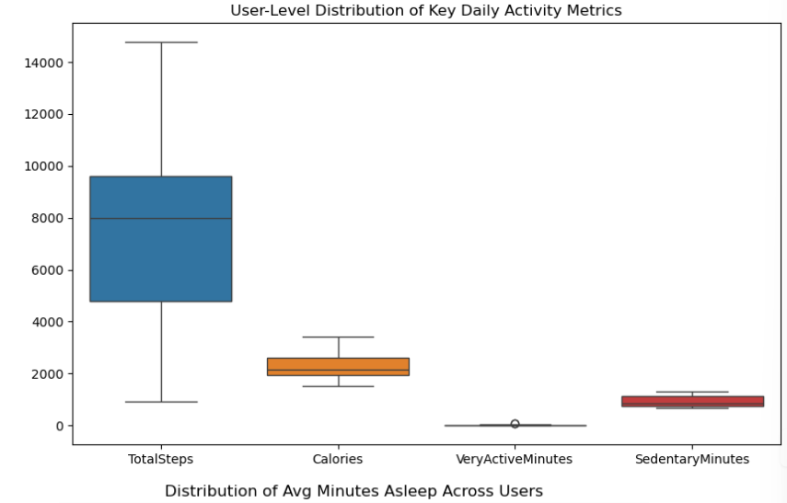
User Level Distribution of Key Daily Activity Metrics

Slide 13
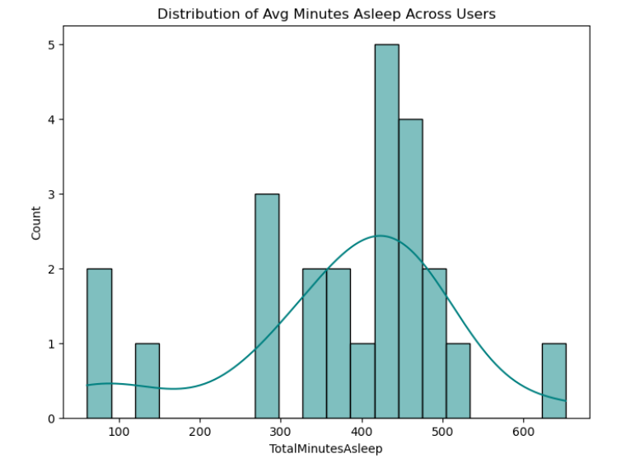
Average Minutes of Sleep Across Users

Slide 14
6. Act — Recommendations for Leaf
Sleep wellness campaigns: bedtime reminders, stress reduction prompts.
Gamified streaks & challenges: 7-day activity streaks; rewards for 10k steps.
Timed nudges: Midday activity & afternoon mindfulness prompts.
Community & influencer programs: social proof and shared goals.
Differentiate Leaf: a fashionable, holistic wellness companion (bracelet/necklace/clip).

Slide 15
Data Limitations & Next Steps
Limitations
Small, short-duration Fitbit sample.
Not fully representative of Bellabeat’s female user base.
Potential missingness in sleep/weight data.
Next Steps
Leverage Bellabeat app data for scale and gender specificity.
Surveys to capture motivations and barriers.
Extend to other products (Time, Spring) for cross-sell insights.

Slide 16
Thank You
Contact: Mehar Fatima Portfolio Case Study — Bellabeat Leaf

