Slide 1

Project Name:
Data Analytics for health and safety in mining sector
Team Members:
-Alisha Panday
-Meharban Singh
Supervisor Name:
-Dr. Naeem Janjua
Client Name:
- Dr. Desmond Dev Menon/Mark Joyce(Gen Core Health Tech Pty. ltd. )

Slide 2
Project Goal
Design and development of descriptive and predictive models for health and safety for mining discovery team.
Introduction
This project consists of two modules
In the first module we pre-process the real data set provided by the client and perform all the task required to prepare the data for second module.
apply data analytics techniques (Descriptive analytic and Predictive analytic) on it and generates some result in the form of graphs with the help of data models developed in anaconda python.

Slide 3
Background to the Problem
A novel real-time wireless sensor for monitoring gas and particulates has been developed as an Occupational Health and Safety device to provide mining discovery teams real-time information.
Data collected and collated continuously at the operations centre is expected to be fed into an algorithm.
Finally, using the predictive modelling algorithm, need to predict the level of dangerous gases.
For an instance, if level of dangerous gas such as- “Carbon monoxide (CO)” is High then it can be detected and alert the mining team.

Slide 4
The Solution
Scope
While health and safety is major concern to save a life and to have a safe working environment for mining discovery teams
-The first requirement for this project is data pre-processing.
Real-world data is often incomplete, inconsistent, and/or lacking in certain behaviors or trends, and is likely to contain many errors.
-Descriptive Analytics: encompasses the set of technique that describe what has happened in the past.
we are using the data dash board which are collection of tables, charts, maps and summary
statistics that gets updated as new data becomes available
-In second, phase we will apply predictive analytics techniques on our given sample data to develop the
algorithm which will use to predict the desire value

Slide 5
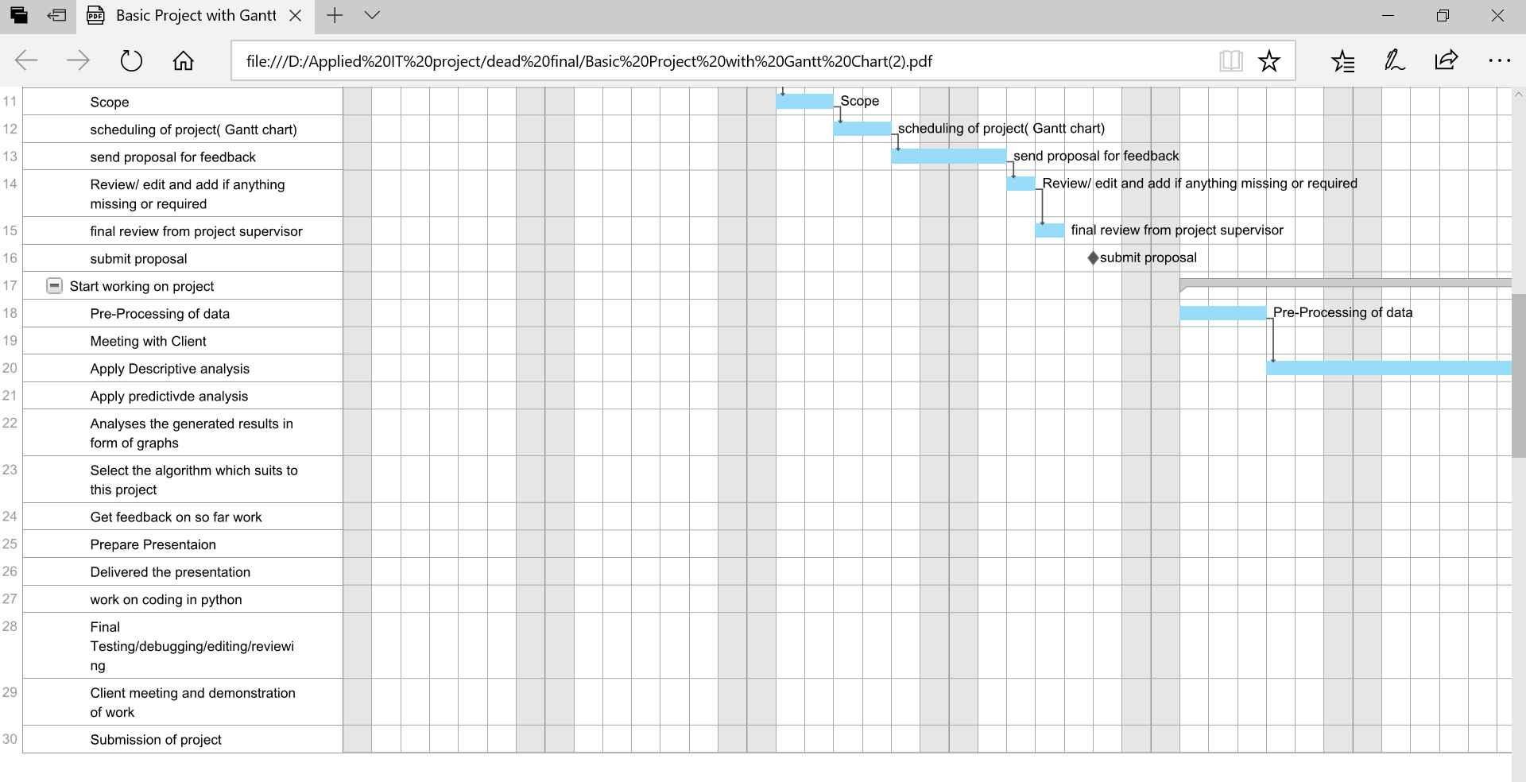

Slide 6
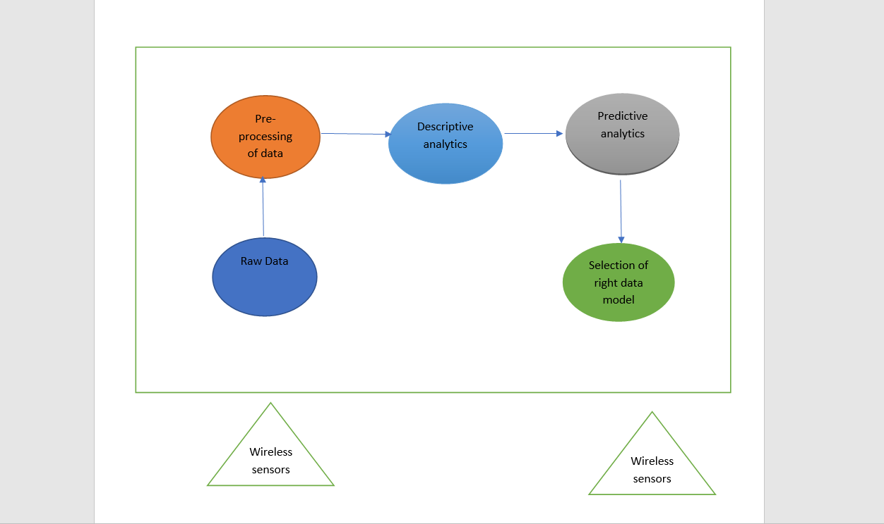
Architectural Framework

Slide 7
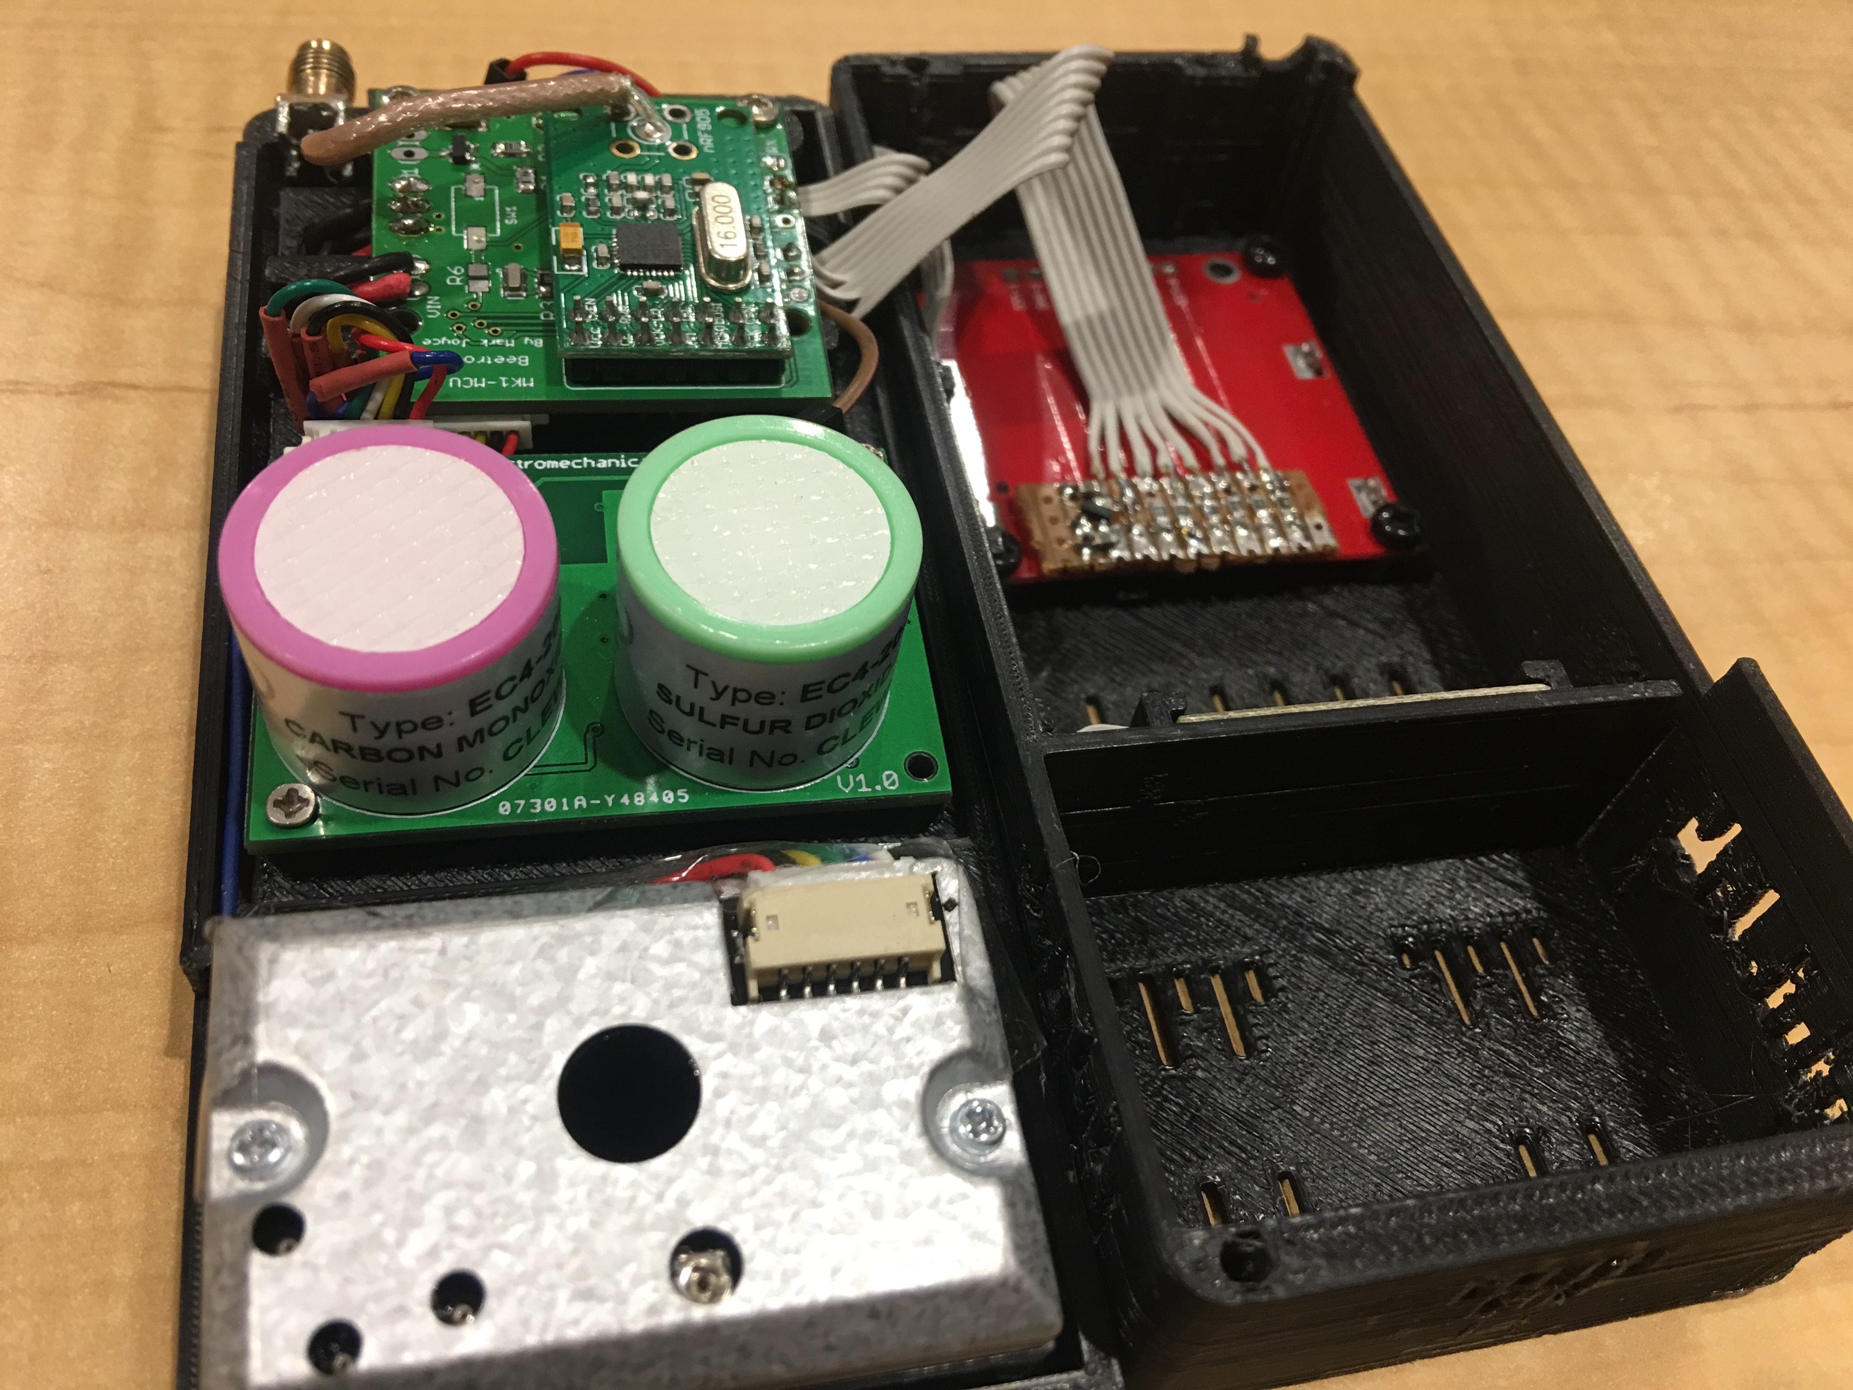

Slide 8
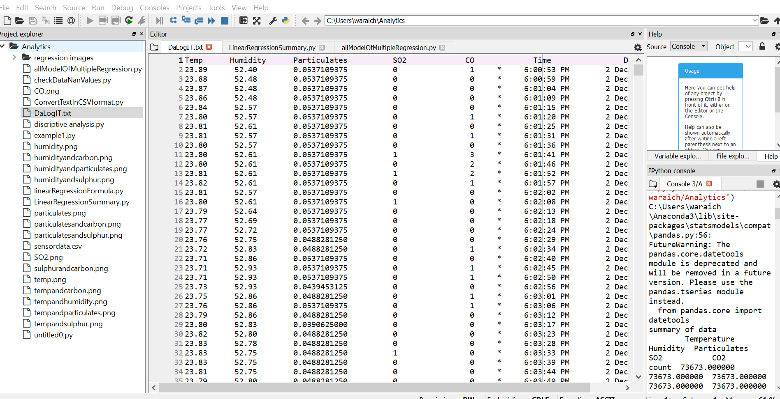
Raw Data in python editor (SPYDER)

Slide 9
Data Pre-Processing
Data preparation (or data preprocessing) in this context means manipulation of data into a form suitable for further analysis and processing. It is a process that involves many different tasks and which cannot be fully automated. Many of the data preparation activities are routine, tedious, and time consuming.
Validate Data
Clean the Data
Statistically adjust the data
Store the data set for analysis
Analyse Data

Slide 10
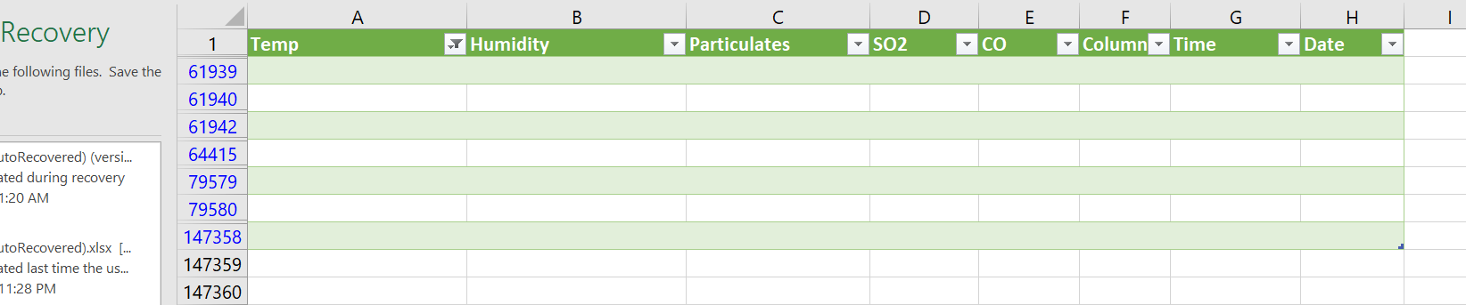
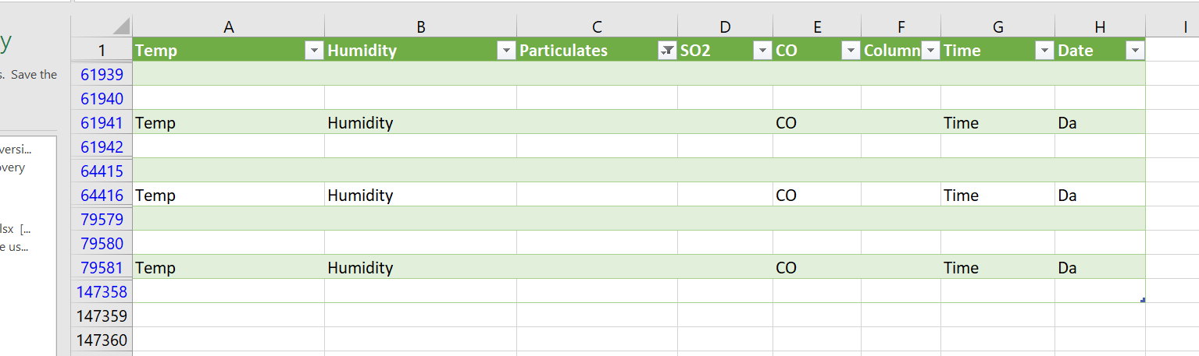
Data Anomaly
Empty rows in data
Unformatted Data

Slide 11
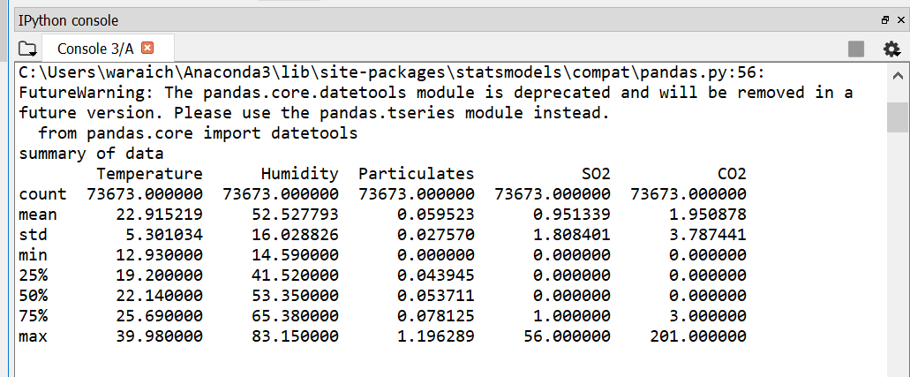
Descriptive Statistics

Slide 12
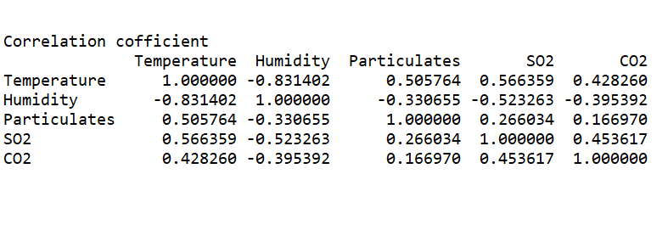
Co-relation Matrix

Slide 13
Predictive Analysis
Linear regression
Multiple regression

Slide 14
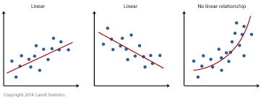
The Simple Linear Regression Model
The equation that describes how y is related to x and an error term is called linear regression model
Simple Linear Regression Model
Y = B0 + B1X + E

Slide 15
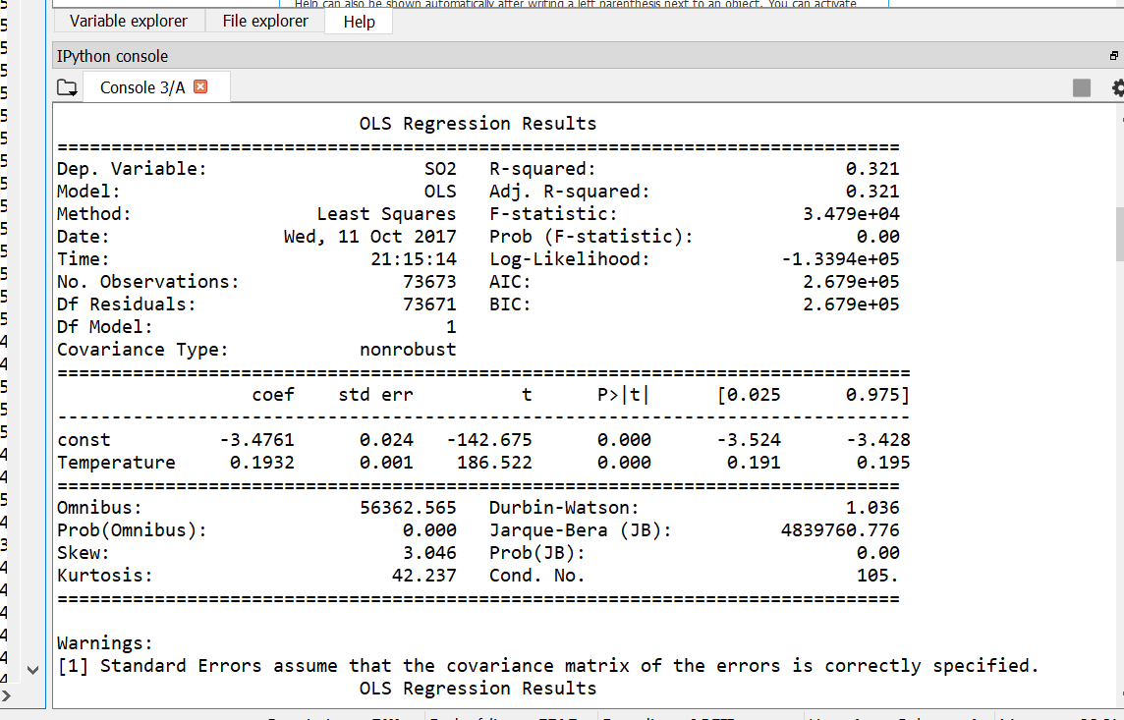
Simple linear regression to predict SO2

Slide 16
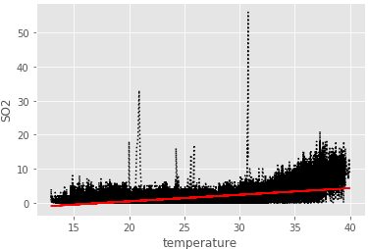
Scatter Diagram
A scatter Diagram showing the relationship between the sulphur dioxide and temperature as follow:
The sample co relation coefficient between these variable is .566. The scatter diagram and the sample correlation coefficient indicates a positive relationship between sulphur dioxide and the temperature. Thus, the sample data supports the conclusion that if temperature increase SO2 also increase.

Slide 17
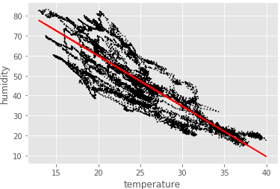
A scatter Diagram showing the relationship between the Temperature and Humidity as follow:
The sample co relation coefficient between these variable is -0.831402. The scatter diagram and the sample correlation coefficient indicates a Negative relationship between Humidity and the temperature. Thus, the sample data supports the conclusion that if temperature increase then humidity will decrease.

Slide 18
Multicollinearity
Multicollinearity is a state of very high intercorrelations or inter-associations among the independent variables. It is therefore a type of disturbance in the data, and if present in the data the statistical inferences made about the data may not be reliable.
Multicollinearity can result in several problems.
Multicollinearity makes it tedious to assess the relative importance of the independent variables in explaining the variation caused by the dependent variable.
The partial regression coefficient due to multicollinearity may not be estimated precisely. The standard errors are likely to be high.

Slide 19
Multiple Regression
The equation that describes how the dependent variable y is related to the independent variables x1,x2……,xq and an error term is called the multiple regression model
Multiple regression model
y = B0+ B1X1 + B2X2 +…… +BqXq + e
In the multiple regression model, B0,B1,B2,….Bq are parameters and the error term e.
q is number of independent variables.
y is dependent variable.

Slide 20
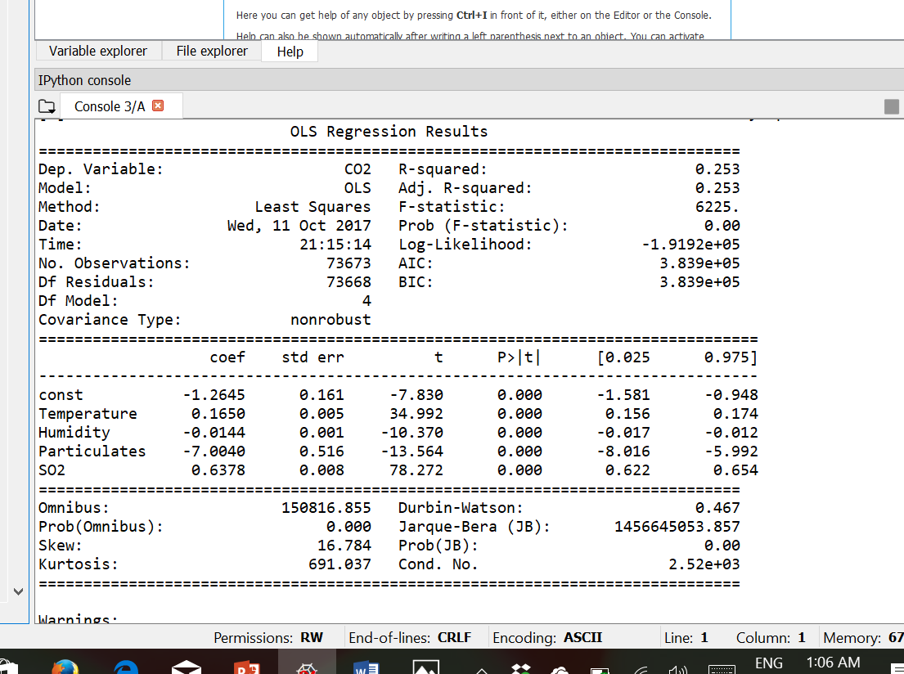
Multiple regression
Y = -1.2645 + 0.1650 * x1 - 0.0144 * x2 - 7.0040 * x3 + 0.6378 * x4

Slide 21
Remaining Tasks
Test the Selected model-
Train the model with sample data.
Generate predicted values.
Compare the predicted values with Existed values.
Testing for an overall Regression Relationship.
Generate Scatter chart of Predicted Values and residuals
Testing Individual Regression Parameters.

