Slide 1
COMPUTER APPLICATION DEPARTMENT WEBSITE
Frontend Project Presentation
Chitkara University Punjab
Submitted To:
Department of Computer Applications
Submitted By:
Mehardeep Kaur (2510987027)
Simran Kaur (2510987040)
Shikha (2510987038)

Slide 2
Computer Applications Department
INTRODUCTION
A fully functional, multi-page website for the Department of Computer Applications at Chitkara University.
Designed to serve as an official portal for students, faculty, and prospective applicants.
Features include:
Program details (BCA, MCA, Specializations)
Faculty profiles
Event announcements and schedules
Online admission form
Contact information and inquiry forms

Slide 3
Problem Statement
While creating the Computer Applications Department website using only HTML and CSS, we face challenges in website layout and maintaining a consistent design across all pages.
Solution to the Problem Statement
We use Semantic HTML tags (<header>, <nav>, <section>, <footer>) which gives a uniform structure to all pages of our website.
Instead of writing separate styles for each page, we used one common CSS file for the whole website.

Slide 4
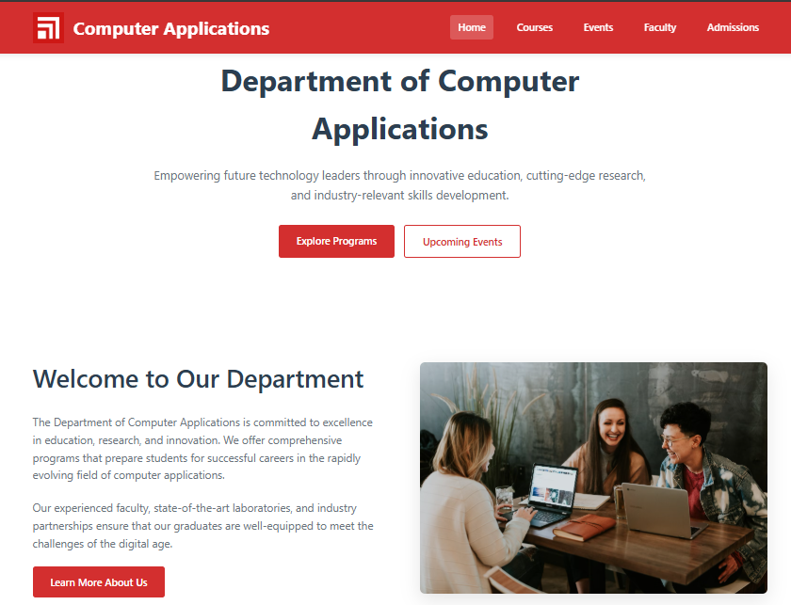
HOME PAGE

Slide 5
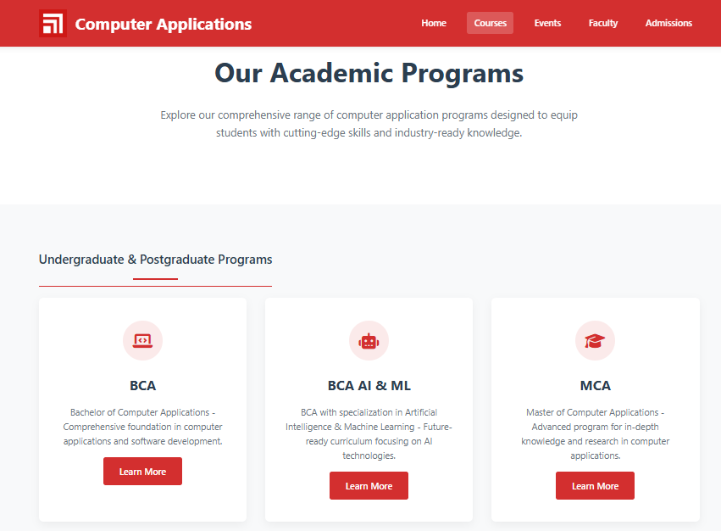
COURSES PAGE

Slide 6
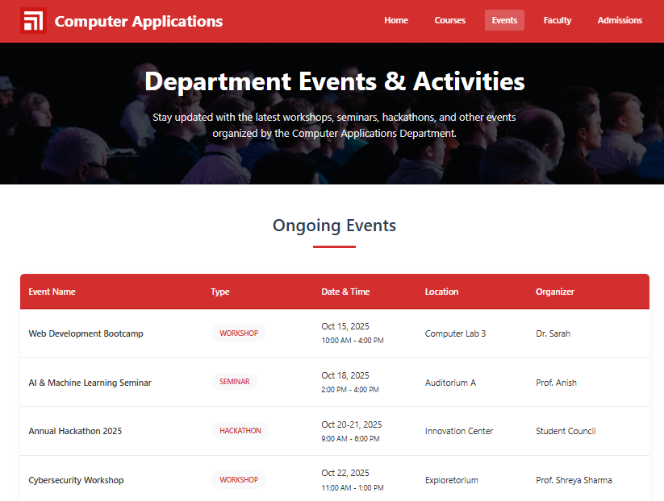
EVENTS PAGE

Slide 7
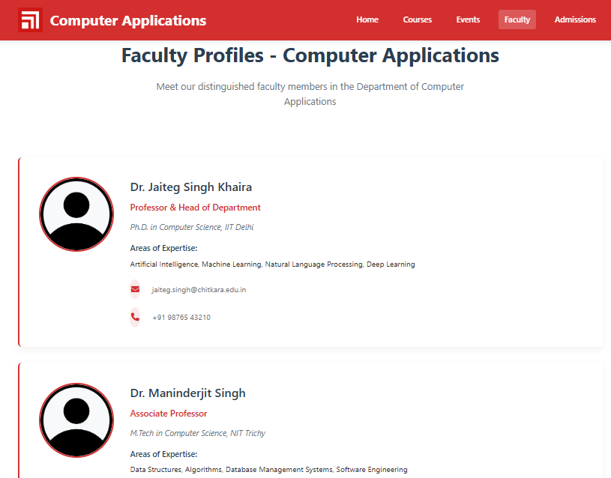
FACULTY PAGE

Slide 8
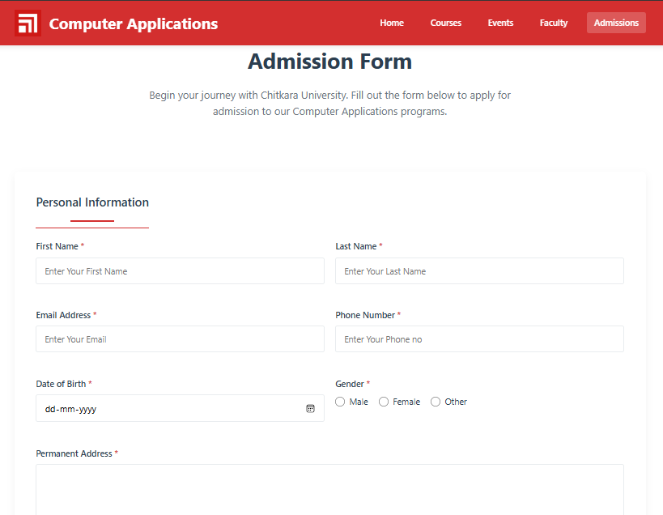
ADMISSIONS PAGE

Slide 9
CONCLUSION
We built a clean and consistent Computer Applications Department website using HTML and CSS.
All pages are organized and linked making it easy to access information about courses, faculty, events and admission.
This project helped us improve our HTML and CSS skills.

Slide 10
CA Department Website
THANK YOU

