Slide 1

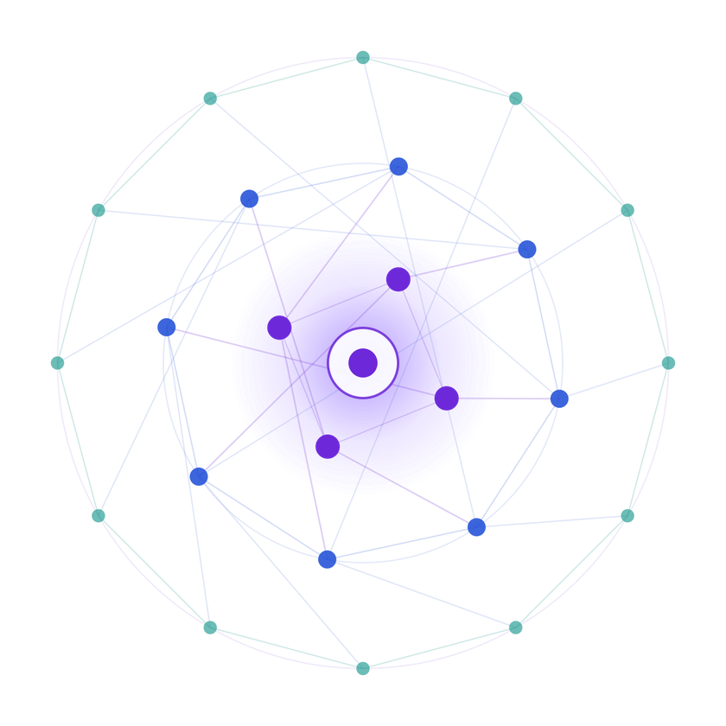
SAMSUNG PRISM
Generative AI
Hackathon
3rd Edition 2026 – 27
  Theme ID - 5
  Team Name - TheMPeople
  College Name - Thapar Institute of Engineering & Technology
  Member Name & Email 1- Mannat Singh
msingh4_be24@thapar.edu
  Member Name & Email 2- Mehatva Mansukhani
mmansukhani_be24@thapar.edu
  Submission Github link - https://github.com/Mehatva/PRISM-GenAI-Hackathon-Theme5
Notes:
Opening slide for the 3rd edition of the PRISM Generative AI Hackathon. Replace the SAMSUNG PRISM pill with the official PRISM logo image if you have the asset. Confirm the academic year label (2026-27) before circulating.
1

Slide 2
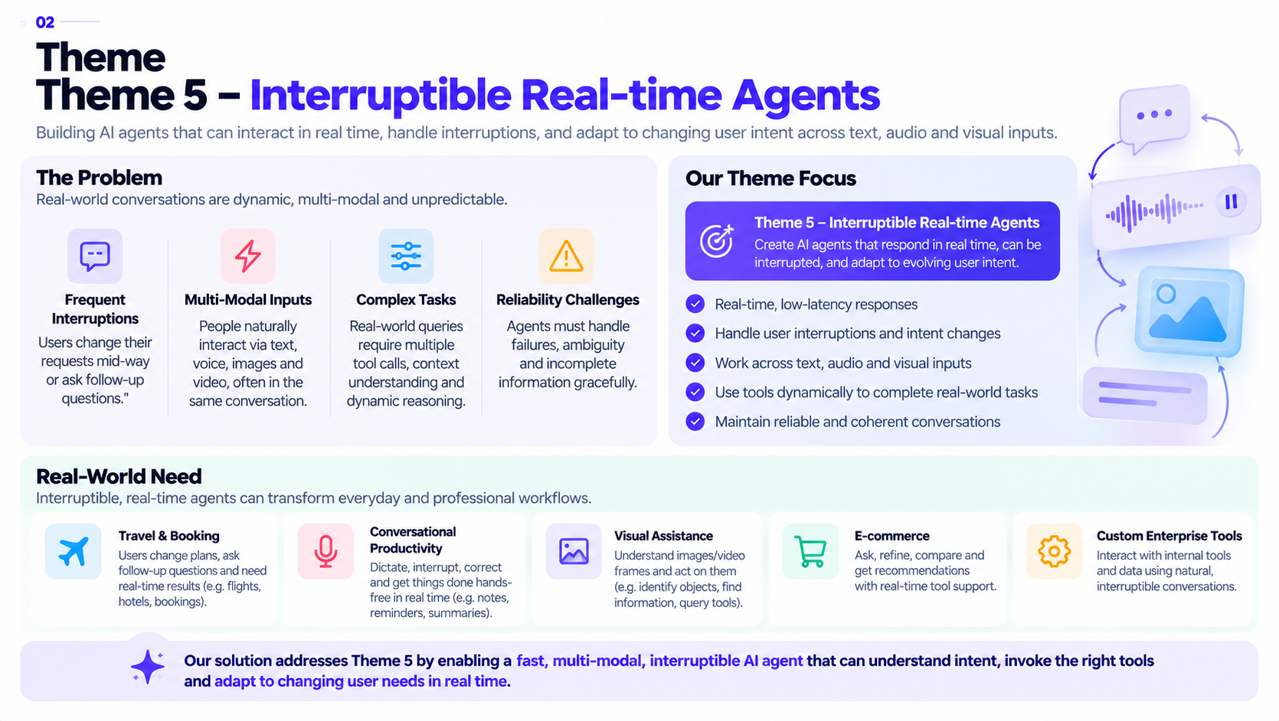
Theme

Slide 3
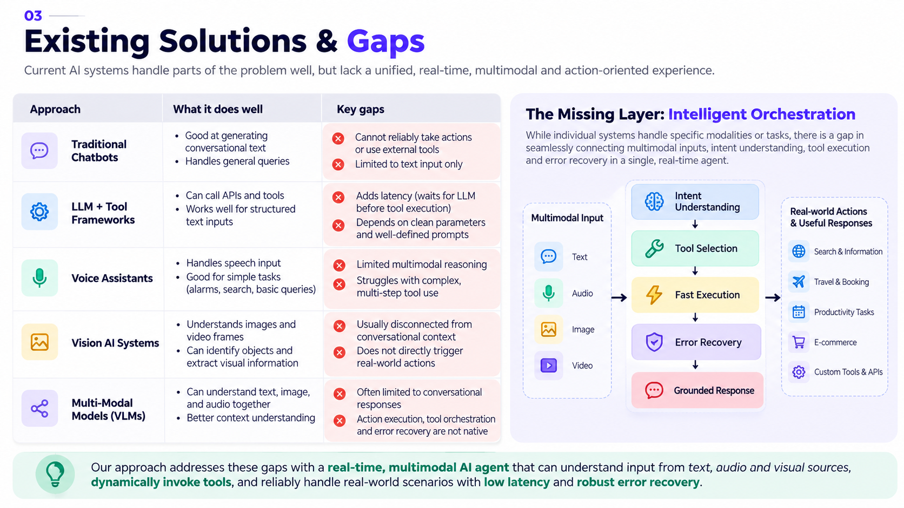
Existing Solutions & Gaps

Slide 4
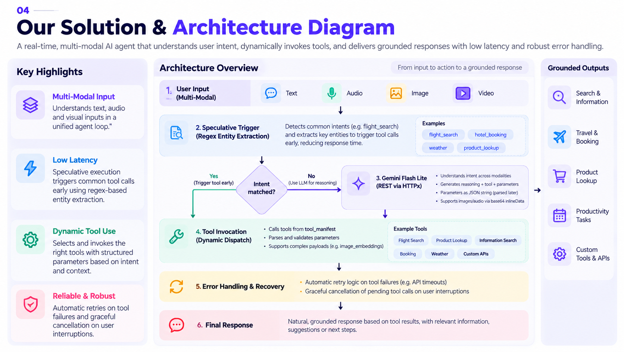
Our Solutions & Architecture Diagram

Slide 5
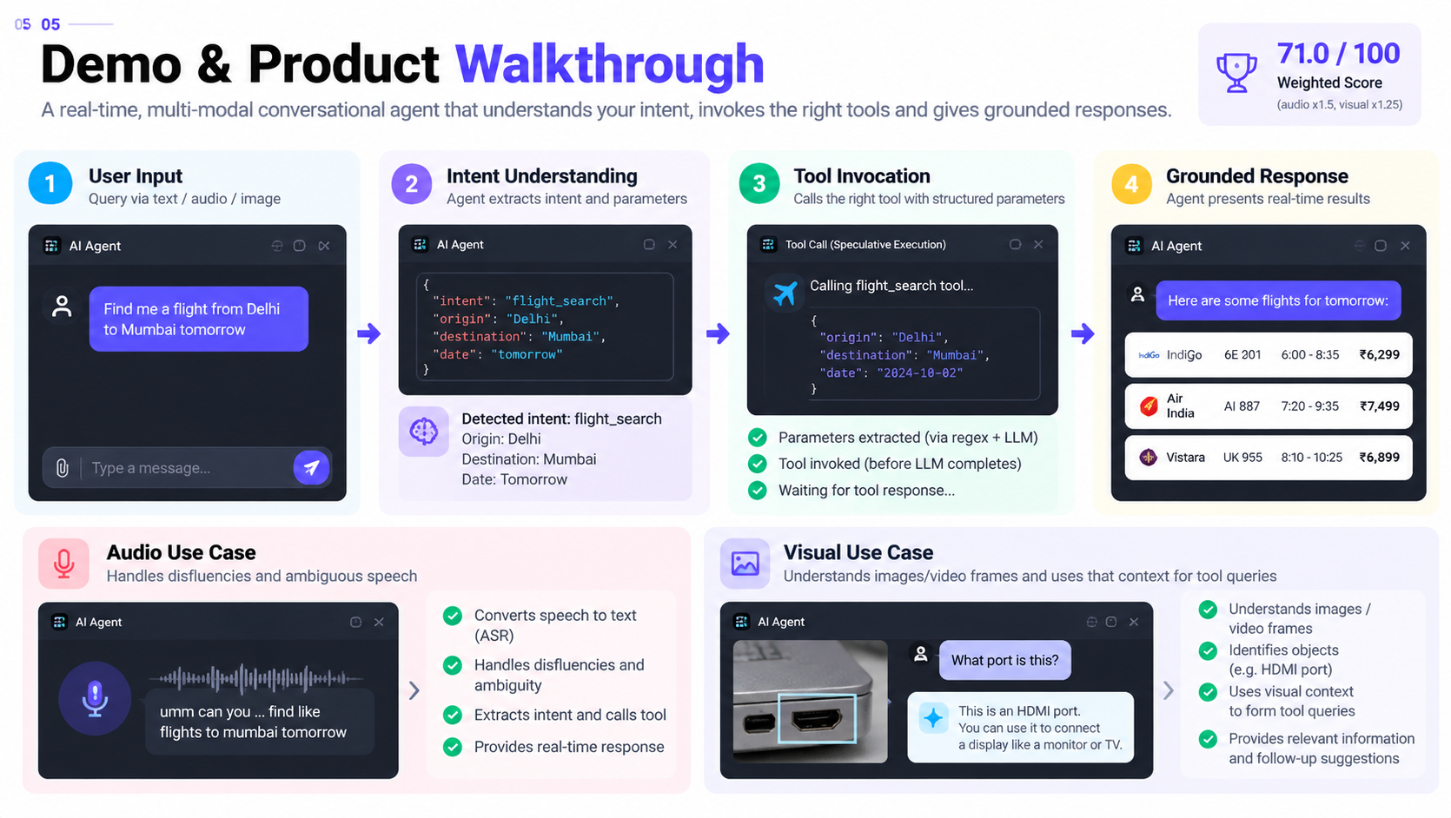
Demo & Product Walkthrough

Slide 6
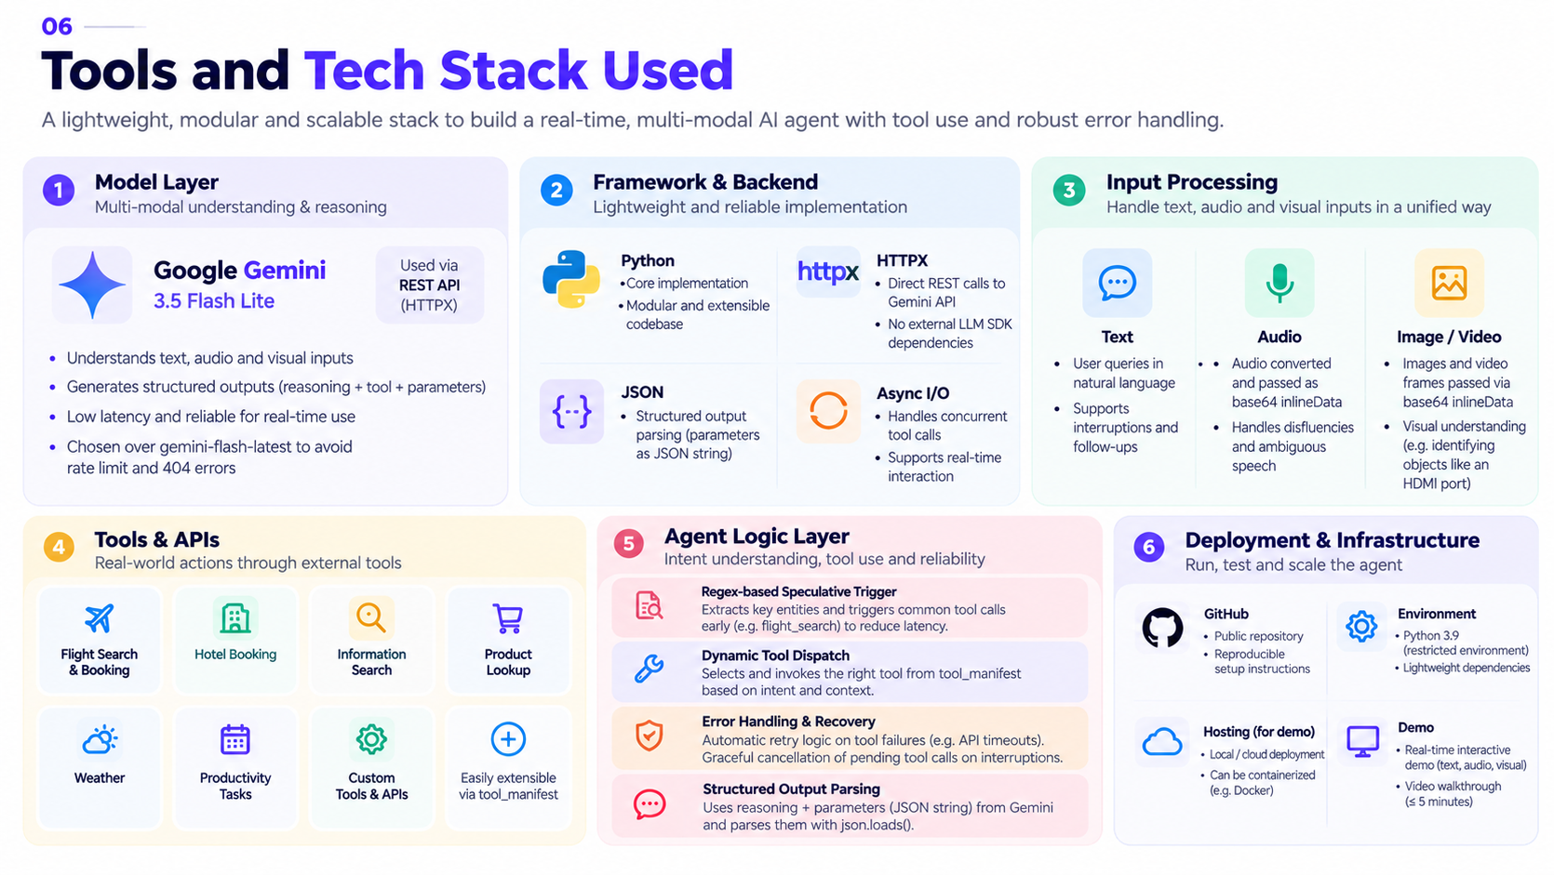
Tools and tech stack used

Slide 7
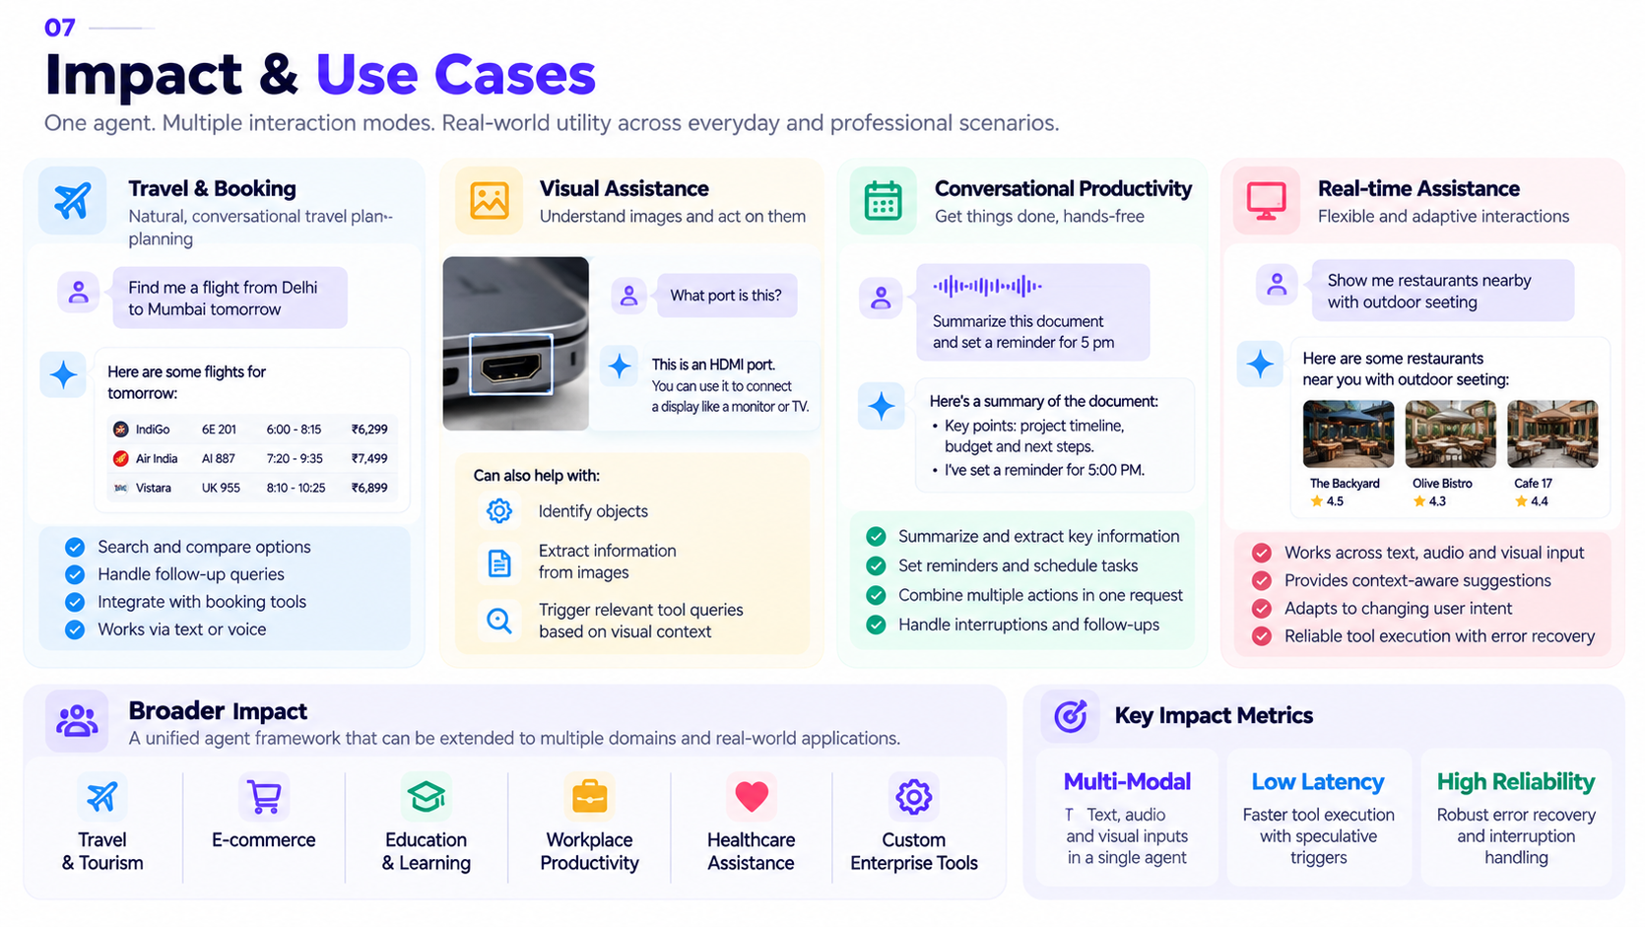
Impact & Use case

Slide 8
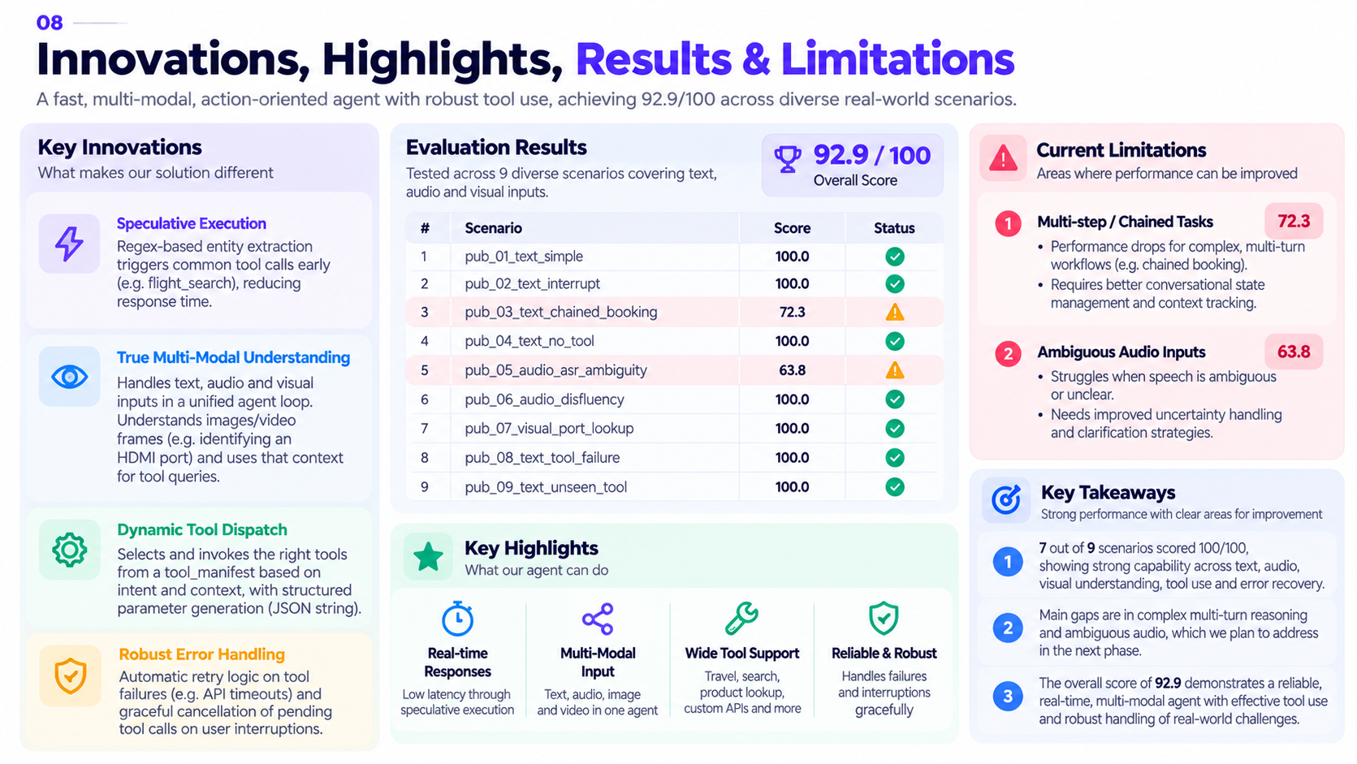
Innovation highlights, results and limitations

Slide 9
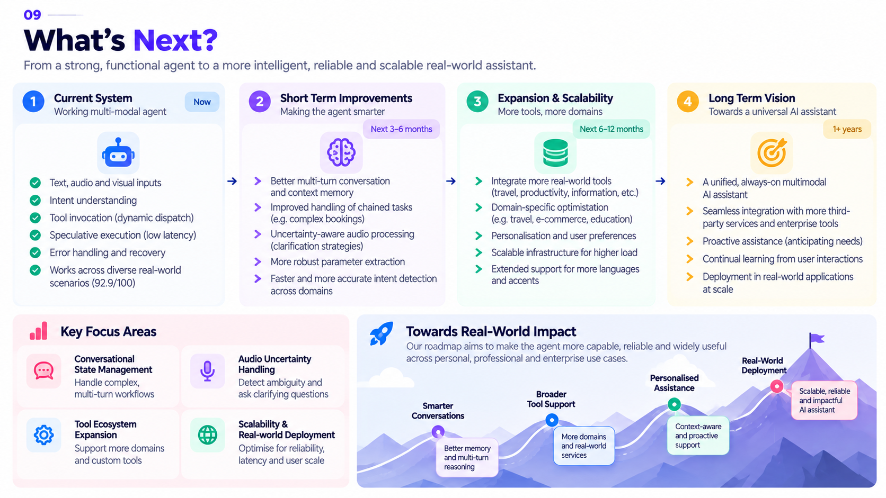
What’s next

Slide 10
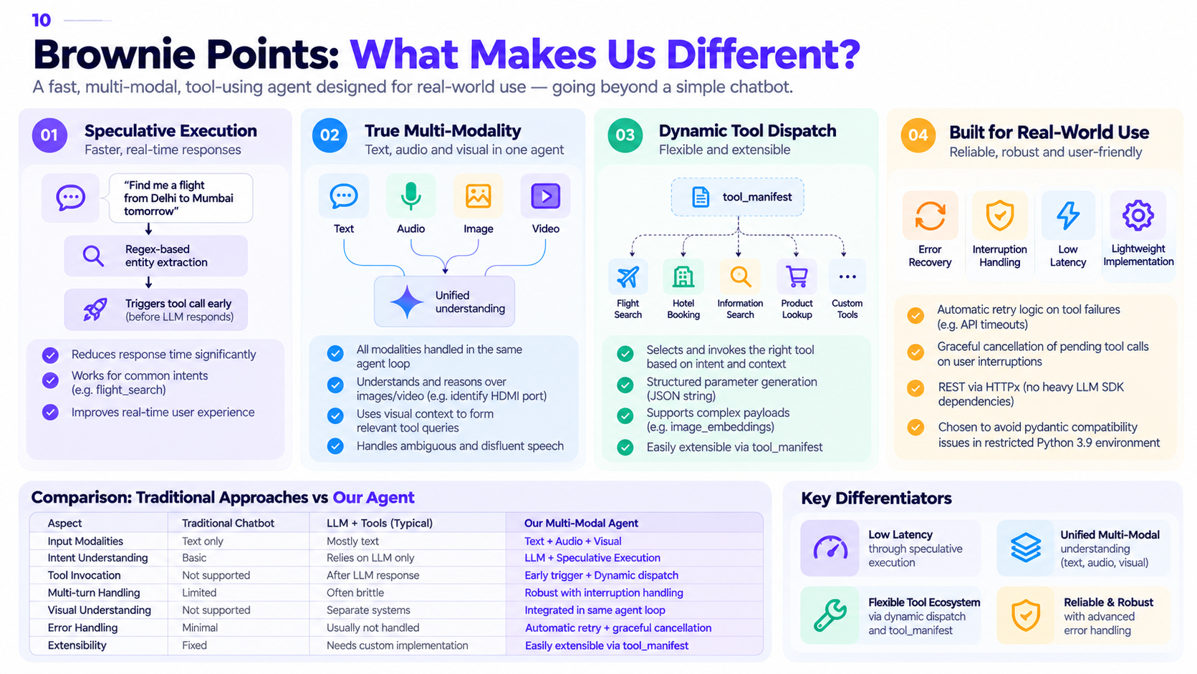
Brownie points slide( differentiation)

Slide 11
Thank you
Organised by the Language AI Team and the PRISM Team, Samsung R&D Institute India
Notes:
Closing slide. Add the Google Form URL and a contact email before sharing. Edition 2 organising team for reference: Language AI - Sourabh Tiwari, Gaurav, Sanjeeth Pothireddy, Gorang Maniar; PRISM - Binny Lakra, Prakhar Chandrakar, Vishu Kumar; Kick-off and mentors - Giridhar Jakki, Deepraj Prabhakar Patkar (Language AI), Srimanu Prasad Nagaraju, Ashish Kumar (Tech Strategy).
12

