Slide 1


SNS COLLEGE OF TECHNOLOGY An Autonomous Institution
AI-powered Nutrition Analyzer for Fitness Enthusiasts
PRESENTED BY :
MADHAVAN.M
MEHA V.S
NEERAJ.D
NANDHINI.S

Slide 2
PROBLEM STATEMENT
Food is essential for human life and has been the concern of many healthcare conventions. Nowadays new dietary assessment and nutrition analysis tools enable more opportunities to help people understand their daily eating habits, exploring nutrition patterns and maintain a healthy diet. Nutritional analysis is the process of determining the nutritional content of food. It is a vital part of analytical chemistry that provides information about the chemical composition, processing, quality control and contamination of food. The main aim of the project is to building a model which is used for classifying the fruit depends on the different characteristics like colour, shape, texture etc. Here the user can capture the images of different fruits and then the image will be sent the trained model.

Slide 3
INTRODUCTION
In a world where we're constantly bombarded with information and choices, it's difficult to know what's best for our health. Fortunately, there are now AI - powered nutrition analysis tools that can help us make better decisions about what to eat. These tools use data from our own bodies to provide personalized recommendations about which foods will help us reach our goals. Whether we're trying to lose weight, gain muscle, or just improve our overall health, it can be a valuable asset in our quest for wellness. A new AI-powered nutrition analyzer has been developed that can help fitness enthusiasts better understand their dietary needs.

Slide 4
EXISTING SYSTEM
Precision Nutrient Management Using Artificial Intelligence Based on Digital Data Collection Framework : (1) Nutritional intake is fundamental to human growth and health, and the intake of different types of nutrients and micronutrients can affect health. (2) Methods: An artificial intelligence model for precision nutritional analysis allows the user to enter the name and serving size of a dish to assess a total of 24 nutrients. A total of two AI models, including semantic and nutritional analysis models, were integrated into the Precision Nutritional Analysis.

Slide 5
A total of five different algorithms were used to identify the most similar recipes and to determine differences in text using cosine similarity. (3) Results: This study developed two models to form a precision nutrient analysis model. The 2013–2016 Taiwan National Nutrition Health Status Change Survey (NNHS) was used for model verification. The model’s accuracy was determined by comparing the results of the model with the NNHS. The results show that the AI model has very little error and can significantly improve the efficiency of the analysis.

Slide 6
ABSTRACT
Food is essential for human life and has been the concern of many healthcare conventions Nowadays new dietary assessment and nutrition analysis tools enable more opportunities to help people understand their daily eating habits, exploring nutrition patterns and maintain a healthy diet. In this project, We will be creating an AI-powered nutrition analyzer for fitness enthusiasts. This tool will be used to help users track their macronutrient intake and ensure that they are getting the right amount of nutrients for their desired results.

Slide 7
OBJECTIVE
By the end of this project you will:
know fundamental concepts and techniques of Convolutional Neural Network.
gain a broad understanding of image data.
Knowhow to pre-process/clean the data using different data preprocessing techniques.
know how to build a web application using the Flask framework.

Slide 8
PROPOSED SYSTEM
S.NO | PARAMETER | DESCRIPTION
1. | Idea / Solution description | In order to distinguish between fruits and vegetables based on colour, texture, shape, and other features, an ordinary human needs employ cutting-edge AI-based analysis software. The user must be informed of the nutritional value of that particular food at the moment of identification
2. | Novelty / Uniqueness | Home cures and easy fixes for common issues are suggested. A diet tailored to each person's needs and health status. Flexibility in diet is encouraged to encourage a nutritious and productive eating routine.

Slide 9
3. | Social Impact / Customer Satisfaction | Healthy lifestyle development Continuous calorie tracking produces a fitness attitude
4. | Scalability of the Solution | Extending data collecting and increasing accuracy utilizing user input data • The best way to store a certain meal • Everyone may use and profit from it because to its user-friendly UI

Slide 10
SYSTEM REQUIREMENTS
Hardware Specifications:
Windows (minimum 10), Mac & Linux
Ram - 4GB ( minimum)
Hard Disk - 100GB (minimum)
Processor - Intel i3 (minimum), Mac M1
Software Specifications:
Anaconda Navigator - https://www.anaconda.com/products/distribution
Google Colab - https://colab.research.google.com/
Spyder / VS Code / Pycharm
Jupyter Notebook

Slide 11
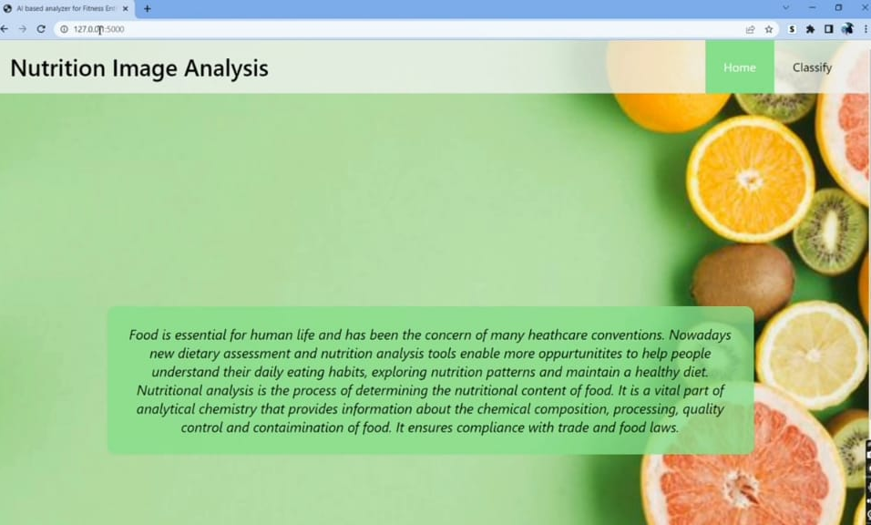
IMPLEMENTATION

Slide 12
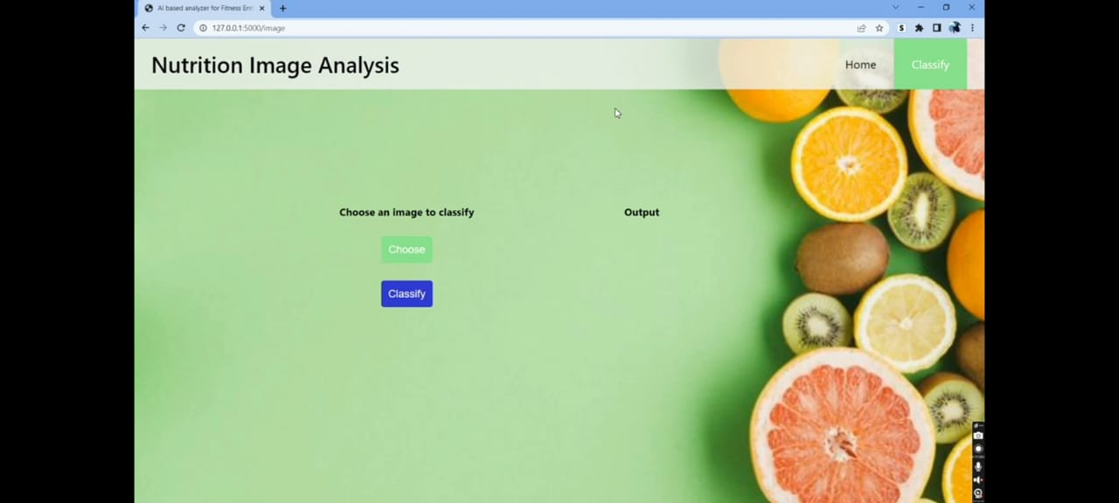

Slide 13
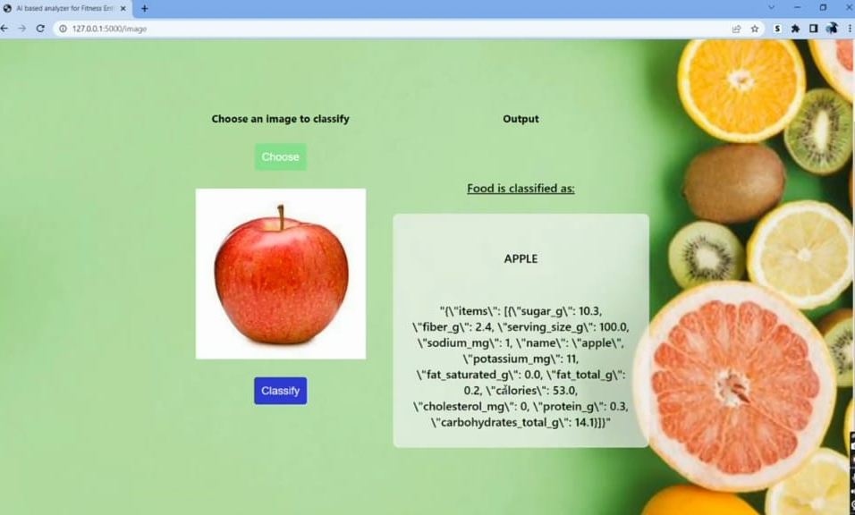

Slide 14
THANK YOU

