Slide 1

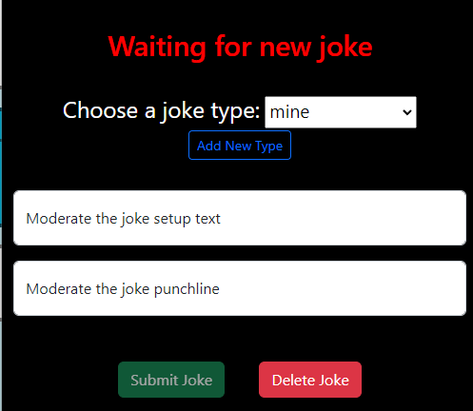
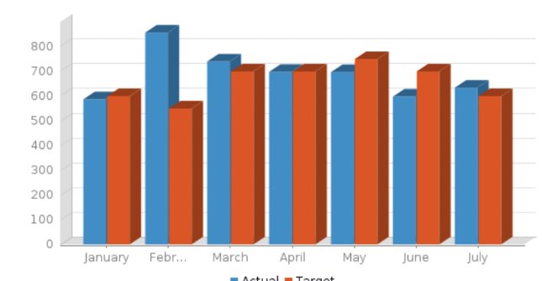

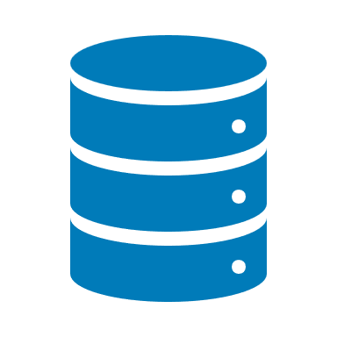
Public internet
Virtual machine
Container port number
Azure private network
Application container
Application port number
/joke/
Azure private network API routes
/mod/
Docker private network
Rabbitmq combined container
/sub/
80
kong
public IP: 51.142.102.246
private IP: 10.0.0.7
8445
/types
/types API
/types
/docs
/joke
/mod
/types
/sub
4000
4100
4200
joke
moderate
submit
4300
analytics
/types API
submitted jokes
3000
3100
3200
types
3300
4002
4302
mysql
4102
4201
4202
mongodb
rmq-admin
SUBMITTED_JOKES
rmq-admin
types
3306
mysql-db
15672
5672
15672
27017
mongo-db
public IP: 51.105.25.229
private IP: 10.0.0.4
4301
4001
etl
etl
4101
moderated jokes
MODERATED_JOKES
LOGGED_JOKES
logged jokes
3001
5672
3301
public IP: 20.90.114.181
private IP: 10.0.0.8
public IP: 20.117.157.2
private IP: 10.0.0.5
public IP:
private IP:

