Slide 1
ClassicModels KPI Dashboard
Generated on 2025-02-04

Slide 2
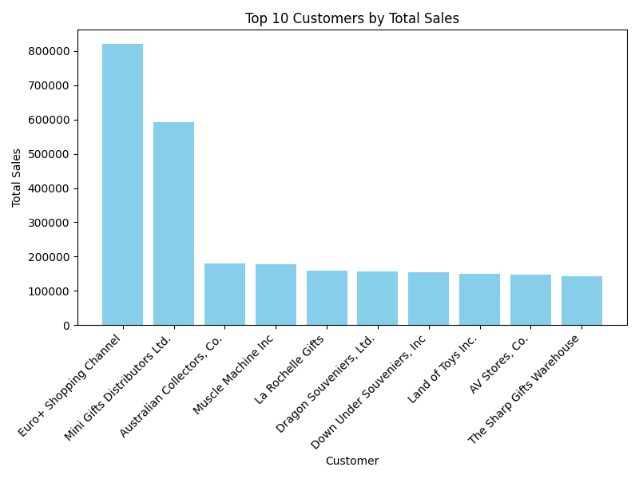
Top 10 Customers by Total Sales

Slide 3
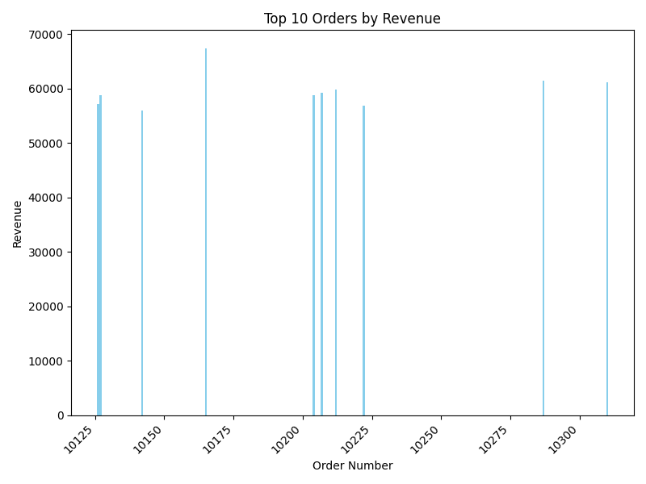
Top 10 Orders by Revenue

Slide 4
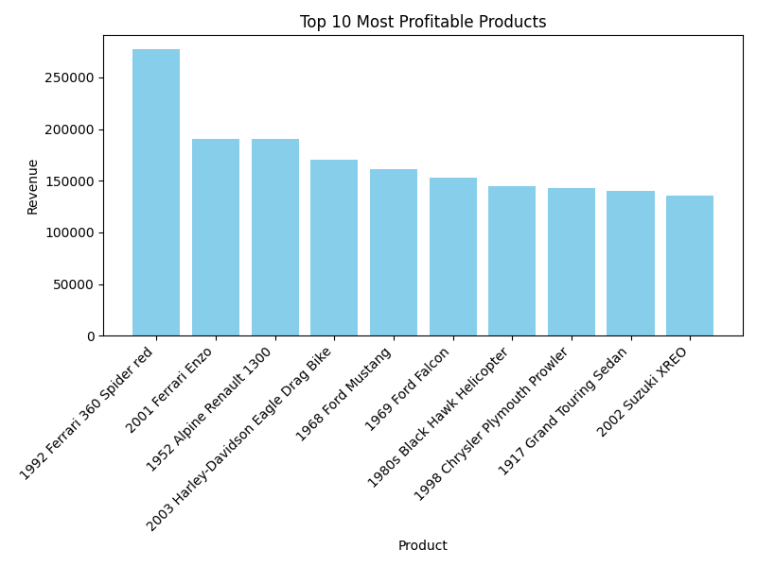
Top 10 Most Profitable Products

Slide 5
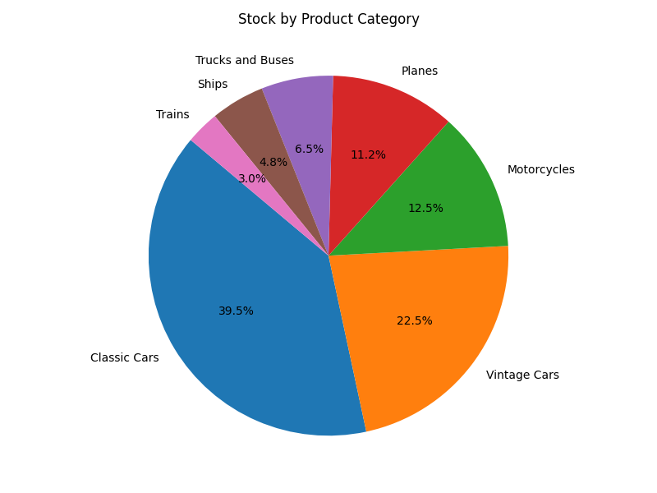
Stock by Product Category

Slide 6
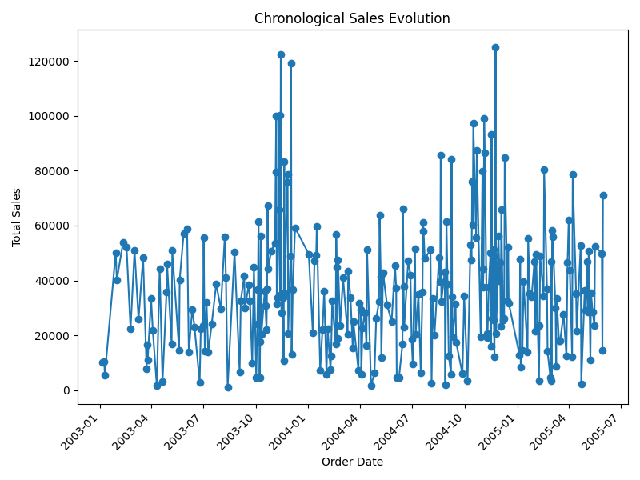
Chronological Sales Evolution

Slide 7
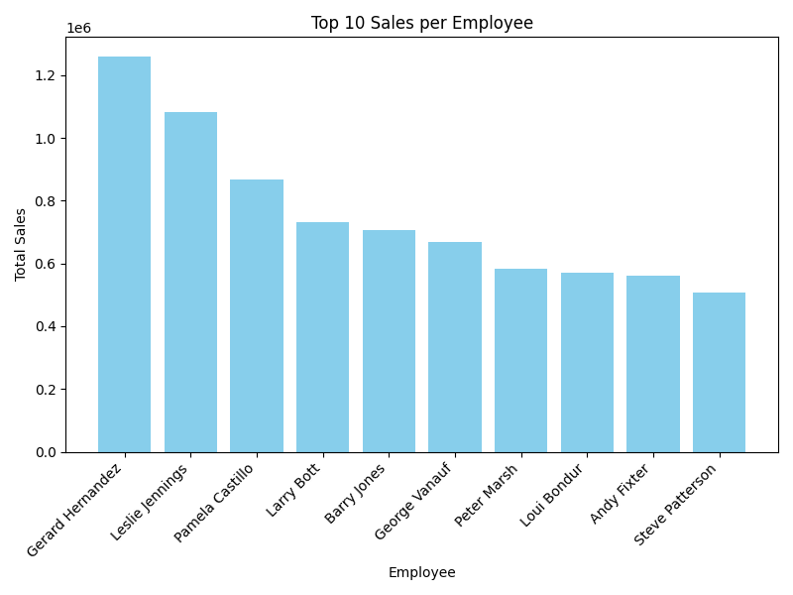
Top 10 Sales per Employee

Slide 8
Average Fulfillment Time
The average fulfillment time is 3.76 days.

Slide 9
On-Time Delivery Rate
The on-time delivery rate is 99.68%.

Slide 10
Conclusion
This dashboard provides a comprehensive view of ClassicModels' KPIs, including sales performance, inventory levels, and operational metrics.

