Slide 1
Checkpoint 1
Introduction To Web Development.
Web Fundamentals Project

Slide 2
How does the web work?
When you type a web address into your browser (for our analogy that's like walking to the shop):
The browser goes to the DNS server, and finds the real address of the server that the website lives on (you find the address of the shop).
The browser sends an HTTP request message to the server, asking it to send a copy of the website to the client (you go to the shop and order your goods). This message, and all other data sent between the client and the server, is sent across your internet connection using TCP/IP.
If the server approves the client's request, the server sends the client a "200 OK" message, which means "Of course you can look at that website! Here it is", and then starts sending the website's files to the browser as a series of small chunks called data packets (the shop gives you your goods, and you bring them back to your house).
The browser assembles the small chunks into a complete web page and displays it to you (the goods arrive at your door — new shiny stuff, awesome!).

Slide 3
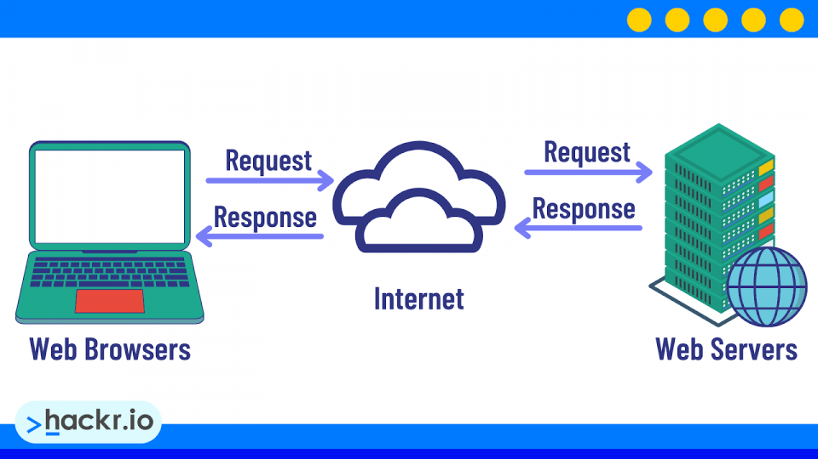
How does the web work?
Source :https://hackr.io/blog/what-is-a-web-server

Slide 4
What do you need to be a web developer?
Foundations: Web Developers create websites, so to become a Web Developer, you should develop a comprehensive understanding of how the web works
Front end side programming : Foundational knowledge of HTML and CSS.
Programming fundamentals: Foundational knowledge of computer programming, JavaScript
Web servers: To become a Web Developer, you’ll need to know how to build servers using a modern back-end framework and how to develop custom APIs and serve static websites and files.
Server-side programming: It’s important for Web Developers to have an understanding of Server Side Rendering and Templating Engines, which are used to create empty page templates populated with dynamic data, such as a series of product pages for an eCommerce store.
Databases: Aspiring Web Developers will also have to understand core concepts around data and learn how to manage databases and data on a web server.

Slide 5
Why did you choose to learn web development?
Learn JavaScript
To know how web is working.
Creating web pages using HTML and CSS

