Slide 1
Introduction to Programming (CSE-141)
Lecture 2: Variable and Datatypes

Slide 2
Insertion Operator ( << )
Variable cout is predefined to denote an output stream that goes to the standard output device (display screen).
The insertion operator << called “put to” takes 2 operands.
The left operand is a stream expression, such as cout. The right operand is an expression of simple type or a string constant.

Slide 3
Output Statements
SYNTAX
cout statements can be linked together using << operator.
These examples yield the same output:
cout << “The answer is “ ;
cout << 3 * 4 ;
cout << “The answer is “ << 3 * 4 ;
cout << Expression << Expression . . . ;

Slide 4
Output Statements (String constant)
String constants (in double quotes) are to be printed as is, without the quotes.
cout<<“Enter the number of candy bars ”;
OUTPUT: Enter the number of candy bars
“Enter the number of candy bars ” is called a prompt.
All user inputs must be preceded by a prompt to tell the user what is expected.
You must insert spaces inside the quotes if you want them in the output.
Do not put a string in quotes on multiple lines.

Slide 5
Output Statements (Expression)
All expressions are computed and then outputted.
cout << “The answer is ” << 3 * 4 ;
OUTPUT: The answer is 12

Slide 6
1 // FirstProgram.cpp
2 // Printing multiple lines with a single statement
3 #include <iostream>
4
5 // function main begins program execution
6 int main()
7 {
8 std::cout << "Welcome\nto\n\nC++!\n";
9
10 return 0; // indicate that program ended successfully
11
12 } // end function main
Welcome
to
C++!

Slide 7

cin and the Extraction Operator >>
Cin is used for user input
The syntax of an input statement using cin and the extraction operator >> is:
The extraction operator >> is binary
Left-side operand is an input stream variable
Example: cin
Right-side operand is a variable

Slide 8
Input using Cin
#include <iostream>
using namespace std;
int main() {
int num;
cout << "Enter a number: ";
// take integer input
cin >> num;
cout << "You entered: " << num;
return 0;
}

Slide 9
What is an Identifier?
An identifier is the name to denote labels, types, variables, constants or functions, in a C++ program.
C++ is a case-sensitive language.
Work is not work
Identifiers should be descriptive
Using meaningful identifiers is a good programming practice

Slide 10
Identifier
Identifiers must be unique
Identifiers cannot be reserved words (keywords)
double main return
Identifier must start with a letter or underscore, and be followed by zero or more letters (A-Z, a-z), digits (0-9), or underscores
VALID
age_of_dog _taxRateY2K
PrintHeading ageOfHorse
NOT VALID
age# 2000TaxRate Age-Of-Dog main

Slide 11
C++ keywords and reserved words
template
this
thread_local
throw
true
try
typedef
typeid
typename
union
unsigned
using
virtual
void
volatile
wchar_t
alignas
alignof
and
and_eq
asm
atomic_cancel
atomic_commit
atomic_noexcept
auto
bitand
bitor
bool
break
case
catch
char
char8_t
char16_t
char32_t
class
compl
concept
const
consteval
constexpr
constinit
const_cast
continue
co_await
co_return
co_yield
decltype
default
delete
do
double
dynamic_cast
else
enum
explicit
export
extern
false
float
for
friend
goto
if
inline
int
long
mutable
namespace
new
noexcept
not
not_eq
nullptr
operator
or
or_eq
private
protected
public
reflexpr
register
reinterpret_cast
requires
return
short
signed
sizeof
static
static_assert
static_cast
struct
switch
synchronized
while
xor
Xor_eq

Slide 12
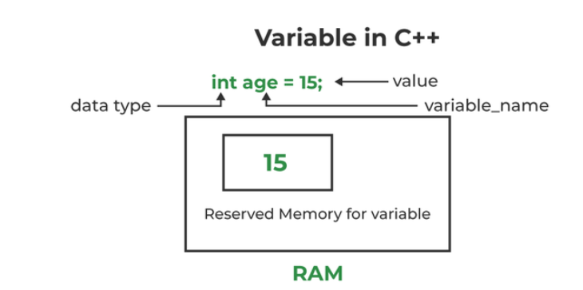
What is a Variable?
A variable is a memory address where data can be stored and changed.
Declaring a variable means specifying both its name and its data type.

Slide 13
Variables
The computer’s RAM (Read Access Memory) consists of millions of successive memory cells that are used to store data
A variable is a memory location with a given name
Naming variables:
can contain letters, digits, and underscore characters _
must begin with either a letter or the underscore character
must not be a C++ keyword
Examples:
count
sum
_x
sum_2
The value of a variable is the content of its memory location

Slide 14
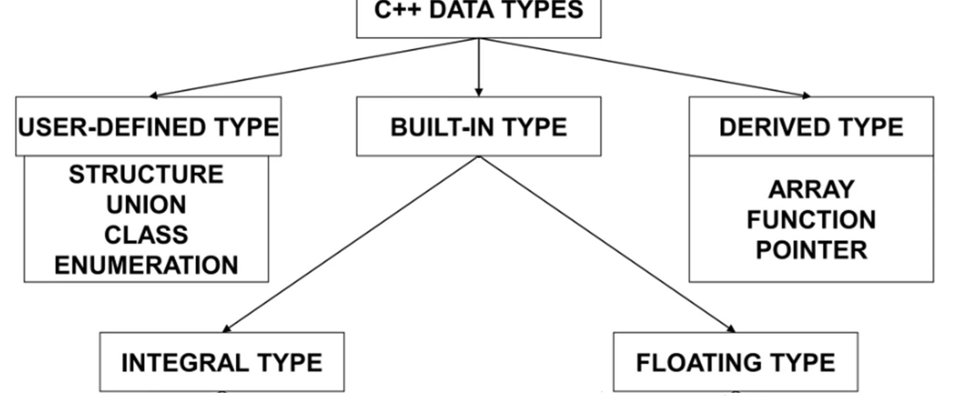

Slide 15
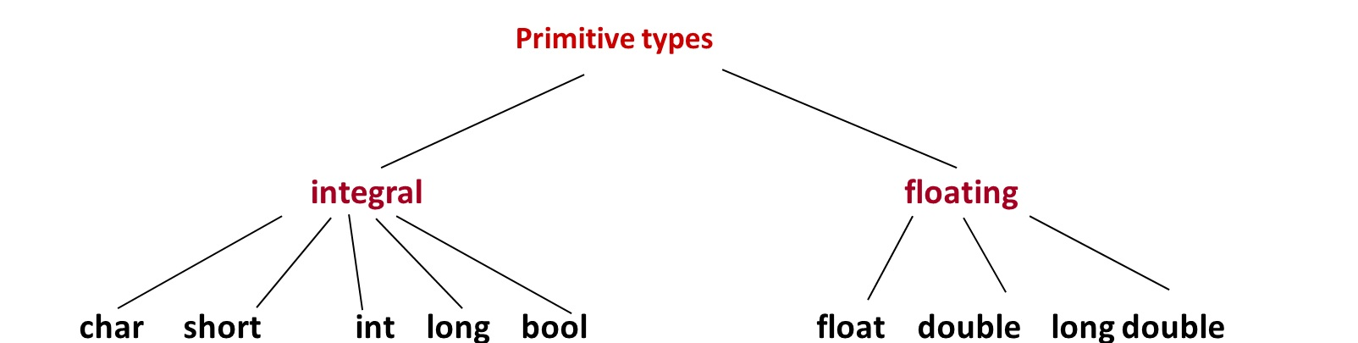
C++ Primitive Data Types

Slide 16
Data types
A data type is set of values and set of operations on those values.
type | set of values | examples of values | examples of operations
int | integers | 17 12345 | add, subtract, divide, multiply
double | floating-point numbers | 3.14159 7.034e23 | add, subtract, divide, multiply
char | characters | 'a' '$' | compare
std::string | sequence of characters | "Hello World!" "C++ is fun" | concatenate
bool | truth values | true false | and, or, not

Slide 17
Why different numeric types?
Tradeoff between memory use and range for integers.
Tradeoff between memory use and precision for real numbers.
char
short
int
long (windows)
float
long (linux)
long long
double

Slide 18
Premitive Data Types in C++
Integral Types
represent whole numbers and their negatives
declared as int, short, or long
Character Types
represent single characters
declared as char
Stored by ASCII values
Boolean Type
declared as bool
has only 2 values true/false
will not print out directly
Floating Types
represent real numbers with a decimal point
declared as float, or double
Scientific notation where e (or E) stand for “times 10 to the ” (.55-e6)

Slide 19
What Does a Variable Declaration Do?
A declaration tells the compiler to allocate enough memory to hold a value of this data type, and to associate the identifier with this location.
int ageOfDog;→
char middleInitial; →
float taxRate;→

Slide 20
Samples of C++ Data Values
int sample values
4578 -4578 0
bool values
true false
float sample values
95.274 95.0 .265
char sample values
‘B’ ‘d’ ‘4’ ‘?’ ‘*’

Slide 21
bool Data Type
Type bool is a built-in type consisting of just 2 values, the constants true and false
We can declare variables of type bool
bool hasFever; // true if has high temperature
bool isSenior; // true if age is at least 55
The value 0 represents false
ANY non-zero value represents true

Slide 22
Variable Declaration
All variables must declared before use.
At the top of the program
Just before use.
Commas are used to separate identifiers of the same type.
int count, age;
Variables can be initialized to a starting value when they are declared
int count = 0;
int age, count = 0;

Slide 23
Variable Declaration
Data types define the kind of data a variable can hold
To use a variable, you need to declare its data type and name
int age; // Declares an integer variable named 'age’
double price; // Declares a double variable named 'price’
char initial; // Declares a character variable named 'initial’
bool isReady; // Declares a boolean variable named 'isReady'
We can declare multiple names on the same line:
int a, b, c; // Declares three variable of type int

Slide 24
Assignment
After declaring a variable, you can assign a value to it.
Use assignment operator '='
age = 25; // Assigns the value 25 to the 'age' variable
price = 9.5; // Assigns the value 9.99 to the 'price' variable
initial = 'J'; // Assigns the character 'J' to the 'initial' variable
isReady = true; // Assigns the value 'true' to the 'isReady' variable
Right-hand side could be an expression
double dp = 0.75*price; // initialize 'dp' variable with 25% discount price

Slide 25
Initialization
While declaring a variable, you can also initialize it.
int x = 123;

Slide 26
What is an Expression in C++?
An expression is a valid arrangement of variables, constants, and operators.
In C++, each expression can be evaluated to compute a value of a given type
In C++, an expression can be:
A variable or a constant (count, 100)
An operation (a + b, a * 2)
Function call (getRectangleArea(2, 4))

Slide 27
Arithmetic Operators
Operators: +, -, * /
For floating numbers, the result as same as Math operations.
Note on integer division: the result is an integer. 7/2 is 3.
% (remainder or modulo) is the special operator just for integer. It yields an integer as the result. 7%2 is 1.
Both / and % can only be used for positive integers.
Precedence rule is similar to Math.

Slide 28
Assignment Operator
An operator to give (assign) a value to a variable.
Denote as ‘=‘
Only variable can be on the left side.
An expression is on the right side.
Variables keep their assigned values until changed by another assignment statement or by reading in a new value.

Slide 29
Assignment Operator Mechanism
Example:
int count = 0;
int starting;
starting = count + 5;
Expression evaluation:
Get value of count: 0
Add 5 to it.
Assign to starting

Slide 30
Constant
A constant is a type of variable whose value cannot be changed once it has been initialized. Constants are used to represent fixed values that should not be modified during the execution of a program.
You should always declare the variable as constant when you have values that are unlikely to change:
const int minutesPerHour = 60; const float PI = 3.14;
Question: Given the user input of radius, calculate the area of circle.

Slide 31
C++ Data Type String
A string is a sequence of characters enclosed in double quotes
string sample values
“Hello” “Year 2000” “1234”
The empty string (null string) contains no displayed characters and is written as “”

Slide 32
C++ Data Type String (cont.)
string is not a built-in (standard) type
it is a programmer-defined data type
it is provided in the C++ standard library
Need to include the following two lines:
#include <string>
using namespace std;
string operations include
comparing 2 string values
searching a string for a particular character
joining one string to another (concatenation)
etc...

Slide 33
#include <iostream>
#include <string>
int main() {
// Create a string
std::string greeting = "Hello, World!";
// Print the string
std::cout << greeting << std::endl;
// Get the length of the string
std::cout << "Length of the string: " << greeting.length() << std::endl;
// Change the string
greeting = "Goodbye, World!";
std::cout << greeting << std::endl;
return 0;
}

Slide 34
Cin vs getline()
The primary difference between std::getline and std::cin in C++ lies in how they handle input.
std::cin
Reads input from the standard input (usually the keyboard) up to the first whitespace character (space, tab, or newline).
reads only a single word or token. It stops reading when it encounters whitespace, which means if the user types a string with spaces, only the part before the first space will be read.
std::getline
Reads an entire line of input, including spaces, until it encounters a newline character.

Slide 35
Arithmetic Expressions
Arithmetic operations can be used to express the mathematic expression in C++:

Slide 36
Boolean Expression
Expression that yields bool result
Include:
6 Relational Operators
< <= > >= == !=
3 Logical Operators
! && ||

Slide 37
Relational Operators
are used in boolean expressions of form:
ExpressionA Operator ExpressionB
temperature > humidity
B * B - 4.0 * A * C > 0.0
abs (number) == 35
initial != ‘Q’
Notes:
== (equivalency) is NOT = (assignment)
characters are compared alphabetically. However, lowercase letters are higher ASCII value.
An integer variable can be assigned the result of a logical expression
You cannot string inequalities together:
Bad Code: 4<x<6 Good Code: (x > 4) &&(x < 6)

Slide 38
Relational Operators
int x, y ;
x = 4;
y = 6;
EXPRESSION VALUE
x < y true
x + 2 < y false
x != y true
x + 3 >= y true
y == x false
y == x+2 true
y = x + 3 7
y = x < 3 0
y = x > 3 1

Slide 39
Logical Operators
are used in boolean expressions of form:
ExpressionA Operator ExpressionB
A || B (true if either A or B or both are true. It is false otherwise)
A && B (true if both A and B are true. It is false otherwise)
or
Operator Expression
!A (true if A is false. It is false if A is true)
Notes:
Highest precedence for NOT, AND and OR are low precedence.
Associate left to right with low precedence. Use parenthesis to override priority or for clarification
x && y || z will evaluate “x && y ” first
x && (y || z) will evaluate “y || z” first

Slide 40
Logical Operators
int age ;
bool isSenior, hasFever ;
float temperature ;
age = 20;
temperature = 102.0 ;
isSenior = (age >= 55) ; // isSenior is false
hasFever = (temperature > 98.6) ; // hasFever is true
EXPRESSION VALUE
isSenior && hasFever false
isSenior || hasFever true
!isSenior true
!hasFever false

Slide 41
Precedence Chart
++, --, !, - (unary minus), + (unary plus)
*, /, %
+ (addition), - (subtraction)
<<, >>
<, <=, >, >=
==, !=
&&
||
=
Highest
Lowest

Slide 42
Boolean Expression (examples)
taxRate is over 25% and income is less than $20000
temperature is less than or equal to 75 or humidity is less than 70%
age is between 21 and 60
age is 21 or 22

