Slide 1
Introduction to Programming Language (CSE-141)
Lecture 1: Introduction to C++

Slide 2
Instructor’s Introduction
Name | Maria Rahim
Designation | Lecturer
Qualifications: | Pursuing PhD in Computer Science (Natural Language Processing)
 | MS(CS) From IBA Karachi
 | BS(CS) From IBA Karachi
Course Profile | ITP , OOP , ICA , Database Systems , ITC
Job Profile | Lecturer at IBA
Email: | mrkhowaja@iba.edu.pk
Counselling Hours | Tuesday/Thursday 3:00 pm- 5:00 pm at Faculty Longue, City Campus

Slide 3
Course Introduction
Course Title | Introduction to Programming Language
Course Code | CSE-141 ( 3,1,4)
Class Schedule & ERP | Lecture: Tuesday &Thursday ( 11:30 am – 12:45 pm) Section: 97141 ( 1:00 pm- 2:15 am) Section : 97126 Lab: Saturday (11:30 am To 02:15 pm) Section: 97126 Saturday (2:30 pm To 05:15 pm) Section: 97141
Class Venue | CFC3 and CCL1

Slide 4
Course Objective
This course serves as an introduction to computational problem solving using a modern programming language. The main objective is to provide students with understanding of programming essentials, including algorithms, data types, elementary control structures, functions, and recursion used within the framework of structural and modular programming paradigms. The students will learn to apply an integrated program development tool to design, implement, test, debug, and document programs. This course prepares students for the more advanced programming courses such as CSE142 (Object Oriented Programming Techniques) and CSE247 (Data Structures).
Notes:
DQL : SELECT
DDL : CREATE, ALTER, DROP, COMMENT, RENAME , TRUNCATE
DML: INSERT, UPDATE, DELETE
DCL: GRANT, REVOKE
TCL: COMMIT, ROLLBACK, SAVEPOINT , SET TRANSACTION

Slide 5
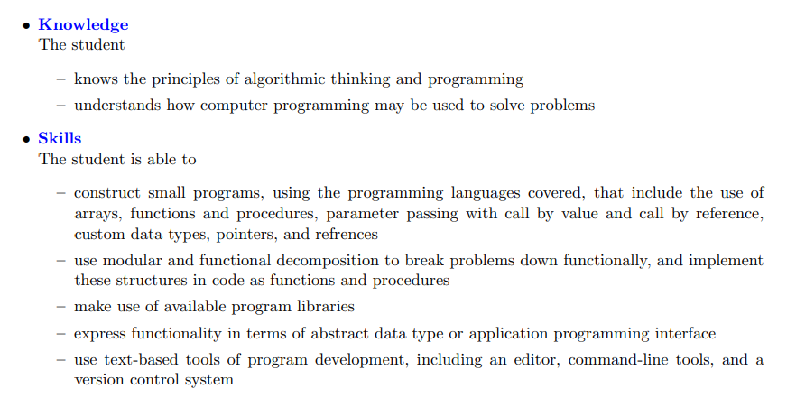
Course Learning Outcomes

Slide 6
Marks Distribution (Tentative)
Component | Marks Distribution
Homework | 10%
Quizzes | 15%
Lab Assignments | 10%
Lab Exam | 10%
Mid Term | 20%
Final | 35%

Slide 7
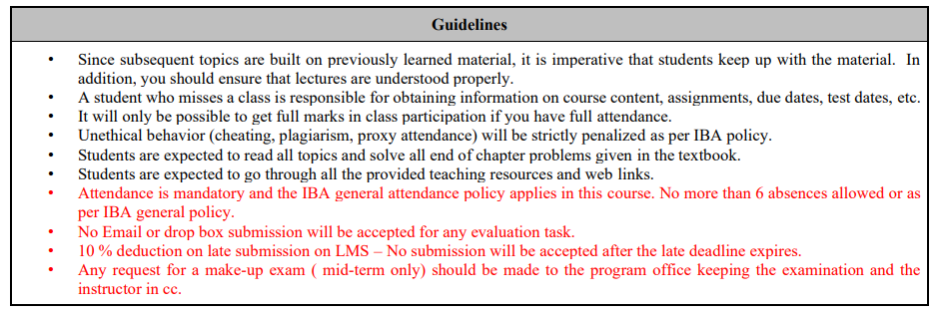
Guidelines

Slide 8
Resources
Introduction to C++ by George Tselikis, CRC Press, 2023.
Modern C++ for Absolute Beginners: A Friendly Introduction to the C++ Programming Language and C++11 to C++23 Standards by Slobodan Dmitrovic, Apress, 2nd Edition, 2023.
C++ Primer by Lippman, Lajoie, and Moo, 5th Edition, Addison-Wesley, 2012.
Tutorials: C++ Language at https://cplusplus.com/doc/tutorial/.

Slide 9
Lecture 1 : Introduction to C++

Slide 10
What a computer program is?
For a computer to be able to perform specific tasks (i.e. print what grade a student got on an exam), it must be given instructions to do the task.
The set of instructions that tells the computer to perform specific tasks is known as a computer program

Slide 11
Machine Languages, Assembly Languages and High-Level Languages
Machine language
“Natural language” of computer component
Machine dependent
Assembly language
English-like abbreviations represent computer operations
Translator programs convert to machine language
High-level language
Allows for writing more “English-like” instructions
Contains commonly used mathematical operations
Compiler convert to machine language

Slide 12
An Overview Of Computer Languages
 | 1-Machine language | 2-Assembly language | 3-High-level language
representation | Collection of binary numbers | Symbolic form of machine language (I.e. symbolic names are used to represent operations, registers & memory locations) | combines algebraic expressions with symbols taken from English language(e.g. Pascal, FORTRAN, …etc)
examples | 10100001 00000000 00000000 00000101 00000100 00000000 10100011 00000000 00000000 | MOV AX,A MOV A , AX ADD AX, | A=A+4 *c
how does the computer understand ? | Directly understood by a computer | Assembler→ convert to machine language | Compiler or (interpter )→convert to machine language
Easier to use
More powerful

Slide 13
Levels of Program Development
Human thought
Pseudo-Natural Language (English, Arabic)
High Level Programming Language (C, C++, Java, …)
Machine Code

Slide 14
The Programmer’s Algorithm
An algorithm is a finite sequence of instructions that produces a solution to a problem.
The programmer’s algorithm:
Define the problem.
Plan the problem solution.
Code the program.
Compile the program.
Run the program.
Test and debug the program.

Slide 15



1-Defining the Problem
The problem must be defined in terms of:
Input: Data to be processed.
Output: The expected result.
Look for nouns in the problem statement that suggest output and input.
and processing: The statements to achieve.
Look for verbs to suggest processing steps.
input data
output data
Keyboard
Processing
Screen

Slide 16
Input and Output
Inputs
Can come from many sources, such as users, files, and other programs
Can take on many forms, such as text, graphics, and sound
Outputs
Can also take on many forms, such as numbers, text, graphics, sounds, or commands to other programs

Slide 17
Example 1 Area and Perimeter of a rectangle
Input
Length
width
Processing
Area = length*width
Perimeter = 2*( length + width)
Output
Area
Perimeter

Slide 18
Example 2 Sum and Average of 5 numbers
Input
five number x1, x2, x3, x4, x5
Processing
Sum = x1+x2+x3+x4+x5
Average = Sum/5
Output
Sum
Average

Slide 19
Example 3 Area and Perimeter of a circle
Input
Radius
PI
Processing
Area = PI * Radius * Radius
Perimeter = 2 * PI * Radius
Output
Area
Perimeter

Slide 20
2-Planning the Solution
When planning, algorithms are used to outline the solution steps using English like statements, called pseudocode.
A flowchart is useful for the graphical representation of an algorithm.
They are drawn using rectangles, diamonds, ovals, and small circles.

Slide 21
Write a Program to Print the Sum of two integer Numbers
start
Start the program
Read the first number and save in the variable ( N1 )
Read the second number and save in the variable ( N2 )
Sum the both numbers and save the result in the variable ( Sum ) ➔ Sum = N1 + N2
Print the variable ( Sum )
End the program
Read N1
Read N2
Sum = N1 + N2
Print Sum
End

Slide 22
3-Coding the Program
Coding is writing the program in a formal language called Programming Language.
Programming Language : A set of rules, symbols and special words used to write statements.
The program is written by translating the algorithm steps into a programming language statements.
The written program is called Source code and it is saved in a file with “.cpp” extension.
Algorithm
Pseudocode
Coding
Translating
Program
Source Code
(The “.cpp”)

Slide 23
Why Coding in Programming Languages
We write computer programs (i.e. a set of instructions) in programming languages such as C, C++, and Java.
We use these programming languages because they are easily understood by humans
But then how does the computer understand the instructions that we write?

Slide 24
4-Compiling Computer Programs
Computers do not understand programs written in programming languages such as C, C++ and Java
Programs must first be converted into machine code that the computer can run
A Software that translates a programming language statements into machine code is called a compiler
In C , Preprocessor program, execute automatically before the compiler translation phase begin
Preprocessor indicate that certain manipulations are to be performed on the program before compilation.
Program
Source code
Compiling
Translating
Machine code
Machine Code

Slide 25
Programming Language Compiler
A compiler is a software that:
Checks the correctness of the source code according to the language rules.
Syntax errors are raised if some rules were violated.
Translates the source code into a machine code if no errors were found.

Slide 26
5-Running The Program
Before running..
links the object code with the code for the missing functions to produce an executable image (with no missing pieces) , this is called link phase .
If the program compiles and links correctly, a file called a.out is produced.
Before a program can be executed, the program must first be placed in memory this called load phase .
the computer, under the control of its CPU, executes the program one instruction at a time

Slide 27
6-Testing and Debugging the Program
Testing
Be sure that the output of the program conforms with the input.
There are two types of errors:
Logical Errors: The program run but provides wrong output.
Runtime errors: The program stop running suddenly when asking the OS executing a non accepted statement (divide by zero, etc).
Debugging
Find, Understand and correct the error

Slide 28
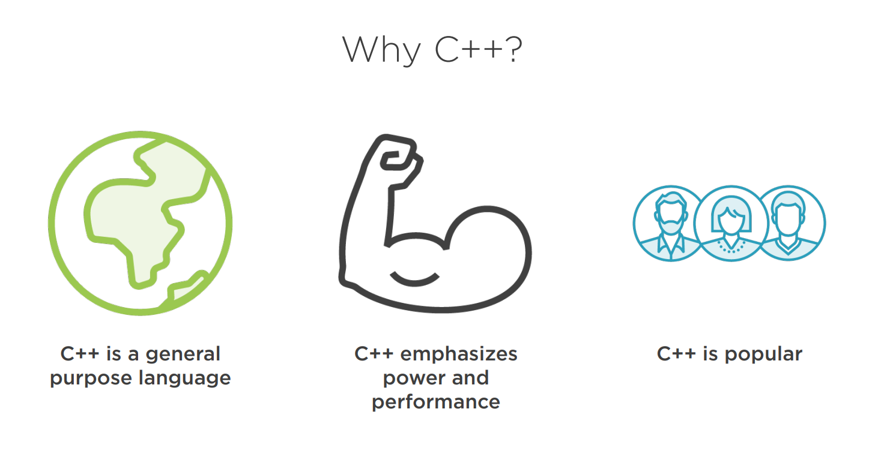

Slide 29
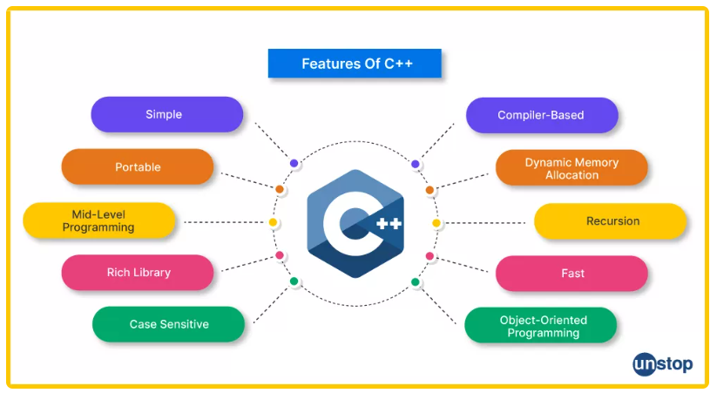

Slide 30
Why C++?
C++ is a powerful language used by millions of developers
C++ has a reputation for being difficult
But it doesn’t have to be
Modern C++ is clean and simple
The Standard Library does a lot of work for you
Modern C++ looks a lot like C# or Java But faster!

Slide 31
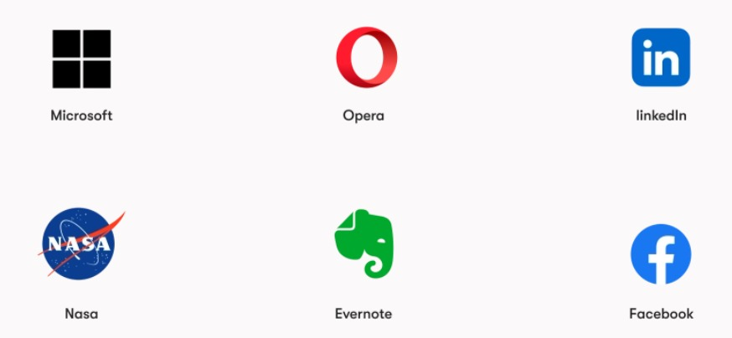
Companies that uses C++

Slide 32
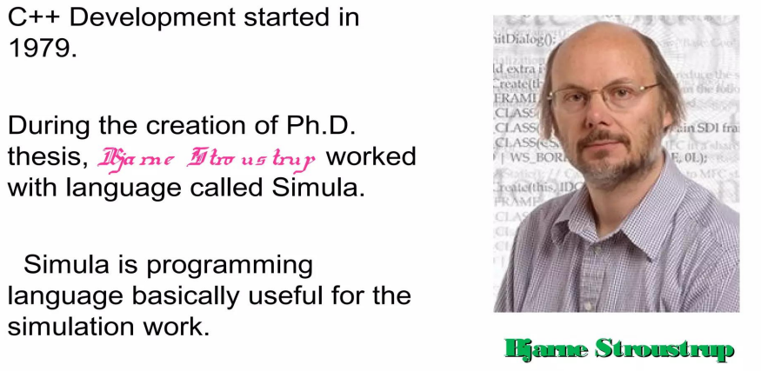
History of C++

Slide 33
History of C++
Simula was first language of support object-oriented programming (OOP).
However, Simula was too slow for practical use.
After that Bjarne Stroustrup start working on c and added extra feature of OOP to C (C++) in such fashion that basic flavor of c remain unaffected.

Slide 34
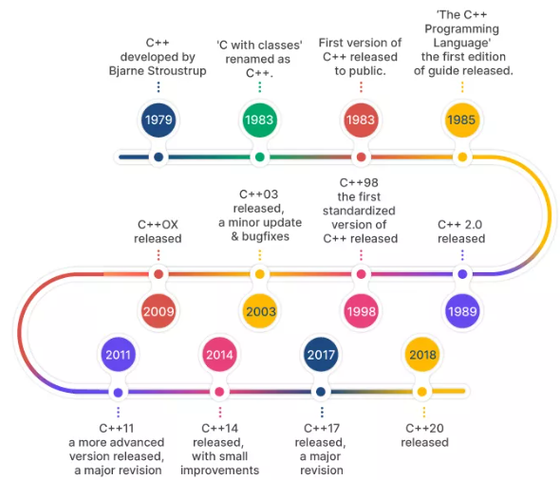
History of C++

Slide 35
Basics of a Typical C++ Environment
Phases of C++ Programs:
Edit
Preprocess
Compile
Link
Load
Execute
Editor
Disk
Program is created in
the editor and stored
on disk.
Preprocessor
Disk
Preprocessor program
processes the code.
Compiler creates
object code and stores
it on disk.
Compiler
Disk
Linker
Linker links the object
code with the libraries,
creates a.out and
stores it on disk
Disk
Primary
Memory
Loader
Loader puts program
in memory.
Disk
.
.
.
.
.
.
Primary
Memory
CPU
CPU takes each
instruction and
executes it, possibly
storing new data
values as the program
executes.
.
.
.
.
.
.

Slide 36
Basics of a Typical C++ Environment
Input/output
cin
Standard input stream
Normally keyboard
cout
Standard output stream
Normally computer screen
cerr
Standard error stream
Display error messages

Slide 37
A Simple Program: Printing a Line of Text
Comments
Document programs
Improve program readability
Ignored by compiler
Single-line comment
Begin with //
Preprocessor directives
Processed by preprocessor before compiling
Begin with #

Slide 38
A Simple Program: Printing a Line of Text
1 // Fig. 1.2: fig01_02.cpp
2 // A first program in C++.
3 #include <iostream>
4
5 // function main begins program execution
6 int main()
7 {
8 std::cout << "Welcome to C++!\n";
9
10 return 0; // indicate that program ended successfully
11
12 } // end function main
Single-line comments.
Function main returns an integer value.
Preprocessor directive to include input/output stream header file <iostream>.
Left brace { begins function body.
Function main appears exactly once in every C++ program..
Statements end with a semicolon ;.
Corresponding right brace } ends function body.
Stream insertion operator.
Name cout belongs to namespace std.
Keyword return is one of several means to exit function; value 0 indicates program terminated successfully.
Welcome to C++!

Slide 39
A Simple Program: Printing a Line of Text
Standard output stream object
std::cout
“Connected” to screen
<<
Stream insertion operator
Value to right (right operand) inserted into output stream
Namespace
std:: specifies using name that belongs to “namespace” std
std:: removed through use of using statements
Escape characters
\
Indicates “special” character output

Slide 40
A Simple Program: Printing a Line of Text

Slide 41
1 // FirstProgram.cpp
2 // Printing a line with multiple statements.
3 #include <iostream>
4
5 // function main begins program execution
6 int main()
7 {
8 std::cout << "Welcome ";
9 std::cout << "to C++!\n";
10
11 return 0; // indicate that program ended successfully
12
13 } // end function main
Multiple stream insertion statements produce one line of output.
Welcome to C++!

Slide 42
1 // FirstProgram.cpp
2 // Printing multiple lines with a single statement
3 #include <iostream>
4
5 // function main begins program execution
6 int main()
7 {
8 std::cout << "Welcome\nto\n\nC++!\n";
9
10 return 0; // indicate that program ended successfully
11
12 } // end function main
Using newline characters to print on multiple lines.
Welcome
to
C++!

