Slide 1
Introduction to Programming
Recursion

Slide 2

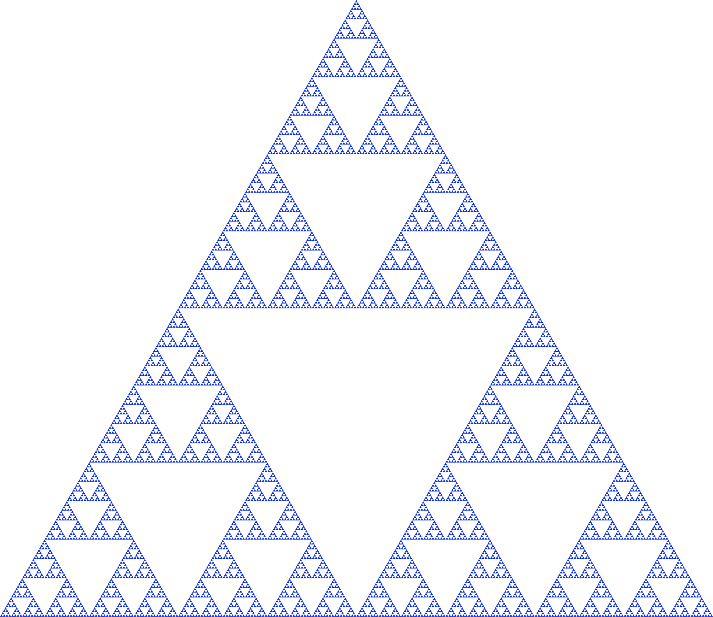
Overview
Q. What is recursion
A. When something is specified in terms of itself.
Why learn recursion?
Represents a new mode of thinking.
Provides a powerful programming paradigm.
Enables reasoning about correctness.
Gives insight into the nature of computation.
Many computational artifacts are naturally self-referential.
File system with folders containing folders.
Fractal graphical patterns.
Divide-and-conquer algorithms (stay tuned).

Slide 3
Example: Convert an integer to binary
Recursive program
string convert(int N) {
if(N==1) return "1";
return convert(N/2) + to_string(N%2);
}
int main() {
int N; cin >> N;
cout << convert(N);
}
To compute a function of a positive integer N
Base case. Return a value for small N .
Reduction step. Assuming that it works for smaller values of its argument, use the function to compute a return value for N.

Slide 4
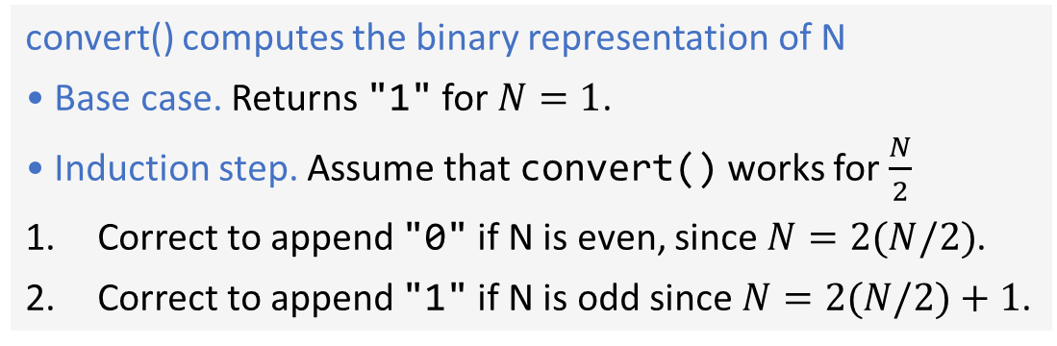
Proving a recursive program correct
Recursion
Mathematical induction
To compute a function of N
Base case. Return a value for small N .
Reduction step. Assuming that it works for smaller values of its argument, use the function to compute a return value for N.
To prove a statement involving N
Base case. Prove it for small N.
Induction step. Assuming that the statement is true for all positive integers less than N, use that fact to prove it for N.
Recursive program
Correctness proof, by induction
convert() computes the binary representation of N
• Base case. Returns "1" for $N=1$.
• Induction step. Assume that convert() works for $\frac{N}{2}$
Correct to append "0" if N is even, since $N=2(N/2)$.
Correct to append "1" if N is odd since $N=2(N/2)+1$.
string convert(int N) {
if(N==1) return "1";
return convert(N/2) + to_string(N%2);
}

Slide 5
Mechanics of a function call
System actions when any function is called
• Save environment (values of all variables and call location).
• Initialize argument variables.
• Transfer control to the function.
• Restore environment (and assign return value)
• Transfer control back to the calling code.
convert(26)
if(N==1) return "1";
return "1101" + "0";
convert(13)
if(N==1) return "1";
return "110" + "1";
convert(6)
if(N==1) return "1";
return "11" + "0";
string convert(int N) {
if(N==1) return "1";
return convert(N/2) + to_string(N%2);
}
int main() {
int N; cin >> N;
cout << convert(N);
}
convert(3)
if(N==1) return "1";
return "1" + "1";
convert(1)
if(N==1) return "1";
return convert(0) + "0";

Slide 6
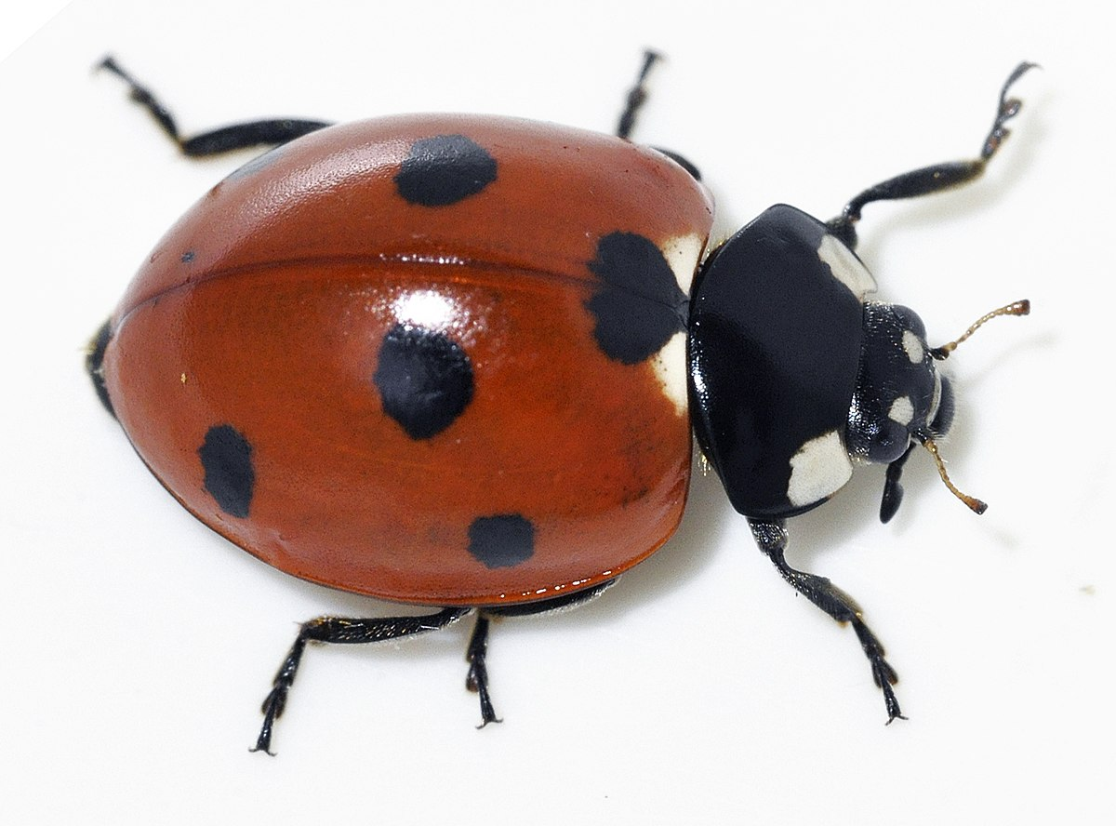
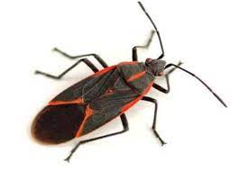
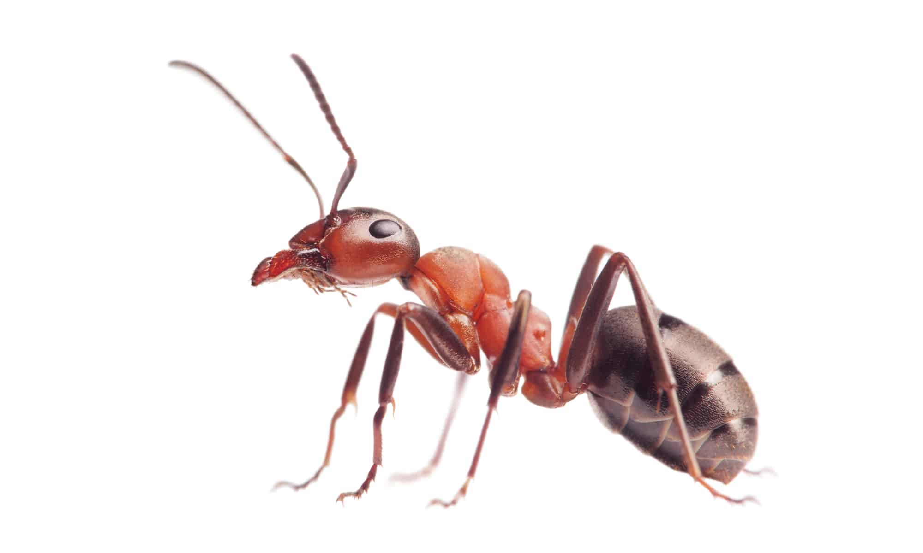


Programming with recursion: typical bugs
double bad(int N) {
return bad(N-1) + 1.0/N;
}
Missing base case
double bad(int N) {
if (N == 1) return 1.0;
return bad(1 + N/2) + 1.0/N;
}
No convergence
guarantee
try $N=2$
Both lead to infinite recursive loops (bad news).

Slide 7
Collatz Sequence
Collatz function of N.
If N is 1, stop.
If N is even, divide by 2.
If N is odd, multiply by 3 and add 1.
7 22 11 34 17 52 26 13 40 20 10 5 16 8 4 2 1
void collatz(int N) {
cout << N << " ";
if (N == 1) return;
if (N % 2 == 0)
collatz(N / 2);
collatz(3*N + 1);
}
Amazing fact. No one knows whether or not this function terminates for all N (!)
Note. We usually ensure termination by only making recursive calls for smaller N.

Slide 8
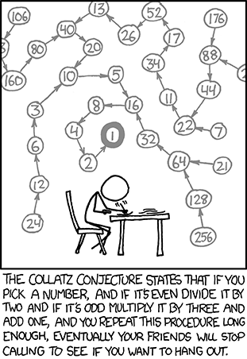

Slide 9
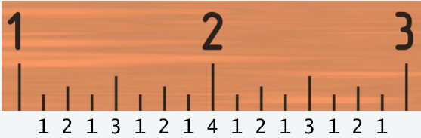
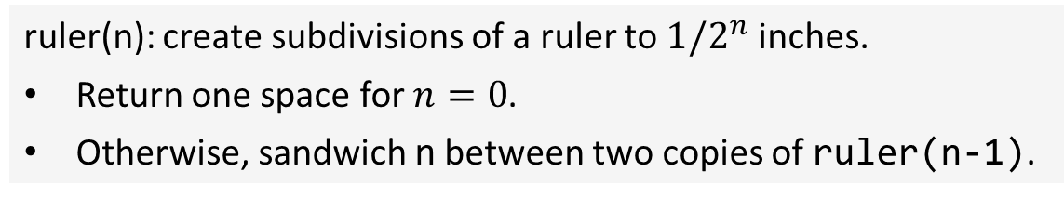

Warmup: subdivisions of a ruler (revisited)
ruler(n): create subdivisions of a ruler to $1/2^{n}$ inches.
Return one space for $n=0$.
Otherwise, sandwich n between two copies of ruler(n-1).
string ruler(int n) {
if (n == 0) return " ";
return ruler(n-1) + to_string(n) + ruler(n-1);
}
int main() {
int N; cin >> N;
cout << ruler(N);
}
a.exe
4
1 2 1 3 1 2 1 4 1 2 1 3 1 2 1
a.exe
50
terminate called after throwing an instance of 'std::bad_alloc'
$2^{50}−1$ integers in output!

Slide 10
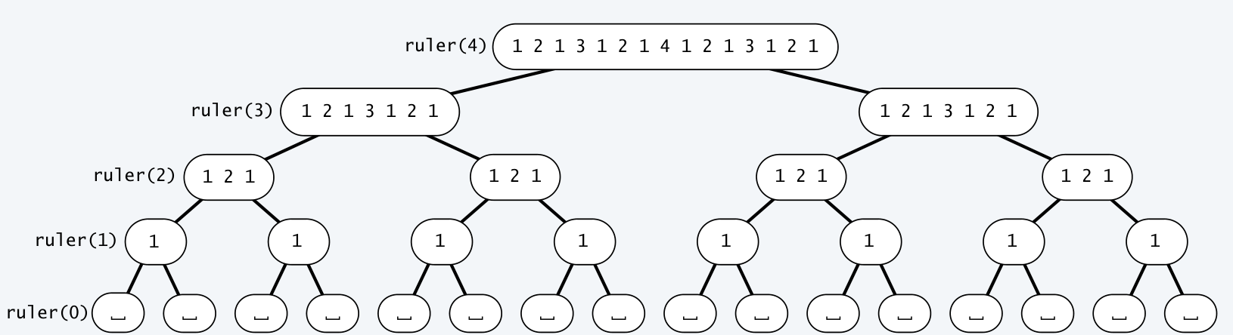
Tracing a recursive program
Use a recursive call tree
One node for each recursive call.
Label node with return value after children are labeled.

Slide 11
A classic example
Tower of Hanoi puzzle

Slide 12
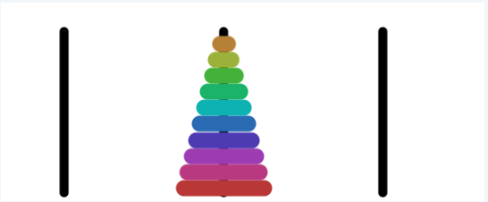
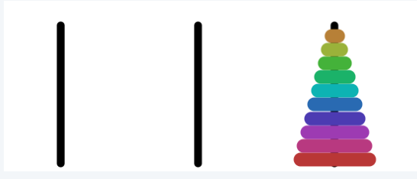
Tower of Hanoi puzzle
A legend of uncertain origin
n = 64 discs of differing size; 3 posts; discs on one of the posts from largest to smallest.
An ancient prophecy has commanded monks to move the discs to another post.
When the task is completed, the world will end.
Rules
Move discs one at a time.
Never put a larger disc on a smaller disc.
before
Q. Generate list of instruction for monks ?
after
Q. When might the world end ?
n=10 disks

Slide 13
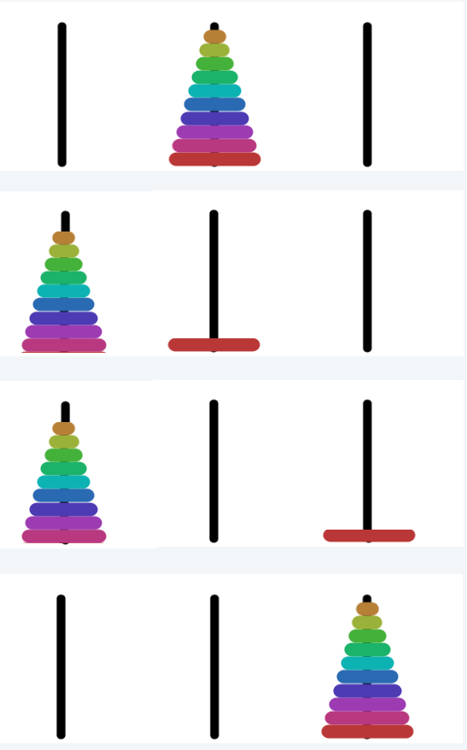

Tower of Hanoi
For simple instructions, use cyclic wraparound
• Move right means: A to B, B to C, C to A
• Move left means: A to C, B to A, B to A,
A
B
C
A recursive solution
Move n − 1 discs to the left (recursively).
Move largest disc to the right.
Move n − 1 discs to the left (recursively).

Slide 14
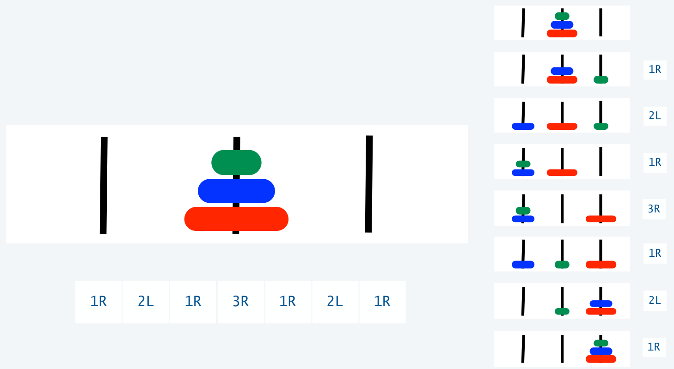
Tower of Hanoi solution (n=3)

Slide 15
Towers of Hanoi: recursive solution
hanoi(n): Print moves for n discs.
Return one space for n=0.
Otherwise, set move to the specified move for disc n.
Then sandwich move between two copies of hanoi(n-1).
string hanoi(int N, bool left) {
if(N==0) return " ";
string inst;
if(left)
inst = to_string(N) + “L";
else
inst = to_string(N) + “R";
return hanoi(N-1, !left) + inst + hanoi(N-1, !left);
}

Slide 16
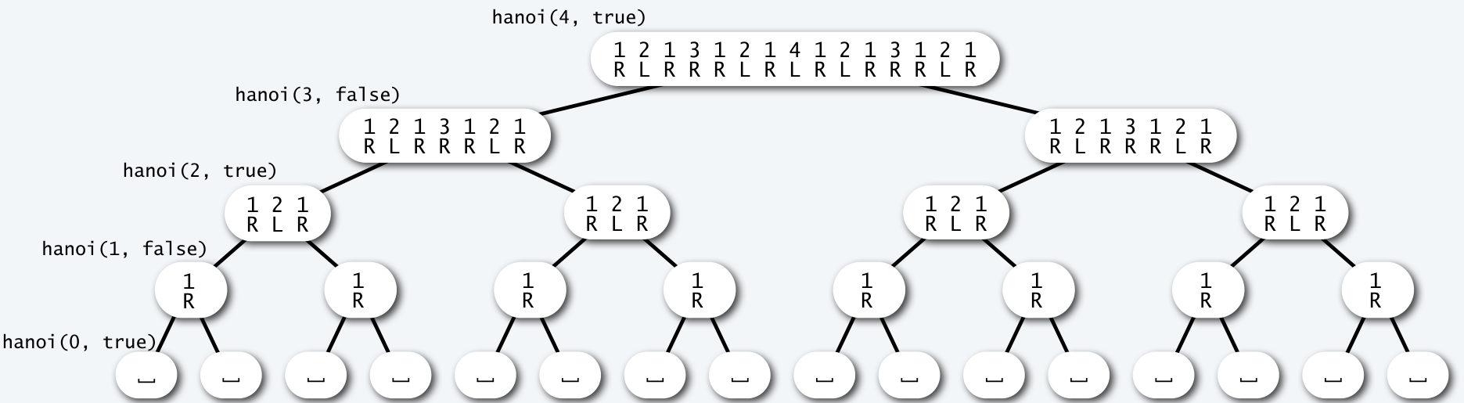
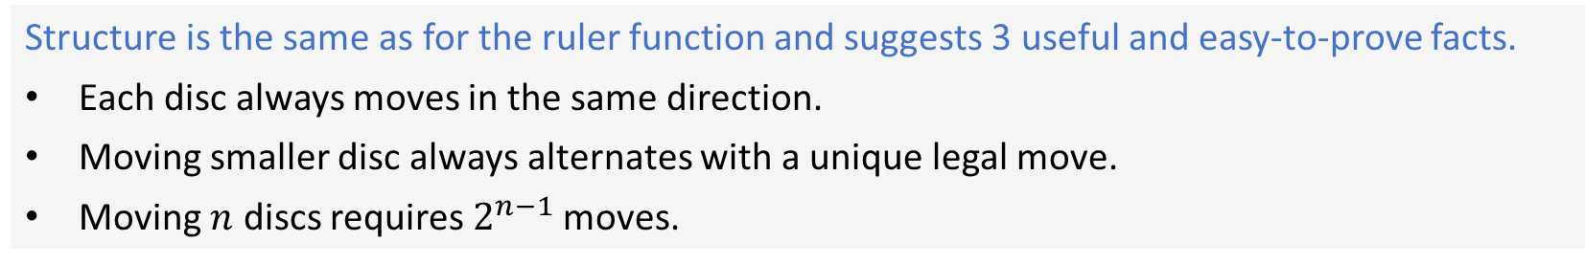
Recursive call tree for towers of Hanoi
Structure is the same as for the ruler function and suggests 3 useful and easy-to-prove facts.
Each disc always moves in the same direction.
Moving smaller disc always alternates with a unique legal move.
Moving $n$ discs requires $2^{n−1}$moves.

Slide 17


Answers for towers of Hanoi
Q. Generate list of instructions for monks ?
A. (Long form). 1L 2R 1L 3L 1L 2R 1L 4R 1L 2R 1L 3L 1L 2R 1L 5L 1L 2R 1L 3L 1L 2R 1L 4R ...
A. (Short form). Alternate "1L" with the only legal move not involving the disc 1.
"L" or "R" depends on whether n is odd or even
Q. When might the world end ?
moves per second | end of world
1 | 5.84 billion centuries
1 billion | 5.84 centuries
A. Not soon: need $2^{64}−1$moves.
Note: Recursive solution has been proven optimal.

