Slide 1




Hybrid modeling for remaining useful life prediction in power module prognosis
Mehdi Ghrabli, Mounira Bouarroudj, Ludovic Chamoin, Emanuel Aldea
mehdi.ghrabli1@ens-paris-saclay.fr
CNRS, SATIE & LMPS Laboratories
April 8, 2024
25th International Conference on Thermal, Mechanical and Multi-Physics Simulation and Experiments in Microelectronics and Microsystems
Catania, April 7-8-9-10, 2024

Slide 2
OUTLINE
Introduction
Damage mechanism
Datasets
Methodology
Results
Conclusion
25th International Conference on Thermal, Mechanical and Multi-Physics Simulation and Experiments in Microelectronics and Microsystems
Catania, April 7-8-9-10, 2024
1

Slide 3
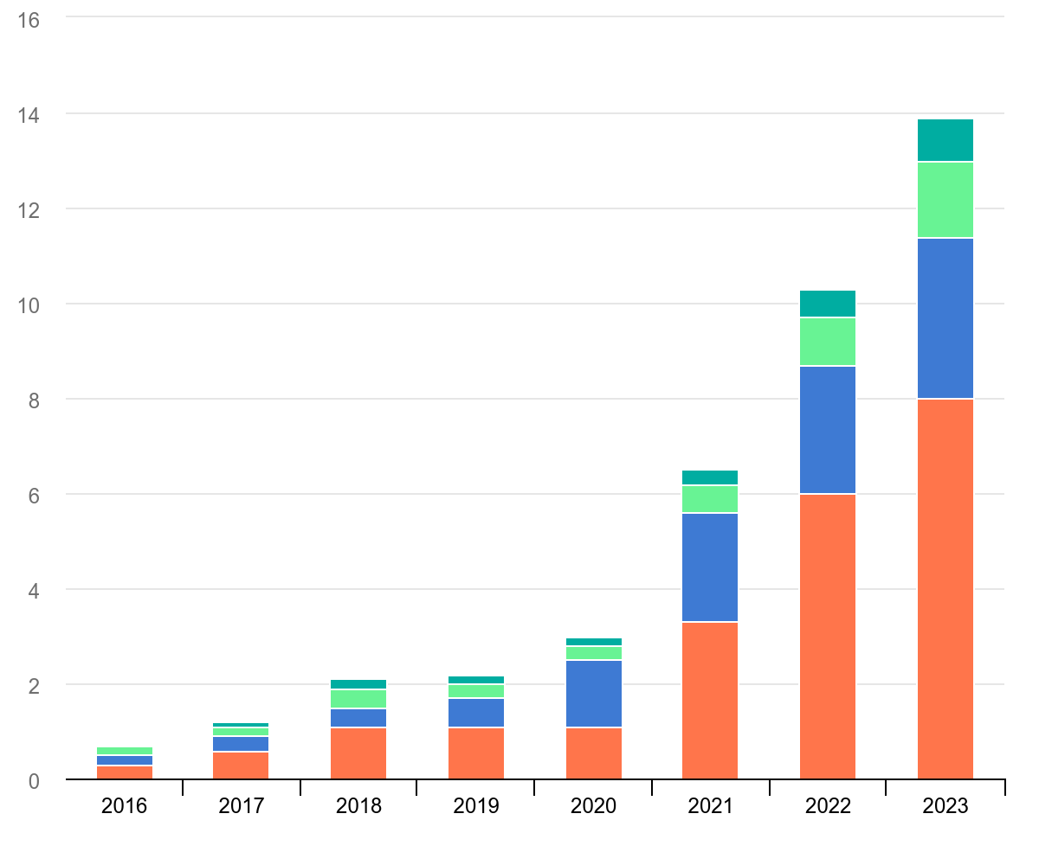
INTRODUCTION
GENERAL CONTEXT
Exponential growth in electric cars market
Alternative for fossil fuel-powered vehicles
2035 zero-emission agreement
Electric car sales, 2016-2023 [1]
25th International Conference on Thermal, Mechanical and Multi-Physics Simulation and Experiments in Microelectronics and Microsystems
Catania, April 7-8-9-10, 2024
2

Slide 4
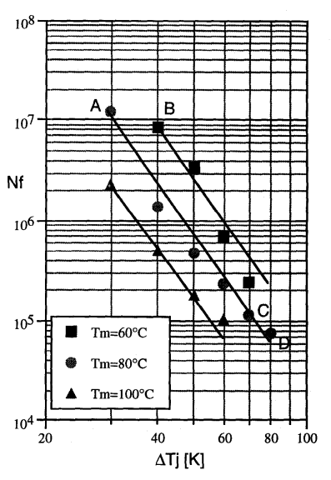
INTRODUCTION
PROBLEM
Estimate the lifetime of electric modules
Classical answer : Point estimates
Environmental temperature? (Warm/Cold)
Frequency of usage? (Extreme/Moderate)
Remaining useful life after degradation?
An empirical model for failure prediction [2]
25th International Conference on Thermal, Mechanical and Multi-Physics Simulation and Experiments in Microelectronics and Microsystems
Catania, April 7-8-9-10, 2024
3

Slide 5
INTRODUCTION
GENERAL PURPOSE
Given a load profile + sequence of observed previous states, estimate the remaining useful life (RUL) of the power electronic module caused by damage in the wire bonds
25th International Conference on Thermal, Mechanical and Multi-Physics Simulation and Experiments in Microelectronics and Microsystems
Catania, April 7-8-9-10, 2024
4

Slide 6
OUTLINE
Introduction
Damage mechanism
Datasets
Methodology
Results
Conclusion
25th International Conference on Thermal, Mechanical and Multi-Physics Simulation and Experiments in Microelectronics and Microsystems
Catania, April 7-8-9-10, 2024
5

Slide 7
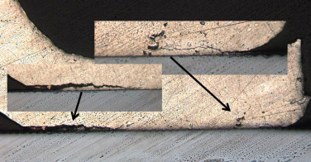
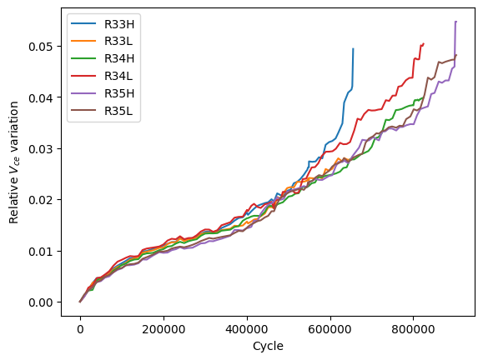

DAMAGE MECHANISM
HEALTH INDICATOR
Monitor using non-intrusive measurements
Collector-emitter voltage $V_{ce}$ : viable to assess degradation in the top interconnexions
Increase of 5% w.r.t. initial value = failure
Degradation in a bond wire [3]
Evolution of the relative variation of the collector-emitter voltage during test cycles [4]
25th International Conference on Thermal, Mechanical and Multi-Physics Simulation and Experiments in Microelectronics and Microsystems
Catania, April 7-8-9-10, 2024
6

Slide 8
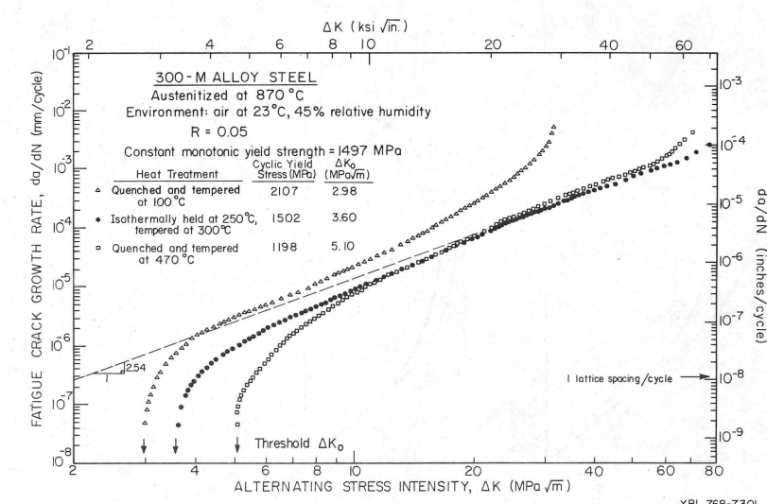
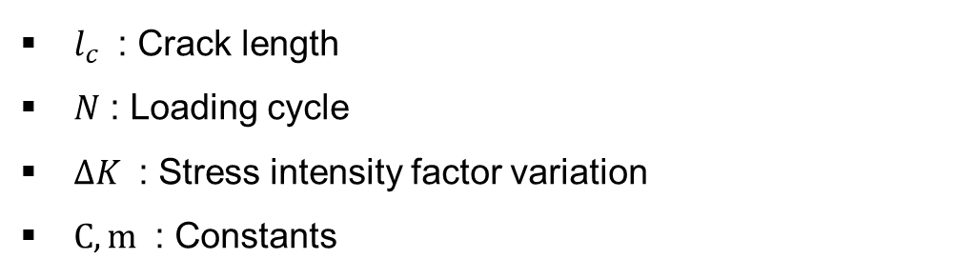

DAMAGE MECHANISM
PARIS’ LAW
$$\frac{Δl_{c}}{ΔN}=C{\left(ΔK\right)}^{m}$$
Paris-Erdogan equation
$l_{c}$ : Crack length
$N$ : Loading cycle
$ΔK$ : Stress intensity factor variation
$C, m$ : Constants
Experimental illustration of Paris’ law [5]
25th International Conference on Thermal, Mechanical and Multi-Physics Simulation and Experiments in Microelectronics and Microsystems
Catania, April 7-8-9-10, 2024
7

Slide 9
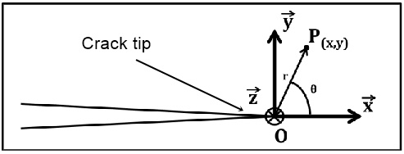
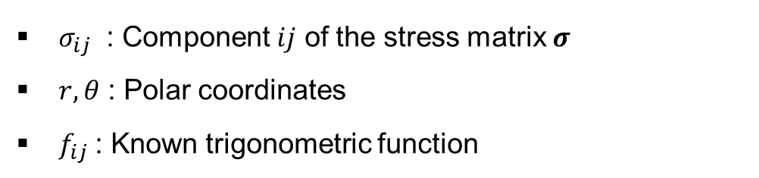

DAMAGE MECHANISM
IRWIN’S EQUATION
$$σ_{ij}=\frac{K}{\sqrt{2πr}}f_{ij}(r,θ)$$
Irwin’s equation
$σ_{ij}$ : Component $ij$ of the stress matrix $σ$
$r, θ$ : Polar coordinates
$f_{ij}$: Known trigonometric function
Polar coordinate system near the crack tip [6]
25th International Conference on Thermal, Mechanical and Multi-Physics Simulation and Experiments in Microelectronics and Microsystems
Catania, April 7-8-9-10, 2024
8

Slide 10
OUTLINE
Introduction
Damage mechanism
Datasets
Methodology
Results
Conclusion
25th International Conference on Thermal, Mechanical and Multi-Physics Simulation and Experiments in Microelectronics and Microsystems
Catania, April 7-8-9-10, 2024
9

Slide 11
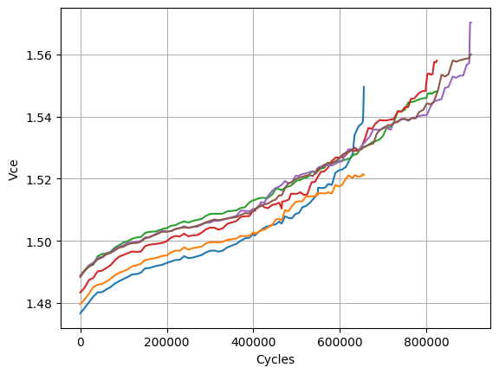
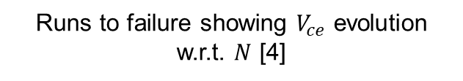
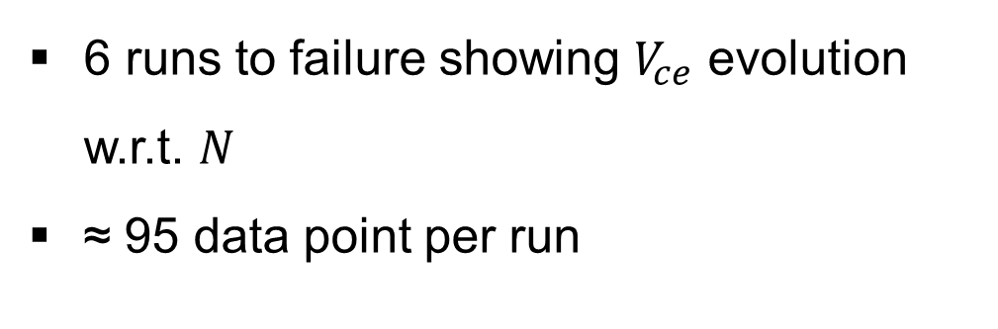
DATASETS
EXPERIMENTAL DATA
6 runs to failure showing $V_{ce}$ evolution w.r.t. $N$
≈ 95 data point per run
Runs to failure showing $V_{ce}$ evolution w.r.t. $N$ [4]
25th International Conference on Thermal, Mechanical and Multi-Physics Simulation and Experiments in Microelectronics and Microsystems
Catania, April 7-8-9-10, 2024
10

Slide 12
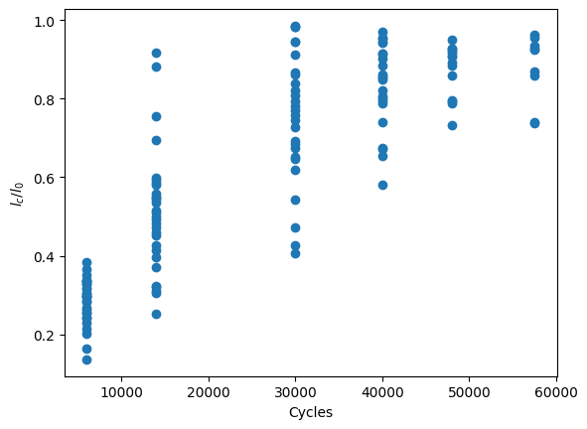
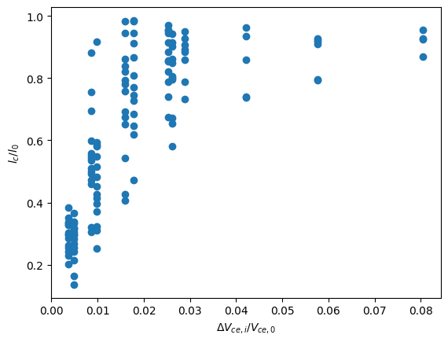
DATASETS
EXPERIMENTAL DATA
Destructive campaigns leading to 96 data points showing normalized $l_{c}$ variation with respect to $N$ (Left) and relative $V_{ce}$ variations (Right) [4]
25th International Conference on Thermal, Mechanical and Multi-Physics Simulation and Experiments in Microelectronics and Microsystems
Catania, April 7-8-9-10, 2024
11

Slide 13
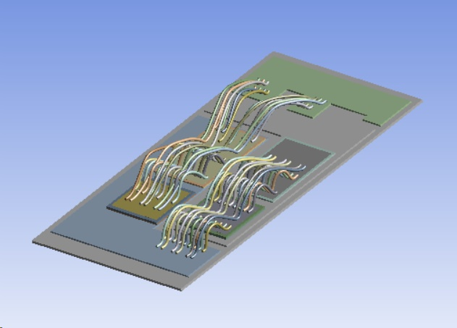
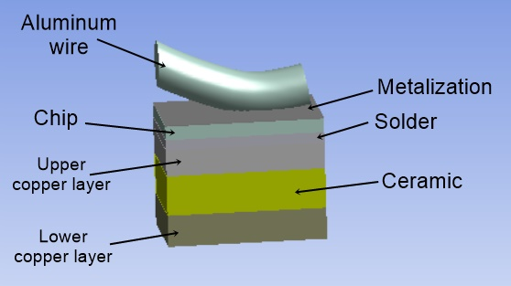
DATASETS
SIMULATED DATA
Full geometric model of the IGBT
Simplified geometric IGBT model
25th International Conference on Thermal, Mechanical and Multi-Physics Simulation and Experiments in Microelectronics and Microsystems
Catania, April 7-8-9-10, 2024
12

Slide 14
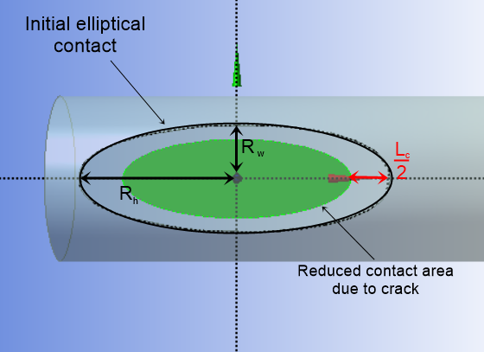
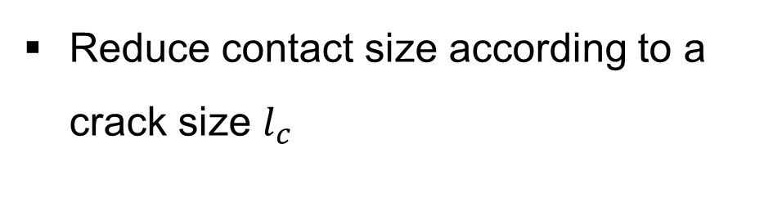
DATASETS
SIMULATED DATA
Reduce contact size according to a crack size $l_{c}$
Geometric modeling of a crack of length $l_{c}$
25th International Conference on Thermal, Mechanical and Multi-Physics Simulation and Experiments in Microelectronics and Microsystems
Catania, April 7-8-9-10, 2024
13

Slide 15

DATASETS
SIMULATED DATA
Reduce contact size according to a crack size $l_{c}$
Apply current $I_{load}$ inducing self-heating identical to experiments
Geometric modeling of a crack of length $l_{c}$
25th International Conference on Thermal, Mechanical and Multi-Physics Simulation and Experiments in Microelectronics and Microsystems
Catania, April 7-8-9-10, 2024
14

Slide 16

DATASETS
SIMULATED DATA
Reduce contact size according to a crack size $l_{c}$
Apply current $I_{load}$ inducing self-heating identical to experiments
Measure $σ$
Geometric modeling of a crack of length $l_{c}$
25th International Conference on Thermal, Mechanical and Multi-Physics Simulation and Experiments in Microelectronics and Microsystems
Catania, April 7-8-9-10, 2024
15

Slide 17

DATASETS
SIMULATED DATA
Reduce contact size according to a crack size $l_{c}$
Apply current $I_{load}$ inducing self-heating identical to experiments
Measure $σ$
Calculate $K$
Geometric modeling of a crack of length $l_{c}$
25th International Conference on Thermal, Mechanical and Multi-Physics Simulation and Experiments in Microelectronics and Microsystems
Catania, April 7-8-9-10, 2024
16

Slide 18

DATASETS
SIMULATED DATA
Reduce contact size according to a crack size $l_{c}$
Apply current $I_{load}$ inducing self-heating identical to experiments
Measure $σ$
Calculate $K$
Repeat for different values of $l_{c}$
Geometric modeling of a crack of length $l_{c}$
25th International Conference on Thermal, Mechanical and Multi-Physics Simulation and Experiments in Microelectronics and Microsystems
Catania, April 7-8-9-10, 2024
17

Slide 19
OUTLINE
Introduction
Damage mechanism
Datasets
Methodology
Results
Conclusion
25th International Conference on Thermal, Mechanical and Multi-Physics Simulation and Experiments in Microelectronics and Microsystems
Catania, April 7-8-9-10, 2024
18

Slide 20
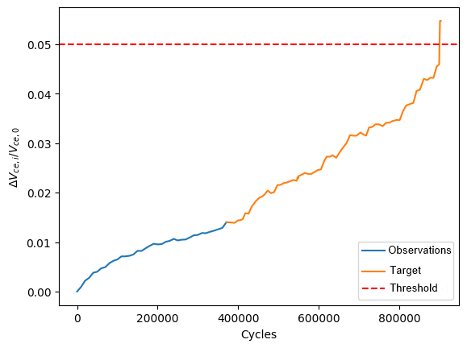

METHODOLOGY
FORMULATION
Estimate evolution of w.r.t. given previous observations
Iterative process
Governed by the Paris regime : $\left[ΔK_{1};ΔK_{2}\right]$ ($⇔ [l_{c,1 };l_{c,2 }]$ $⇔ \left[V_{ce,1};V_{ce,2}\right]$)
Prediction framework.
25th International Conference on Thermal, Mechanical and Multi-Physics Simulation and Experiments in Microelectronics and Microsystems
Catania, April 7-8-9-10, 2024
19

Slide 21
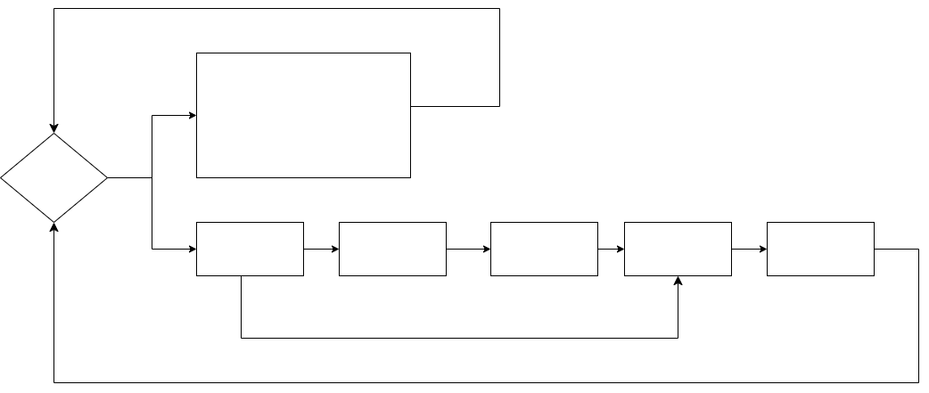

METHODOLOGY
FORMULATION
Check :
$$V_{ce}$$
In Paris regime
25th International Conference on Thermal, Mechanical and Multi-Physics Simulation and Experiments in Microelectronics and Microsystems
Catania, April 7-8-9-10, 2024
20

Slide 22
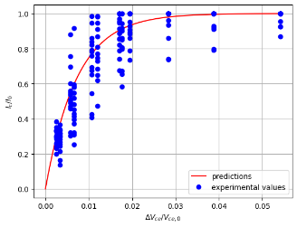

METHODOLOGY
FORMULATION
Regression
Check :
$$V_{ce}$$
$$l_{c}$$
In Paris regime
25th International Conference on Thermal, Mechanical and Multi-Physics Simulation and Experiments in Microelectronics and Microsystems
Catania, April 7-8-9-10, 2024
21

Slide 23

METHODOLOGY
FORMULATION
Numerical simulation
Check :
$$V_{ce}$$
$$l_{c}$$
$$ΔK$$
In Paris regime
25th International Conference on Thermal, Mechanical and Multi-Physics Simulation and Experiments in Microelectronics and Microsystems
Catania, April 7-8-9-10, 2024
22

Slide 24

METHODOLOGY
FORMULATION
Paris’ law
Check :
$$V_{ce}$$
$$l_{c}$$
$$ΔK$$
$$δl_{c}$$
In Paris regime
25th International Conference on Thermal, Mechanical and Multi-Physics Simulation and Experiments in Microelectronics and Microsystems
Catania, April 7-8-9-10, 2024
23

Slide 25


METHODOLOGY
FORMULATION
Adding to previous $l_{c}$value
Check :
$$V_{ce}$$
$$l_{c}$$
$$ΔK$$
$$δl_{c}$$
$$l_{c}+ δl_{c}$$
In Paris regime
25th International Conference on Thermal, Mechanical and Multi-Physics Simulation and Experiments in Microelectronics and Microsystems
Catania, April 7-8-9-10, 2024
24

Slide 26
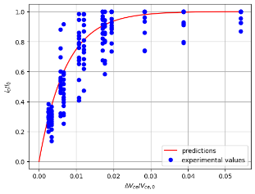

METHODOLOGY
FORMULATION
Using (inverse) regression
Check :
$$V_{ce}$$
$$l_{c}$$
$$ΔK$$
$$δl_{c}$$
$$l_{c}+ δl_{c}$$
$$V_{ce}+ δV_{ce}$$
In Paris regime
25th International Conference on Thermal, Mechanical and Multi-Physics Simulation and Experiments in Microelectronics and Microsystems
Catania, April 7-8-9-10, 2024
25

Slide 27
METHODOLOGY
FORMULATION
Not in Paris regime
Adaptive interpolation until failure/Paris regime
Check :
$$V_{ce}$$
$$l_{c}$$
$$ΔK$$
$$δl_{c}$$
$$l_{c}+ δl_{c}$$
$$V_{ce}+ δV_{ce}$$
In Paris regime
25th International Conference on Thermal, Mechanical and Multi-Physics Simulation and Experiments in Microelectronics and Microsystems
Catania, April 7-8-9-10, 2024
26

Slide 28
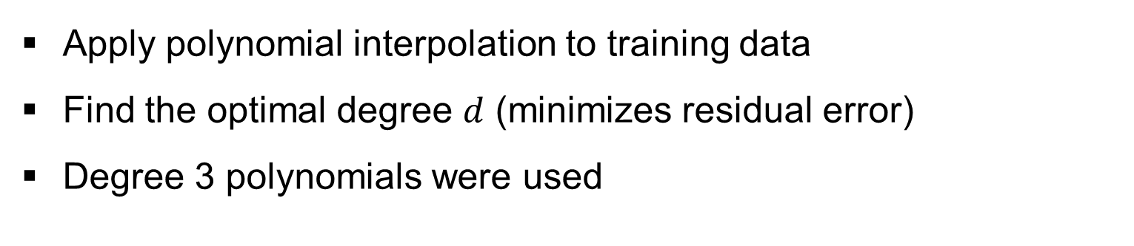
METHODOLOGY
INTERPOLATION
Apply polynomial interpolation to training data
Find the optimal degree $d$ (minimizes residual error)
Degree 3 polynomials were used
25th International Conference on Thermal, Mechanical and Multi-Physics Simulation and Experiments in Microelectronics and Microsystems
Catania, April 7-8-9-10, 2024
27

Slide 29
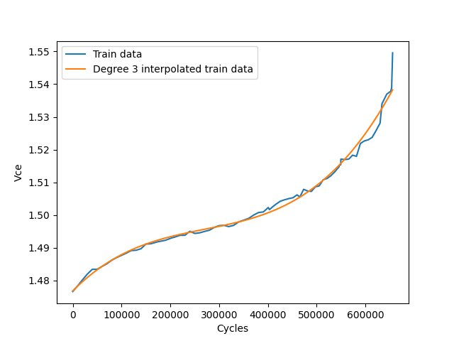
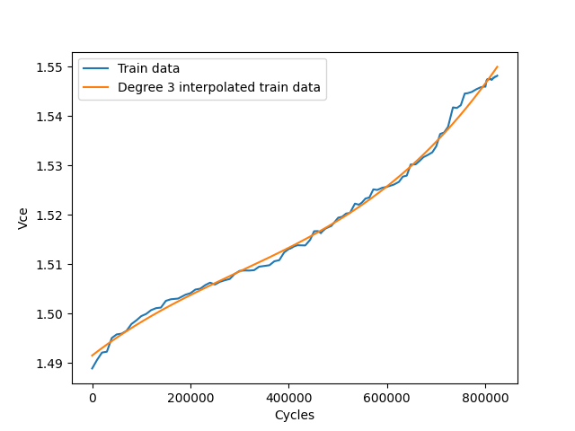
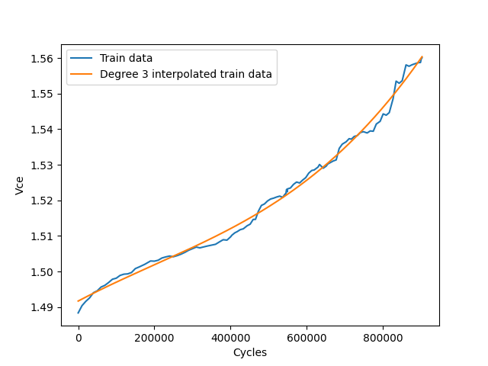
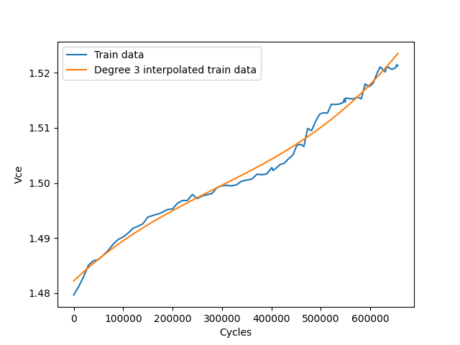
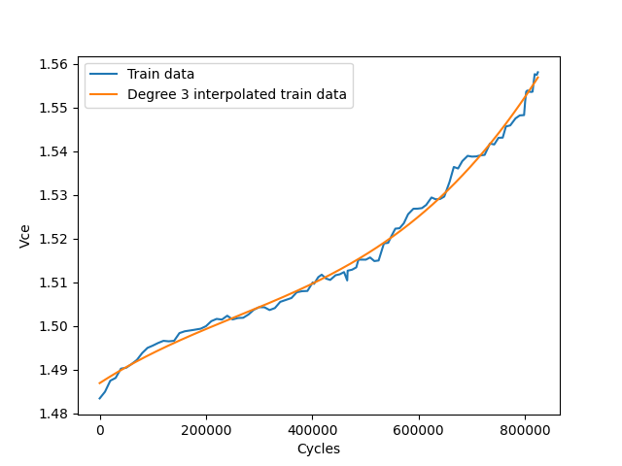
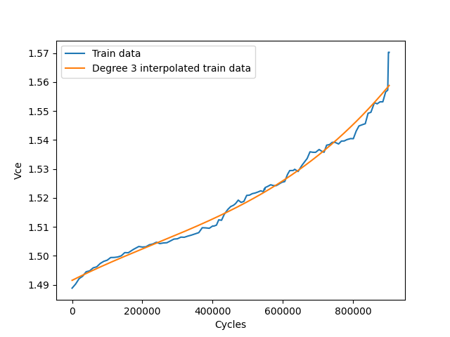
METHODOLOGY
Degree 3 polynomials as an approximation of $V_{ce}$ w.r.t. $N$
25th International Conference on Thermal, Mechanical and Multi-Physics Simulation and Experiments in Microelectronics and Microsystems
Catania, April 7-8-9-10, 2024
28

Slide 30
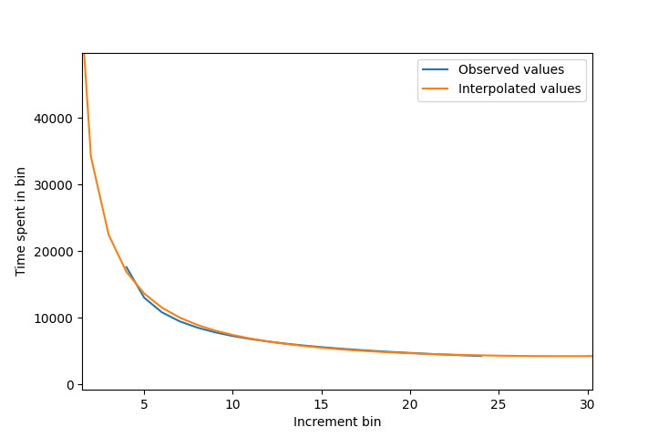

METHODOLOGY
INTERPOLATION
$V_{ce}$ increment growth assumed to be polynomial of degree $d−1$
Polynomial of degree $d−1$ is fitted on observed test increments
Generate increments using fitted polynomial
Degree 2 polynomial fitted on observed test increments
25th International Conference on Thermal, Mechanical and Multi-Physics Simulation and Experiments in Microelectronics and Microsystems
Catania, April 7-8-9-10, 2024
29

Slide 31
OUTLINE
Introduction
Damage mechanism
Datasets
Methodology
Results
Conclusion
25th International Conference on Thermal, Mechanical and Multi-Physics Simulation and Experiments in Microelectronics and Microsystems
Catania, April 7-8-9-10, 2024
30

Slide 32
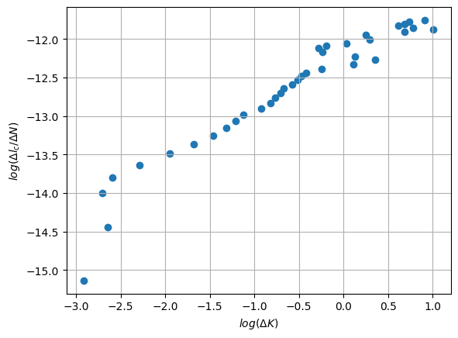
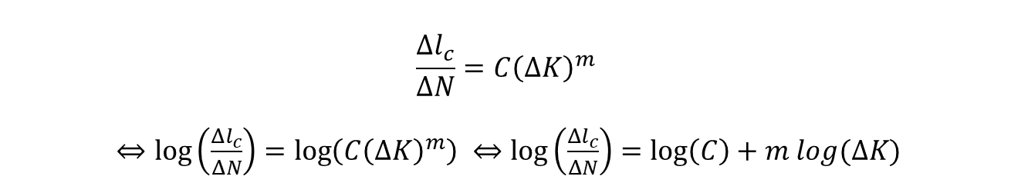

RESULTS
PARIS’ LAW VALIDITY
50 simulated points relating $l_{c}$ to $ΔK$
Paris regime : linear regime on the log scale
$$\frac{Δl_{c}}{ΔN}=C{\left(ΔK\right)}^{m}$$
$⇔\log\left(\frac{Δl_{c}}{ΔN}\right)=\log\left(C{\left(ΔK\right)}^{m}\right) ⇔\log\left(\frac{Δl_{c}}{ΔN}\right)=\log\left(C\right)+m log(ΔK)$
Logarithmic Paris equation
Simulated data on the logarithmic scale
25th International Conference on Thermal, Mechanical and Multi-Physics Simulation and Experiments in Microelectronics and Microsystems
Catania, April 7-8-9-10, 2024
31

Slide 33
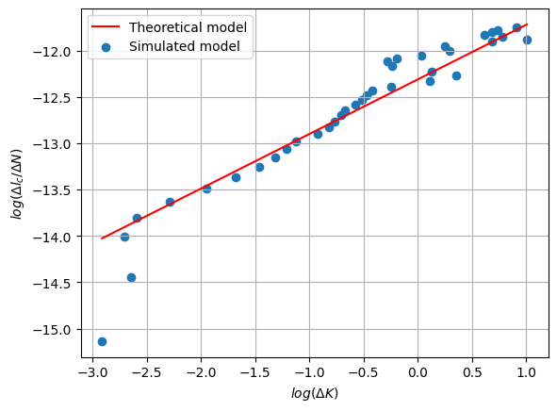
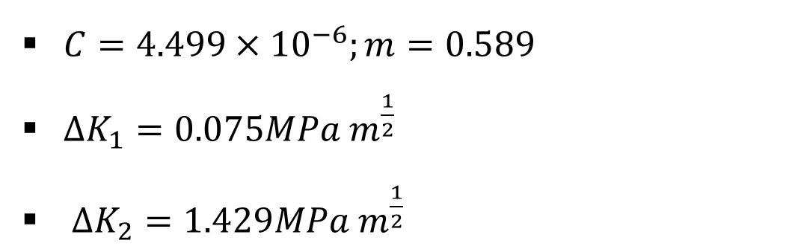
RESULTS
PARIS’ LAW VALIDITY
$C=4.499×{10}^{−6};m=0.589$
$ΔK_{1}=0.075MPa m^{\frac{1}{2}}$
$ΔK_{2}=1.429MPa m^{\frac{1}{2}}$
Linear regression on Paris simulations
25th International Conference on Thermal, Mechanical and Multi-Physics Simulation and Experiments in Microelectronics and Microsystems
Catania, April 7-8-9-10, 2024
32

Slide 34
RESULTS
VALIDATION PROCESS
5 runs to failure are used in training
Cross validation is used ( 6 folds)
Percentage of observed test values : 10%, 20%, 30%
25th International Conference on Thermal, Mechanical and Multi-Physics Simulation and Experiments in Microelectronics and Microsystems
Catania, April 7-8-9-10, 2024
33

Slide 35
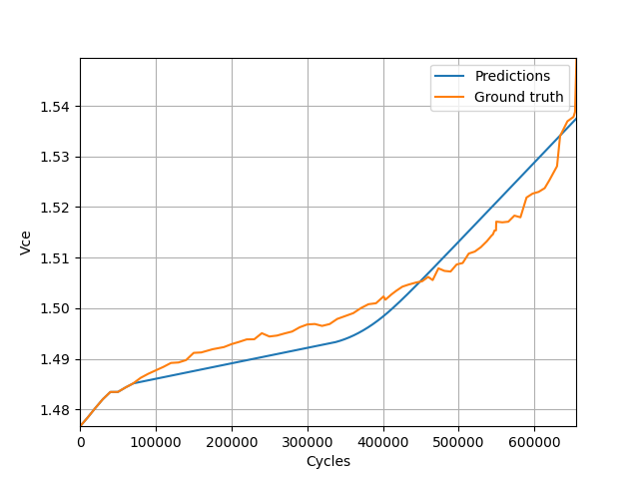
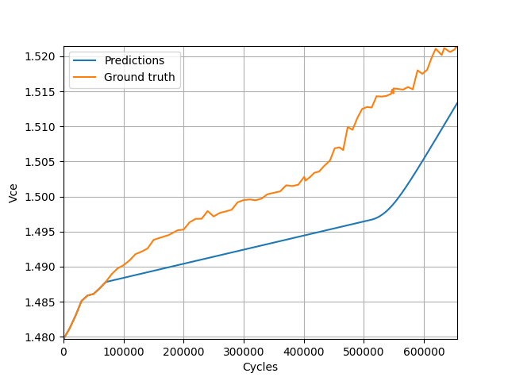
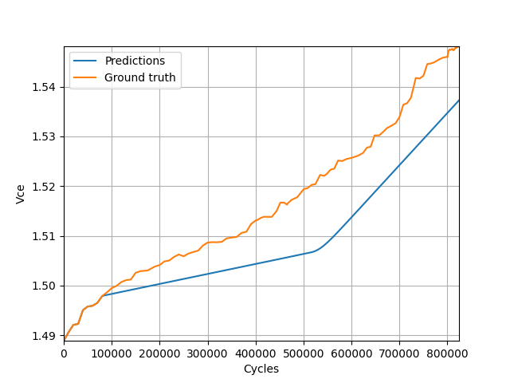
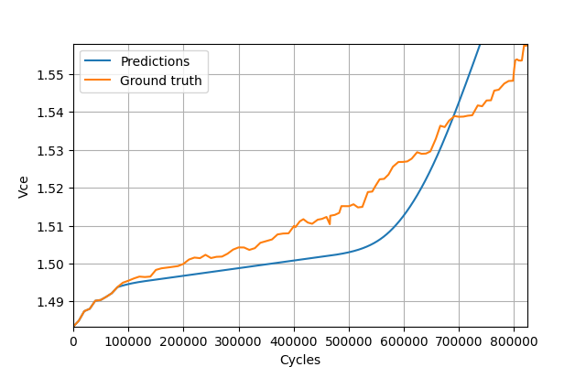
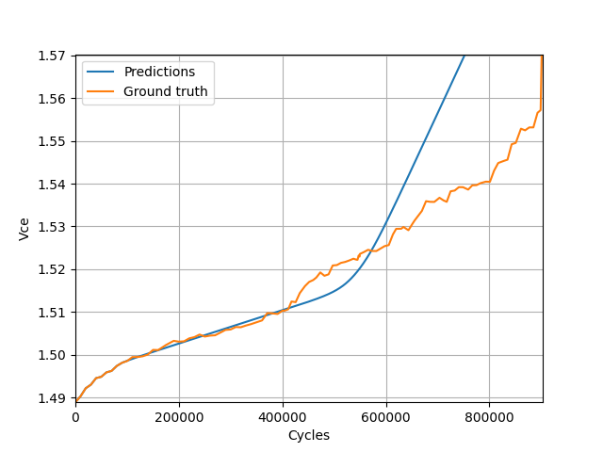
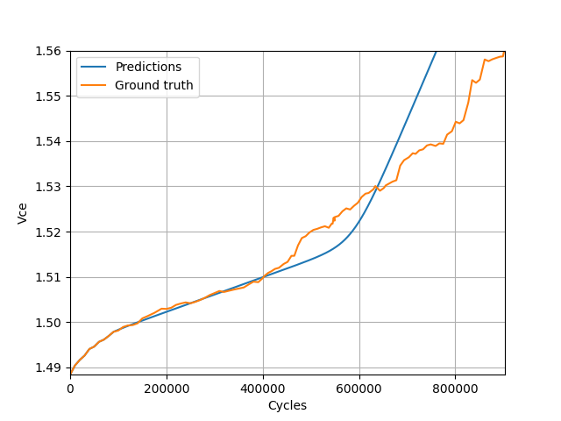
RESULTS
Predictions on 10% of observed test data
25th International Conference on Thermal, Mechanical and Multi-Physics Simulation and Experiments in Microelectronics and Microsystems
Catania, April 7-8-9-10, 2024
34

Slide 36
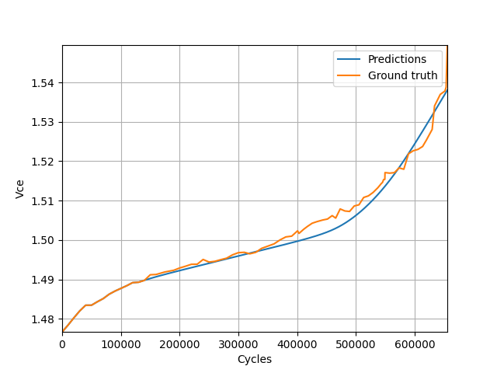
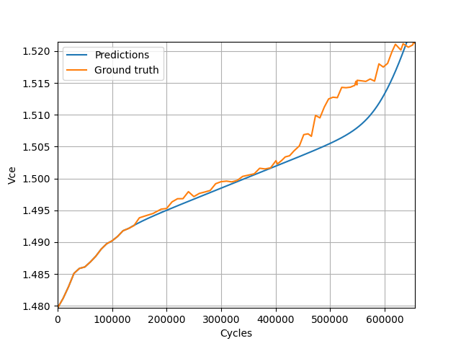
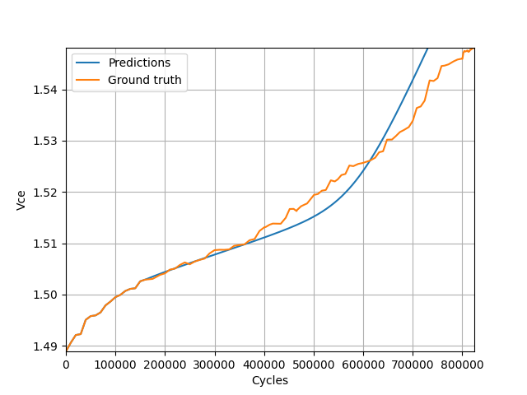



RESULTS
Predictions on 20% of observed test data
25th International Conference on Thermal, Mechanical and Multi-Physics Simulation and Experiments in Microelectronics and Microsystems
Catania, April 7-8-9-10, 2024
35

Slide 37






RESULTS
Predictions on 30% of observed test data
25th International Conference on Thermal, Mechanical and Multi-Physics Simulation and Experiments in Microelectronics and Microsystems
Catania, April 7-8-9-10, 2024
36

Slide 38
OUTLINE
Introduction
Damage mechanism
Datasets
Methodology
Results
Conclusion
25th International Conference on Thermal, Mechanical and Multi-Physics Simulation and Experiments in Microelectronics and Microsystems
Catania, April 7-8-9-10, 2024
37

Slide 39
CONCLUSION
KEY TAKEAWAYS
Paris’ law is viable to describe an important phase of the power module’s lifetime
Incorporating physical knowledge adaptively limits losses in accuracy due to incompleteness in said knowledge
Pairing data with physical models can achieve accurate and robust predictions in complex applications, with possibilities of extrapolation
25th International Conference on Thermal, Mechanical and Multi-Physics Simulation and Experiments in Microelectronics and Microsystems
Catania, April 7-8-9-10, 2024
38

Slide 40


CONCLUSION
FUTURE WORK
Probabilistic predictions
Uncertainty incorporation
Extrapolation to unseen conditions
Gaussian process-based regression to estimate $l_{c}$ from $V_{ce}$
25th International Conference on Thermal, Mechanical and Multi-Physics Simulation and Experiments in Microelectronics and Microsystems
Catania, April 7-8-9-10, 2024
39

Slide 41
REFERENCES
[1] IEA, Electric car sales, 2016-2023, IEA, Paris https://www.iea.org/data-and-statistics/charts/electric-car-sales-2016-2023, IEA. Licence: CC BY 4.0
[2] M. Held et al. "Fast power cycling test of IGBT modules in traction application," Proceedings of Second International Conference on Power Electronics and Drive Systems, 1997
[3] O. Schilling et al. Power cycling testing and fe modelling focussed on al wire bond fatigue in high power igbt modules. Microelectronics Reliability, 2012.
[4] N. Dornic. Elaboration et comparaison de deux modèles de durée de vie des fils d’interconnexion des modules de puissance, l’un base sur les déformations et l’autre sur les dégradations. PhD thesis, Université Paris-Saclay, 2019
[5] R. O. Ritchie. Near-threshold fatigue crack propagation in ultra-high strength steel: Influence of load ratio and cyclic strength. 1976
[6] F. Fremy. Fissuration par fatigue en mode mixte I+II+III non proportionnel dans l’acier 316L : approche expérimentale et modélisation des effets de la plasticité. PhD thesis, ENS, 2012
25th International Conference on Thermal, Mechanical and Multi-Physics Simulation and Experiments in Microelectronics and Microsystems
Catania, April 7-8-9-10, 2024
40

Slide 42




APPENDIX
REGRESSION $l_{c}=f(V_{ce})$
Crack length w.r.t. relative $V_{ce}$ variation (Paris prediction)
$\frac{l_{c}}{l_{0}}=1−e^{−α\frac{ΔV_{ce}}{V_{ce,0}} }$
$α=7.19$
Normalized crack length with respect to relative $V_{ce}$ variation
25th International Conference on Thermal, Mechanical and Multi-Physics Simulation and Experiments in Microelectronics and Microsystems
Catania, April 7-8-9-10, 2024
41

Slide 43



APPENDIX
REGRESSION $l_{c}=f(N)$
Crack length w.r.t. current cycle (Calibration)
$\frac{l_{c}}{l_{0}}=1−e^{−ω\frac{N}{N_{max}} }$
$ω=2.55$
Normalized crack length with respect to normalized test cycle
25th International Conference on Thermal, Mechanical and Multi-Physics Simulation and Experiments in Microelectronics and Microsystems
Catania, April 7-8-9-10, 2024
42

Slide 44


APPENDIX
DATASET $(Δl_{c},ΔK$)
$S_{a}$ and $S_{b}$ two different simulations :
${S_{a} : l}_{c,a }, K_{a,max }, K_{a,min}$
${S_{b} : l}_{c,b }, K_{b,max}, K_{b,min}$
$\frac{Δl_{c}}{ΔN }=C{\left(ΔK\right)}^{m}$
$\left|l_{c,a}−l_{c,b}\right|=C{\left(\max\left(K_{a,max };K_{b,max}\right)−\min\left(K_{a,min};K_{b,min}\right)\right)}^{m}$
$\frac{Δl_{c}}{ΔN}=|l_{c,a }−l_{c,b}|$ ; $ΔK=\max\left(K_{a,max };K_{b,max}\right)−\min\left(K_{a,min};K_{b,min}\right)$
25th International Conference on Thermal, Mechanical and Multi-Physics Simulation and Experiments in Microelectronics and Microsystems
Catania, April 7-8-9-10, 2024
43

Slide 45


APPENDIX
ORDER $d−1$ INCREMENTS
$f_{k} :$ A polynomial function $"f"$ of degree $k$
$V_{ce }\left(i\right)=a_{d}i^{d}+…+a_{1}i+a_{0}$
$V_{ce }\left(i+1\right)=a_{d}{(i+1)}^{d}+…+a_{1}(i+1)+a_{0}$
$V_{ce }\left(i+1\right)−V_{ce}(i)=a_{d}({i+1)}^{d}+…+a_{1}(i+1)+a_{0}−a_{d}i^{d}−…−a_{0 }$
$V_{ce }\left(i+1\right)−V_{ce}\left(i\right)=a_{d}i^{d}+P_{d−1}\left(i\right)−a_{d}i^{d}−Q_{d−1}\left(i\right)$
$V_{ce }\left(i+1\right)−V_{ce}\left(i\right)=P_{d−1}\left(i\right)−Q_{d−1}\left(i\right)=h_{d−1}(i)$ : Polynomial function of degree$d−1$
25th International Conference on Thermal, Mechanical and Multi-Physics Simulation and Experiments in Microelectronics and Microsystems
Catania, April 7-8-9-10, 2024
44

Slide 46


APPENDIX
INCREMENETS QUANTIZATION
Parabolic behavior of increments w.r.t. cycles
Reduce the number of possible values of increments to $n_{bins}$ possible values
Increment quantization on 50 bins
25th International Conference on Thermal, Mechanical and Multi-Physics Simulation and Experiments in Microelectronics and Microsystems
Catania, April 7-8-9-10, 2024
45

Slide 47

APPENDIX
INCREMENETS QUANTIZATION
Quadratic decrease of the number of cycles per bin
25th International Conference on Thermal, Mechanical and Multi-Physics Simulation and Experiments in Microelectronics and Microsystems
Catania, April 7-8-9-10, 2024
46

Slide 48

APPENDIX
INCREMENETS QUANTIZATION
Quadratic decrease of the number of cycles per bin illustrated by a square root growth of the inverse of the numbers of cycles per
25th International Conference on Thermal, Mechanical and Multi-Physics Simulation and Experiments in Microelectronics and Microsystems
Catania, April 7-8-9-10, 2024
47

Slide 49


APPENDIX
ADAPTIVE INTERPOLATION
Quantization of a partially observed run
Quadratic decrease of the number of cycles per bin of a partially observed run
25th International Conference on Thermal, Mechanical and Multi-Physics Simulation and Experiments in Microelectronics and Microsystems
Catania, April 7-8-9-10, 2024
48

Slide 50

APPENDIX
ADAPTIVE INTERPOLATION
Quadratic decrease of the number of cycles per bin of a partially observed run bin, illustrated by a square root growth of the inverse of the numbers of cycles per
25th International Conference on Thermal, Mechanical and Multi-Physics Simulation and Experiments in Microelectronics and Microsystems
Catania, April 7-8-9-10, 2024
49

