Slide 1

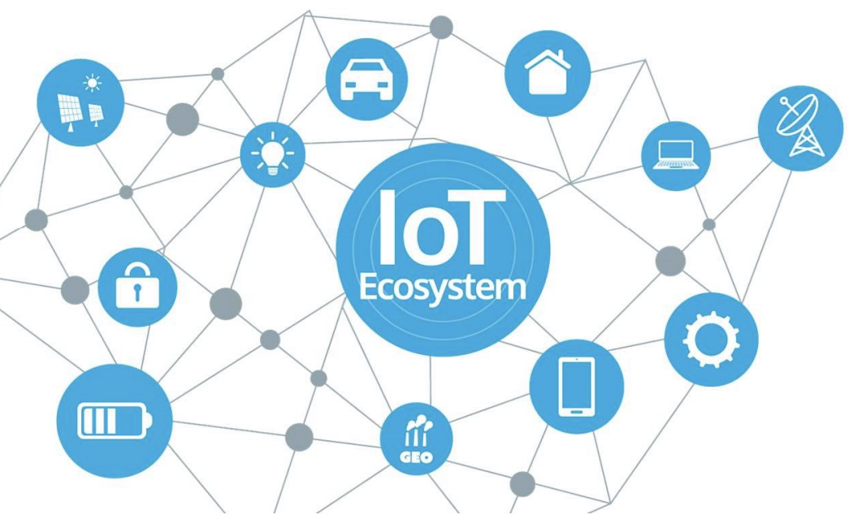
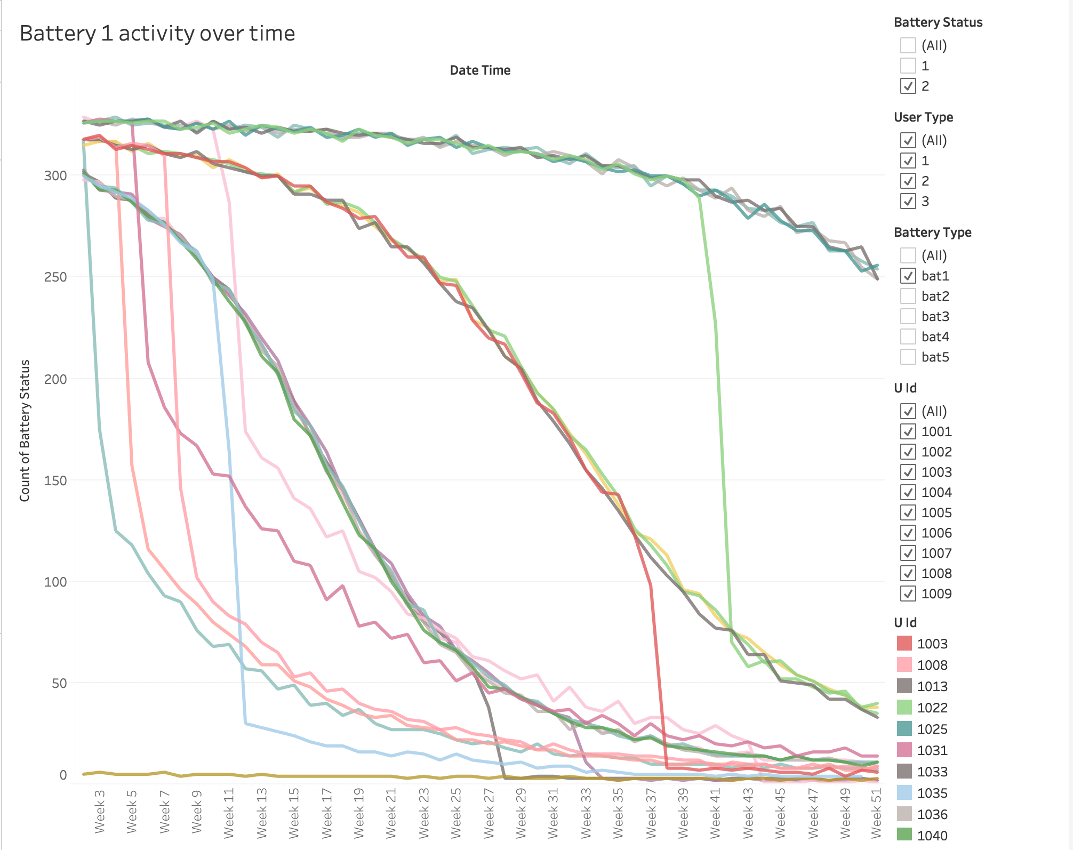
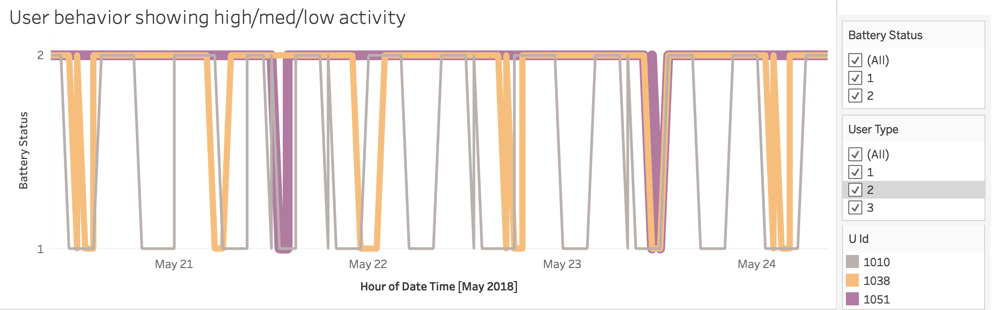
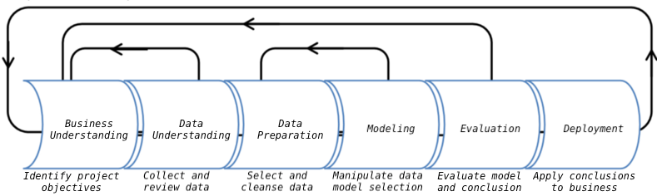
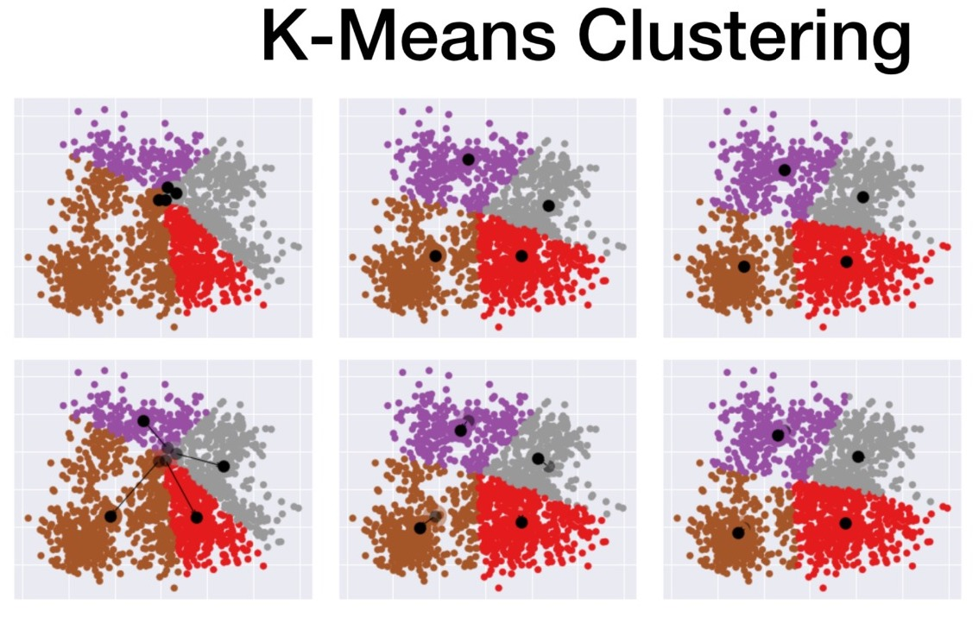
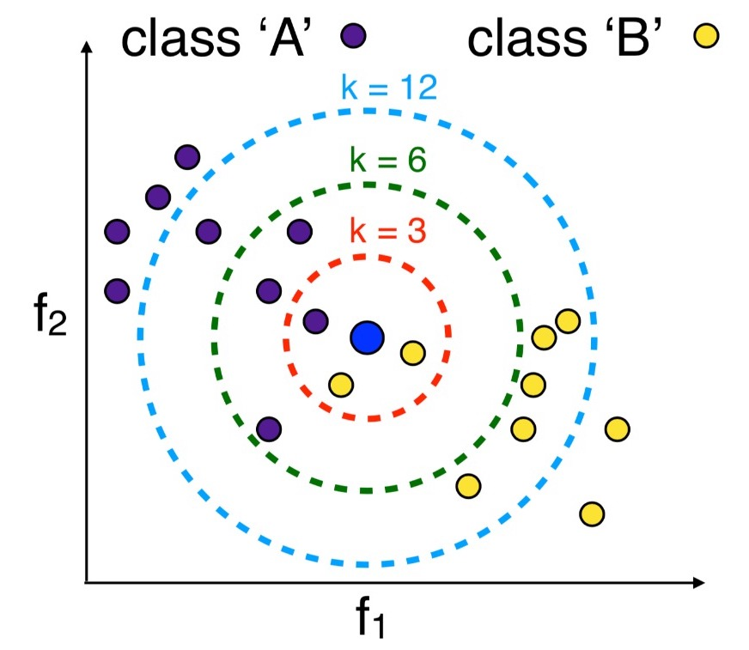
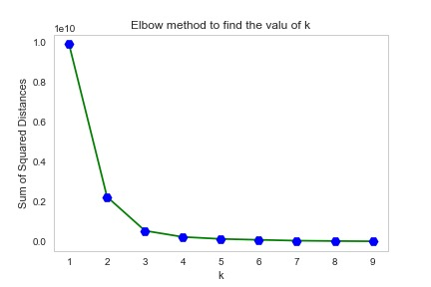
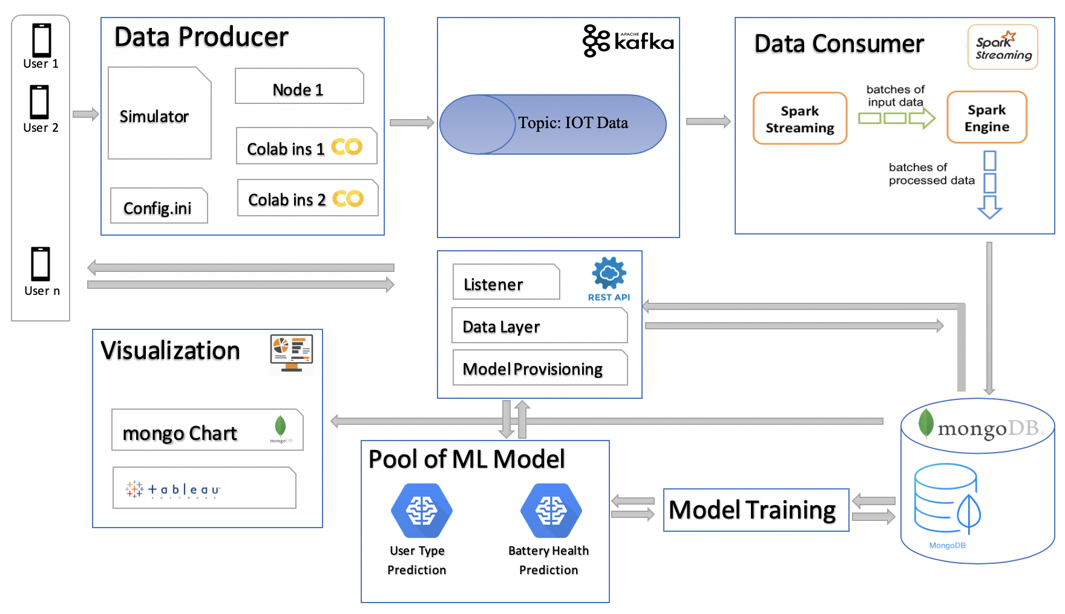
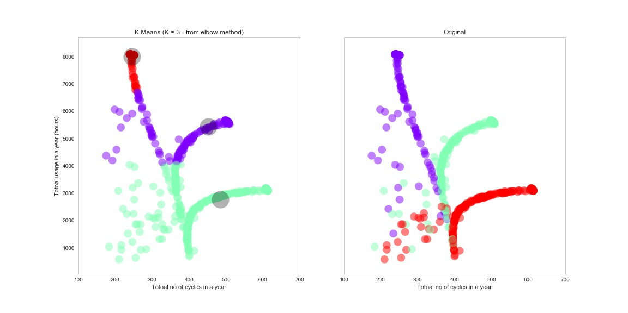
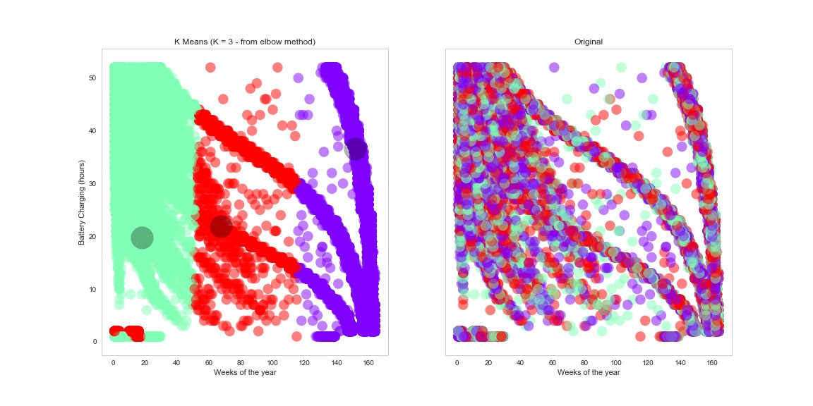
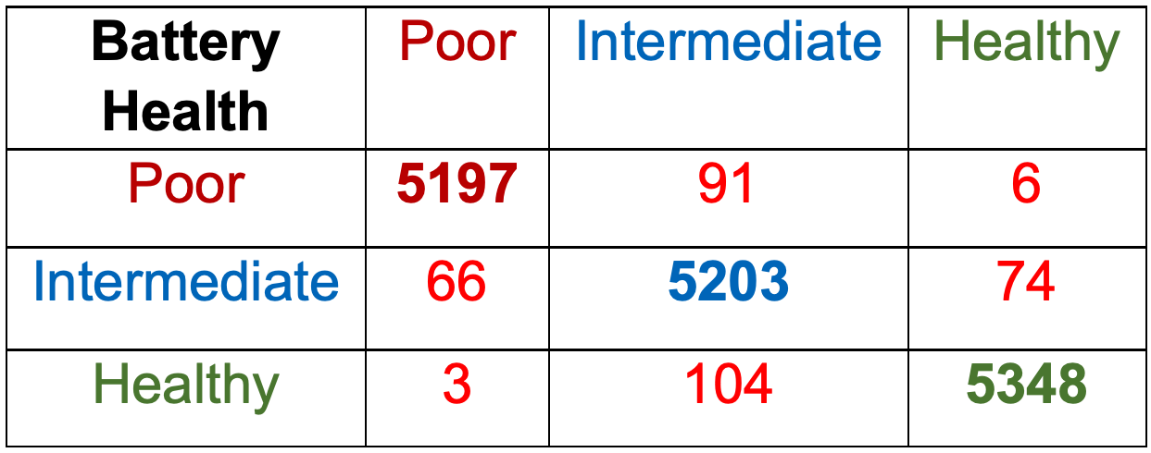
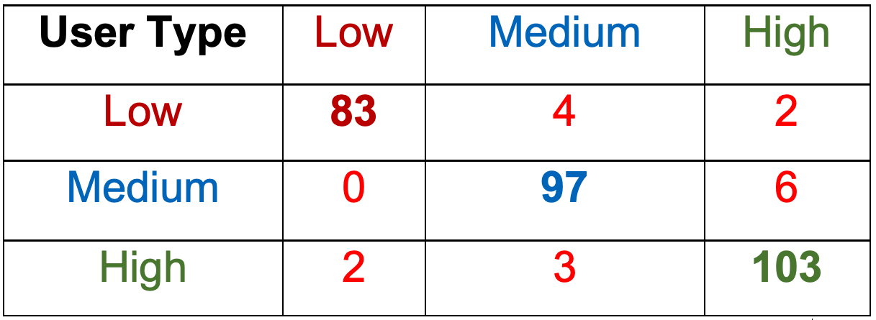
Machine Learning on IoT Data: Predicting Battery Health Status and User Type
Simon Fraser University
Mehdi Lebdi - Mirza Tauqeer Baig - Mehdi Nikkhah - Junaid Qazi
ABSTRACT
With the rise of IoT devices in the market, the cost incurred on maintenance will be consequential and vast. The models are applied to a case study where the main goal is to predict battery health status and the user type based on its usage behavior. The unsupervised and supervised ML methods, such as K-Means Clustering, and K-Nearest Neighbors (KNN) are implemented and results are presented in this study.
Objective: Can we build a predictive model that can warn us of those initial glitches or anomalies that would help a company detect a complication before it turns into a costly liability?
Exploratory data analysis
Conclusion
IoT data can be used to avoid costly liabilities such as device failure that could result into bad reputation.
Targeted marketing strategies can be successfully planned.
Available ML models are good candidates in future planning and business intelligence in this competitive environment for companies.
Discharging
Battery Status
Discharge Time
Charging
May 21
May 22
May 23
May 24
Hour of Date [May 2018]
Plot shows trends of different types of users for a device over the period of 1 year. Sudden drops depicts unusual behavior (anomalies) of the device.
Plot depicting usage pattern for 3 distinctive types of users (low/med/high activity). Low user has experienced a lower frequency of charging/discharging cycle.
Data-science Pipeline
Methods / Models Formulation
Future Work
Explore other ML models for predicting Remaining Useful Life (RUL) of batteries.
Explore IoT data from other devices such as electric cars, home appliances, etc. to optimize their performance.
Provide device recommendation to users depending on their daily device usage.
K-Means Clustering Algorithm
Unsupervised Learning
K-Nearest Neighbors Algorithm (K-NN)
Supervised Learning
Elbow method to find the value of k
Business Understanding
Data Generation
Data Mining, EDA and aggregation
Modeling
Evaluation
Deployment
Identify project objectives
Generate and simulate IoT data
EDA and prepare data for ML
Manipulate data model selection
Evaluate model and conclusion
Apply conclusions to business
Centroids are initiated in the beginning leading to new cluster centroids in each iteration until converged. Cluster centroids are shown as points in black.
Distinct values of k leads to distinct predictions for the new data points. The optimum value of k is computed using Elbow method.
Elbow method to find the value of k for our data points. We can clearly see Elbow point at k=3.
Data-science Architecture
Experiments & Outcomes
Confusion Matrix
Acknowledgments
Thanks to Bandeep Singh (Data Scientist, Samsung Electronics Canada) for guidance on the project.
Thanks to the instructors Jiannan Wang, Steven Bergner
References
Exploring Big Data Clustering Algorithms for Internet of Things Applications. Hind Bangui et. al. Proceedings of the 3rd International Conference on Internet of Things, Big Data and Security (IoTBDS 2018), pages 269-276.
Machine learning for Internet of Things data analysis: A survey. Mohammad et. al. Digital Communications and Networks (2017).
K=3 – Predicted Clusters
Original Clusters
K=3 – Predicted Clusters
K-Means clustering results to cluster user types based on their usage behavior.
Clustering of data points for battery health from K-Means clustering algorithm.

