Slide 1
Machine learning Mini-project: PEP 8
Kristian Siebenrock

Slide 2
Table of Contents
What is PEP 8?
Why should it be used?
Key Points
When shouldn’t it be used?
Implementation

Slide 3
Table of Contents
What is PEP 8?
Why should it be used?
Key Points
When shouldn’t it be used?
Implementation

Slide 4
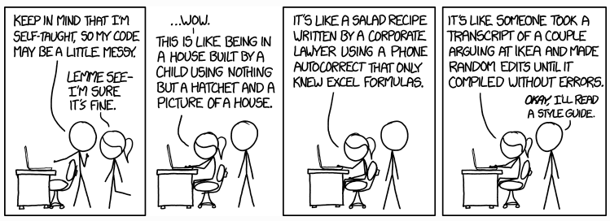
What is PEP 8?
https://geo-python.github.io/site/notebooks/L3/gcp-3-pep8.html
Notes:
As you noticed, Python forces us to indent our code when writing for loops and conditional statements. Without the indentation, the code won’t work at all, or then it will not work as you would want it to work.
However, there are many cases in which you are able to write code that runs without errors, but you (or others!) might have a hard time reading it and understanding what the code actually does.
Coding conventions = are a set of generally agreed ways of writing programming code in a specific programming language. And they help programmers write code that is consistent and easy to read.

Slide 5

What is PEP 8?
PEP (Python Enhancement Proposal): A document that describes and documents new features for the community
PEP 8 is a document containing guidelines and best practices for writing Python code.
Focus: Improve readability and consistency of Python code
Written by Guido van Rossum, Barry Warsaw and Nick Coghlan in 2001
Notes:
Guido van Rossum = know to be the creator of the Python programming language

Slide 6
Table of Contents
What is PEP 8?
Why should it be used?
Key Points
When shouldn’t it be used?
Implementation

Slide 7
Why should it be used?
“Code is read much more often than it is written.”
- Guido van Rossum
Notes:
The guidelines described in PEP 8 are therefore intended to improve the readability of code and make it consistent across the wide spectrum of Python code.

Slide 8
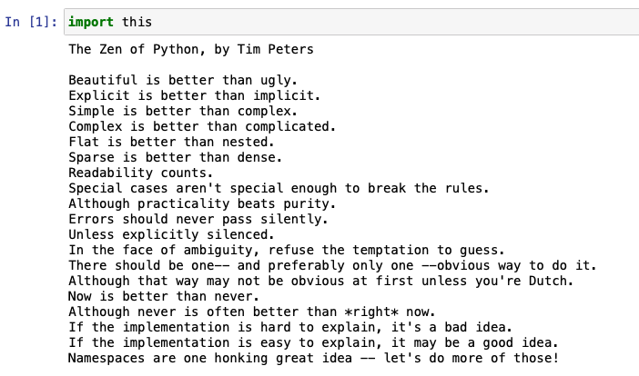
Why should it be used?
“Code is read much more often than it is written.”
- Guido van Rossum
Notes:
This insight from Guido van Rossum and a lot of ways he based Python off of were derived from the so called Zen of Python, apparently.
The Zen of Python (PEP 20) is a collection of 19 guiding principles for writing computer programs that influenced the Python programming language. It was written in 1999 by software engineer Tim Peters.

Slide 9



Why should it be used?
Improve readability and consistency
Shows professionalism
Improved experience while collaborating with others
Notes:
Oftentimes, you spend hours or days working on a specific project. Once it is finished, it is rarely written again. It will, however, most definately be read again. Each time someone returns to that piece of code, they must be able to understand what it does and why it was written that way. Therefore, readability is important. If you follow PEP 8, you can be sure that you have named your variables well. You will know that you have added enough spaces to make it easier to follow the logical steps in your code and you have also commented your code well. All this means that your code is easier to read and recall. Especially as a beginner, following the rules of PEP 8 can make learning Python a much more enjoyable task.
2. Following PEP 8 is especially important if you are looking for a development job. Writing clear, readable code shows professionalism. It will tell an employer that you understand how to structure your code well.
3. If you have more experience writing Python code, you may need to collaborate with others. Writing readable code is crucial here. Other people you may have never met before or seen your coding style need to read and understand your code. If you have guidelines that you follow and recognize, others can read your code more easily.

Slide 10
Table of Contents
What is PEP 8?
Why should it be used?
Key Points
Naming Conventions
Code Layout
Indentation
Comments
Whitespace
When shouldn’t it be used?
Implementation

Slide 11
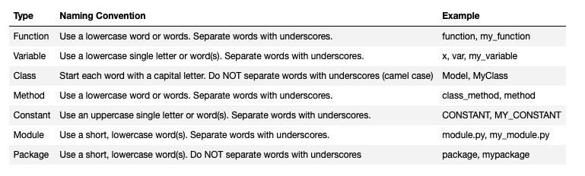
Key Points – Naming Conventions
“Explicit is better than Implicit”
- The Zen of Python
Notes:
The choice of sensible names will save a lot of time and energy in the long run as the reader will be able to figure out, from the name, what a certain variable, function or class represents

Slide 12


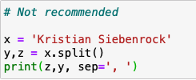



Key Points – Naming Conventions
Choosing Names:
1. Never use l, O or I single letter names:
2. Do not use x, y or z when naming varibales:
3. Try not to use abbreviations:
Notes:
Ideally, names should be chosen based on their representation. Therefore, descriptive names should be used. Always try to use concise but descriptive names when possible.
Never use l, O or I single letter names as they can easily be mistaken for 1 and 0 depending on the typeface
While it may be tempting to use simple, single-letter lowercase names when naming a variable (like x), it is not clear what it represents. Therefore, unless x is referring to an argument of a mathematical function, it should not be used.
The same counts when choosing the name of a function. While it may seem logical, at first, to use 'hf' as an abbreviation for 'half', it may not be as clear to someone else reading the code.

Slide 13
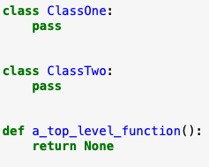
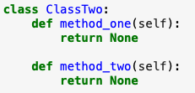
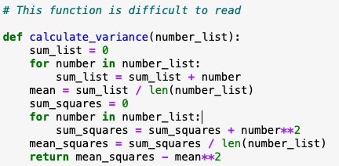
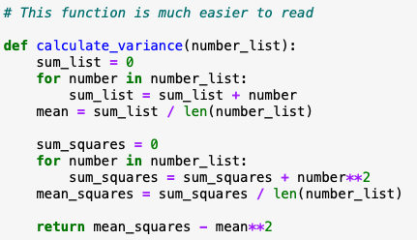
Key Points – Code Layout
“Beautiful is better than ugly”
- The Zen of Python
Blank lines:
1. Surround top-level functions and classes with two blank lines:
2. Surround method definitions inside classes with a single blank line:
3. Use blank lines sparingly inside functions to depict steps:
Notes:
How code is laid out plays a huge role in how readable it is. In this regard, blank lines as well as maximum line length and line breaking should be chosen accordingly.
Vertical whitespace can greatly improve the readability of code. Code that is bunched up together can feel quite overwhelming, especially if the reader didn't program it himself. On the other side, too many blank lines can make code look very sparse and the reader will have to scroll more than necessary. Therefore, the following guidlines defined by PEP 8 should be upheld:
As top-level functions and classes should be fairly self-contained and should handle separate functionalities, therefore, it makes sense to include extra vertical space around them.
Inside a class, functions are related to one another. Nevertheless, a single line between functions should be included.
Sometimes, a function must complete multiple steps before the return statement. To ensure that the reader understands the logic behind each step, it can be helpful to leave a blank line between each step. Breaking up code can also help the reader understand how certain sections relate to one another.

Slide 14




Key Points – Code Layout
Maximum Line Length:
PEP 8 suggests that lines should be limited to 79 characters
Line Breaking:
Implied Continuation
Use Backslashes to break lines:
Break lines before binary operators:
Notes:
Max line length: this allows you to have multiple files open next to one another, while also avoiding line wrapping.
It is, however, no always possible to keep statements to 79 characters or less. For these cases, PEP 8 also outlines formatting rules for statements to run over several lines.
Implied Continuation: Python will assume line continuation if code is continued within parenthesis, brakets or braces.
If not possible then:
Use backslashes to break lines
Break lines before binary operators –> This rule stems from mathematics as breaking lines before binary operators improves readability. Looking at the two examples below, it is immediately visible, at the first example, which variable is being added or subtracted. This is because the operator is right next to the variable being operated on. In the second example, however, it is not as easy to see. It must be said that code that consistently breaks after a binary operator is still PEP 8 compliant, as consistency is key in PEP 8.

Slide 15
Key Points – Indentation
“There should be one—and preferably only one—obvious way to do it.”
- The Zen of Python
Prefer spaces over tabs
Use 4 consecutive spaces to indicate indentation
Notes:
Indentation is also known as leading whitespace and has a deciding role in Python. The indentation level of lines of code in Python determines how statements are grouped together.
As mentioned above, spaces are the preferred indentation method. Therefore, tabs should be used solely to remain consistent with code that is already indented with tabs.
It is possible, however, to adjust the settings of the text editor in order to output 4 spaces instead of a tab character, when pressing the 'Tab' key. In Jupyter Notebook, this is the default indentation setting

Slide 16








Key Points – Indentation
Indentation following line breaks:
1. Align the indented block with the opening delimeter
If
2. Hanging Indent
3. Breaking lines inside parenthesis, brackets or braces:
Notes:
When trying to keep lines of code under 79 characters, it is oftentimes useful to use indentation in order to improve readability. This allows the reader to distinguish between two lines of code and a single line of code that spans two lines. PEP 8 provides two possible methods of indentation:
Align indented block with opening delimiter -> However, sometimes only four spaces are necessary to align with the opening delimeter. This will oftentimes occur in 'if' statements that span multiple lines. In this case, it can be difficult to distinguish the nested code block from the 'if' statement. If that’s the case then either add a comment after the final condition or add an extra indentation.
Hanging indent: This means that every line apart from the first in a paragraph or statement is indented. It is important, however, that there aren't any arguments on the first line
Either line up closing brace with the first non-whitespace character of the previous line or line up the closing brace with the first character of the line that starts the construct.

Slide 17

Key Points – Comments
“If the implementation is hard to explain, it’s a bad idea.”
- The Zen of Python
1. Limit the line length of comments and docstrings to 72 characters
2. Use complete sentences, starting with a capital letter
3. Make sure to update comments if the code is changed
Comments should generally always be written in English
Notes:
Comments should be used to document code as it is written, in order to ensure that the code is understandable. PEP 8 provides guidelines that should be adhered to while adding comments:
It is also important to mention that coders from non-English speaking countries must still write their comments in English, unless it is very unlikely that the code will never be read by people who do not speak the specific language.

Slide 18


Key Points – Comments
Inline Comments
Use inline comments sparingly
Write inline comments on the same line as the statement they refer to
Separate inline comments by two or more spaces from the statement
Start inline comments with a # and a single space
Do not use them to state the obvious
Block Comments
Indent block comments to the same level as the code they describe
Start each line with a # and a single space
Separate paragraphs by a line containing a single #
Documentation Strings
Surround docstrings with three double quotes on either side
Write them for all public modules, functions, classes and methods
Put the “ “ ” that ends a multiple docstring on a line by itself

Slide 19



Key Points – Whitespace
“Sparse is better than dense”
- The Zen of Python
Whitespace should be surrounded by the following operators:
Assignment Operators (=, +=, -=, …)
Comparisons (==, !=, >, <, …)
Booleans (and, or, not)
Only add whitespace to operators with the lowest priority:
Notes:
Whitespace can be very helpful when used properly. If there is not enough, the code can be difficult to read, whereas if there is too much, it can be difficult to visually combine related terms in a statement.
However, = should not be surrounded with whitespace when it is used to assign a default value to a function argument.
In slices, colons act as binary operators. Therefore, the same rules apply and there should be the same amount of whitespace on both sides.

Slide 20










Key Points – Whitespace
When to avoid adding whitespace:
Immediately inside parenthesis, brackets or braces
Before a comma, semicolon or colon
Before the open bracket that starts an index or slice
Between a trailing comma and a closing parenthesis
To align assignment operators
Notes:
In some cases, adding whitespace can make code difficult to read. Therefore, PEP 8 outlines very clear exmaples where whitespace is inappropriate.
However, it must be said that the most important place to avoid whitespace is at the end of a line as, known as trailing whitespace. It is invisible and can produce errors that are difficult to trace.

Slide 21
Table of Contents
What is PEP 8?
Why should it be used?
Key Points
When shouldn’t it be used?
Implementation

Slide 22



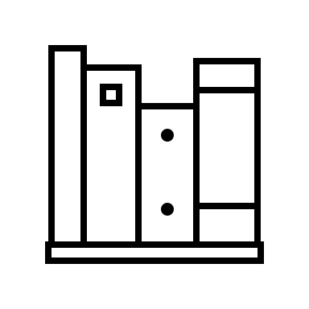

Why shouldn’t it be used?
If complying would result in breaking backwards compatibility
When applying a guidline would make the code less readable
To be consistent with code that does not adhere to it
When code needs to be compatible with older versions of Python that don’t support certain features
Notes:
A style guide is about consistency. However, in certain situations it can be important to be inconsistent as sometimes style guide recommendations aren't applicable.

Slide 23
Table of Contents
What is PEP 8?
Why should it be used?
Key Points
When shouldn’t it be used?
Implementation
Linters
Autoformatters

Slide 24

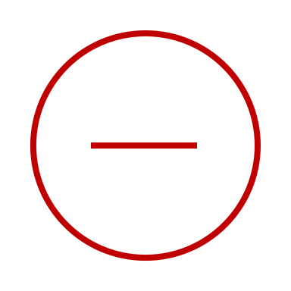
Implementation – Linters
Linters are programs that analyse code and flag errors and provide suggestions on how to fix the error in regard to PEP 8.
Especially useful when installed as extensions to a text editor, as they flag errors and stylistic problems in real time
Only report the problems they identify in the source code and leave the changing of the code to the developers
Most popular linters for Python:
pycodestyle: https://pycodestyle.pycqa.org/en/latest/
Pylint: https://www.pylint.org
Flake8: https://flake8.pycqa.org/en/latest/

Slide 25
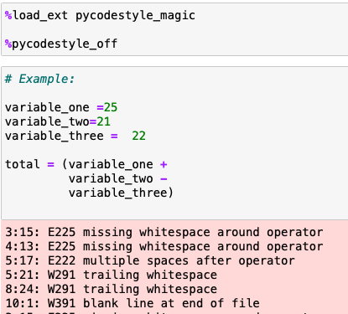
Implementation – Linters
1. pycodestyle
Features that are able to be checked:
Indentation
Whitespace
Blank lines
Import
Line length
Runtime
Line Breaks
Features not in the scope:
Naming conventions
Docstring conventions
Notes:
However, some rules entailed in PEP 8 cannot be expressed with a simple algorithm while other rules are only recommendations.

Slide 26
Implementation – Linters
Implementing pycodestyle in Jupyter Notebook:
Step 1: pip install pycodestyle
Step 2: pip install pycodestyle_magic
Step 3: %load_ext pycodestyle_magic
Step 4: %pycodestyle_on

Slide 27
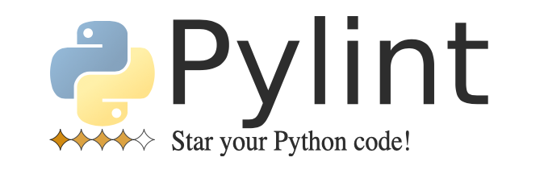
Implementation – Linters
2. Pylint
https://www.pylint.org
Static code checker, unlike pycodestyle
Most commonly used tool for linting in Python
Has more error/warning checks than many other linters
More descriptive
Delivers a code rating and compares to previous versions
Integrated in numerous editors
Cannot be implemented in Jupyter Notebook
Can only take .py files
Notes:
ylint is a static code checker, meaning it can analyse code without actually running it, unlike pycodestyle. Pylint checks for errors and tries to enforce a coding standard and style. It is the most commonly used tool for linting in python.
It includes the following features:
Checking the length of each line
Checking if variable names are well-formed according to the project's coding standard
Checking if declared interfaces are truly implemented

Slide 28
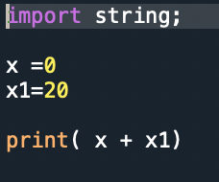
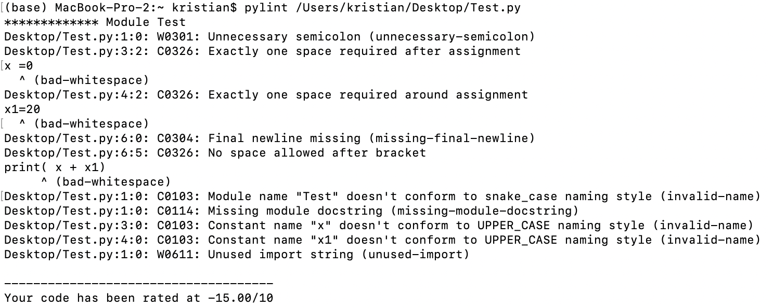
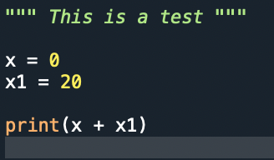
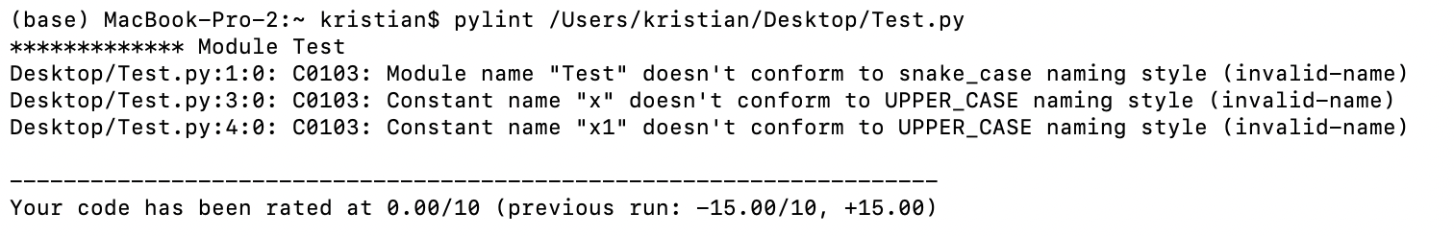
Implementation – Linters

Slide 29
Implementation – Linters
Implementing Pylint:
Step 1: pip install pylint
Step 2: pip module1.py, (module2.py,…)
Using Pylint in other editors:
Visual Studio: Python > Run Pylint
Spyder: View > Panes > Static code analysis

Slide 30
Implementation – Auto-Formatters
Auto-formatters are tools that will format code in a way that complies with PEP 8.
Fixes inconsistencies instead of just raising warnings/errors
Uniform style after auto-formatting
Removes flexibility in regard to formatting
Most popular Auto-formatters for Python:
Autopep8: https://github.com/hhatto/autopep8#features
Black: https://github.com/psf/black

Slide 31

Implementation – Auto-Formatters
1. Black
One of the most popular auto-formatters for PEP 8 compliance
Reformats entire files in place
Fast
Transparent
Blocks of code can be selected to not be formatted
Can be integrated into numerous editors
Not configurable
Doesn’t take previous formatting into account
https://github.com/psf/black#the-black-code-style

Slide 32
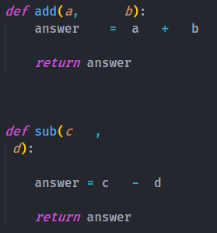
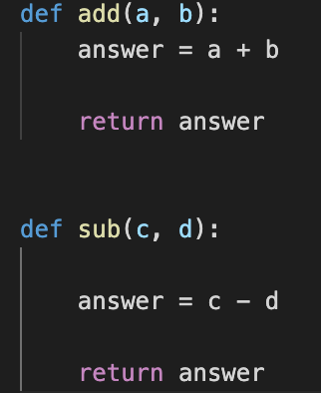
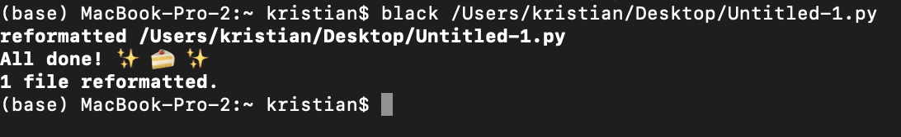
Implementation – Auto-Formatters

Slide 33
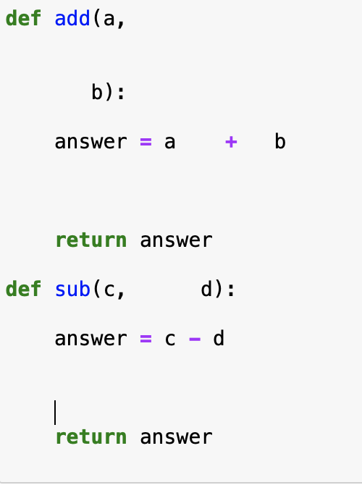
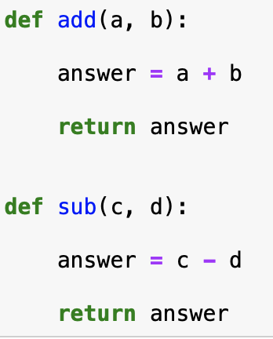
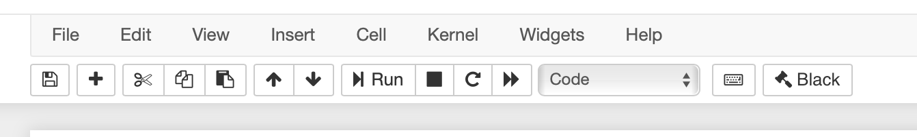
Implementation – Auto-Formatters
1. Jupyter Black
Jupyter Notebook version of Black
Jupyter Black reformats code in a notebooks cell.
Therefore it is possible to just reformat certain cells

Slide 34
Implementation – Auto-Formatters
Implementing Black:
Step 1: pip install black
Step 2: black module1.py, (module2.py,…)
Implementing Jupyter Black:
Step 1: pip install jupyter_contrib_nbextensions
Step 2: jupyter nbextension install https://github.com/drillan/jupyter-black/archive/master.zip --user
Step 3: jupyter nbextension enable jupyter-black-master/jupyter-black
Step 4: Open notebook and click on 'Black' button on desired cell to apply

Slide 35
References
https://pep8.org
https://en.wikipedia.org/wiki/Zen_of_Python
https://www.codeflow.site/de/article/python-pep8
https://realpython.com/python-pep8/
https://sourcelevel.io/blog/what-is-a-linter-and-why-your-team-should-use-it
https://pypi.org/project/pycodestyle/
http://pylint.pycqa.org/en/latest/intro.html
https://www.freecodecamp.org/news/auto-format-your-python-code-with-black/

