Slide 1
Machine learning
Mini-project: Gradient Descent with Momentum and Nesterov-Accelerated Gradient
Noah Gollnick
Wirtschaftsinformatik

Slide 2
Introduction
Classical gradient descent
Gradient with momentum
Nesterov accelerated gradient
Main goal: Accelerate the machine learning process

Slide 3
Learning-rate-Dilemma in classic Gradient descent
High learning rate
Low learning rate
Faster training process, smaller number of iterations for best result Higher probability of overshooting and oscillating around the minimum | Slower training process, higher number of iterations for best result Smaller probability of overshooting, higher chance to find the perfect minimum

Slide 4
Approach of using momentum
Possible Approach: Dynamic learning rate
Assumption 1:
The risk of overshooting is higher at the end of the training process
Assumption 2:
The loss is getting generally better over time, so the steps are getting smaller
Learning algorithm adjusts to the size of the last gradient descent step

Slide 5


Concept and Computation of Momentum
Momentum: Adding a velocity vector to the changes made in one machine learning step. The velocity equals the difference between the parameters of the last 2 steps:
$$ν_{t}= θ_{t}−θ_{t−1}$$
The velocity vector is added to the next step (multiplicated with a scalar factor) while subtracting the gradient:
$$θ_{t+1}= θ_{t}−εΔf\left(θ_{t}\right)+μν_{t}$$

Slide 6


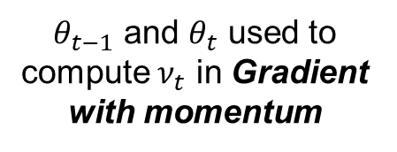
Difference between GDM and NAG
Difference between classical Gradient with momentum and Nesterov accelerated gradient:
NAG splits up gradient update step and momentum update step
Update for $θ_{t−2}$to $θ_{t−1}$
Update for $θ_{t−1}$to $θ_{t}$
Gradient update
Momentum update
Gradient update
Momentum update
$θ_{t−1}$ and $θ_{t}$ used to compute $ν_{t}$ in Gradient with momentum

Slide 7
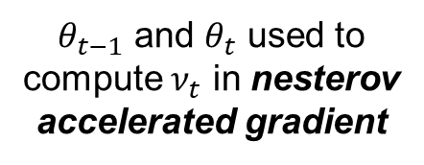
Difference between GDM and NAG
Difference between classical Gradient with momentum and Nesterov accelerated gradient:
NAG splits up gradient update step and momentum update step
Update for $θ_{t−2}$to $θ_{t−1}$
Update for $θ_{t−1}$to $θ_{t}$
Gradient update
Momentum update
Gradient update
Momentum update
$θ_{t−1}$ and $θ_{t}$ used to compute $ν_{t}$ in nesterov accelerated gradient

Slide 8
Comparing Methods for Linear Regression
Tested Model: | Linear Regression
Dataset: | Diabetes Dataset (Scikit-Learn)
Number of Samples: | 422
Number of Features | 10
Loss function: | Mean Squared Error
Learning Rate: | 0.00001
Momentum rate (if Momentum): | 0.9
Number of iterations: | 1000
Random Seed: | 57

Slide 9
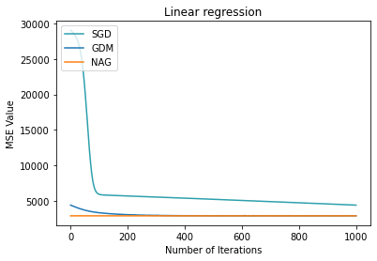
Comparing Methods for Linear Regression

Slide 10
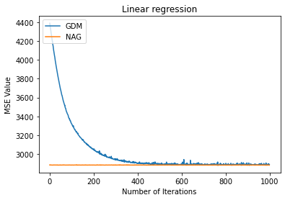
Comparing Methods for Linear Regression

Slide 11
Comparing Methods for Linear Regression
Tested Model: | Logistic Regression
Dataset: | Iris Dataset (Scikit-Learn)
Number of Samples: | 100
Number of Features | 4
Loss function: | Binary Crossentropy
Learning Rate: | 0.001
Momentum rate (if Momentum): | 0.9
Number of iterations: | 1000
Random Seed: | 57

Slide 12
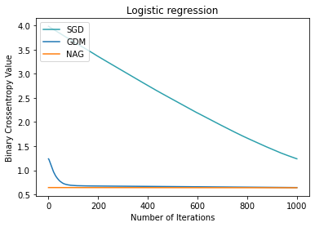
Comparing Methods for Logistic Regression

Slide 13
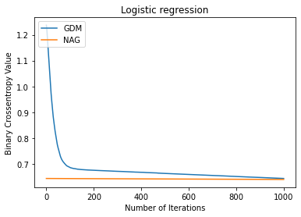
Comparing Methods for Logistic Regression

Slide 14
Library Implementations for Sklearn/Pytorch/Keras
Scikit-learn: | No Explicit Bulit-in Implementation
Theano/Lasagne: | Function sgd for gradient descent Function apply_momentum for momentum Function apply_nesterov_momentum for NAG
Pytorch: | Class SGD for gradient descent momentum as float argument nesterov as boolean argument
Tensorflow/Keras: | Class SGD for gradient descent momentum as float argument nesterov as boolean argument

Slide 15
Conclusion
Momentum and NAG does not give you better results,
but it give you a good result much faster!
You might use it when: | You might not use it when:
…the prediction just have to be good, but not perfect …fast Training process is required For Example: model is trained live while usage multiple times | …there is a high requirement for the best accuracy possible …time is no important matter For example: model is only trained once without gathering new data

Slide 16
References
http://www.cs.utoronto.ca/~ilya/pubs/ilya_sutskever_phd_thesis.pdf
https://jlmelville.github.io/mize/nesterov.html
https://scikit-learn.org/stable/index.html
https://github.com/Lasagne/Lasagne
https://pytorch.org/
https://keras.io/

