Slide 1
Cross Industry Standard Process for Data Mining (CRISP-DM)

Slide 2
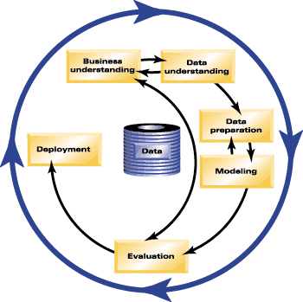
Data Mining Process Source: CRISP-DM (SPSS.com website)

