Slide 1





Software defined Network Inference with Passive/active Evolutionary-optimal pRobing (SNIPER)
ELECTRICAL &
COMPUTER ENGINEERING
Mehdi Malboubi, Yanlei Gong, Wang Xiong, Chen-Nee Chuah, Puneet Sharma

Slide 2
Network Measurement Under Hard Resource Constraints
Per-flow performance metrics are useful and demanding for different networking applications
Under hard constraints of network measurement resources network inference techniques are powerful tools that can be applied
In matrix completion sampling points are randomly selected; accordingly, an important question is how to measure/sample such that the inference accuracy is improved while less measurement resources are utilized
Challenge:
There is not a direct relation between the structure of the sampling matrix and the ultimate performance of network inference (here, matrix completion methods). It is a very complicated process to formulate the ultimate accuracy, directly.
Sacrificing the estimation accuracy, other criteria such as the coherency and condition number are used
To the best of our knowledge, this is the first work that targets the estimation accuracy directly using evolutionary optimization techniques
Networks sharing resources so there are spatial-temporal correlations/structures

Slide 3
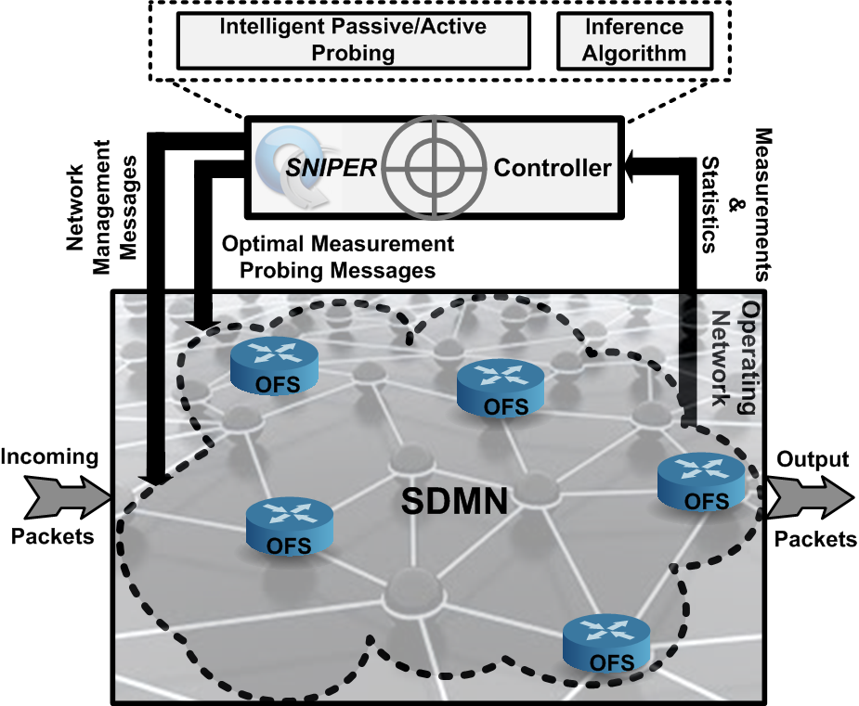
Main Idea
Intelligently probes/samples a sub-set of the set of attributes of interest to capture the inherent spatial-temporal correlations and provide the best possible partial measurements (side information) which potentially leads to the best estimation accuracy
Software Defined Measurement Network (SDNM): Sub-set of measurement OpenFlow Switches (OFS) in the operating network used for network measurement which guarantees the observability and measurability of all attributes of interest
SNIPER Controller: An OpenFlow controller which: 1) manages the network; 2) intelligently probes the sub-set of attributes of interest by optimally reconfiguring the measurement infrastructure; 3) effectively polls and process the network measurements and statistics

Slide 4
Main Idea
Intelligently probes/samples a sub-set of the set of attributes of interest to capture the inherent spatial-temporal correlations and provide the best possible partial measurements (side information) which potentially leads to the best estimation accuracy
Per-Flow Size: On regular intervals, the controller installs the flow ID prefixes in the TCAM entries and polls the statistics, providing accurate estimate of the per-flow size.
Per-Flow Throughput (will be discussed in footnote): On regular intervals, the controller determines specific path for each flow and queries switches to retrieve per-flow statistics where for each query determines the amount of bytes sent and the duration of each flow enabling the SNIPER to calculate the effective throughput for each flow.
Per-Flow Packet Loss (will be discussed in footnote): By polling flow statistics from the first and last switch of each path and by subtracting the increase of the source switch packet counter with the increase of the packet counter of the destination switch, we obtain an accurate measurement of the packet loss over the past sample.
Per-Flow Delay: By assigning a specific path to each flow and regularly injecting packets into the first switch and polling the statistics from the last switch. The SNIPER, then computes the per-flow delay by calculating the difference between the packet’s departure and arrival times, subtracting with the estimated latency from the switch-to-controller delays.

Slide 5
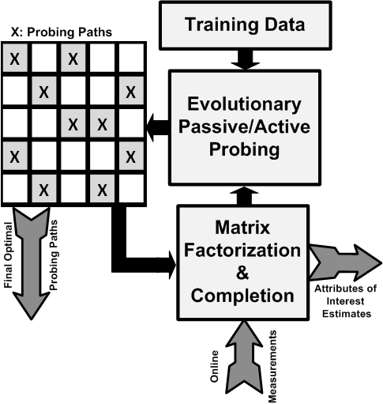
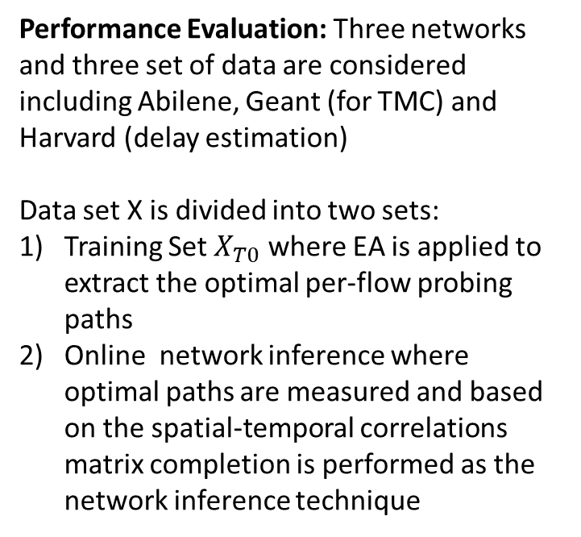
SNIPER
Evolutionary Algorithms (EA) are applied in a supervised training mode to find the most informative per-flow probing paths where training data is available and EA targets the ultimate estimation accuracy as the final
Performance Evaluation: Three networks and three set of data are considered including Abilene, Geant (for TMC) and Harvard (delay estimation)
Data set X is divided into two sets:
Training Set $X_{T0}$ where EA is applied to extract the optimal per-flow probing paths
Online network inference where optimal paths are measured and based on the spatial-temporal correlations matrix completion is performed as the network inference technique

Slide 6
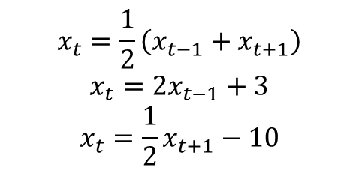
Illustrative Example
$$x_{t}=\frac{1}{2}\left(x_{t−1}+x_{t+1}\right)$$
$$x_{t}=2x_{t−1}+3$$
$$x_{t}=\frac{1}{2}x_{t+1}−10$$
Assuming the processes in different rows are independent
15 20
13 29
10 40 100
0 1
1 0 0
0 0 1
Optimal Sampling Matrix
Random sampling matrix fails for perfect recovery

Slide 7
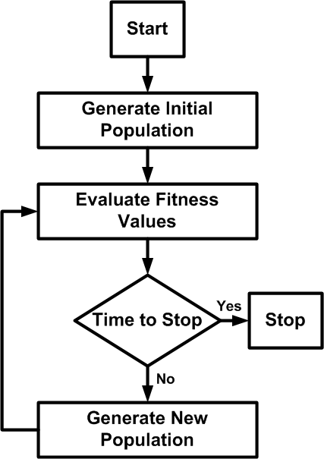
Evolutionary Algorithms
1) Genetic Algorithms (GA)
2) Particle Swarm Optimization (PSO)
PSO is used to reduce the computational complexity of the GA
Fitness functions:
Direct fitness where the ultimate NMSE and NMAE are targeted
Indirect fitness where the norm of the observation matrix are used as the metric to address the scalability and computational complexity processes
The evolution is stopped after certain number of iterations

Slide 8
Delay Estimation
It is assumed that the topology of the network is given where the distance between nodes are known
EA is applied when there is no noise in the training stage
The delay between nodes is modeled as:
$\frac{d_{ij}}{c}+n$ where $n\sim Exp(λ)$ where $μ=\frac{1}{λ}, σ^{2}=\frac{1}{λ^{2}} , 0≤n≤10ms$
Average delay in Abilene and Geant networks are about 3.5ms

Slide 9
Average performance
By increasing the variance of noise NMSE is increased
By decreasing the sampling ratio NMSE is increased
GA is better than random sampling

Slide 10
Average performance
By increasing the variance of noise NMSE is increased
By decreasing the sampling ratio NMSE is increased
GA is better than random sampling

Slide 11
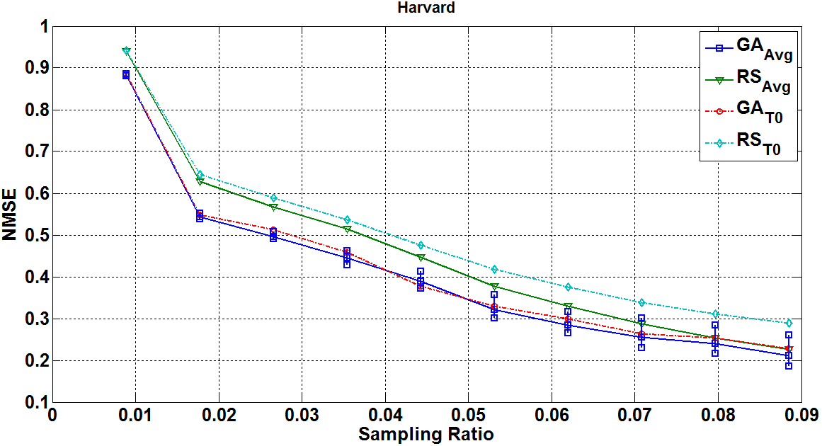
Delay Estimation
(on Real data)
GA performs better under lower sampling rations which is good for our recourse constrained case

Slide 12
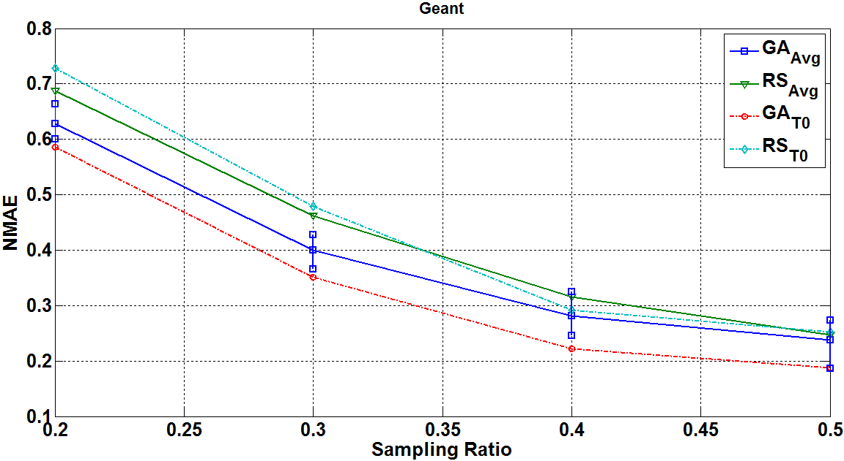
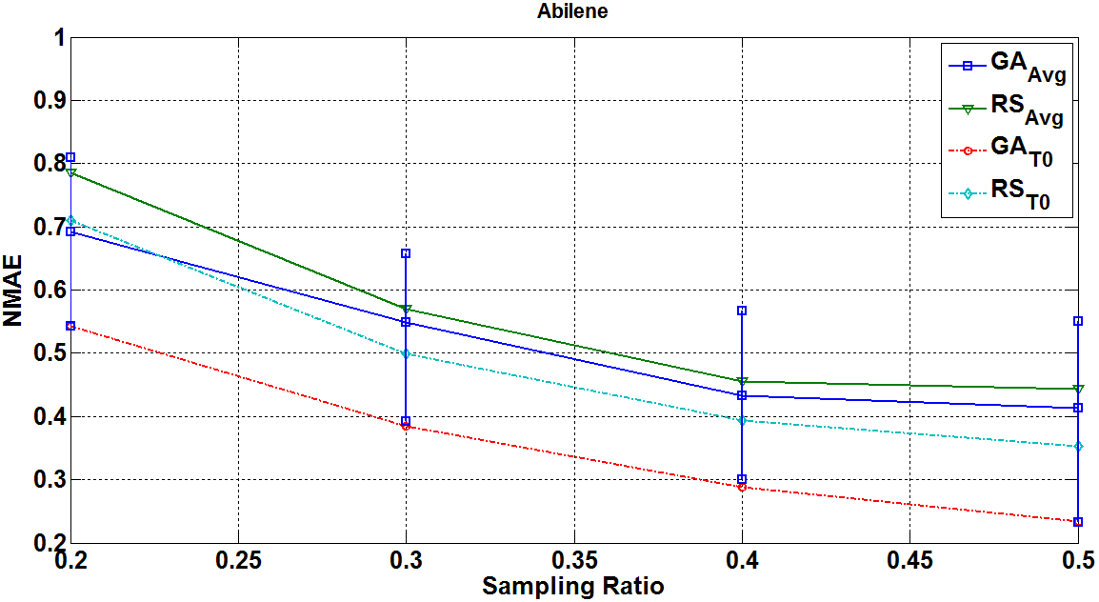
TM Completion
(GA targets reducing the ultimate NMAE)
GA performs better under lower sampling rations which is good for our constrained recourse constraint scenarios
Almost, in all sampling ratios and time intervals the GA was better than random sampling

Slide 13
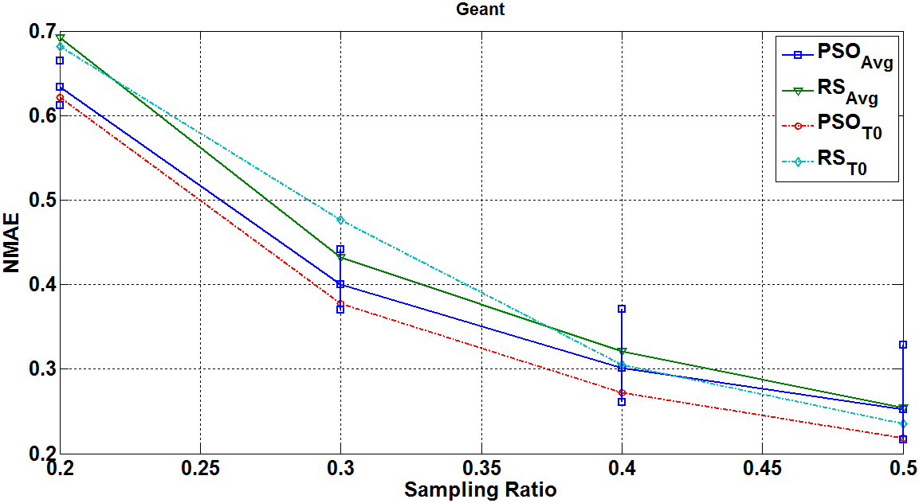
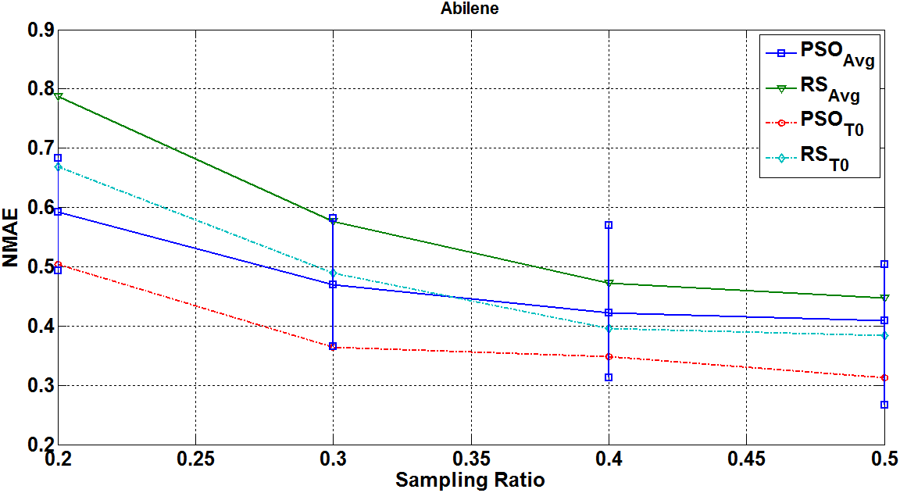
TM Completion
(PSO targets reducing the ultimate NMAE)
PSO performs better under lower sampling rations which is good for our constrained recourse constraint scenarios
Almost, in all sampling ratios and time intervals the PSO was better than random sampling

Slide 14
- Norm of sampling matrix showed a strong correlation with the estimation accuracy
By minimizing the norm of the sampling matrix we can reduce the error while reducing the processing time

Slide 15
Paper Outline
(Conext2014 (June 15th) , ICNC2015 (July5th),Infocom2015 (July 11th Abstract) )
1) Introduction (2-3 pages)
SNIPER Framework (problem formulation+ Evolutionary Algs, … 4-5 pages )
SNIPER Performance Evaluation (3-4 pages)
4) Conclusion
More results are required (increasing mutation prob)
Pd&Pfa for HH detection on GEANT and Abilene
Representing the Precision for the Delay
Ways to compare with iSTAMP

Slide 16
What is really needed is Mininet simulation of TMC, just measuring the TMs at particular points
Future works:
Recommended systems (intelligent online recommended systems)

Slide 17
Some problems (1/3)
（1）GA needs the “training measurements” to get the optimal sampling matrix. But how can we get the “training measurements” is a problem.
A possible solution: measure all individual flows when the network is low loaded, such as middle night. We can distribute the measuring tasks to every SDN switch. We can use the ILP (Integer Linear Programing) to get an optimal measurement assignment solution.

Slide 18
Some problems (2/3)
（2） The per-flow loss measurement
We don’t have the simulation results for the Pack loss. So I think we’d better not to mention it.

Slide 19
Some problems (3/3)
How to measure the per-flow delay
As mentioned in the INFOCOM 2014 paper, the delay measurements by sending probing packets from controller is not accurate. So in that paper, they use a separate VLAN to send probe packets. But I don’t know what does it mean.
So I am still searching the open-flow specification for finding a better solution.

Slide 21
The 2006 NASA ST5 spacecraft antenna. This complicated shape was found by an evolutionary computer design program to create the best radiation pattern.

Slide 22
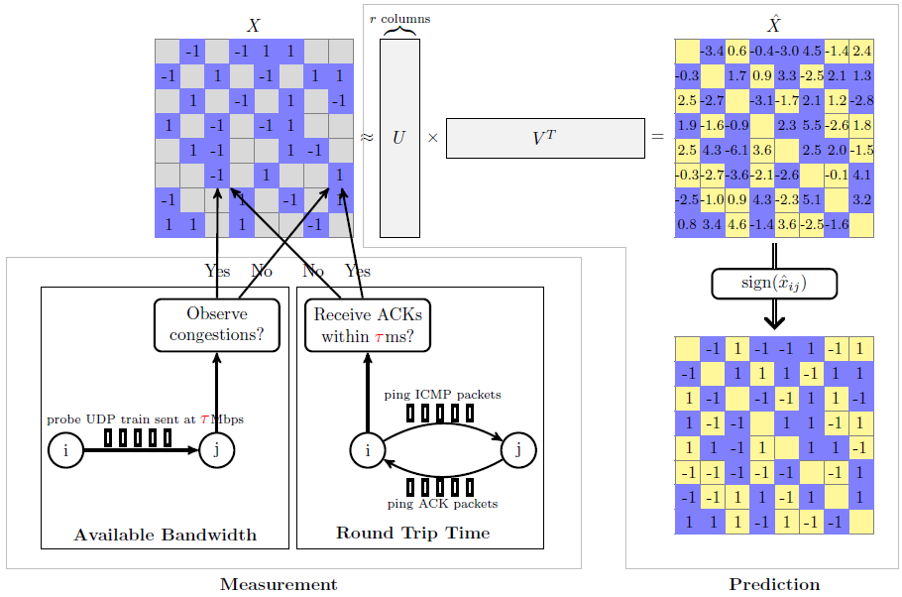
Network Inference with Random Sampling and Matrix Completion
The measurement module probes the performance classes of a small number of paths and forms a matrix
The prediction module estimates the missing entries by applying a matrix factorization technique
Decentralized Prediction of End-to-End Network Performance Classes, CoNext 2011
Spatial-Temporal Compressive Sensing TMC (Sigcomm 2009)

Slide 23
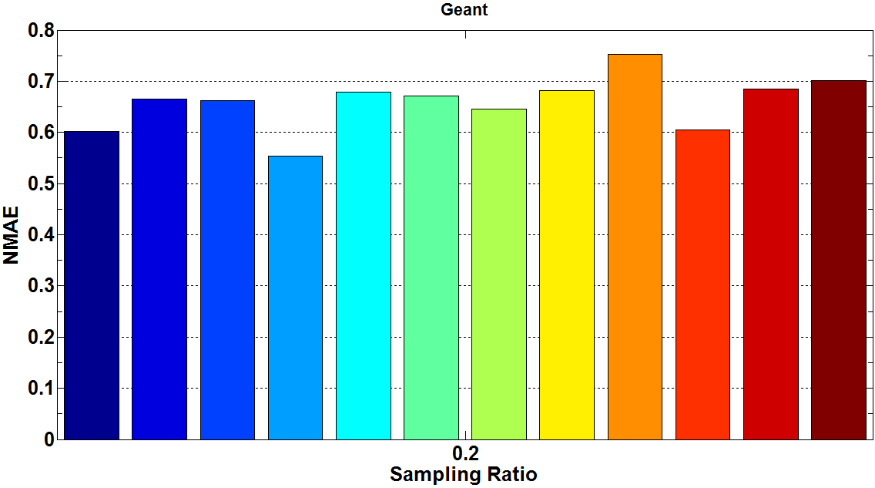
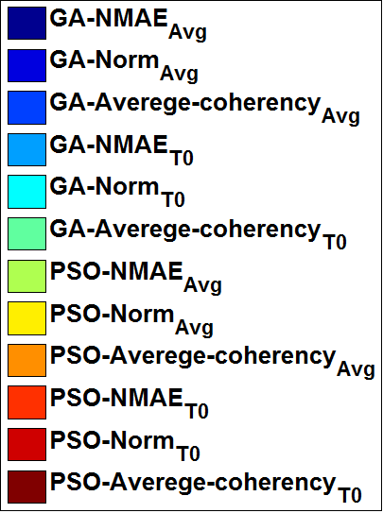
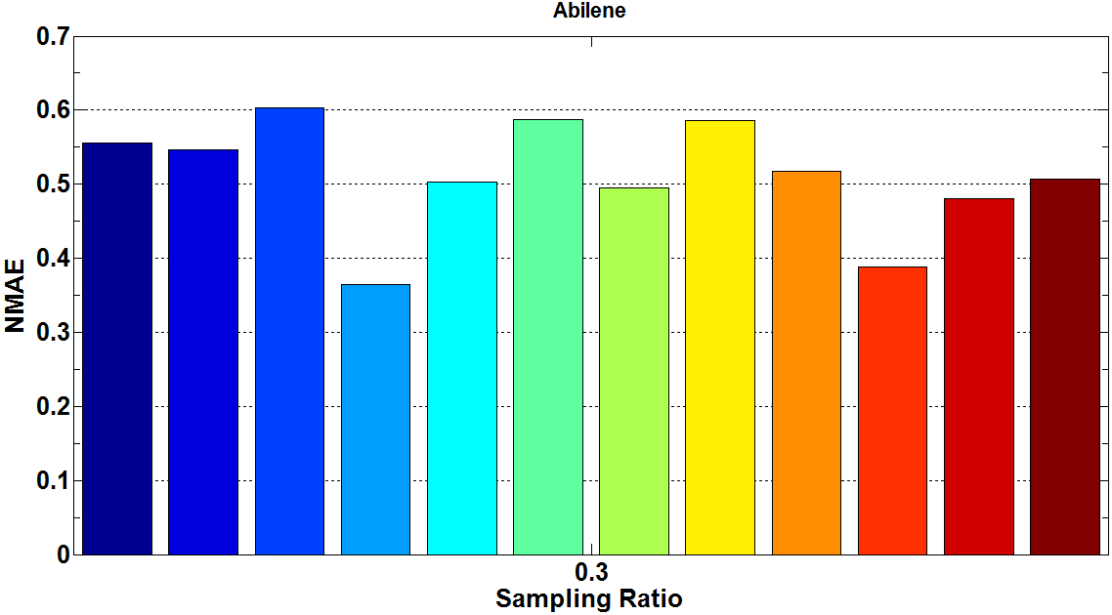
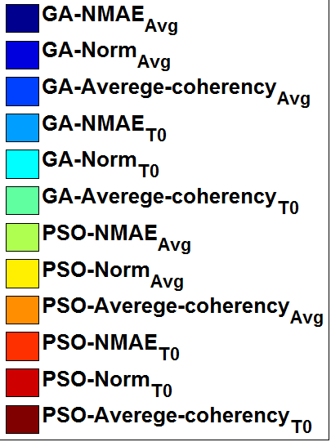
RS_{Avg}
problem

Slide 24
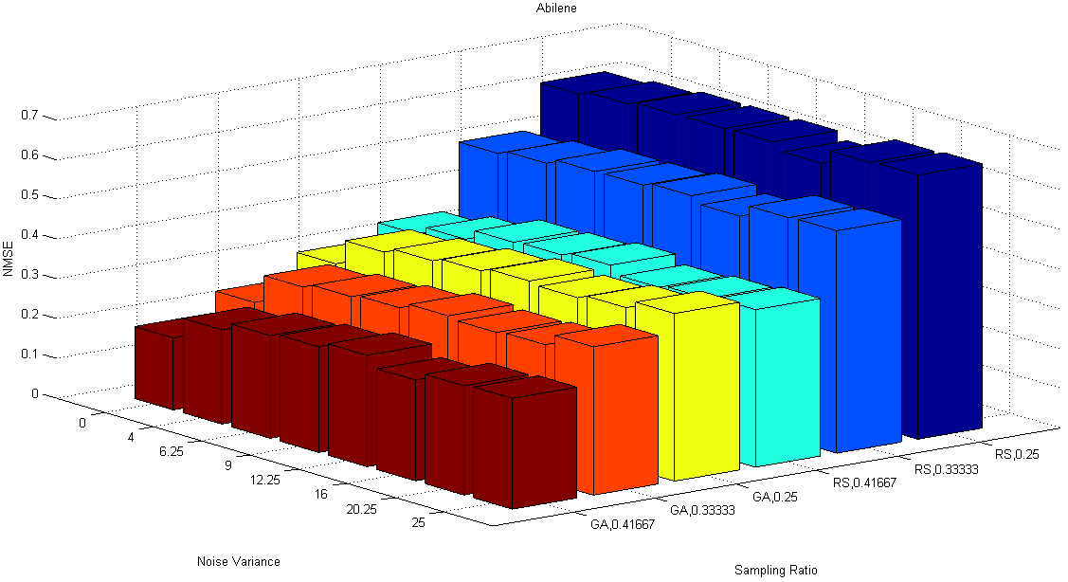
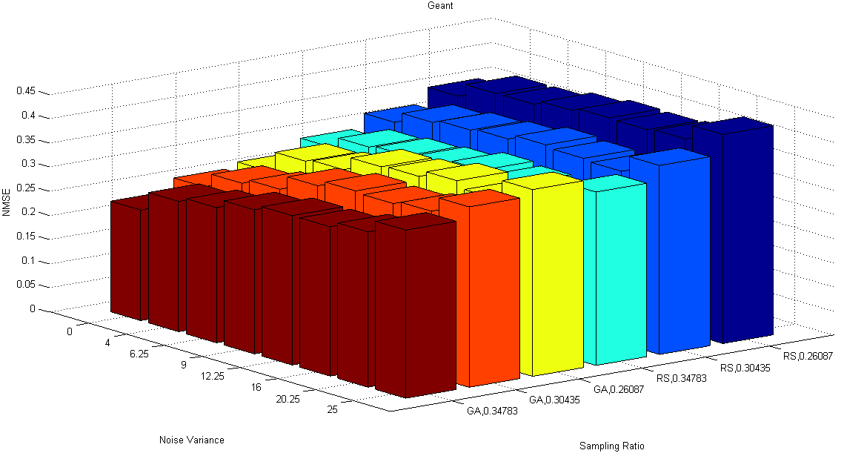
Average performance
By increasing the variance of noise NMSE is increased
By decreasing the sampling ratio NMSE is increased
GA is better than random sampling
3
1
2
3
1
2
3
1
2
3
1
2

