Slide 1


Windows & Linux Kernel
Contents:
What's kernel in operating systems?
Functions of a Kernel
User mode and Kernel mode
Types of Kernel
What is the Difference Between Windows Kernel and Linux Kernel

Slide 2
What is?
Operating System
Kernel

Slide 3
Memory
File system
Access
Kernel
Processes
Resource
Allocation
Devices

Slide 4
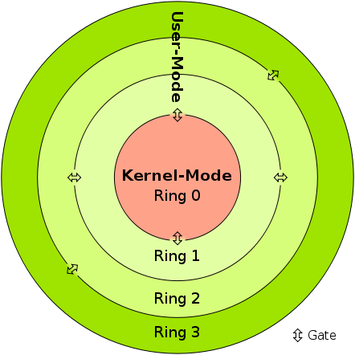
User mode and Kernel mode
User Mode
Kernel Mode
CPU
Memory
Devices

Slide 5
Micro
Kernel
Monolithic Kernel
Types
Hybrid Kernel
Nano Kernel
Exo
Kernel

Slide 6
1. Monolithic Kernels
Software
Kernel
Hardware

Slide 7
2. Micro kernel
Kernel
IPC
Servers
Software

Slide 8
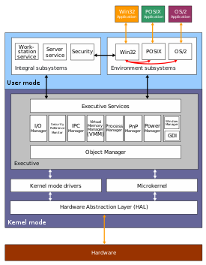
3. Hybrid Kernel

Slide 9
4. Nano kernel
Process
Virtual Memory Core
Object Invocation
Kernel

Slide 10
5. Exo Kernel
Hardware
Programs communicate with Libraries of Kernel
Programs can communicate with hardware much more directly
Kernel
Library
Library
Software

Slide 11

User traditional Unix permissions and POSIX ACL for file access control
An open source Unix- like computer operating system kernel
Support 100% multi-user environment
There is full access to source code
Maintains the configurations in file
Developed by Linux Torvalds
Has monolithic architecture
GUI stack in the user-space
Every device is a file
Developed by Microsoft
Has hybrid architecture
There is no access to source code
Include a GUI stack in the kernel
Users Access Control List (ACL) for file access control
VS
Maintains a registry to store configurations
Has different mechanisms for different devices
A commercial kernel of Windows operating system developed by Microsoft
Support multiple users and sessions but depends on the version and editions

Slide 12

Resources: afteracademy.com www.includehelp.com bytegate.io www.skillpipe.com knowitlikepro.com medium.com www.tutorialandexample.com www.en.wikipedia.org vivaldi.com pediaa.com www.errorpedia.ir www.nrwinvest.com www.pinterest.com www.youtube.com

