Slide 1



GATHERGRID Event management
Jakarta EE

Slide 2
Plan
Introduction
Configuration
Structure du projet
Uml
Liste des dépendances

Slide 3
Introduction
3

Slide 4

Java EE
Jakarta EE 10
Full profile

Slide 5
GlassGish - latest Java EE specifications - Robustness & extensibility - Clustering, security
Application server
TomeEE
- Lightweight & Embedded
- Small memory
- Fast startup

Slide 6
GlassGish 7.0.9
Application server

Slide 7
1. Jakarta platform 10 2. Glassfish 7.0.9 3. JPA 3.1.0 4. Hibernate Core 6.2.4 5. MySql Connector 8.0.33
Liste des dépendances

Slide 8
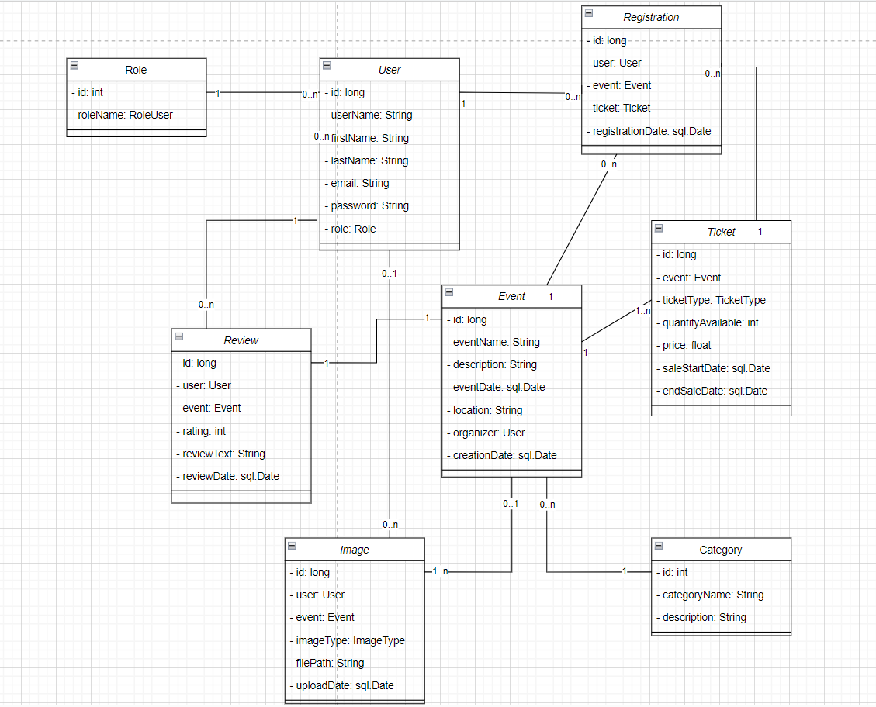
Diagramme de classes

Slide 9
Configuration de la base de donnés
1. Persistence.xml
2. hibernate.cfg.xml

Slide 10
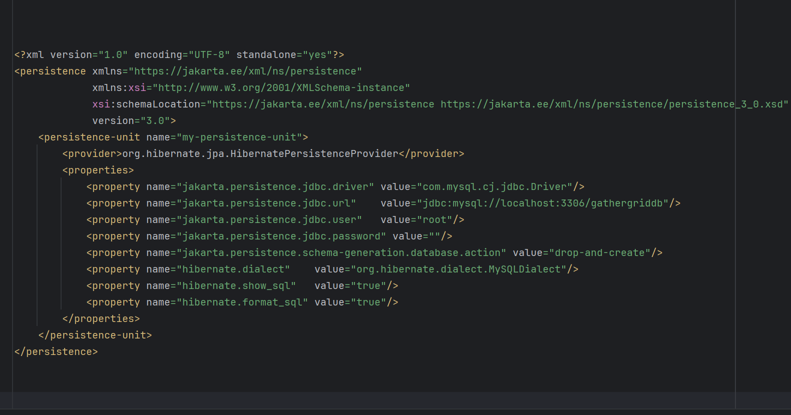
Configuration de la base de donnés
persistence.xml

Slide 11
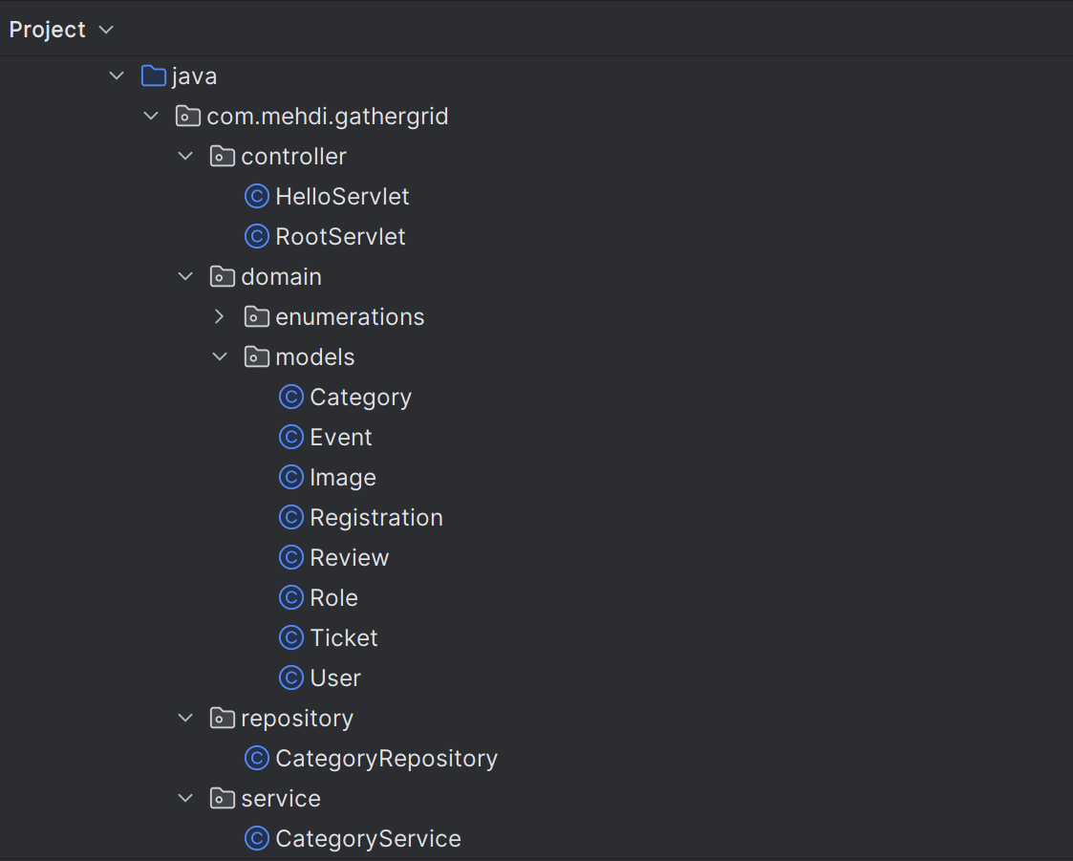
Structure du projet

Slide 12
Démonstration
12

