Slide 1
End-to-End ML Application Stack with MLflow, FastAPI and Streamlit
Mehdi Rezvandehy
Principal Data Scientist at ATB Financial

Slide 2
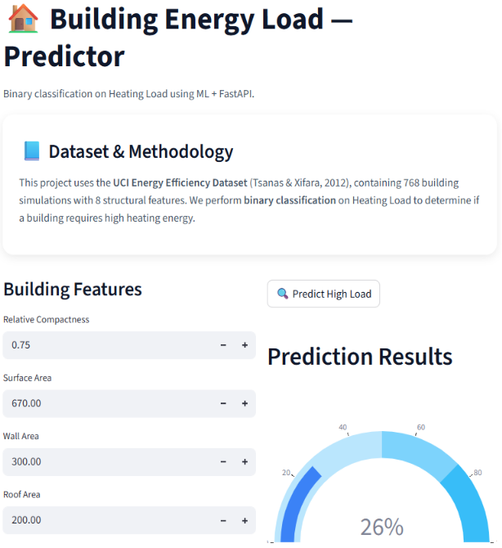
End-to-End ML System (Local to Enterprise)
Simulate a real-world, end-to-end machine learning application in a local development environment by automating deployment with Docker Compose and Kubernetes

Slide 3
Problem Statement
End-to-end ML systems require multiple components (training, API, UI, experiment tracking).
Environment inconsistencies make setups unreliable (“works on my machine”)
Workflows are fragmented, causing:
Poor reproducibility
Difficult collaboration
Slow transition to production
Managing multiple services manually is complex, time consuming and error-prone.
➡️ Gap: Need to run a complete end-to-end ML stack locally that reflects production.

Slide 4
Workflow Steps
Train and track models via MLflow UI (http://localhost:5555)
Serve models using FastAPI (http://localhost:8000/docs)
Visualize predictions in Streamlit (http://localhost:8501)
Streamlit ↔ FastAPI integration for real-time inference
Design locally with Docker Compose with set of containerized services → validate with Kubernetes → scale seamlessly to enterprise production
Align development with production architecture from day one, minimizing rework later

Slide 5
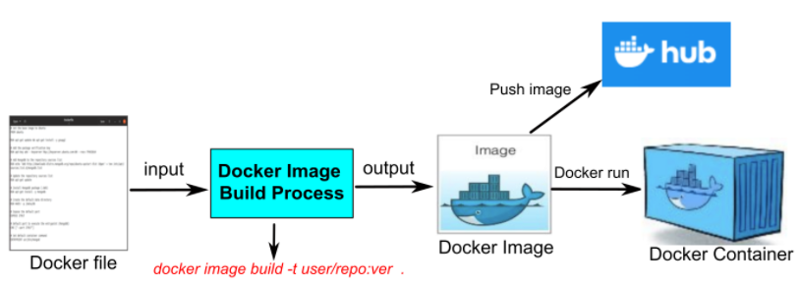
Docker Container
Docker → Lightweight containers package code + dependencies for consistent runs across dev, test, and production.
Reproducibility & Portability → “Build once, run anywhere” (local, cloud, or cluster).
Dependency Management → Locks exact versions; avoids environment issues.
Scalability & Efficiency → Works with orchestration (e.g., Kubernetes); lighter than VMs.

Slide 6
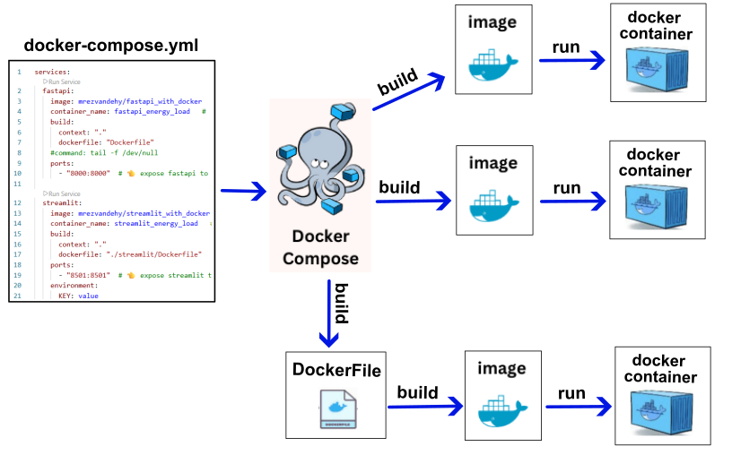
Docker Compose
Docker Compose → a tool for defining and running multiple applications together while Docker Container runs a single application.
Use a docker-compose.yml file to configure services, networks, and volumes, allowing several containers (for example, backend, frontend, and database) to run as one system.

Slide 7
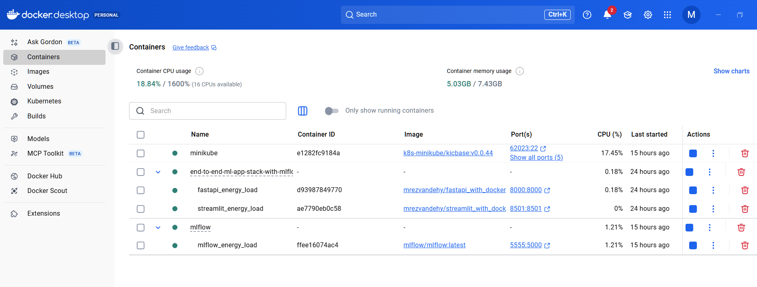
Docker Desktop
User-friendly platform to build, run, and manage containers locally, with optional Kubernetes support
Graphical interface for managing containers and images
Built-in Docker Engine for container execution
Streamlined tools for building, testing, and deploying applications (including ML models) consistently

Slide 8
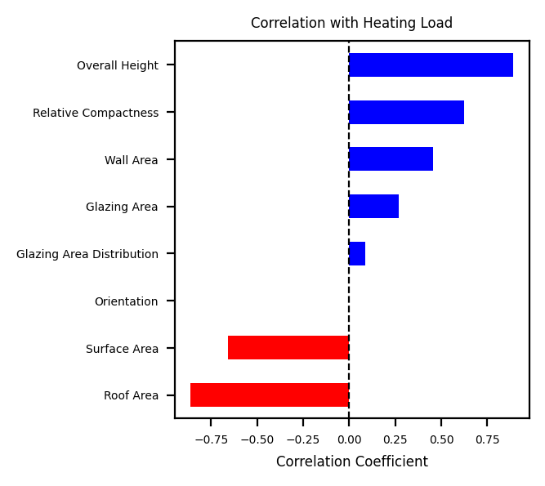
Model Development
Dataset → Energy Efficiency (UCI repository), 768 simulated building samples.
Features → 8 inputs (e.g., Wall Area, Height, Glazing, Orientation).
Target → Heating Load (building energy demand).
Approach → Binary classification on Heating Load.
Use Case → Predict building energy efficiency for better design decisions.
Source → Tsanas & Xifara (2012), Energy and Buildings

Slide 9
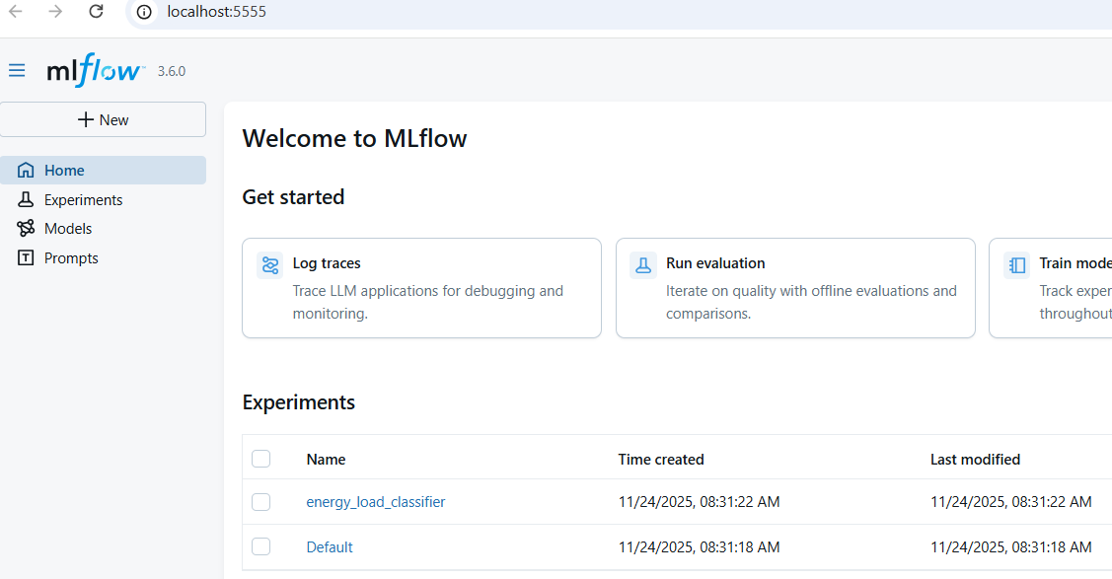
Packaged MLflow
MLflow: open-source platform for tracking, managing, and deploying ML experiments and models.
Logs metrics, hyperparameters, artifacts, and performance results during training.
Docker Compose ensures reproducible setup with consistent versions and dependencies.

Slide 10
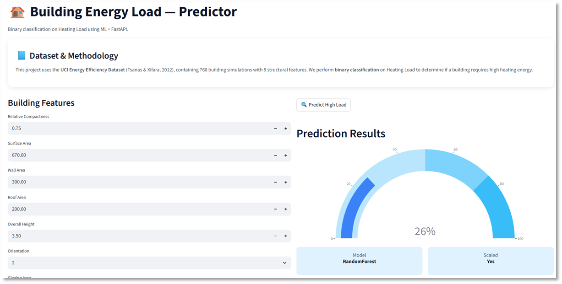
Packaged FastAPI and Streamlit
Streamlit: UI layer for input & visualization
FastAPI: Backend for model inference
Flow: Streamlit → FastAPI → prediction → Streamlit
FastAPI: Scalable API for multi-user inference
Docker Compose: Builds both services with port mapping for communication

Slide 11
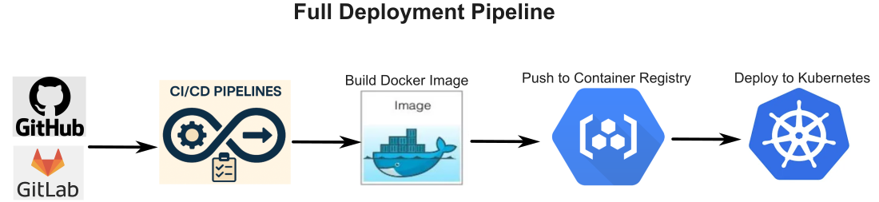
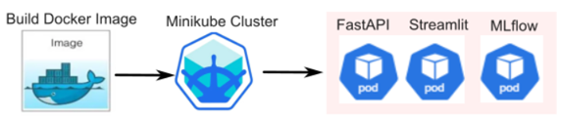
From Docker Compose to Production (Kubernetes)
Docker Compose is ideal for local development but not for large-scale systems
Production requires orchestration to manage many containers efficiently (e.g., scaling containers, load balancing, restarting failed containers, service discovery …)
Kubernetes is the industry standard for scalable, flexible container orchestration
To simulate a production-like environment, Kubernetes can be run locally using lightweight tools: Minikube is a tool that creates and runs a Kubernetes cluster locally

Slide 12
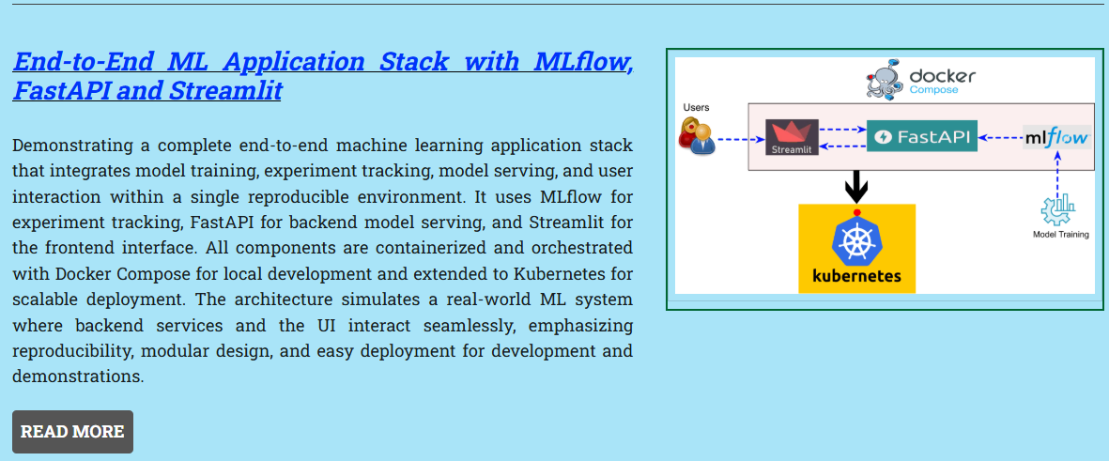
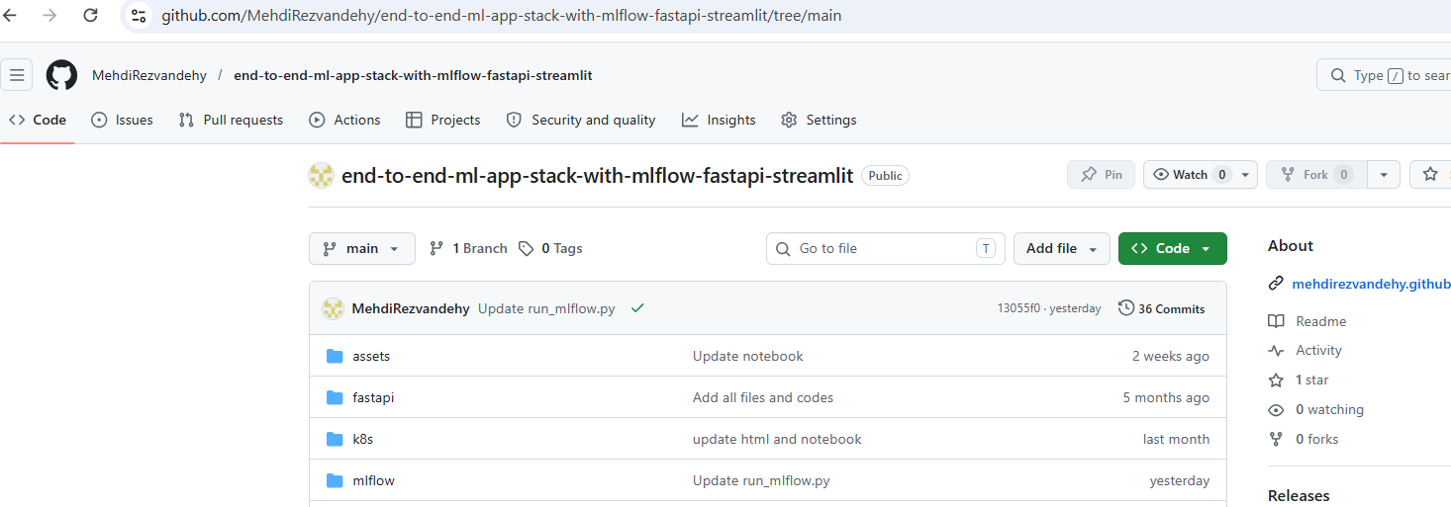
Full Implementation Details
Visit https://mehdirezvandehy.github.io/index.html for complete explanations covering the end-to-end ML workflow, Docker, and MLflow setup.
GitHub repo: end-to-end-ml-app-stack-with-mlflow-fastapi-streamlit to run the ML pipeline

Slide 13
Demo Time

Slide 14
Appendix

Slide 15
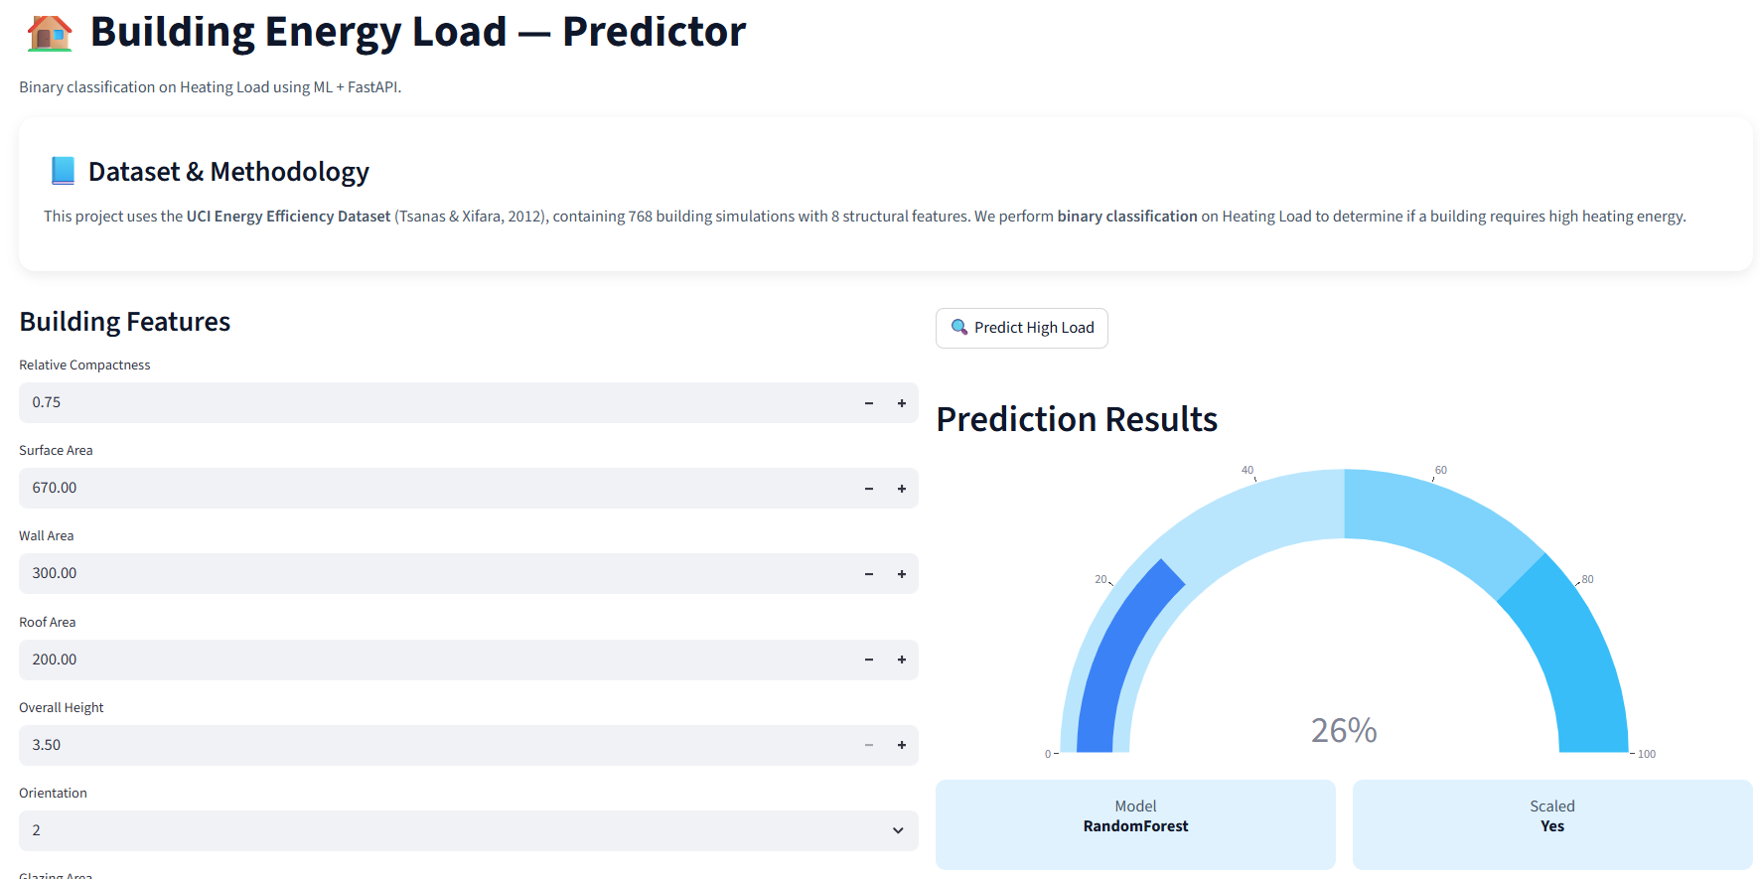
Streamlit (frontend )
Python framework for building ML web UIs that quickly creates interactive dashboards
Runs scripts on every user interaction; best suited for prototyping and demos

Slide 16
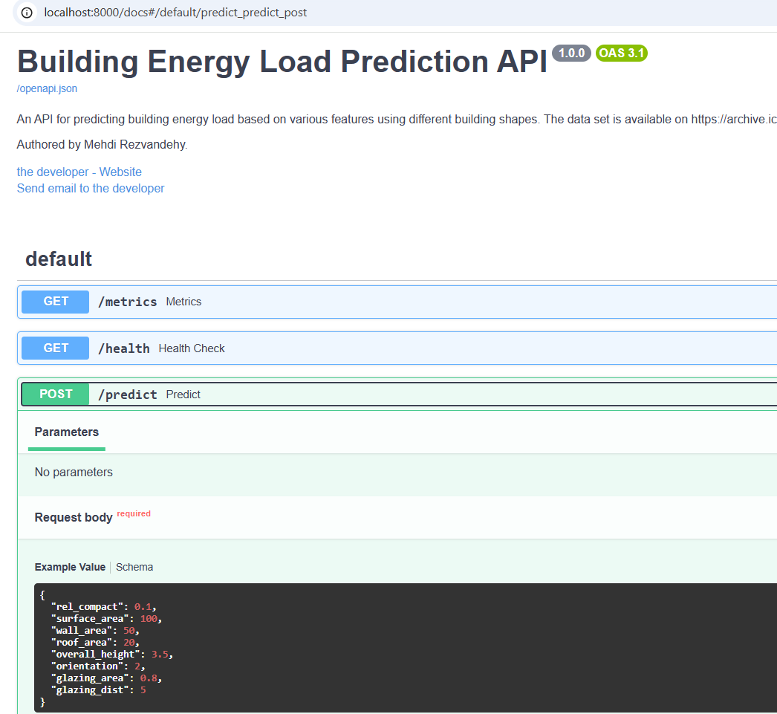
FastAPI (backend)
High-performance Python framework for building APIs and ML inference services
Ideal for production ML systems: scalable, secure, and easy to deploy as microservices

Slide 17
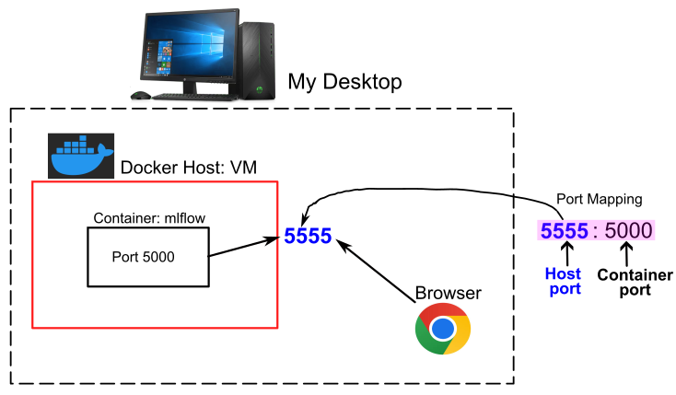
Packaged MLflow
Containerize using Docker Compose to ensure consistent team collaboration by standardizing MLflow version, dependencies, and environment.
Need to expose the container’s internal port by mapping it to a host port, since it isn’t directly accessible from the desktop browser.
After port mapping, MLflow runs on http://localhost:5555/

Slide 18
Docker Container
Docker → Lightweight containers package code + dependencies for consistent runs across dev, test, and production.
Reproducibility & Portability → “Build once, run anywhere” (local, cloud, or cluster).
Dependency Management → Locks exact versions; avoids environment issues.
Scalability & Efficiency → Works with orchestration (e.g., Kubernetes); lighter than VMs.
Docker Desktop → GUI tool to build, run, and manage containers locally with optional Kubernetes support.

