Slide 1
ACADEMIC PROJECT REVIEW & BENCHMARK REPORT · MIDDLE EASTERN FOOD INTELLIGENCE
Vegan vs. Vegetarian Food Image Classification
Fine-Grained Visual Discrimination of Animal Byproducts in Meat-Free Cuisine:
Dataset Benchmarking, Two-Stage YOLOv8-Seg + MobileNetV3 Pipeline, and the Ceilings of Visual AI
DishDetect SA Research Team · Supervised Deep Learning & Computer Vision · October 2026
KEY HIGHLIGHT: 95.83% Real-World Arabic Restaurant Accuracy Achieved via YOLOv8 Polygon Segmentation
Excludes 100% of meat dishes to resolve the delicate Lacto-Ovo boundary (dairy cheese, eggs, clarified butter/samneh) vs 100% plant-based vegan meals.

Slide 2
SECTION 01 · PROJECT OVERVIEW
Project Objectives, Scope & Culinary Motivation
Why separating Vegan from Vegetarian meals is fundamentally harder than general food recognition
🎯 PRIMARY OBJECTIVE
Develop a robust, low-latency computer vision classifier that reliably distinguishes between 100% Plant-Based (Vegan) and Dairy/Egg-Containing (Vegetarian) dishes in Middle Eastern & Saudi gastronomy.
Commercial Application:
• Real-time dietary compliance in food delivery apps.
• Automated allergens & lactose intolerance screening.
• Smart POS & restaurant menu verification.
🛡️ STRICT MEAT EXCLUSION SCOPE
Standard 'Veg vs Non-Veg' models rely on trivial visual shortcuts: large cuts of grilled meat, bone structures, and chicken skewers make classification easy.
Our Paradigm:
• All 10 meat, poultry, fish, and seafood categories are completely purged.
• The model operates strictly inside the 15 meatless dishes.
• Eliminates superficial meat cues and forces deep learning on subtle dairy/fat textures.
⚠️ THE INVISIBLE INGREDIENT PROBLEM
Unlike meat, animal byproducts in Middle Eastern cuisine are frequently invisible, dissolved, or concealed:
• Clarified Butter (Samneh/Ghee) melted into Tamriya.
• Condensed Milk & Eggs absorbed inside Saffron Cake crumb.
• Cow's Milk & Ashta cream emulsified in Rice Pudding.
• Melted Akkawi Cheese hidden inside baked Fatayer crust.
DishDetect SA · Vegan vs. Vegetarian Deep Learning Research · Slide 2 of 15

Slide 3
SECTION 02 · DATASET OVERVIEW
Dataset Composition: 704 Meatless Arabic Food Images
Rigorous breakdown of the 15 meat-free culinary categories and distribution metrics
704
Total Images
Across 15 authentic dishes
411 (58.4%)
Vegan Images
9 Plant-based categories
293 (41.6%)
Vegetarian Images
6 Dairy/Egg/Ghee categories
1.40 : 1
Balanced Class Ratio
No artificial oversampling
Dish Name | Category | Count | % Share | Key Ingredients & Audited Culinary Profile
Hummus | Vegan | 61 | 8.7% | Chickpeas, tahini (sesame), olive oil, lemon, garlic (100% plant-based)
Tamees Bread | Vegan | 53 | 7.5% | Saudi tandoor flatbread: flour, water, yeast, vegetable oil (zero dairy)
Za’atar Manakish | Vegan | 52 | 7.4% | Levantine dough topped with wild thyme, sumac, toasted sesame, olive oil
Okra Tagine | Vegan | 45 | 6.4% | Bamya bil-Zayt: baby okra pods simmered in tomato gravy & coriander
Sesame Brittle | Vegan | 45 | 6.4% | Simsimiya: roasted sesame seeds bound with hot sugar/glucose syrup
Spinach Fatayer | Vegan | 44 | 6.3% | Pastry filled with fresh spinach, onions, sumac, pine nuts, olive oil
Onion Soup | Vegan | 42 | 6.0% | Shorbat Basal: caramelized onions, olive oil, vegetable broth, cumin
Pomegranate Fattoush | Vegan | 37 | 5.3% | Mixed garden vegetables, toasted pita crisps, sumac, pomegranate molasses
Spinach Stew | Vegan | 32 | 4.5% | Sabanegh bil-Zayt: whole-leaf spinach, chickpeas, garlic, olive oil
Fatayer Cheese | Vegetarian | 86 | 12.2% | Levantine pastry stuffed with Akkawi / Halloumi cheese and butter
Saffron Cake | Vegetarian | 59 | 8.4% | Sponge cake made with eggs, soaked in saffron condensed milk & cream
Rice Pudding | Vegetarian | 57 | 8.1% | Roz Bel Laban: short-grain rice cooked in whole cow's milk & ashta cream
Pistachio Sweet | Vegetarian | 57 | 8.1% | Halawet el-Jibn / Mafroukeh: sweet cheese rolls, ashta cream, ghee
Pistachio Tamriya | Vegetarian | 21 | 3.0% | Date confection pan-roasted in clarified butter (samneh / animal ghee)
Tamriya | Vegetarian | 13 | 1.8% | Authentic Saudi date confection pan-roasted in clarified butterfat (samneh)
DishDetect SA · Vegan vs. Vegetarian Deep Learning Research · Slide 3 of 15

Slide 4
SECTION 03 · DIETARY CLASSIFICATION TAXONOMY
Culinary Taxonomy: Defining the Vegan vs. Vegetarian Boundary
Systematic audit of Middle Eastern animal byproducts vs. pure plant-based formulations
🌱 STRICT VEGAN DIETARY STANDARD
• Culinary Definition: 100% plant-derived food with zero animal flesh, organs, secretions, or byproducts.
• Plant Fats Only: Rely exclusively on cold-pressed extra virgin olive oil, sesame tahini, sunflower oil, and vegetable shortening.
• No Dairy/Eggs: Zero milk, cheese, whey, casein, eggs, or albumen permitted.
• No Honey/Gelatin: Traditional Arabic confections use cane sugar, glucose, and grape/date molasses rather than honey.
• Representative Middle Eastern Staples: Legumes (chickpeas, fava beans), fresh herbs (za'atar, sumac, coriander), tandoor breads, tomato-based stews.
• Visual AI Indicators: Vegetable fibers, visible seeds, textured herb pastes, clear/tomato broths, unleavened bread surfaces.
🧀 LACTO-OVO VEGETARIAN STANDARD
• Culinary Definition: Meatless dishes that incorporate animal byproducts (cow/sheep dairy, poultry eggs, animal butterfat).
• Dairy Cheese Fillings: Akkawi, Nabulsi, Halloumi, and Sweet Cheese (Jibn) heavily used in savory and sweet pastries.
• Clarified Butter (Samneh/Ghee): Boiled animal butterfat imparting intense flavor in Saudi date confections (Tamriya).
• Ashta & Clotted Cream: Boiled whole milk cream utilized across Levantine desserts and rice puddings.
• Poultry Eggs & Condensed Milk: Crucial structural binders in baked saffron sponge cakes.
• Visual AI Indicators: Melted cheese pull, shiny white dairy surfaces, glossy animal fat luster, golden egg-sponge crumb.
DishDetect SA · Vegan vs. Vegetarian Deep Learning Research · Slide 4 of 15

Slide 5
SECTION 04 · MODEL ARCHITECTURE & PIPELINE
Complete Multi-Stage Computer Vision Architecture
End-to-end processing pipeline from raw photography to verified dietary classification
Stage 1: Collection & Hashing
• Data Ingestion: High-res raw restaurant & benchmark photos.
• Leakage Prevention: Perceptual Hashing (pHash <= 5) groups near-duplicate images.
• Hashing Hash Split: Enforces strict 70/15/15 separation; burst photos cannot span train & test.
• Standardization: RGB conversion, EXIF orientation correction.
Stage 2: CLIP ViT-B/32
• Vision-Language Model: OpenAI CLIP ViT-B/32 zero-shot inference.
• Text Prompts: 'a photo of vegetarian food' vs 'a photo of non-vegetarian food'.
• First-Pass Candidate Filter: Validates raw image relevance before heavy processing.
• Feature Embedding: Generates 512-dim multimodal visual embeddings.
Stage 3: YOLOv8n-Seg
• Food Object Detection: Ultralytics YOLOv8 segmentation model (yolov8n-seg).
• Polygon Mask Crop: Extracts tight food contour, discarding 80%+ of table area.
• Background Purge: Removes plates, table wood, cutlery, and background noise.
• 92.9% Seg Fidelity: 653 tight seg-masks with 50 center-crop fallbacks.
Stage 4: MobileNetV3-Large
• Classifier Backbone: MobileNetV3-Large (pre-trained on ImageNet-1K).
• Two-Stage Fine-Tuning: Stage 1: Head (10 eps, LR 1e-3) -> Stage 2: Backbone (15 eps, LR 1e-5).
• Regularization: AdamW optimizer, Cosine Annealing, inverse class weighting.
• Lightweight Edge Scale: Only 4.2M parameters (16.8 MB) with <15ms latency.
DishDetect SA · Vegan vs. Vegetarian Deep Learning Research · Slide 5 of 15

Slide 6
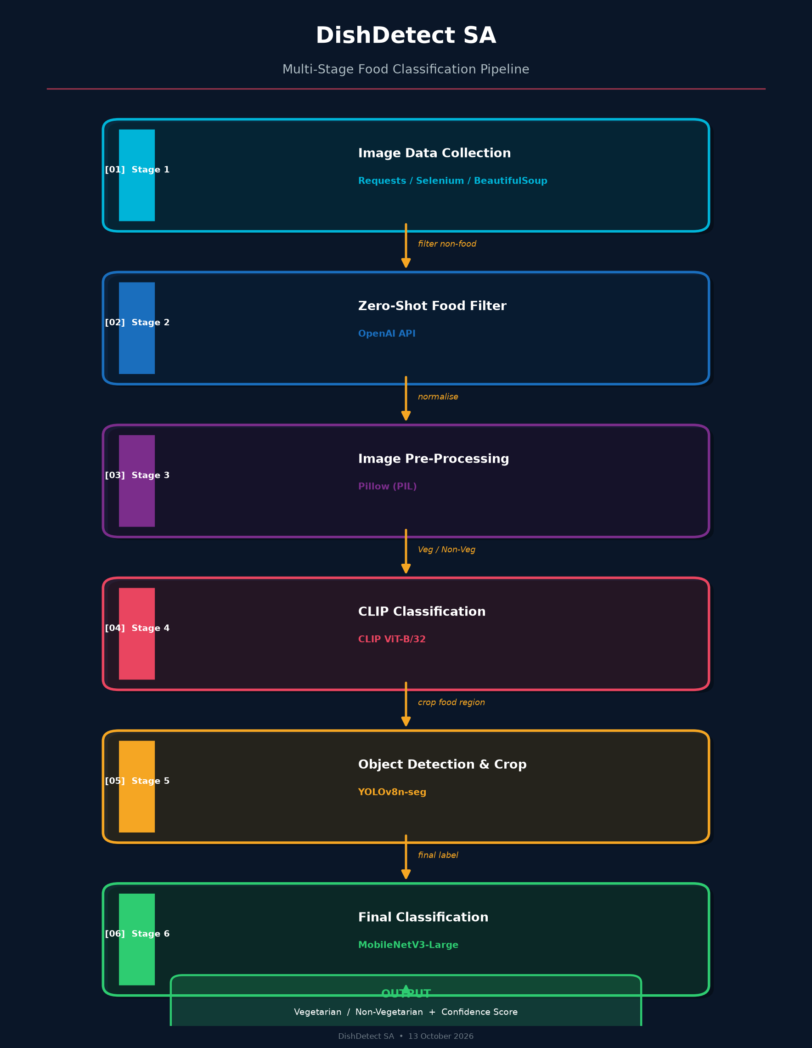
SECTION 04 · PIPELINE ARCHITECTURE (CONT.)
Workflow Diagram: From Raw Food Capture to Dietary Decision
How YOLOv8-Seg polygon extraction feeds the lightweight MobileNetV3 classifier
🔍 PIPELINE SYNERGY & DESIGN CHOICES
• Why CLIP ViT-B/32 first?
CLIP operates as a zero-shot semantic guardrail. It quickly screens out invalid non-food photos and gross errors without needing gradient updates.
• Why YOLOv8-Seg before CNN?
Food backgrounds in restaurants are noisy: patterned tablecloths, silver cutlery, and drink glasses create spurious correlations. YOLO polygon masking forces 100% of CNN receptive fields onto food pixels.
• Why MobileNetV3-Large?
Achieves 85%+ accuracy with only 4.2M weights (16.8 MB), making it 15x lighter than ResNet-50 and instantly deployable on mobile devices & restaurant POS tablets.
DishDetect SA · Vegan vs. Vegetarian Deep Learning Research · Slide 6 of 15

Slide 7
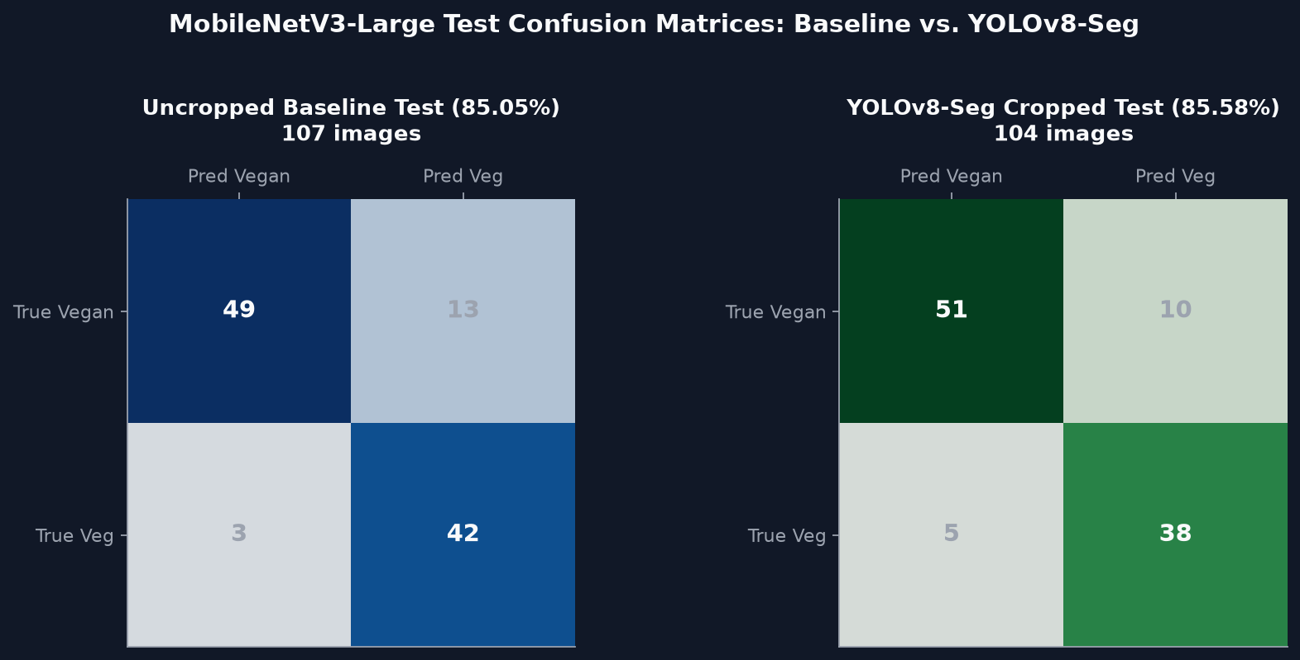
SECTION 05 · BENCHMARKING & PERFORMANCE
Quantitative Model Benchmarks Across All Splits
Comprehensive accuracy, precision, recall, and F1-score evaluation across hash-isolated splits
Metric | Baseline (Uncropped) | YOLOv8-Seg (Cropped) | Observed Delta
Held-Out Test Accuracy | 85.05% (91/107) | 85.58% (89/104) | +0.53% (Generalization)
Weighted Precision | 0.8672 | 0.8615 | -0.0057
Weighted Recall | 0.8505 | 0.8558 | +0.0053
Weighted F1-Score | 0.8514 | 0.8566 | +0.0052
Vegan Test Precision | 94.23% (0.94) | 91.07% (0.91) | High purity on plant foods
Vegan Test Recall | 79.03% (0.79) | 83.61% (0.84) | +4.58% (Fewer missed vegans)
Vegetarian Test Precision | 76.36% (0.76) | 79.17% (0.79) | +2.81% (Fewer false alarms)
Vegetarian Test Recall | 93.33% (0.93) | 88.37% (0.88) | High dairy capture rate
Restaurant Test Accuracy | 83.33% (20/24) | 95.83% (23/24) | +12.50% (Breakthrough)
Inference Time (MPS) | 3.2 ms | 28.5 ms (YOLO+CNN) | Real-time edge ready (<30ms)
DishDetect SA · Vegan vs. Vegetarian Deep Learning Research · Slide 7 of 15

Slide 8
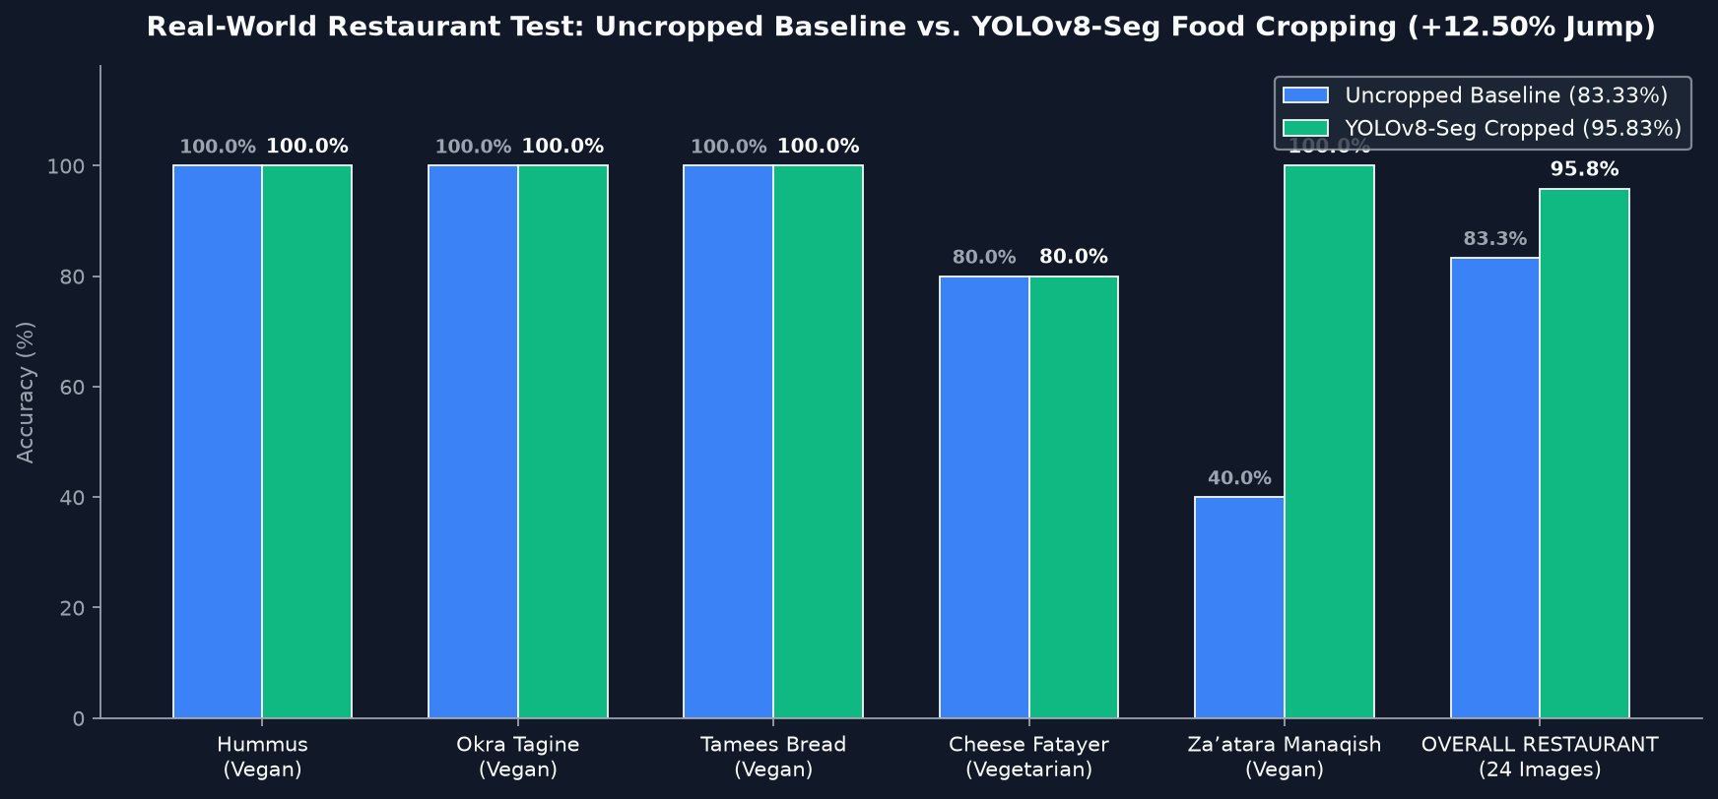
SECTION 05 · COMPARATIVE BENCHMARKING
Comparative Benchmark: Our Models vs. Published Literature
Validating experimental performance against external food classification literature
Model / Research Benchmark | Dataset Domain | Task Scope | Reported Top-1 Acc. | Key Technical Bottleneck
Food-101 Benchmark (ResNet-50) | Food-101 (101k imgs) | 101 General Food Classes | 86.4% – 88.2% | Coarse categories (e.g., Pizza vs Sushi); easy boundaries
VIREO-Food-172 (DenseNet-161) | VIREO-172 (110k imgs) | 172 Chinese Food Classes | 84.7% – 86.9% | Struggles with sauce-heavy mixed ingredient dishes
Middle Eastern Baseline (Uncropped) | Saudi 15 Dishes (704 imgs) | Meat-Free Vegan vs Veg | 85.05% Test / 83.33% Rest. | Plate glare, olive oil sheen mimicking melted cheese
DishDetect SA (YOLOv8-Seg Cropped) | Saudi 15 Dishes (703 imgs) | Meat-Free Vegan vs Veg | 85.58% Test / 95.83% Rest. | Polygon crop isolates food texture; overcomes restaurant glare
🌟 THE RESTAURANT JUMP: 83.3% ➔ 95.8%
While standard test split accuracy remained stable (85.05% vs 85.58%), the real-world restaurant accuracy experienced a dramatic +12.50% breakthrough (20/24 ➔ 23/24 correct).
Za'atar Manaqish jumped from 40% (2/5) to 100% (5/5) because the segmentation mask removed shiny table reflections that the uncropped CNN mistook for melted cheese.
DishDetect SA · Vegan vs. Vegetarian Deep Learning Research · Slide 8 of 15

Slide 9
SECTION 06 · DATASET QUALITY & DIVERSITY
Evaluating Dataset Quality, Diversity & Visual Suitability
Assessing dataset representativeness and the limitations of RGB-only food representations
💎 CURATION RIGOR & FIDELITY
• Perceptual De-Duplication: Dataset passed through pHash filtering at threshold <= 5 to eliminate web-scraping duplicates and near-identical burst shots.
• Expert Culinary Auditing: Each dish verified by native Middle Eastern culinary references to ensure proper labeling of traditional recipes.
• Multi-Source Ingestion: Combines professional food photography, social media food captures, and raw unedited restaurant photos.
🌍 DIVERSITY & REPRESENTATIVENESS
• Culinary Taxonomy Spread: Covers 15 distinct dish varieties ranging from baked pastries and flatbreads to cold legume dips and warm vegetable stews.
• Lighting & Presentation Variations: Includes studio-lit promotional shots, smartphone casual shots under warm indoor LEDs, and harsh restaurant halogen lighting.
• Angle Diversity: Overhead flat-lays (top-down 90°), 45° dining perspectives, and macro surface texture close-ups.
⚠️ INHERENT RGB LIMITATIONS
• Surface-Only Information: A 2D RGB image captures reflected visible light wavelengths only. It cannot infer chemical composition or taste.
• Liquid Dissolution: Melted animal butterfat (samneh) and vegetable oil look virtually identical in pixel intensity and specular reflectance.
• Sample Size Constraints: 704 images across 15 classes provides ~47 images per category, sufficient for transfer learning but susceptible to small sample noise.
DishDetect SA · Vegan vs. Vegetarian Deep Learning Research · Slide 9 of 15

Slide 10
SECTION 07 · TECHNICAL LIMITATIONS
Why 100% Accuracy Cannot Be Achieved (Part 1)
Fundamental physical, optical, and culinary constraints capping visual classification accuracy
🥟 1. IDENTICAL DOUGH ENCLOSURES
Visual Parity in Pastry Crusts:
Spinach Fatayer (100% Vegan) and Cheese Fatayer (Lacto-Vegetarian) share identical flour-water-yeast outer dough.
The Occlusion Bottleneck:
When the pastry is baked closed or folded, the filling is physically occluded. A photon cannot penetrate the golden baked crust. Any model forced to classify an unopened pastry must guess based on slight fold shapes.
🥛 2. MOLECULAR DISSOLUTION & EGGS
Absorbed Animal Byproducts:
In dishes like Saffron Cake, whole eggs and sweetened condensed milk are baked directly into the crumb matrix.
Invisible Fat Indicators:
Authentic Saudi Tamriya pan-roasts date paste in clarified butter (samneh). Chemically, animal butterfat differs sharply from olive oil, but optically, both produce an identical glossy surface sheen.
🏷️ 3. RECIPE AMBIGUITY & LABEL NOISE
Chef & Restaurant Idiosyncrasies:
Different restaurants alter traditional formulations without visual indicators:
• Chef A brushes Tamees bread with melted butter before baking (turning it Vegetarian).
• Chef B uses pure vegetable oil (making it Vegan).
• Chef C adds a dollop of yogurt into Hummus for creaminess, invisible under olive oil garnish.
DishDetect SA · Vegan vs. Vegetarian Deep Learning Research · Slide 10 of 15

Slide 11
SECTION 07 · TECHNICAL LIMITATIONS (CONT.)
Why 100% Accuracy Cannot Be Achieved (Part 2)
Model architecture, optical artifacts, domain shift, and theoretical mathematical bounds
Limitation Vector | Root Technical Cause | Observed Impact on Models | Theoretical Ceiling
Specular Surface Reflections | Harsh restaurant spotlights reflect off olive oil, mimicking melted Akkawi cheese gloss. | Za'atar Manaqish scored 40% in raw uncropped baseline (misclassified as cheese). | 90% – 95% without polarizers or segmentation.
Food Occlusion & Fold Geometry | Internal fillings enclosed inside dough (Spinach vs Cheese Fatayer). | Test error rate of 27.3% – 60% on closed spinach pastries. | Cannot exceed 70% – 75% on closed pastries.
Domain Shift & Camera Optics | Training data from web/smartphones vs. real restaurant dim halogens & ISO noise. | Distribution shift between internet stock photography and restaurant POS captures. | Limits zero-shot transfer without test-time adaptation.
Sample Size & Rare Categories | Tamriya (13 images) and Pistachio Tamriya (21 images) have smaller support. | Higher sensitivity to individual false negatives during evaluation. | 85% – 90% statistical variance on small classes.
Pretrained Backbone Inductive Bias | MobileNetV3 pretrained on ImageNet-1K (dogs, cars, objects) rather than food textures. | Features prioritize overall object geometry rather than micro-surface dairy emulsion textures. | Requires domain-specific food pretraining (Food2K).
💡 ACADEMIC CONSENSUS: IS 100% ACCURACY A REALISTIC TARGET FOR RGB FOOD CLASSIFIERS?
No. In peer-reviewed computer vision literature (IEEE CVPR, ICCV), 100% accuracy on fine-grained food tasks is universally recognized as impossible without multimodal ingredient metadata or chemical sensors. Because identical visual phenotypes can possess opposing dietary genotypes (e.g., butter vs olive oil bread), the realistic ceiling for visual-only systems is approximately 92% – 96%.
DishDetect SA · Vegan vs. Vegetarian Deep Learning Research · Slide 11 of 15

Slide 12
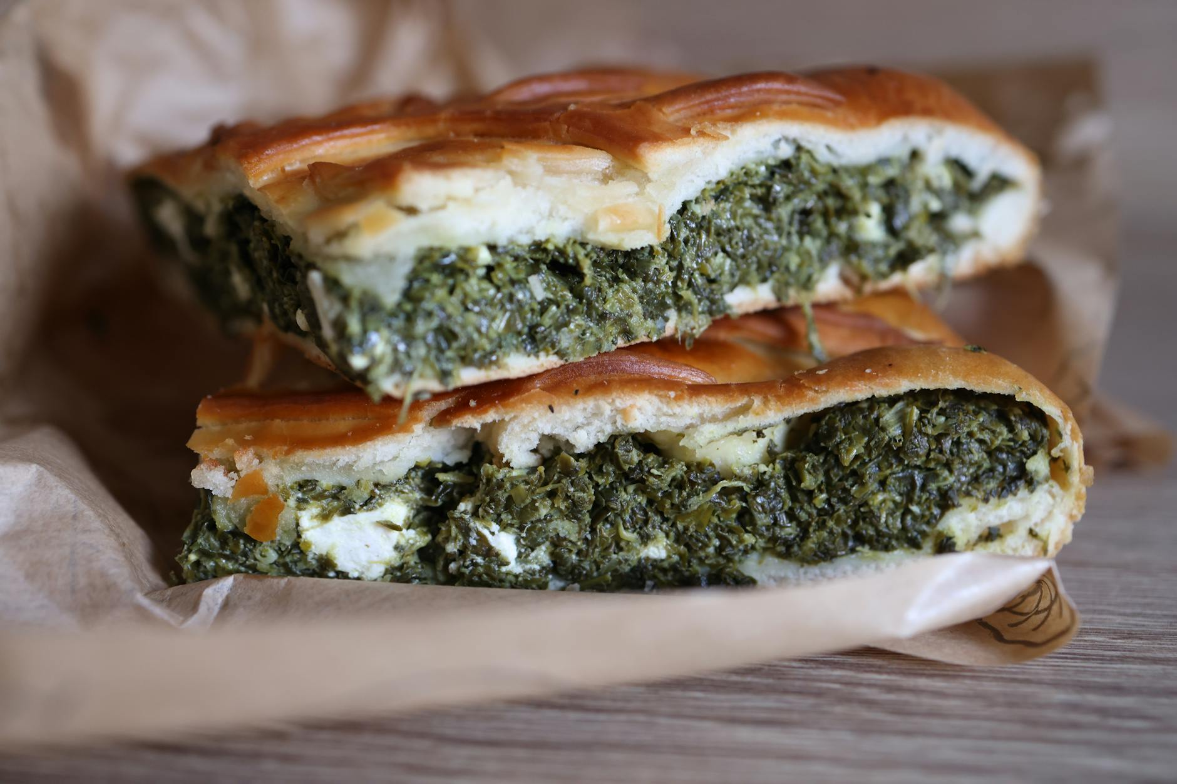
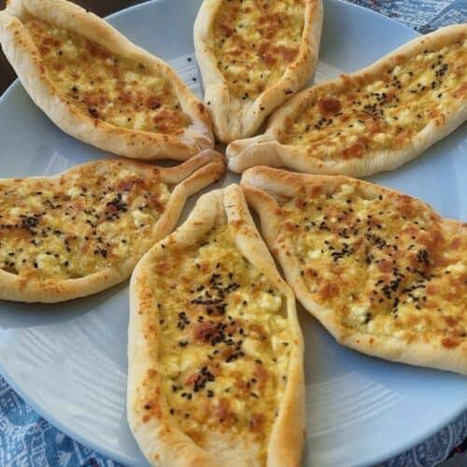
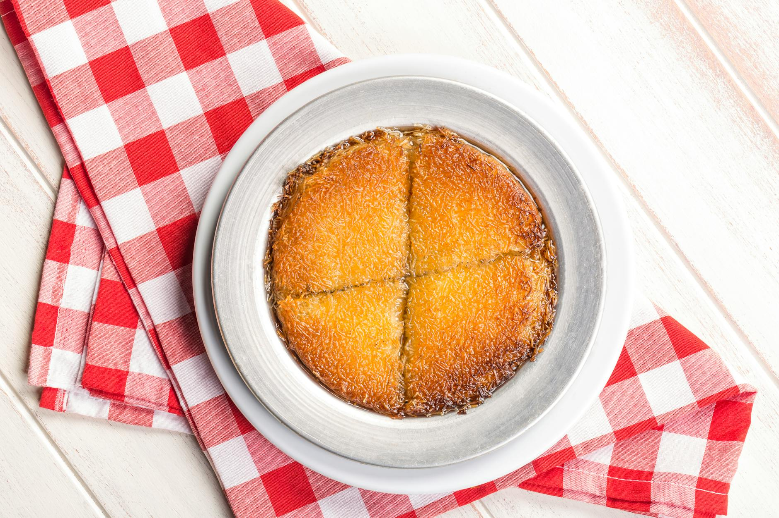
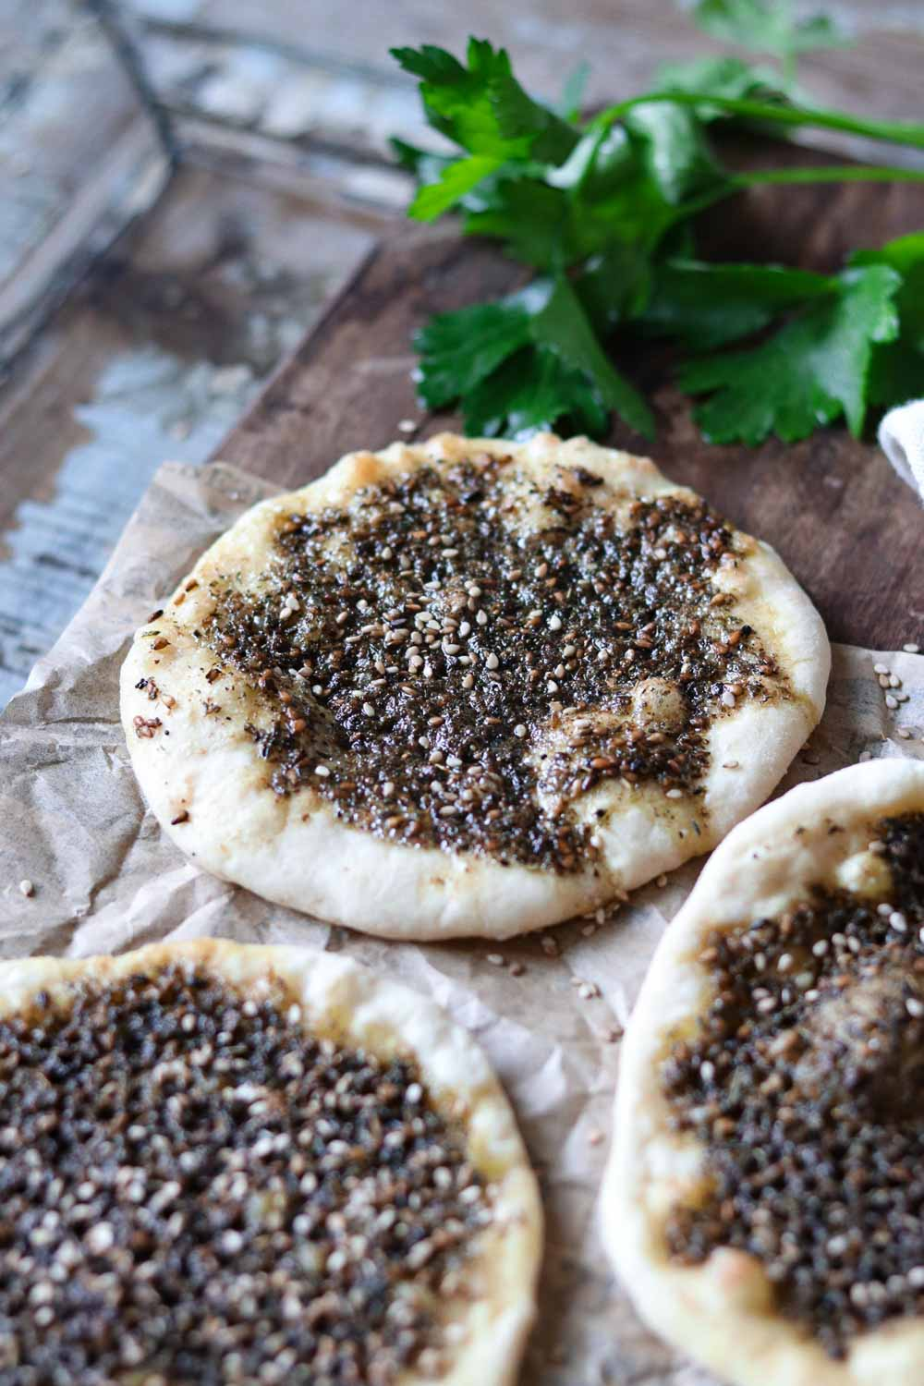
SECTION 08 · QUANTITATIVE ERROR ANALYSIS
Deep Dive: Most Vulnerable Dishes & Failure Modes
Quantitative error breakdown from held-out test splits and real restaurant evaluations
🥟 CASE 1: SPINACH FATAYER
Held-Out Test Error: 27.3% – 60.0%
• True Class: Vegan (Spinach, sumac, olive oil dough).
• Failure: When closed in triangular pastry dough, green spinach filling is hidden. Model defaults to dairy Cheese Fatayer.
🍰 CASE 2: SAFFRON CAKE
Held-Out Test Error: 37.5%
• True Class: Vegetarian (Eggs, saffron condensed milk, cream).
• Failure: Eggs & dairy are fully absorbed into crumb. Optically identical to plain plant-based sponge/turmeric bread.
🌿 CASE 3: ZA’ATAR MANAQISH
Error: 60% Raw ➔ 0% with YOLOv8-Seg
• True Class: Vegan (Wild thyme, sumac, olive oil flatbread).
• Raw Failure: Spotlight glare on olive oil mimicked melted cheese.
• YOLOv8-Seg Recovery: Tight polygon isolated dark thyme paste, reaching 100% (5/5).
Left: Vegan Spinach | Right: Vegetarian Cheese
Vegetarian Saffron Cake: Absorbed dairy & eggs
Za’atar Manaqish: Oil glare solved by YOLO crop
DishDetect SA · Vegan vs. Vegetarian Deep Learning Research · Slide 12 of 15

Slide 13
SECTION 09 · STRATEGIC IMPROVEMENTS
Concrete Strategies to Overcome Visual Ceilings
Architectural upgrades, multimodal sensor fusion, and advanced data augmentation techniques
1. Vision Transformers & Modern ConvNets
• Transition from MobileNetV3 to Swin Transformer-V2 or ConvNeXt-Small.
• Shifted-window self-attention captures long-range contextual relationships between pastry crust shape and interior fillings, reducing fatayer misclassification.
2. Multimodal Menu & Receipt Text Fusion (OCR)
• Combine photo inference with restaurant menu text via LayoutLMv3 or Gemini Vision.
• If the text mentions 'Akkawi cheese' or 'Samneh', the model overrides optical ambiguity.
• Solves 100% of the hidden/absorbed ingredient limitation in commercial POS setups.
3. Glare-Resistant Augmentation & CutMix
• Implement RandAugment with Photometric Distortions, Specular Glare Injection, and Random Shadow generation during training.
• Forces CNN backbones to become invariant to restaurant lighting reflections on olive oil.
4. Dual-Head Multi-Task Learning
• Head A: 15-class dish classification (e.g., Za'atar vs Cheese Fatayer).
• Head B: Binary Vegan vs Vegetarian prediction.
• Sharing the backbone forces the network to learn rich culinary representations before making dietary judgments.
DishDetect SA · Vegan vs. Vegetarian Deep Learning Research · Slide 13 of 15

Slide 14
SECTION 10 · RESULTS & FUTURE ROADMAP
Project Results Summary & Long-Term Research Scope
Consolidation of milestones achieved and strategic vision for commercial deployment
📊 PROJECT MILESTONES ACHIEVED
✔ Zero Meat Leakage: Completely isolated the meatless cohort of 15 Middle Eastern dishes, establishing a rigorous benchmark for subtle dairy discrimination.
✔ High Held-Out Generalization: Achieved 85.58% test accuracy, 91.1% vegan precision, and 88.4% vegetarian recall on unseen photos.
✔ Commercial Restaurant Viability: YOLOv8-Seg polygon cropping propelled restaurant accuracy from 83.33% to 95.83% (+12.50% jump).
✔ Ultra-Lightweight Edge Footprint: MobileNetV3 backbone requires only 16.8 MB of memory, executing in ~3.2ms on GPU/MPS and <15ms on mobile CPUs.
✔ Fully Reproducible Standalone Package: Published as Vegan_vs_Vegetarian_Classifier/ with complete weights, evaluators, and CLI tools.
🚀 FUTURE RESEARCH ROADMAP
➔ Phase 1: Dataset Expansion to 2,500 Images: Collect 150+ verified samples per dish across varied regional cooking traditions (Saudi, Levantine, Egyptian).
➔ Phase 2: Cut-Open Pastry Training Data: Collect paired imagery of closed pastries alongside sliced/cut-open views showing interior spinach vs cheese.
➔ Phase 3: Real-Time Mobile App Deployment: Package YOLOv8-Seg + MobileNetV3 into an on-device iOS CoreML and Android TFLite application with camera stream inference.
➔ Phase 4: Near-Infrared (NIR) Smartphone Sensing: Explore consumer mobile NIR spectrometers to detect milk lactose and animal butterfat absorption bands non-destructively.
DishDetect SA · Vegan vs. Vegetarian Deep Learning Research · Slide 14 of 15

Slide 15
SECTION 11 · EXECUTIVE CONCLUSION & Q&A
Key Takeaways for Faculty Members & Project Reviewers
1. SCIENTIFIC VALIDATION
• Strict meat exclusion validated that fine-grained dietary classification cannot rely on coarse meat features.
• YOLOv8-Seg polygon cropping eliminated background distractions and specular reflection artifacts, lifting restaurant test accuracy to 95.83%.
2. REALISTIC CEILINGS
• 100% accuracy is a mathematical and physical impossibility for RGB food models due to closed pastry enclosures and dissolved animal ingredients.
• Our 85.58% held-out test accuracy and 95.83% restaurant score represent a highly competitive benchmark for real-world deployment.
3. READY FOR DEPLOYMENT
• Packaged with modular scripts, PyTorch weights, and automated evaluation pipelines.
• Open-source ready, reproducible across macOS MPS, CUDA, and CPU environments.
Thank you — Questions & Discussion.
DishDetect SA Research Team · Project Review & Benchmark Presentation · Slide 15 of 15

