Slide 1
Datasets
Fashion MNIST Dataset
Labeled Faces in the Wild Dataset

Slide 2
CNN Architectures
MiniVGGNet
MiniGoogLeNet

Slide 3
Setup
Scaled image sizes
Limited training time
Varied learning rates
Original and Augmented

Slide 4
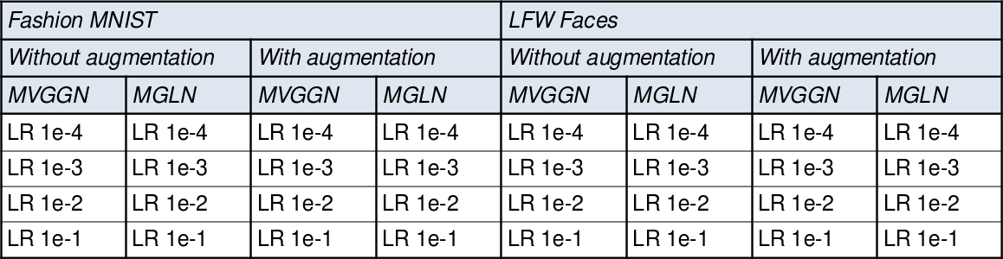
Training

Slide 5
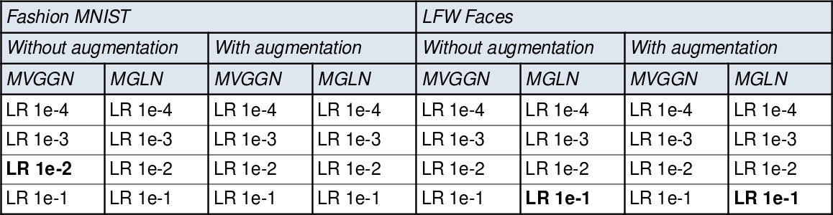



Training

Slide 6
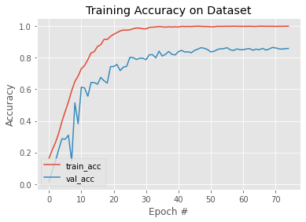
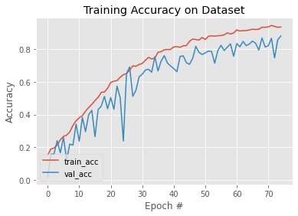
Augmentation and Learning Curves
Without augmentation
With augmentation

Slide 7
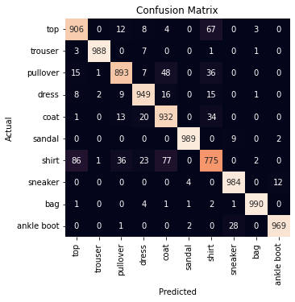
MNIST Fashion Confusion Matrix

Slide 8
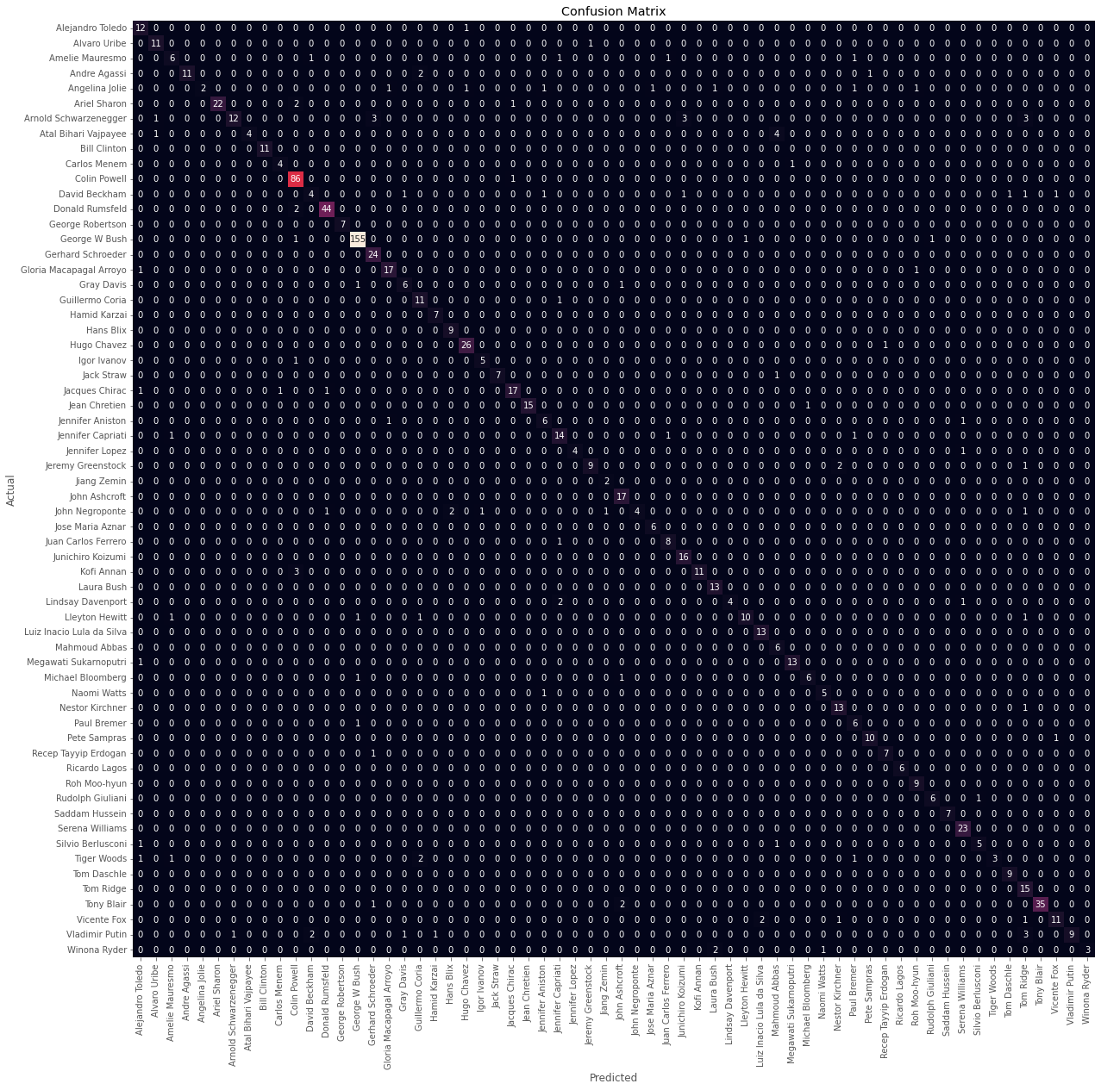
LFW People Confusion Matrix

Slide 9
Limitations
Time limitations
      Longer training → better results
      More samples → generalization
Difficulties setting seed with Keras

