Slide 1
LESSON 1 · TEACH THE MACHINE
GRADES 9–12 · 30–40 MIN
How does a machine learn?
Teach a machine to see. Then find out what it really learned.
PART 1 · THE LESSON
PART 2 · THE ACTIVITY
Notes:
Welcome. Today in one line: how does a machine learn anything? In 30 minutes you will know, and then you will build one yourself on your phone. Keep the energy up — the payoff is the activity.

Slide 2
What is this?
Notes:
1 min. Say nothing else. Wait for the shout: apple. Then: how did you know? You have never seen this exact drawing. Hold the answer — the next slide makes it bigger.

Slide 3
Which one is the mango?
Filled, tilted
Outline only
Small, wobbly
Big, upright
All of them. You knew instantly. How?
Notes:
3 min. Ask: which one is the mango? Wait. All four are mangoes, drawn by four different people. Ask: how did you know so fast? Nobody gave you a rule. Collect two or three answers, then move on — the point lands on the next slide.

Slide 4
Nobody handed you a rulebook.
You saw hundreds of mangoes.
In the bazaar. On the tree. Cut on a plate. Badly drawn by a cousin.
Every single one nudged your idea of “mango” a tiny bit.
Learning
from
examples
Machines can do this too. That is what “AI” mostly means today.
Notes:
3 min. Nobody handed you a rulebook for 'mango'. You saw hundreds: in the bazaar, on trees, cut on a plate, badly drawn by a cousin. Each one nudged your idea of 'mango' a little. That is learning from examples. Hold this phrase; it is the whole lesson.

Slide 5
Try writing the rules.
IF it is orange…
A raw mango is green.
An orange is round and orange.
Half the mangoes in the market have no stem.
A drawing smells of nothing.
IF it is round-ish…
IF it has a stem…
IF it smells sweet…
RULES BREAK. EXAMPLES BEND.
Notes:
4 min, interactive. Ask students to shout rules for 'is this a mango?'. Write two or three on the board. Then ask for something that breaks each rule. Green mangoes exist. Oranges are round and orange. Drawings have no smell. Every rule breaks somewhere; examples bend instead. This is why nobody programs face unlock with rules.

Slide 6
How a computer sees your drawing.
0 0 0 1 1 1 1 1 1 1 1 1 1 1 1 0
0 0 1 1 1 1 1 1 1 1 1 1 1 1 1 0
0 0 1 0 1 1 1 1 1 1 1 1 1 1 1 0
0 0 1 1 0 1 1 1 1 1 1 1 1 1 1 0
0 1 1 1 1 1 1 1 1 1 1 1 1 1 1 0
0 0 1 1 1 1 1 1 1 1 1 1 1 1 0 0
→
…and 10 more rows like these.
16 × 16 = 256 numbers, each between 0 (white) and 1 (black). That is all the machine ever gets. No colour, no smell, no “mango”.
Your drawing is also moved to the middle and scaled, so drawing in a corner doesn't matter.
Notes:
4 min. This is the only technical slide that matters. A drawing is squashed to a 16 by 16 grid: 256 little squares. Each square becomes a number from 0 (white) to 1 (black). The machine never sees a mango. It sees 256 numbers. Ask: could you tell a mango from a cricket ball if someone read you 256 numbers? No. Yet the machine will.

Slide 7
Where the idea came from.
A BRAIN CELL
THE COPY, 1943
signals in
cell body
signal out
numbers in
add them up, weighted
a number out
Your brain has about 86 billion of these. Each one takes many signals in and sends one out. In 1943 two scientists copied that idea as maths. That copy is what we build today.
Notes:
3 min. This is why it is called a neural network: it borrows the shape of a brain cell, not the brain. One neuron does almost nothing. Millions wired together learn. Keep it to the shape; don't do biology.

Slide 8
Inside the machine.
Every line has a knob (a “weight”). About 2,600 knobs in total.
At the start they are all random. The machine guesses like a coin toss.
…
256 inputs
one per pixel
10 “detectives”
each learns one pattern
1 answer
mango or cricket ball
Notes:
5 min. Cartoon version of a neural network, and it is honestly what runs on their phones later. Left: 256 inputs, one per pixel. Middle: 10 neurons. Call them detectives: each one learns to look for some pattern (a curve here, a straight line there). Right: one output, mango or cricket ball. Every line between them has a knob, a weight. There are about 2,600 knobs. At the start every knob is set randomly, so the machine guesses like a coin toss.

Slide 9
Training = guess, check, nudge.
👀
✅
🎛️
GUESS
CHECK
NUDGE
→
→
Show it one drawing. It says: “72% cricket ball.”
You labelled it “mango”. So the guess was wrong by a lot.
Turn every knob a tiny bit in the direction that would have made it less wrong.
↺ repeat with the next drawing
240 LAPS OVER 10 DRAWINGS · ABOUT 1 SECOND ON A PHONE
Notes:
3 min. Training is a loop. Show it one drawing. It guesses. Compare the guess with the label you gave. Nudge every knob a tiny bit in the direction that would have made the guess less wrong. Next drawing. Ten drawings, 240 laps, about one second on a phone. Don't use the word gradient. If someone asks how it knows which way to nudge: it tries the tiniest change and keeps the direction that helped.

Slide 10
The answer is a confidence.
Cricket ball
78% sure
0 · definitely mango
1 · definitely cricket ball
Never certain. A machine can be very sure and still wrong. Remember that.
Notes:
2 min. The output is never yes or no. It is a number between 0 and 1, which we show as a percentage. 0.78 means 'leaning cricket ball'. 0.51 means 'no idea'. Keep this in mind for later: a confident machine can still be confidently wrong.

Slide 11
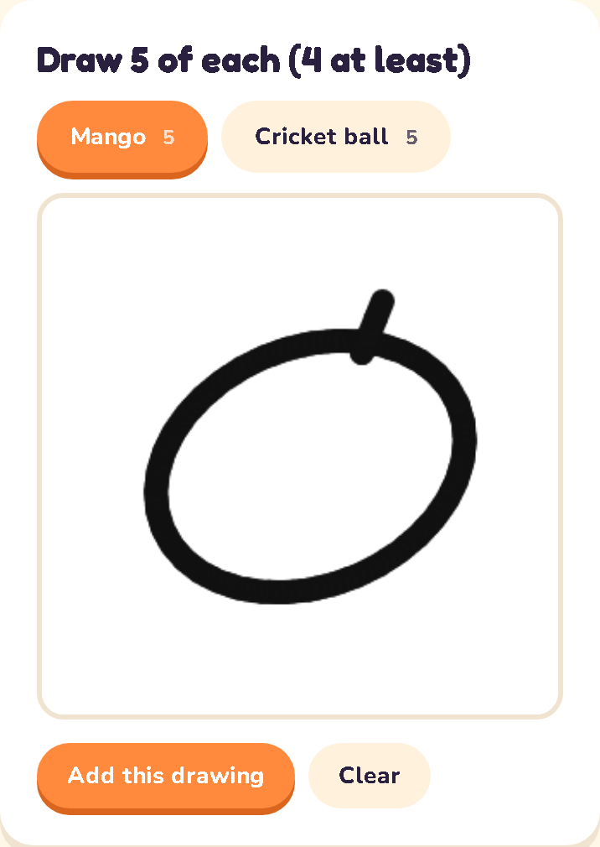
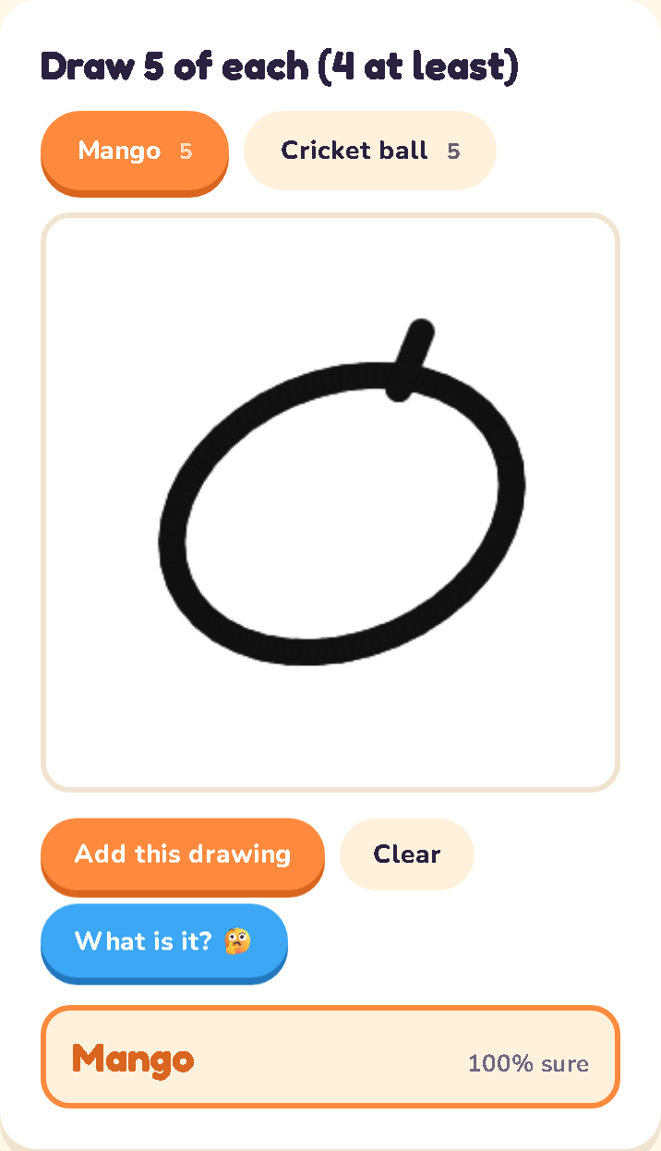
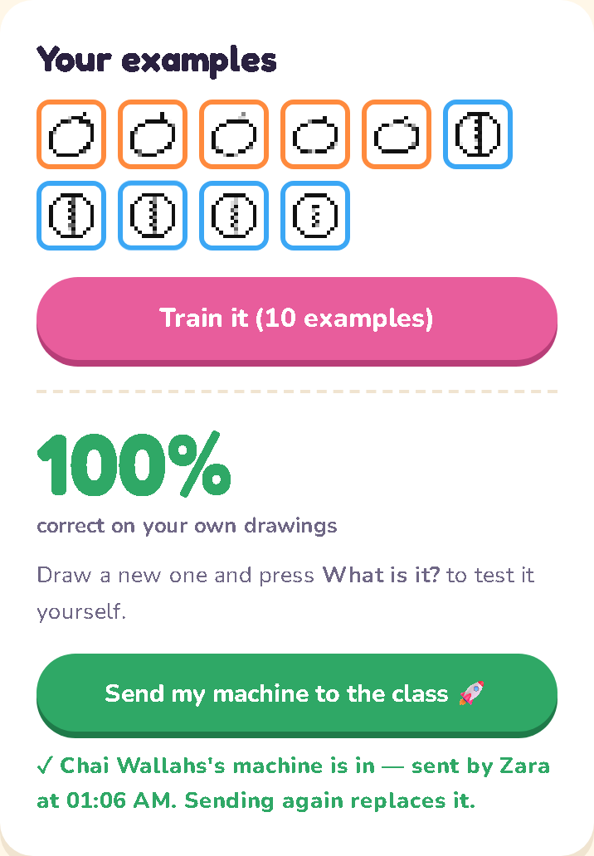
What it looks like.
Draw big, in the middle.
Add this drawing.
5 of each. Train it.
Fresh one. What is it?
Send to the class.
1 · draw and add
2 · test it yourself
3 · your examples + score
Notes:
3 min. This is the app you will use in a few minutes. Left: a team drawing mangoes and cricket balls; each drawing added becomes one example under Your examples (the third shot). Right: after Train, the score on their own drawings and a test with a fresh drawing. Walk through the buttons: Add this drawing, Train it, What is it?, Send my machine to the class.

Slide 12
It's already in your pocket.
🔓
📧
⌨️
▶️
🏦
Face unlock
Spam filter
Autocorrect
Video picks
Fraud alerts
thousands of photos of you
millions of emails people flagged
what everyone typed and fixed
what you watched and skipped
what your normal spending looks like
ALL LEARNED FROM EXAMPLES. NONE FROM RULES.
Notes:
3 min. Every one of these learned from examples, not rules. Face unlock saw thousands of photos of your face. The spam filter saw millions of emails people marked as spam. Autocorrect saw what people typed and fixed. Recommendations watch what you skip. Fraud alerts learned what normal spending looks like for you. Ask: which of these has ever been wrong for you? All of them have.

Slide 13
Hands up: which of these learned?
🧮
🔓
⏰
📧
🗺️
Calculator
Face unlock
Alarm clock
Spam filter
Maps arrival time
For you: calculator no · face unlock yes · alarm clock no · spam filter yes · maps yes.
“Computer” doesn't mean “learned”. Most software is still rules. Learning is the new part.
Notes:
2 min, quick poll. Read each one; hands up if it learned from examples. Calculator: no, pure rules. Face unlock: yes. Alarm clock: no. Spam filter: yes. Maps arrival time: yes, it learned from millions of past trips. The point: 'computer' does not mean 'learned'. Most software is still rules. Learning is the new part.

Slide 14
Your machine is going to score 100%.
Then something is going to happen.
No spoilers.
Notes:
1 min. Build suspense and say nothing more. Whatever you do, do not explain what is coming. The activity only works if the drop surprises them.

Slide 15
The activity.
1
2
3
4
5
👥
📱
✏️
🧠
🚀
Teams
Join
Draw
Train & test
Send
Up to 4. Everyone draws at least one of each.
Room code or QR from the projector. Type your name.
5 mangoes + 5 cricket balls. Big, in the middle.
Press Train. Draw a fresh one. Ask it.
When the whole team agrees: Send my machine.
20 MINUTES · DON'T PEEK AT THE PROJECTOR UNTIL YOU'RE TOLD
Notes:
3 min. Briefing. Teams of up to four; every member draws at least one of each. Join with the room code or QR on the projector. Draw five mangoes and five cricket balls, big and in the middle. Train. Test with a fresh drawing. Only send when the whole team agrees the machine is good. Twenty minutes for all of it.

Slide 16
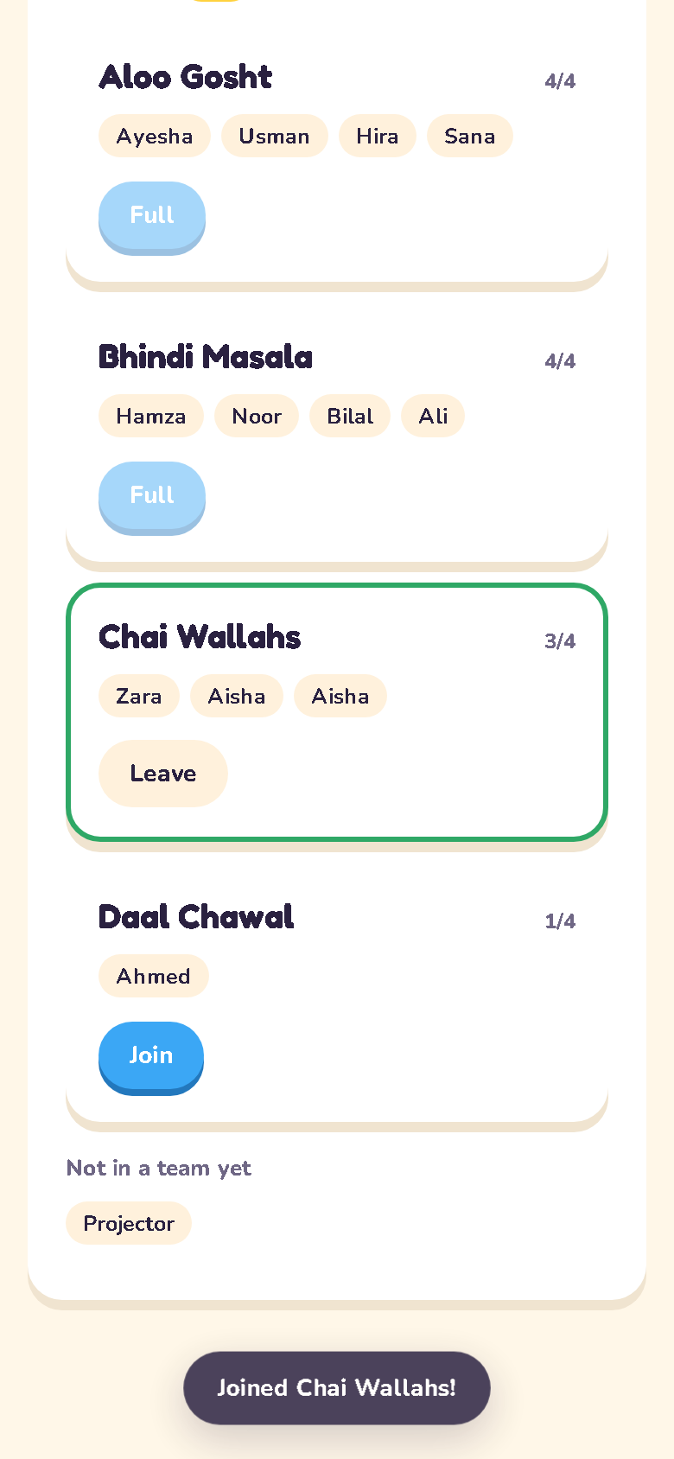
Join now.
mehdy922.github.io/neural-lab
ROOM CODE
— on the projector —
Scan the QR, or open the link → Activity 1 · Teach the machine → Student → code → your name → make or join a team.
Notes:
Switch the projector to the app now: Rejoin room CODE, or choose Activity 1 · Teach the machine → Teacher. The Lobby shows the code and QR live. Leave this slide up only if the projector can't switch. Press Start teaching once teams are formed.

Slide 17
APPENDIX · USE AFTER THE TOURNAMENT
The debrief.
Only after the numbers have fallen and the room has argued about why.
Notes:
Do not show anything past this point until the tournament has been revealed and the room has argued about it. The gap between 'own' and 'strangers' is the lesson; it only lands if they were surprised.

Slide 18
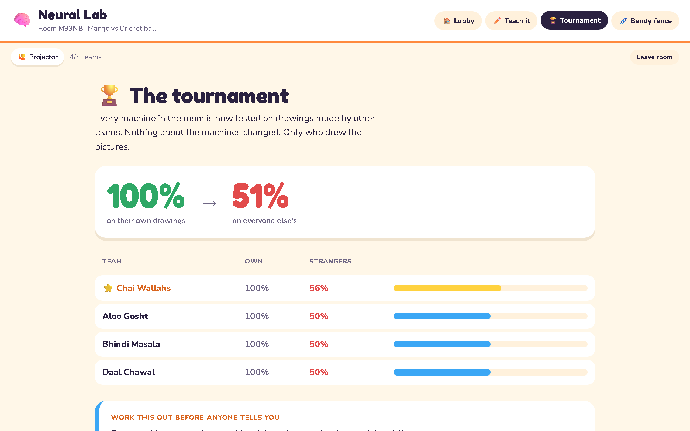
What just happened?
A MACHINE ONLY KNOWS WHAT IT WAS SHOWN
Overfitting
It memorised the quirks of your ten drawings, not the idea of a mango.
Generalisation
Working on examples it has never seen. The only score that matters.
SAME MACHINES. DIFFERENT PENCILS.
Notes:
Let them tell you first. They will say 'it learned our handwriting', 'it only knows how we draw'. Now, and only now, give the words. Overfitting: it memorised the quirks of the few examples it saw. Generalisation: working on examples it never saw, which is the only thing that actually matters. Point at the projector screenshot: same machines, different pencils.

Slide 19
This is not a classroom problem.
🥭 The mango app
🙂
Face recognition
A 2018 MIT study: far more errors on darker-skinned women than lighter-skinned men.
Built from photos of mangoes on one farm in Sindh. Your uncle grows mangoes in Multan. The app says every one of his is bad.
Whose mistake was that?
🎙️
Voice assistants
Shown to make more mistakes with some accents than others.
🏥
Medical imaging
Models trained mostly at one hospital did worse at other hospitals.
WHO WAS MISSING FROM THE EXAMPLES?
Notes:
Now the real world. The mango app from the closing screen: trained on one farm's photos, rejects your uncle's mangoes in Multan. Three documented cases, keep them factual: a 2018 MIT study found commercial face-recognition products made far more errors on darker-skinned women than on lighter-skinned men; voice assistants have been shown to make more mistakes with some accents; medical image models trained mostly at one hospital did worse at other hospitals. Ask the question at the bottom and let it sit.

Slide 20
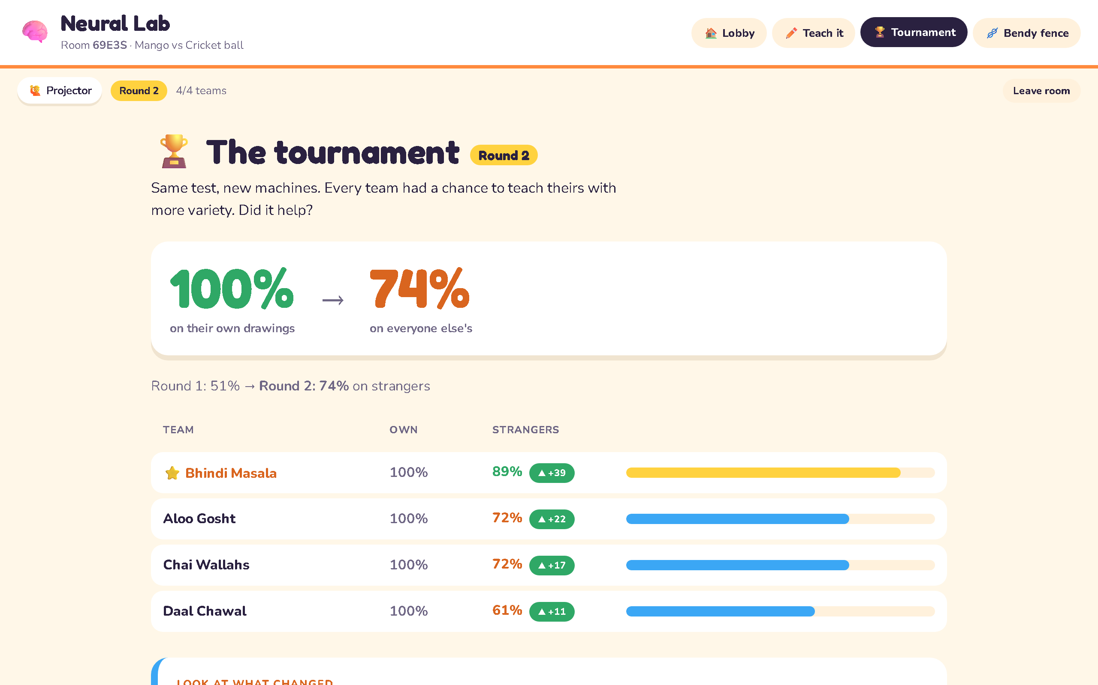
How would you fix it?
🎨
More variety
Mangoes drawn every way you can think of, not just yours.
🧪
Test on strangers
Never trust a score on the examples it learned from.
🔍
Ask who's missing
Before you build: whose examples are not in here?
Round 2 in the app: every team that added other teams' styles climbed. Same machine, wider view.
Notes:
If you ran Round 2, point to the deltas: teams that added drawings in other styles climbed. That is the fix, and it is not a better machine, it is a wider view. Three habits: more variety in the examples; always test on strangers before trusting; ask who is missing from the data before you build.

Slide 21
Exit question
Name one app that learns from you.
Whose examples did it learn from?
Who is missing?
One line each. Bring it next lesson.
Notes:
Exit ticket or homework. One line each. Collect them; the answers make a good opener next lesson.

