Slide 1
LESSON 2 · TALK TO THE MACHINE
GRADES 9–12 · 40 MIN
Last time it saw.
This time it talks.
Ask it anything.
A machine only knows what it was shown.
PART 1 · HISTORYBOT
PART 2 · TRAIN YOUR BOT
Notes:
1 min for this slide and the next. Recap in one line: last time your machine scored 100% on your own drawings and dropped on everyone else's, because a machine only knows what it was shown. Today the machine talks instead of looking, and the same thing is going to happen. Keep the energy up; the payoff is the moment the scoreboard is revealed.

Slide 2
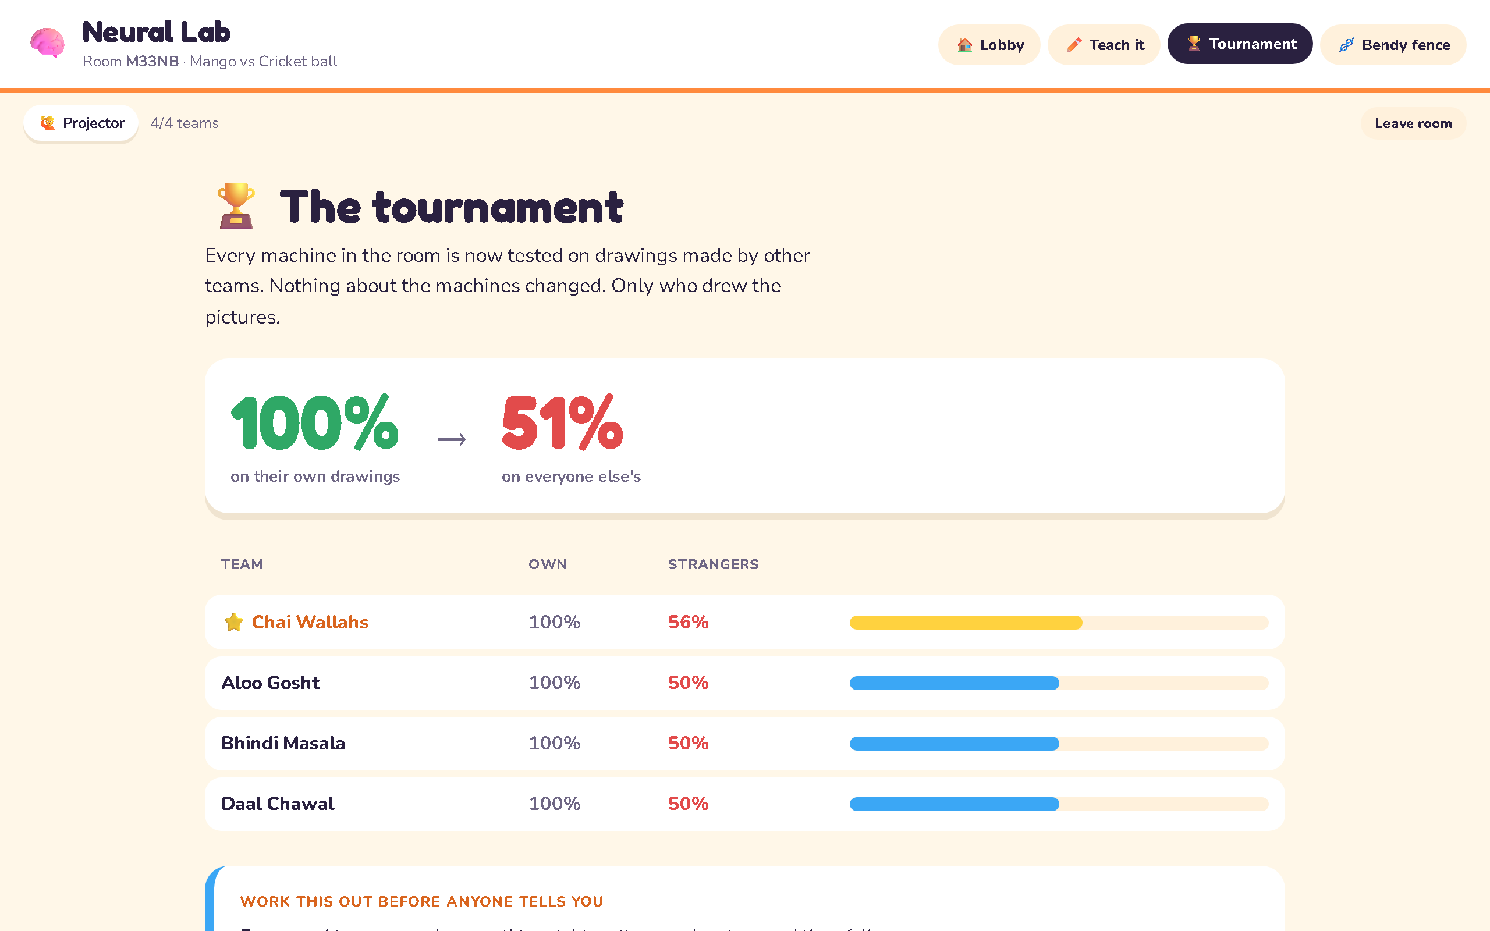
Same machines, different pencils.
What do you remember?
Notes:
Part of the same minute. Ask what they remember from last time. Let them say it: 100% on their own drawings, then the drop on everyone else's, because it had only ever seen their pencils. Do not explain further. This lesson makes the same point with words instead of drawings, and it only lands if they get there themselves.

Slide 3
The briefing.
YOUR MISSION
“There is a bot on your phone. It has read exactly one thing in its life. Ask it anything. Tag the topic, read the answer, then tell me: right, wrong, or nonsense. Be honest — this is a report on it, not a vote for it.”
Find one answer it gets right, one it gets wrong, and one that is pure nonsense. Then try to trick it.
👍 Right
👎 Wrong
🤪 Nonsense
Notes:
2 min. Read the script on the left aloud, slowly. It is the whole briefing. Then the mission. Each verdict is a report on the bot, not a vote for it; say that twice. Do not explain how the bot works or why it might be wrong. They find that out themselves in the next ten minutes.

Slide 4
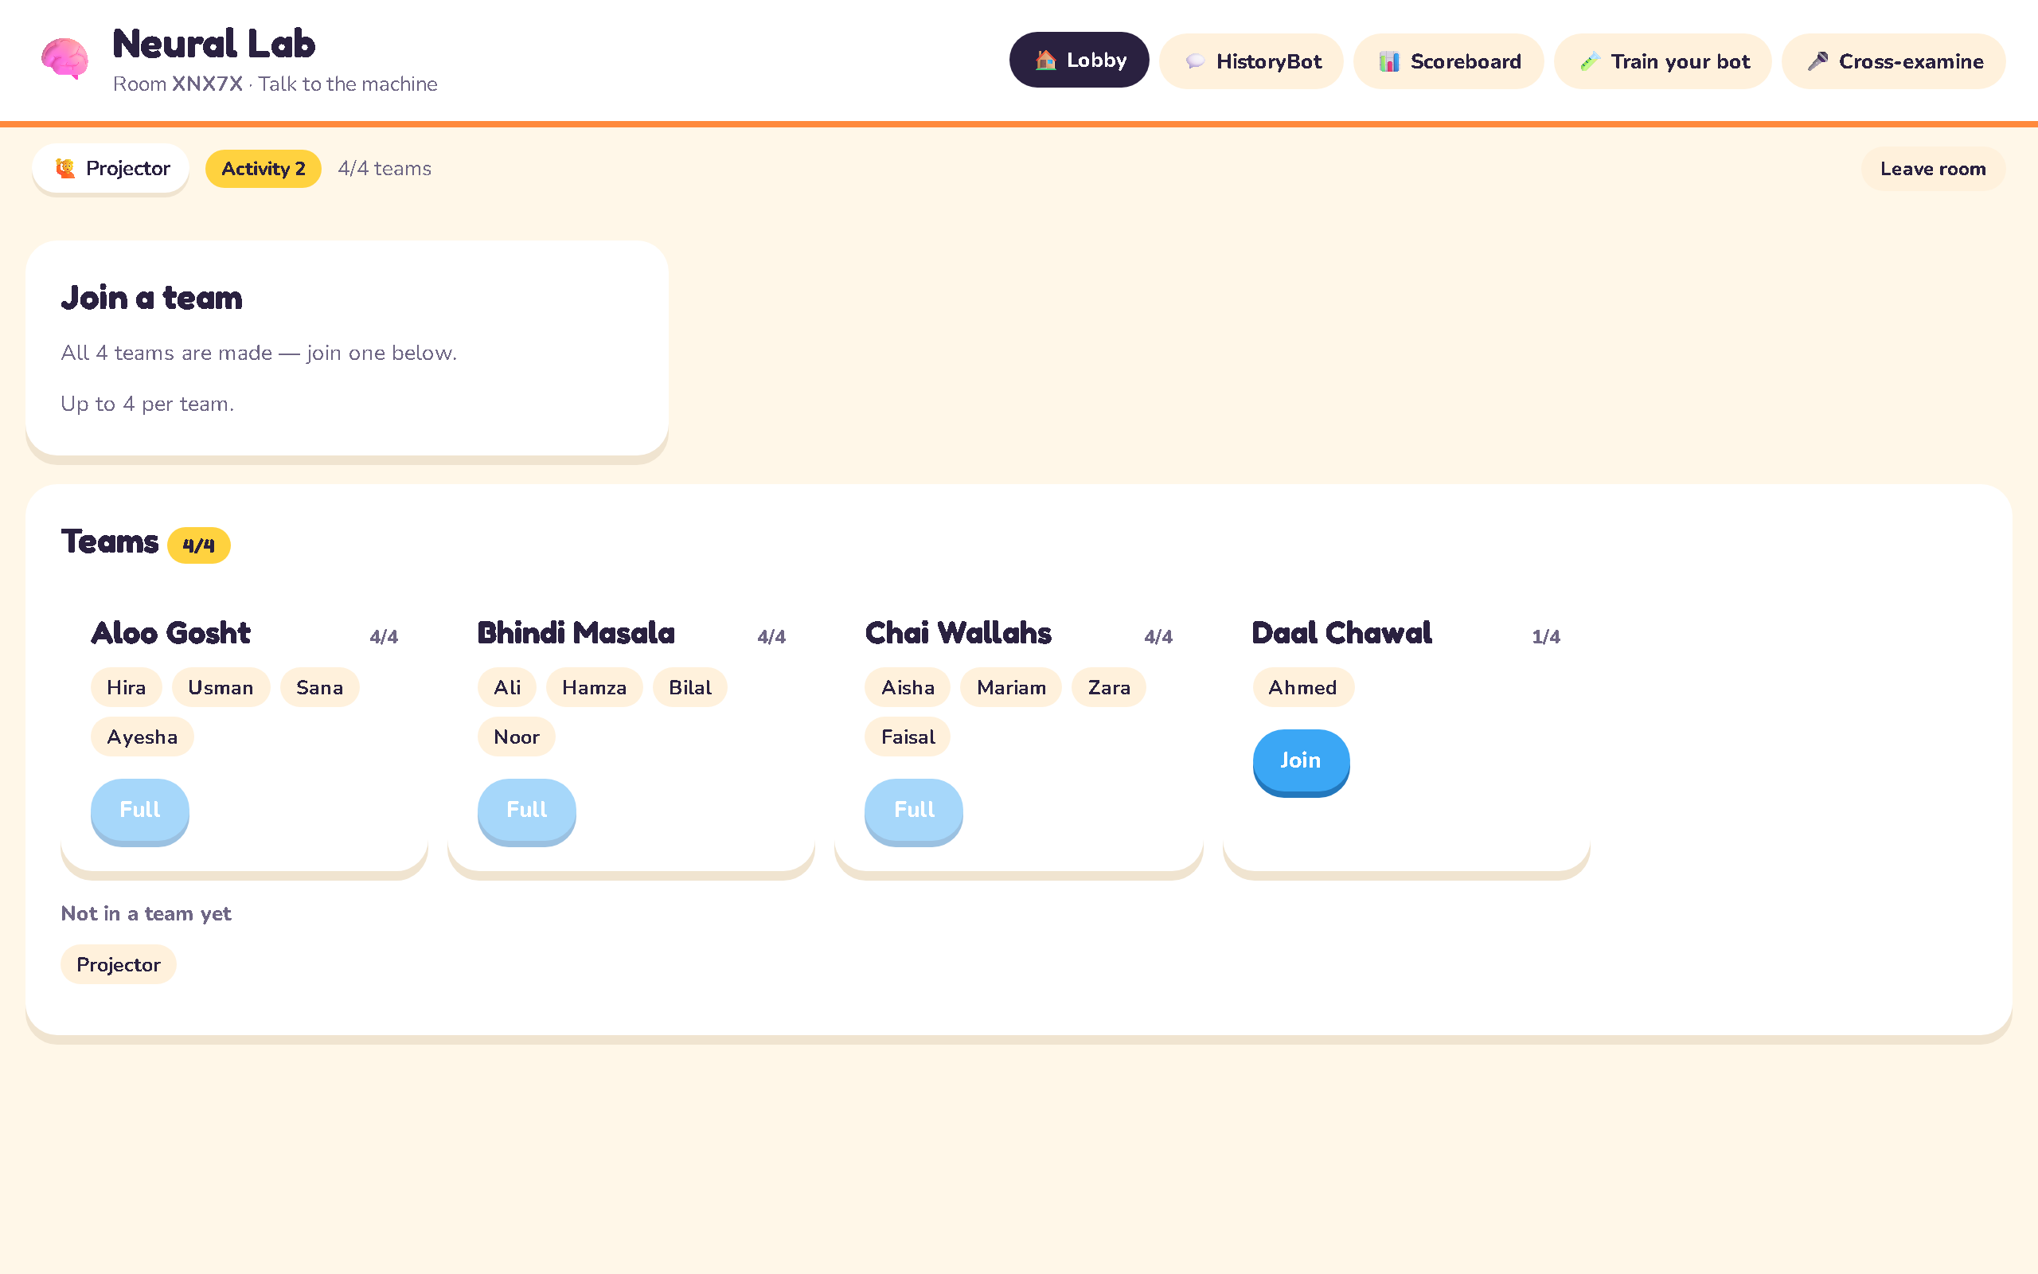
Join now.
mehdy922.github.io/neural-lab
ROOM CODE
— on the projector —
the Lobby's team list, as students see it
Scan the QR, or open the link → Activity 2 · Talk to the machine → Student → code → your name → team.
Notes:
Projector: Lobby now; switch to Scoreboard once you press Start chatting — only the feed shows.

Slide 5
STOP
Do not go past this until the scoreboard is revealed.
Let them chat. Press Reveal scoreboard, let the room read the bars, then continue.
Notes:
About 8 min of chatting. Do not show anything past this point until you have pressed Reveal scoreboard and the room has read the bars. Walk the room; nudge teams towards questions off the history topic. The collapse only lands if they see it before anyone explains it.

Slide 6
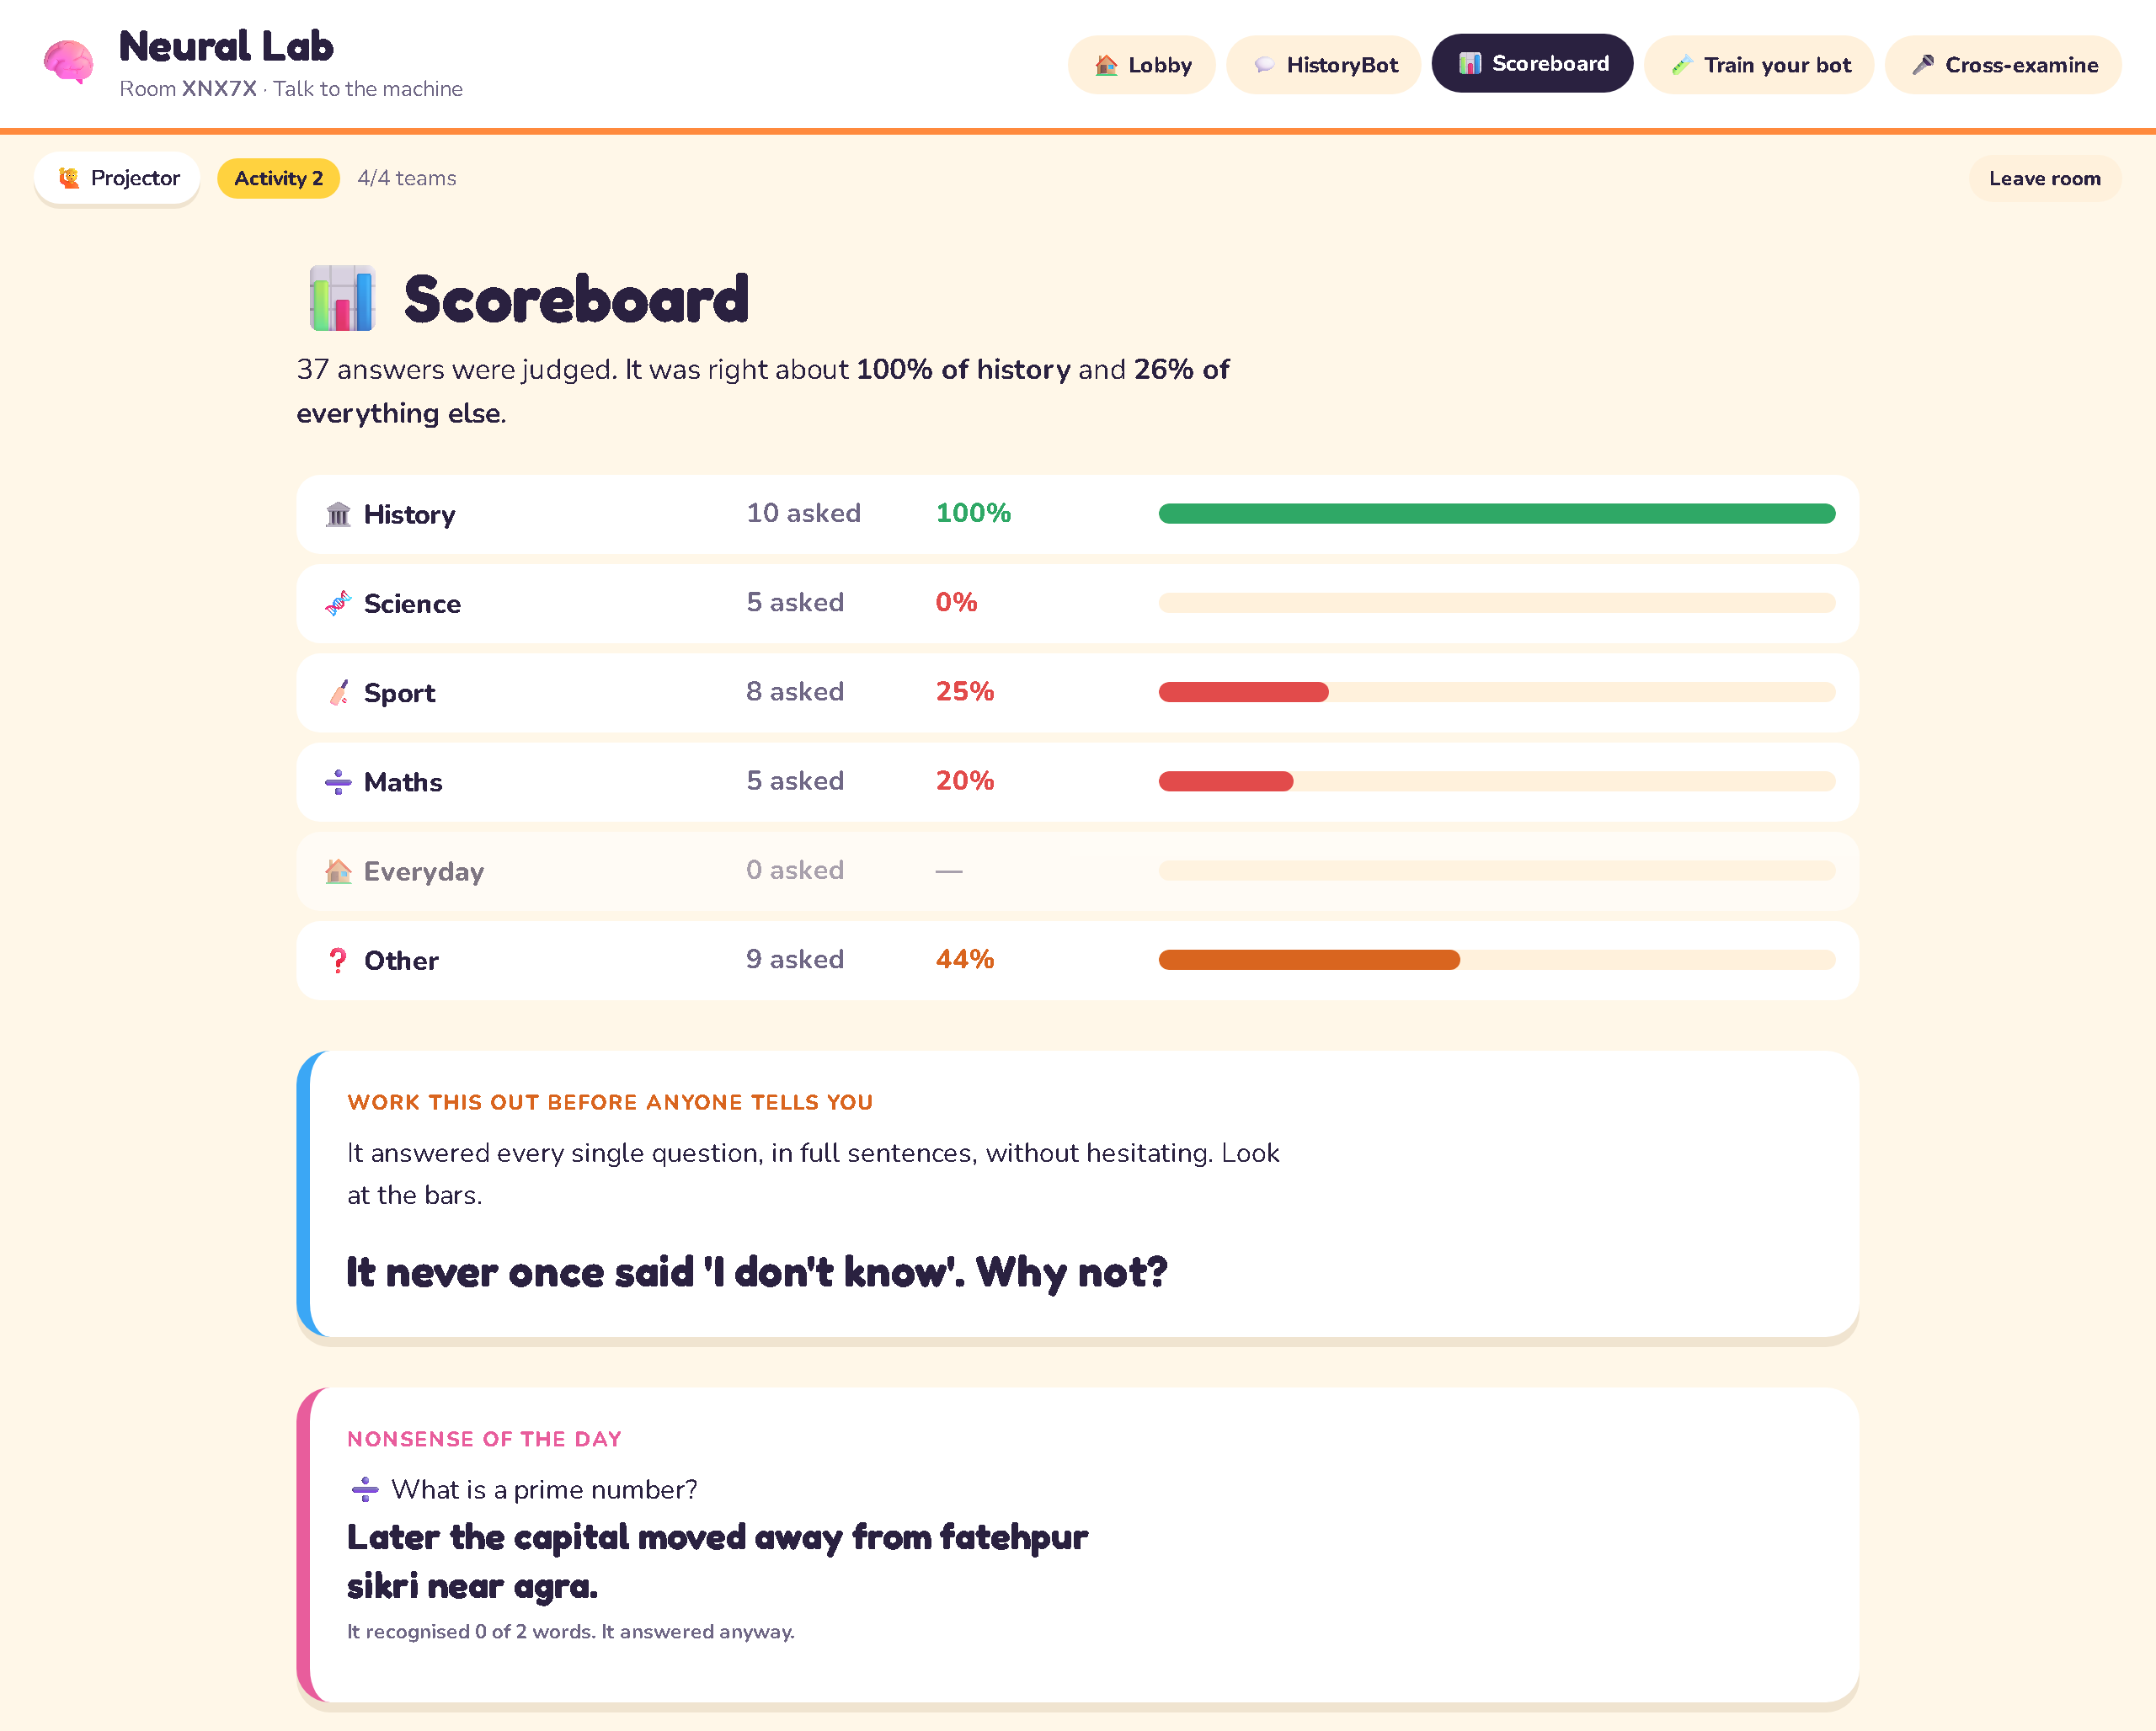
What just happened?
37 answers were judged. It was right about 100% of history and 26% of everything else.
WORK THIS OUT BEFORE ANYONE TELLS YOU
It never once said 'I don't know'. Why not?
Notes:
1 min. Let them read the bars first. Every question got a full-sentence answer: right on history, mostly wrong on everything else. Ask the question on the right. Take three answers from the room and agree with none of them: nod, thank them, move on. The next two slides are the answer.

Slide 7
This is its whole mind.
On the phone:
“Recognised 3 of 3 words in your question.”
“It recognised none of your words. It answered anyway.”
Highlighted: the words from “Who built the Taj Mahal?” it recognised.
The Indus Valley civilisation is the oldest known civilisation of South Asia. The Indus Valley people built cities more than four thousand years ago. Their two biggest cities were Mohenjo-daro and Harappa. Both cities stood in the wide Indus river valley. The streets ran in straight lines and crossed at right angles. Houses were built from baked bricks of the same size. Many homes had their own wells and bathing rooms. Covered drains ran under the streets to take dirty water away. This was one of the best drainage systems in the ancient world. Traders used small stone seals carved with animals and signs. Ships from the Indus Valley likely reached lands as far as Mesopotamia. Around 1900 BCE the great cities slowly emptied out. Rivers may have changed course and farming grew harder. The people scattered into smaller villages across the region.
New groups of people arrived from Central Asia after the Indus cities declined. They spoke an early form of Sanskrit and are called the Vedic people. They composed hymns and prayers that were later collected into the Vedas. These hymns praised gods of the sky, the sun, fire and rain. Cattle were a sign of wealth and were carefully counted and guarded. Families lived in small kingdoms ruled by chiefs and later by kings. Over time these people learned to use iron tools and weapons. Iron ploughs let farmers clear forests and grow more food. Bigger kingdoms called Mahajanapadas grew across the northern plains. Priests, warriors, traders and workers formed different groups in society. This system of groups later hardened into castes.
Chandragupta Maurya built a large empire around 321 BCE. His capital was the city of Pataliputra in the east. His grandson Ashoka became one of the most famous rulers of ancient India. Ashoka fought a hard war against the kingdom of Kalinga. After seeing the suffering of that war he turned to Buddhism. He then chose peace and kindness over further conquest. Ashoka placed stone pillars and edicts across his huge empire. Some of these edicts have been found in the northwest, in what is now Pakistan. He asked officials to treat people fairly and to protect animals. The Maurya empire slowly broke apart after Ashoka died.
The Gandhara region lay around the Peshawar valley in the northwest. It became a center of a special style of art called Gandhara art. This art mixed Greek forms with local Buddhist ideas after old Greek settlers stayed in the region. Kushan kings later ruled Gandhara and supported this art and Buddhist learning. Not far from Gandhara stood the ancient city of Taxila. Taxila was famous as a center of learning for the whole region. Students came from distant lands to study
medicine, grammar and philosophy there. Taxila had teachers, halls and stupas spread across a wide area. The ruins of Taxila can still be seen near Rawalpindi today.
In 712 CE a young Arab general named Muhammad bin Qasim marched into Sindh. He led his army for the Umayyad rulers who sent him from Damascus. His forces met the army of Raja Dahir, the ruler of Sindh. Muhammad bin Qasim defeated Raja Dahir in a hard battle near the Indus. After this victory Sindh came under Arab and later Muslim rule. Many historians see this as the start of Muslim rule in the region. Muhammad bin Qasim set fair terms for the local people who stayed. Trade along the Indus grew stronger under the new rulers.
Mahmud of Ghazni led many raids into South Asia in the early eleventh century. He ruled from the city of Ghazni in what is now Afghanistan. His armies crossed the mountains and reached deep into the Punjab. Lahore became an important city for the Ghaznavid rulers during this time. Later, when Ghazni fell to rivals, Lahore even served as their last capital. Scholars gathered at the Ghaznavid court, including the great writer Al-Biruni. Al-Biruni studied the languages, science and customs of South Asia closely. Lahore grew into a busy center of trade and learning under Ghaznavid rule.
Muhammad Ghori extended Muslim rule further into the northern plains after Mahmud. His general Qutb-ud-din Aybak became the first sultan of Delhi in 1206. This began the long period known as the Delhi Sultanate. Several dynasties ruled one after another from Delhi over the next three centuries. These included the Slave dynasty, the Khalji dynasty, the Tughlaq dynasty and later the Lodi dynasty. The tall tower called the Qutub Minar was built during this early period. Delhi Sultanate rulers built forts, mosques and canals across northern India. Trade routes linked Delhi with Central Asia, Persia and the Arabian Sea coast. The Delhi Sultanate slowly weakened after repeated invasions from the northwest.
Babur was a prince from Central Asia descended from Timur and Genghis Khan. He lost his first small kingdom and looked south for new land. The first battle of Panipat was fought in 1526 between Babur and Sultan Ibrahim Lodi. Babur used cannons and skilled riders to win a clear victory there. This victory ended the Delhi Sultanate and began the Mughal empire. Babur then ruled from Delhi and Agra for a short time before he died.
Babur's son Humayun took the throne next but faced many troubles. A skilled rival named Sher Shah Suri defeated
Humayun and took his lands. Humayun fled west to Persia and lived there for several hard years. With Persian help he returned and won back his throne in 1555. Humayun died just a year later after a fall near his library. His young son Akbar then became the new emperor of the Mughal empire.
Akbar ruled the Mughal empire from 1556 to 1605 and greatly expanded it. He built a stunning new capital city at Fatehpur Sikri near Agra. Fatehpur Sikri had grand courts, a mosque and a tall gateway called the Buland Darwaza. Akbar formed strong alliances with several Rajput kingdoms through marriage and careful diplomacy. He removed the special tax that non-Muslim subjects once had to pay. Akbar also created a new set of ideas called Din-i Ilahi. Din-i Ilahi mixed ideas from several faiths. He invited scholars of different religions to debate at his court. Akbar's fair rule and strong army held the huge Mughal empire together. Akbar built Fatehpur Sikri near Agra as his new capital. Later, the capital moved away from Fatehpur Sikri because water there ran short.
Akbar's son Jahangir ruled the Mughal empire from 1605 to 1627. Jahangir loved gardens, paintings and rare animals from distant lands. He is remembered for a golden chain of bells outside his palace. Any person could pull the chain to ask the emperor for justice. His wife, the clever and powerful Nur Jahan, helped run the empire. Under Jahangir, artists painted detailed pictures of birds, flowers and court life.
Shah Jahan became the Mughal emperor in 1628 and ruled for thirty years. Shah Jahan is best remembered for the Taj Mahal in Agra. Shah Jahan built the Taj Mahal for his wife Mumtaz Mahal. White marble and careful patterns cover every wall of the Taj Mahal. Shah Jahan also added grand halls and gates to Lahore Fort. Near Lahore he laid out the beautiful Shalimar Gardens with rows of fountains. In Delhi he built the Red Fort and the great Jama Masjid mosque. Shah Jahan's rule is often called the golden age of Mughal building. Skilled workers from across the empire and beyond worked on these great projects.
Aurangzeb, Shah Jahan's son, ruled the Mughal empire from 1658 to 1707. Under Aurangzeb the Mughal empire reached its largest size ever. Long wars in the Deccan region drained the treasury for many years. Aurangzeb lived a simple life but ruled with a strict hand. After his death in 1707 the vast Mughal empire began to weaken fast.
Weak emperors followed Aurangzeb and struggled to hold the empire together. In 1739 the Persian ruler Nadir Shah invaded and sacked the city of Delhi. He carried off the famous Peacock Throne and countless other treasures.
Regional powers such as the Marathas and various Nawabs grew stronger and bolder. Sikh groups in the Punjab also grew into a strong military force. The once mighty Mughal empire now controlled little beyond the city of Delhi.
Ranjit Singh united the Sikh groups of the Punjab into one strong state. He became Maharaja and ruled from his capital at Lahore. Under Ranjit Singh the Sikh empire stretched across the Punjab and beyond. He built a modern army trained partly by European officers. Ranjit Singh respected people of every faith across his kingdom. After his death in 1839 the Sikh empire quickly grew weak and divided. Two hard wars against the British followed within the next ten years. The British annexed the Punjab and the Sikh empire in 1849.
The East India Company first arrived in South Asia to trade in cloth and spices. Over time the company built forts, trained soldiers and gathered local allies. The company won the battle of Plassey in Bengal in 1757. That victory let the company take real political power over Bengal. Company rule then spread west and south across the subcontinent. Local rulers signed treaties or lost wars against company forces. By the early 1800s the East India Company controlled vast territories. The company collected taxes, ran courts and shaped trade to suit its own interests.
In 1857 soldiers and common people rose up against East India Company rule. The uprising of 1857 is also called the first war of independence. New rifle cartridges, land taxes and broken promises had angered many groups. The uprising spread quickly across northern India before it was crushed. Delhi, Meerut, Kanpur and Lucknow saw fighting between rebels and company forces. In Punjab the British disarmed the soldiers at Lahore before any fighting began. After the uprising the British Crown took direct control of the region. This new period of direct British rule is often called the British Raj. The East India Company itself was closed down soon after these events.
Sir Syed Ahmad Khan worked hard to help Muslims recover after 1857. He believed modern education would help his community move forward. In 1875 he founded a college at Aligarh for Muslim students. This college later grew into the well known Aligarh Muslim University. Students there studied science and English alongside Islamic teachings and Urdu. Sir Syed's ideas shaped how many Muslim leaders later thought about education and unity.
Muslim leaders formed the All-India Muslim League in Dhaka in December 1906. The League aimed to protect the political rights of Muslims in British India. It grew over the years into
the main voice for Muslim political demands. Many young lawyers and thinkers joined the League during its early decades. The Muslim League was founded in Dhaka in 1906 to speak for Muslims.
The poet and thinker Allama Iqbal addressed the Muslim League in Allahabad in 1930. In his address Iqbal spoke of a separate homeland for Muslims. He suggested that the northwestern regions could form such a homeland. Iqbal's poetry and speeches inspired many who later worked for Pakistan. His ideas gave a clear shape to hopes that had been growing for years.
On 23 March 1940 the Muslim League passed the Lahore Resolution. The resolution called for independent states for Muslims in the northwestern and eastern zones. Huge crowds gathered in Lahore to hear speeches about the resolution. This day is still remembered every year across Pakistan as a key moment. The Lahore Resolution was passed on 23 March 1940 in Lahore. The Lahore Resolution set a clear political goal for the years that followed.
Muhammad Ali Jinnah led the Muslim League through its final and hardest years. He is known across Pakistan as the Quaid-e-Azam, or great leader. Jinnah negotiated firmly with British officials and with Congress leaders. He argued that Muslims needed their own separate and independent country. Jinnah's clear legal mind and steady will guided the League through tense talks. Jinnah is called the Quaid-e-Azam, the great leader of Pakistan.
Pakistan became an independent country on 14 August 1947. Pakistan celebrates its independence day every year on 14 August. The British left South Asia and divided the land into two new countries. Millions of people moved across the new borders in the months that followed. Families left homes, farms and shops built over many generations. Despite great hardship, the new country of Pakistan began building its own institutions. Jinnah became the first Governor-General of the new state of Pakistan.
Karachi served as the first capital of the new country of Pakistan. Government offices, embassies and the first parliament all opened in Karachi. The city grew fast as officials, workers and refugees arrived from many places. Years later the capital moved first to Rawalpindi and then to a new city. That new planned city, built north of Rawalpindi, was named Islamabad. The capital of Pakistan today is Islamabad. Even after the capital moved, Karachi remained the largest city and busiest port. Pakistan's history, from the old Indus cities to 1947, still shapes the country today.
Notes:
3 min. Everything HistoryBot has ever read is on this screen: about 2,000 words, nothing else. Highlighted: the words from 'Who built the Taj Mahal?' that it recognised. Say: 'Find the sentence yours came from.' Give them a minute on their phones (HistoryBot tab → Show me everything it has ever read). Every word it said is in here. Take one answer from the room and find the pieces it was stitched from.

Slide 8
How it works.
📖
🎯
🔁
READ
PICK
REPEAT
→
→
Count which word follows which.
The most likely next word.
One word at a time, until a full stop.
Very sure and still wrong —
remember 'The answer is a confidence.' from last time?
Notes:
2 min. Only now say 'next word'. It read the 2,000 words and counted which word tends to follow which. To answer, it starts from the words in your question that it recognised and picks the most likely next word, then the next, until a full stop. Nothing in there checks whether the sentence is true. It cannot say 'I don't know' because it has no idea what knowing is; it only ever has a next word. Very sure and still wrong: the same lesson as the confidence bar last time. Keep the vocabulary to 'word' and 'bot'.

Slide 9
Nonsense of the day.
NONSENSE OF THE DAY
Maths · What is a prime number?
“Later the capital moved away from fatehpur sikri near agra.”
It recognised 0 of 2 words. It answered anyway.
It answered anyway. That is not lying.
It has nothing else to say.
Notes:
1 min. Read it out with a straight face. The bot recognised nothing in the question, so it started from nowhere and produced the most common path through its 2,000 words: Mughal capitals. That is not lying; lying needs an idea of the truth. It has nothing else to say, so it says this, in a full sentence, confidently.

Slide 10
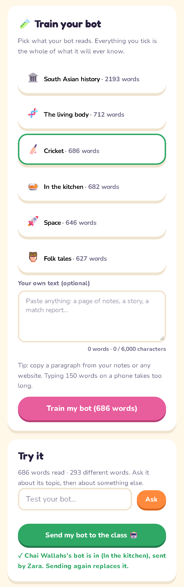
Part 2 · Train your bot.
☑️
Tick what it reads — that is everything it will ever know.
1
Train your bot → Train my bot
📱
One phone per team sends. Agree first.
2
Send my bot to the class
🎤
Ask it about its topic, then about something else.
3
Try it → Test your bot…
student view
Notes:
2 min briefing, then 6 min of training. Each team picks what its bot reads: one of the starter texts, or a paragraph they paste themselves. Everything they tick is the whole of what it will ever know; nothing else exists for it. Try it before sending: ask about its topic, then about something else, and watch the second answer. One phone per team sends, and sending again replaces the bot, so agree first. Press Open cross-examination when every team's bot is in.

Slide 11
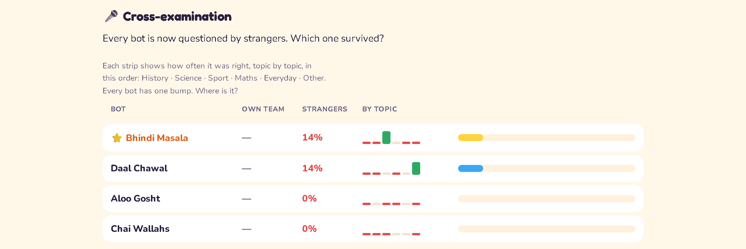
Cross-examination.
Every bot has one bump. Where is it? That is what it read.
OWN TEAM — your own team's votes don't count
STRANGERS 14% the only score that matters
Notes:
8 min of cross-examining, then 2 min here. Every bot is now questioned by strangers, so the Own team column is a dash: only strangers' votes count, the same rule as the tournament last time. Look at the strips. The bots that scored have their bump in exactly one topic — the one they read. Two strips here are flat: those bots were asked about things they had never read, and got them wrong — that is what the reds are. Ask every team with a bump: where is it? Then: what did it read? Same answer, every time.

Slide 12
The big ones.
A language model only says what it has read, one word at a time, confidently, about anything. The big ones have read millions of times more, so the mistakes are rarer and harder to spot. What did it read, and who chose that?
EXIT TICKET
Name one thing you asked a chatbot this month. What might it have read to answer? Who chose that?
One line each.
LAST LESSON: A MACHINE ONLY KNOWS WHAT IT WAS SHOWN
Notes:
4 min. The wrap, then the exit ticket: one line each, collect them. The big ones, the chatbots on their phones, work the same way, one word at a time, only they have read millions of times more, so the mistakes are rarer and much harder to spot. The question to leave in the room: what did it read, and who chose that?

