Slide 1
What is Function?
A function is a self-contained program segment that caries out some specific, well-define task.
Every C program consists of one(at least) or more functions
One of these function must be called main()
Execution of a program always begin by carrying out the instructions in main().

Slide 2
General Form
#include <header file name>
// function prototype here
int main()
{
/*…………*/
}
return-type f1(parameter list)
{
/*………*/
}
return-type f2(parameter list)
{
/*………*/
}
....
return-type fn(parameter list)
{
/*………*/
}

Slide 3
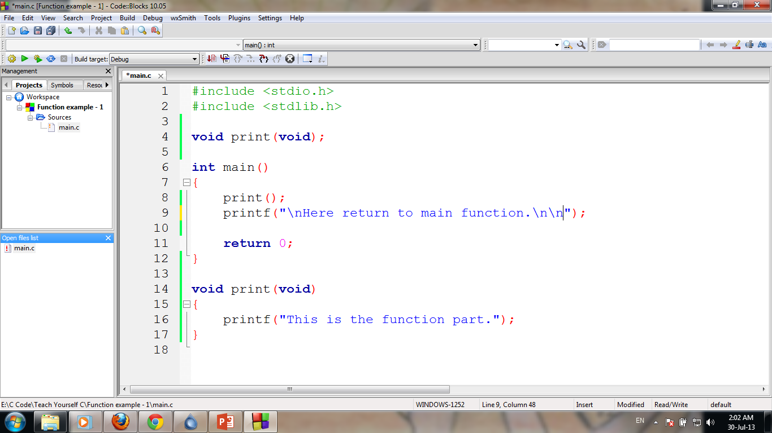
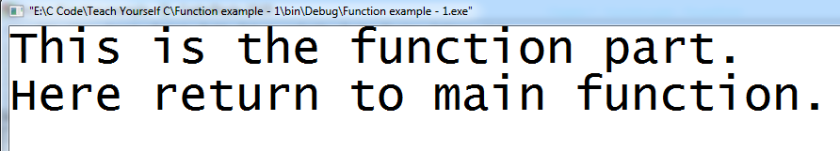
Simple example
Function Prototype
Program

Slide 4
Function General Form
return-type fun-name(type parameter1, type parameter2)
{
/*……function body…*/
}

Slide 5
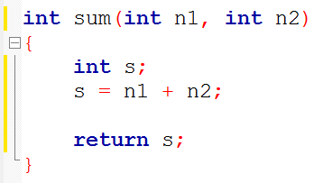
Function General Form
return-type fun-name(type parameter1, type parameter2)
{
/*……function body…*/
}

Slide 6
Function Prototype
return-type fun-name(type parameter1, type parameter2)
{
/*……function body…*/
}
return-type fun-name(type parameter1, type parameter2);

Slide 7
Function Prototype

Slide 8
Function Prototype

Slide 9
Function Prototype
Program

Slide 10
Function of Function Prototype
Declare following attributes associated with a function:
Its return type
The name of its parameters
The type of its parameters
The function name

Slide 11
Function Prototype
A function prototype declares a function before it is used and prior to its definition.
Compiler needs to know this information in order for it to properly execute a call to function.
main() does not need prototype.

Slide 12
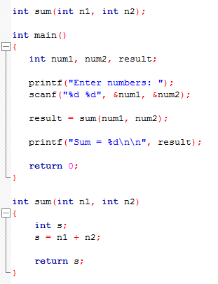
Argument and Parameter

Slide 13
Argument and Parameter
A function’s argument is a value that is passed to the function when the function is called.
A function can have zero to several argument.

Slide 14
Argument and Parameter
For function to be able to take arguments, special variables to receive argument values must be declared, called parameter of the function.
The parameters are declared between the parentheses that follow the function’s name during function definition.
Functions that take arguments are called parameterized function.

Slide 15
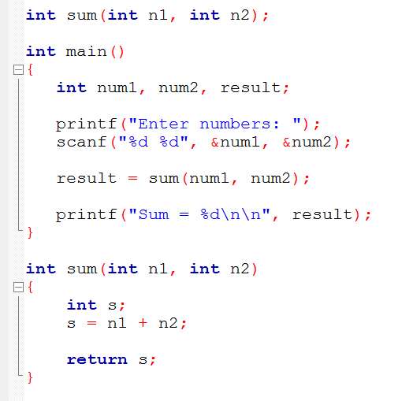
Argument and Parameter
Function Prototype
Function Call
Arguments
Parameter

Slide 16
Declaration vs Definition
A declaration specifies the type of an object.
A definition causes storage for an object to be created
In function-
prototype is declaration
the function itself, which contain the body of the function is a definition

Slide 17
Function Call
We can accessed a function by specifying its name, followed by a list of arguments enclosed in parentheses and separated by commas.
If the function call does not require any arguments, an empty pair of parentheses must follow the name of the function.

Slide 18
Function Call
A function will carry out tis intended action whenever it is accessed (called) from some other portion of the program.
Once the function has carried out its intended action (end of that function is reached), control will be returned to the point from which the function was accessed.
Traditionally, main function is not called by any other function, but there is no technical restriction.

Slide 19
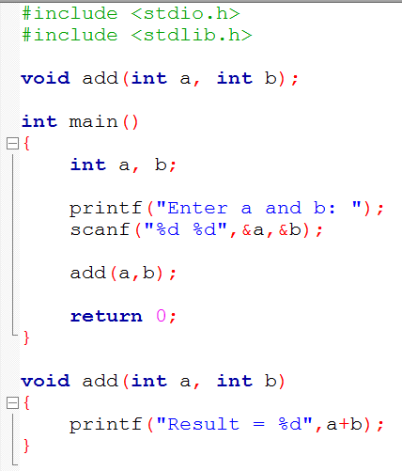
The function call
1
2
3
Function Call
4
5
Finish!
9
10
6
Start the called function execution
7
8
End of Function

Slide 20
The function call
1
2
3
Function Call
4
5
Finish!
9
10
6
Start the called function execution
7
8
End of Function

Slide 21
Function Call
There are four types of functions and they are:
Functions with no arguments and no return values.
Functions with arguments and no return values.
Functions with no arguments and return values.
Functions with arguments and return values.

Slide 22
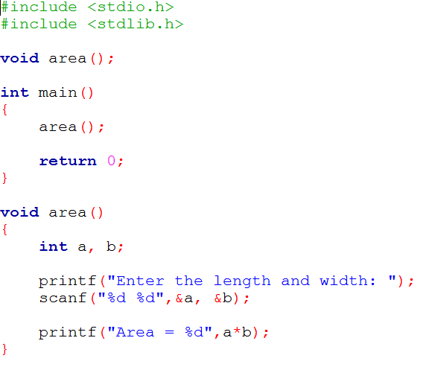
Functions with no arguments and no return values

Slide 23
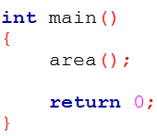
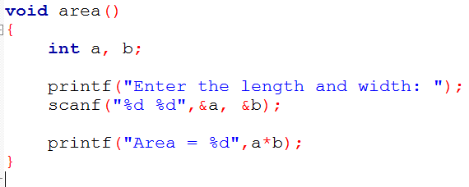
Functions with no arguments and no return values
Control Pass
No argument passing
No return value
Control Pass
Calling Function
Called Function

Slide 24
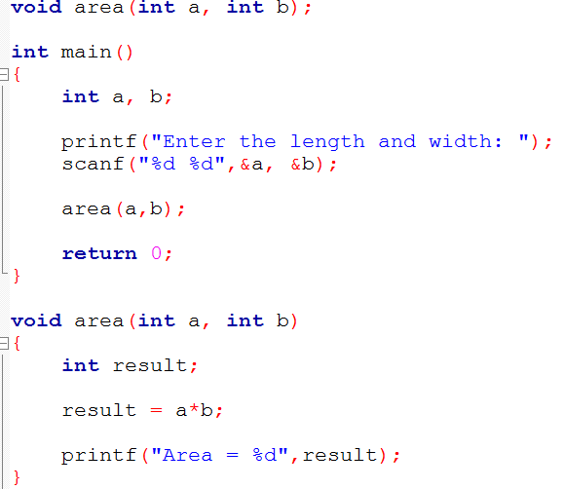
Functions with arguments and no return values

Slide 25
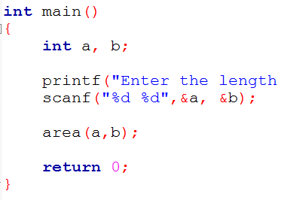
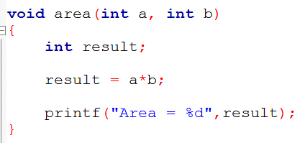
Functions with arguments and no return values
Control Pass
argument passing (a,b)
No return value
Control Pass
Calling Function
Called Function

Slide 26
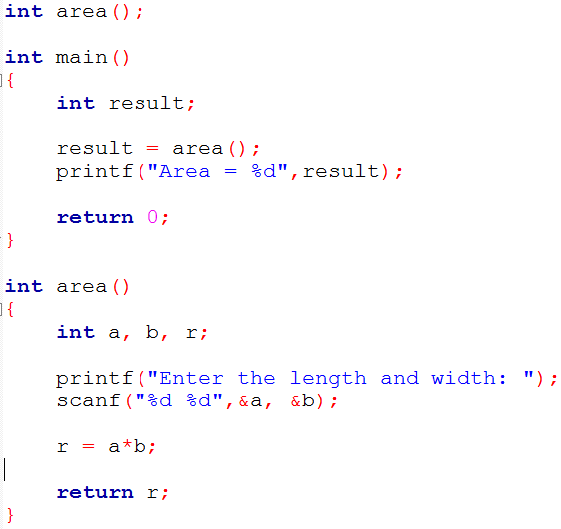
Functions with no arguments and return values

Slide 27
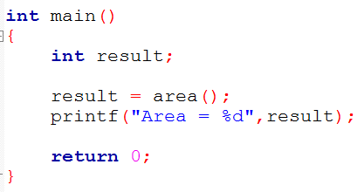
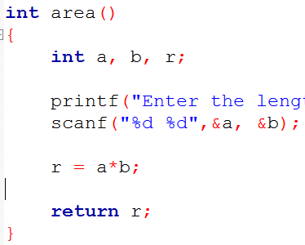
Functions with no arguments and return values
Control Pass
no argument passing
return value r
Control Pass
Calling Function
Called Function

Slide 28
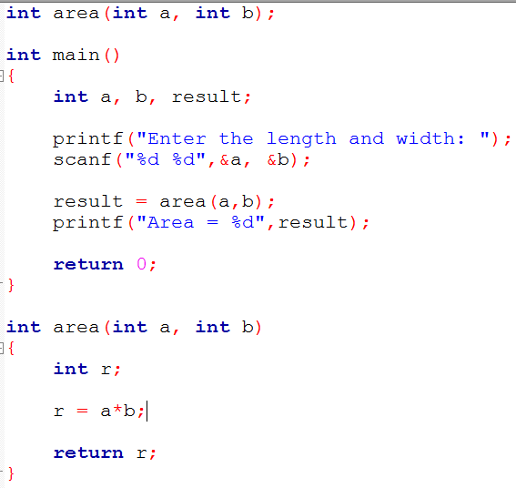
Functions with arguments and return values

Slide 29
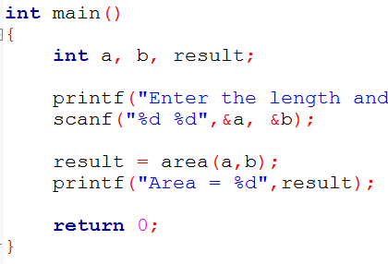
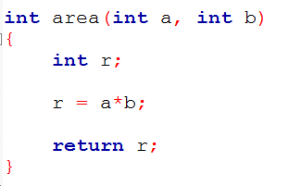
Functions with arguments and return values
Control Pass
argument passing (a,b)
return value r
Control Pass
Calling Function
Called Function

