Slide 1
Welcome To Our Presentation

Slide 2
Course Name : Software Development Project-II Course Code : CSE-3114
Presented By
Md Hasan Uz Zaman Jotirmoy Roy
ID:CE18029 ID:CE18028
Md. Mehedi Hasan Khan
ID:CE18024
SESSION : 2017-18
DEPARTMENT OF CSE,MBSTU
Supervisor
MD.HADIFUR RAHMAN
ASSOCIATE PROFESSOR
DEPARTMENT OF CSE,MBSTU

Slide 3
Presentation on
MBSTU_CHAT_BOX

Slide 4
Contents
Introduction
Purpose
Web Based Application
Developing Tools
Features
Data Flow Diagram
Project View
Limitations
Conclusion and future works

Slide 5
Introduction
Information: Communicate with friends, sharing and react posts.
Module: Provides 4 modules: 1) User 2) Post 3) Conversation 4) Message
Maintenance: Deals with chat, post, make friend, react other posts.
System: Single page application which is run by browser.
Result: i) Dynamic web based application, ii) Create user, conversation, post class etc.
Search: This system will also help to know the personal information.

Slide 6
Purpose
Platform: Our project is web based application but responsiveness of our project in mobile device should be more.
Performance: Our project is faster when internet connection is good otherwise slow.
Security: To increase security.

Slide 7
Web Based Application
System: To overcome these problems we have developed a better system which is web based
Security: In this system records are kept safe and secure
Efficiency: It provides better and efficient service

Slide 8
Developing Tools
Operating System: Windows 7,8,10
Language: Javascript (Reactjs, Nodejs, Expressjs), HTML5, CSS3
Database: MongodB
Browser: Chrome,Mozila Firefox
Tools & Technology: Antd, Git, Firebase, Heroku.
Platform: Visual Studio Code

Slide 9
Features
User account: Every user need to make an account with google account
Make friends: Users can make friend other users.
Users send message: Users can send message with other users
Post: Users can create, update and delete their posts.
React: Users can like any posts.

Slide 10
Data Flow Diagram
UNAME/PASS
USERS
ENTRY
LOGIN
AUNTHEDICATION
USERS ACCESS
INVALID
CHECK
DATABASE

Slide 11
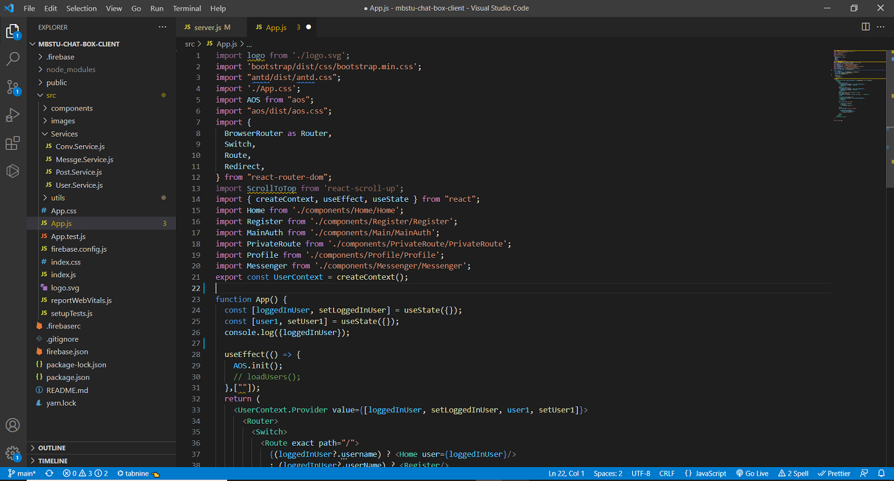
Project View
PROJECT
STRUCTURE

Slide 12
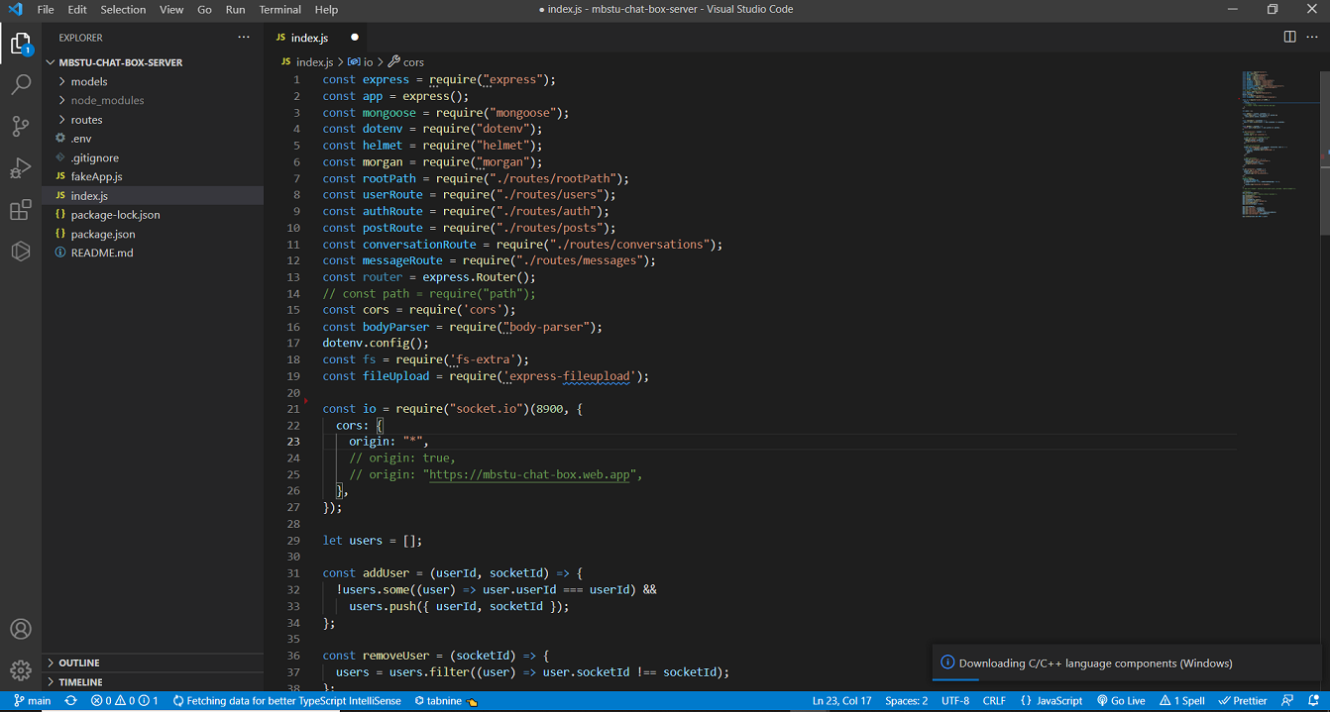
Project View
PROJECT
STRUCTURE

Slide 13
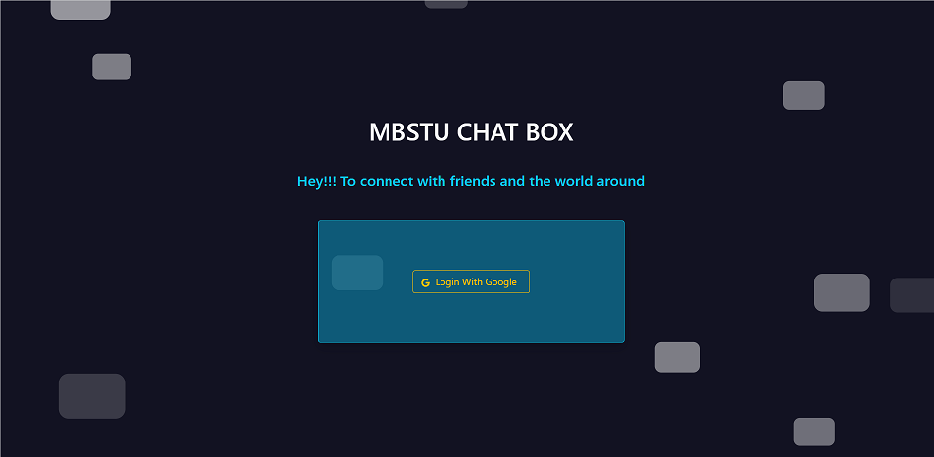
Project View
PROJECT HOME BEFORE
LOGIN

Slide 14
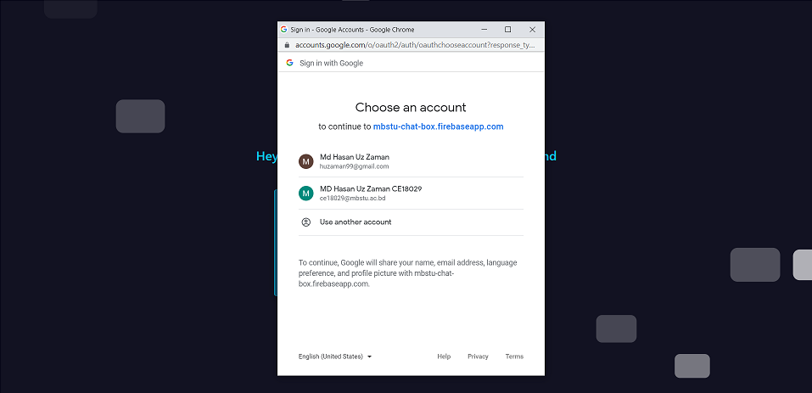
Project View
PROJECT HOME BEFORE
LOGIN

Slide 15
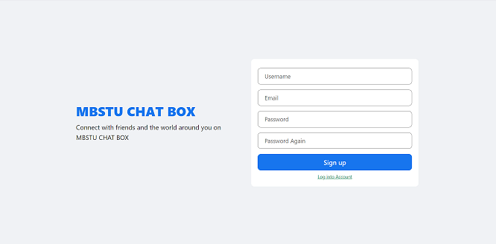
Project View
Sign up/Register

Slide 16
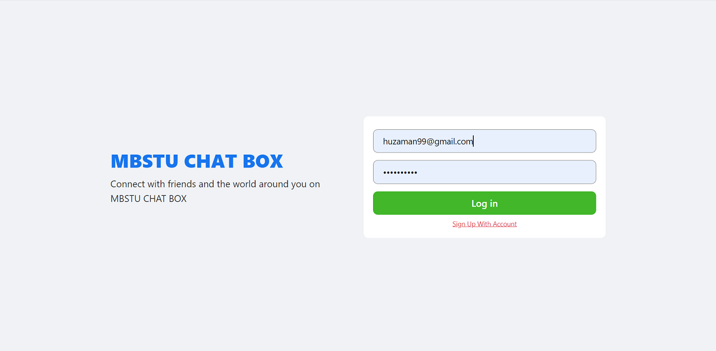
Project View
Log in

Slide 17
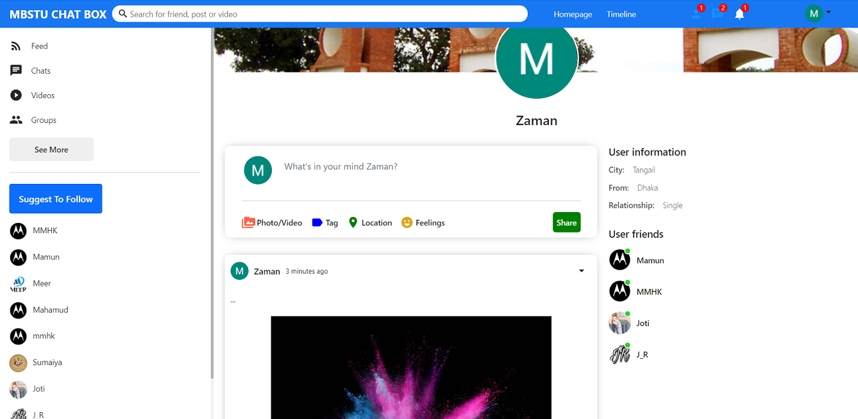
Project View
User’s Profile

Slide 18
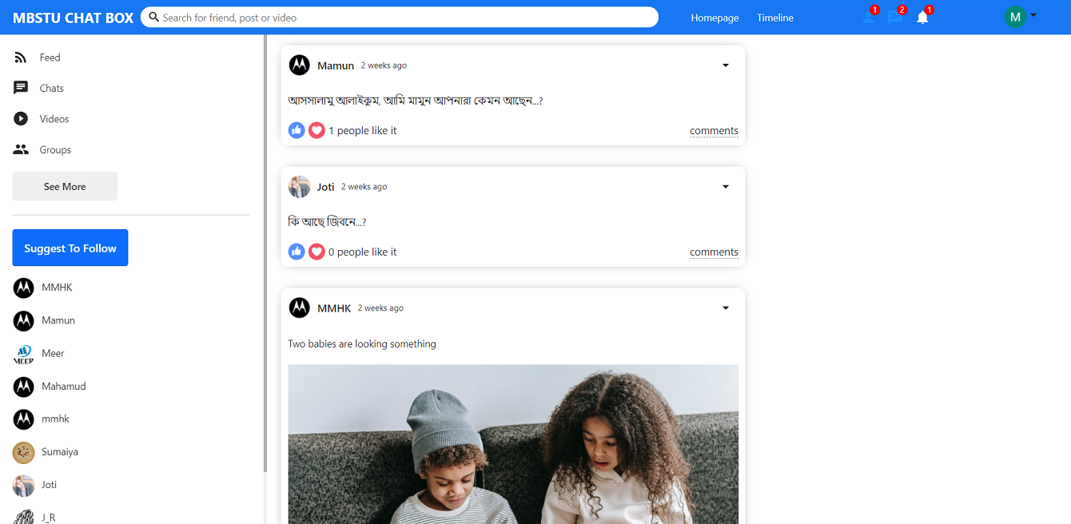
Project View
Newsfeed

Slide 19
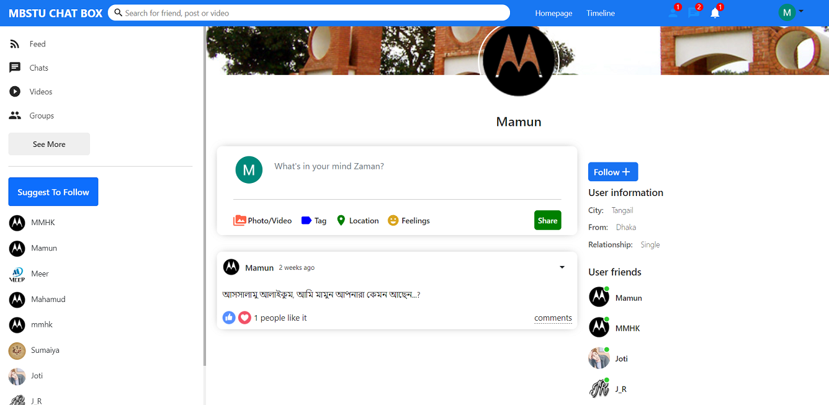
Project View
Other’s Profile

Slide 20
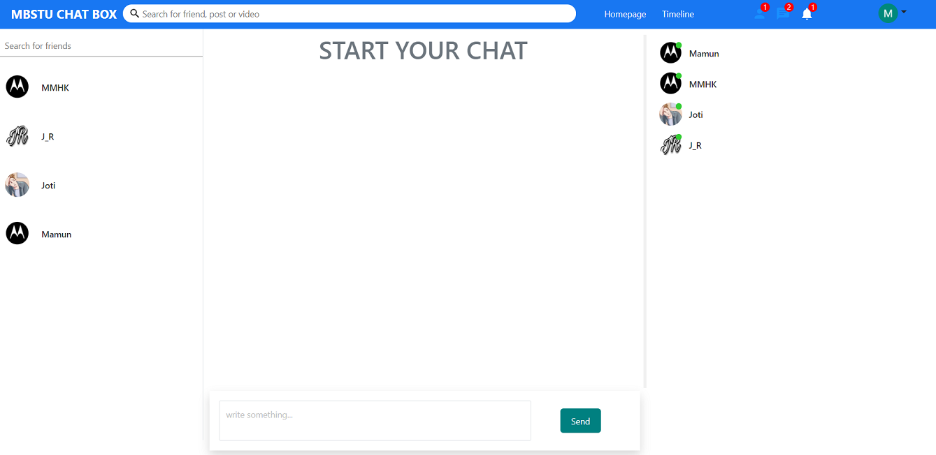
Project View
Chat List

Slide 21
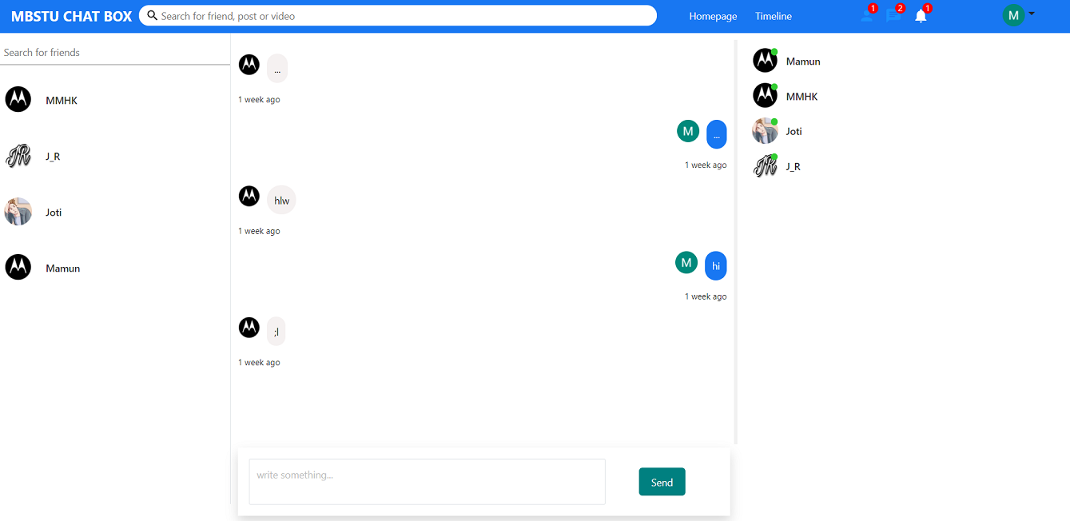
Project View
Online Chat

Slide 22
Limitations
Friends can not chat other in live URL of our project
Message can not delete when it is delivered once
Group can not create
Videos or files can not share
Users can not comment in any post
Users can not get notification
If users refresh a page it will be logout automatically

Slide 23
Conclusion And Future Works
In this work, the web based Mbstu Chat Box is developed using JavaScript(Reactjs), CSS,HTML for front-end and Javascript(Expressjs) for back-end for designing which is fully meet the system’s goals
The system we have developed is fully responsive in Desktop devices but not fully responsive in mobile devices
It is a dynamic, flexible and very user friendly system
We will make some future improvement in our Mbstu Chat Box project using new technology and add attractive feature in order to make more advanced and increase its reliability and effectiveness.

Slide 24
Thank You…

