Slide 1

Ahsanullah University of Science and Technology
Dept. of Computer Science and Engineering
Information System Design and Software Engineering Lab
(CSE 3224)
Hospital Management System
(ER Diagram and Relational Model)
Submitted By :-
Shadman Sakib (16.01.04.092)
A.K.M. Sadman Ali (16.01.04.093)
Tasmia Tuj Juha (16.01.04.095)
Mehedi Hasan Abir (16.01.04.102)

Slide 2
Introduction
This is an overview of the Entity Relationship Diagram and Relational Model of our hospital management system.
An Entity Relationship Diagram gives a good visual representation of data for database designer
A Relational Model helps to structure data in a simplified manner

Slide 3
Entities
Entity | Primary Key (PK) | Foreign Key (FK)
Patient | PatientId
Doctor | DoctorId
DoctorSchedule | ScheduleId | DoctorId
Appointment | AppointmentId | DoctorId, PatientId, PrescriptionId
Prescription | PrescriptionId
Medicine | MedicineId
MedicineDetails | PrescriptionId, MedicineId | PrescriptionId, MedicineId
Test | TestId | AssistantId
Payment | PaymentId | PatientId
LabAssistant | AssistantId

Slide 4
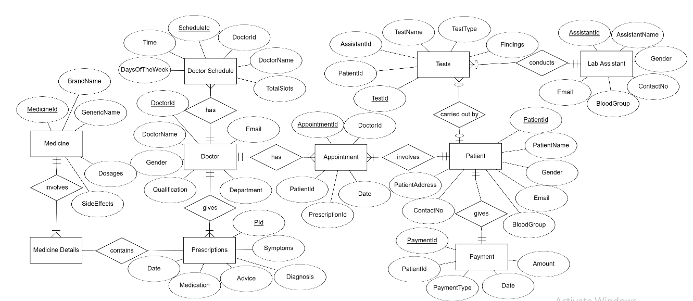
ERD

Slide 5
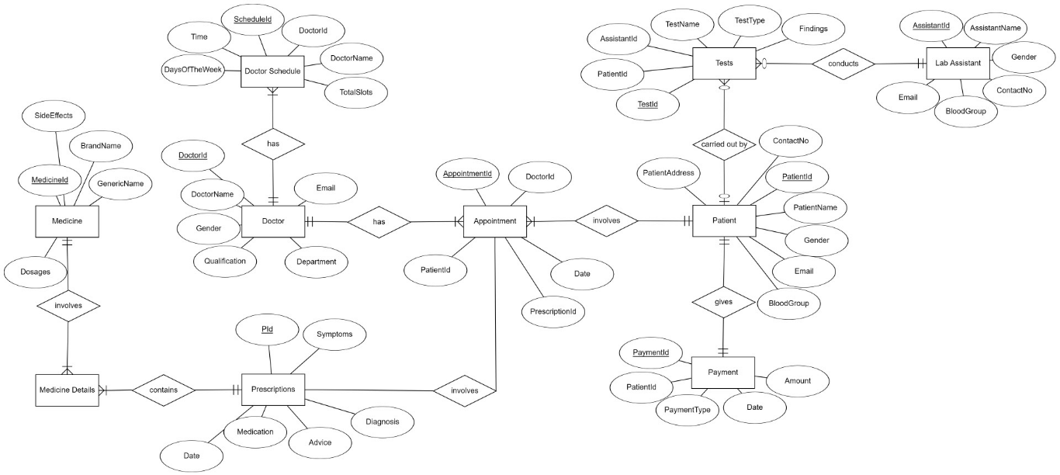
ERD

Slide 6
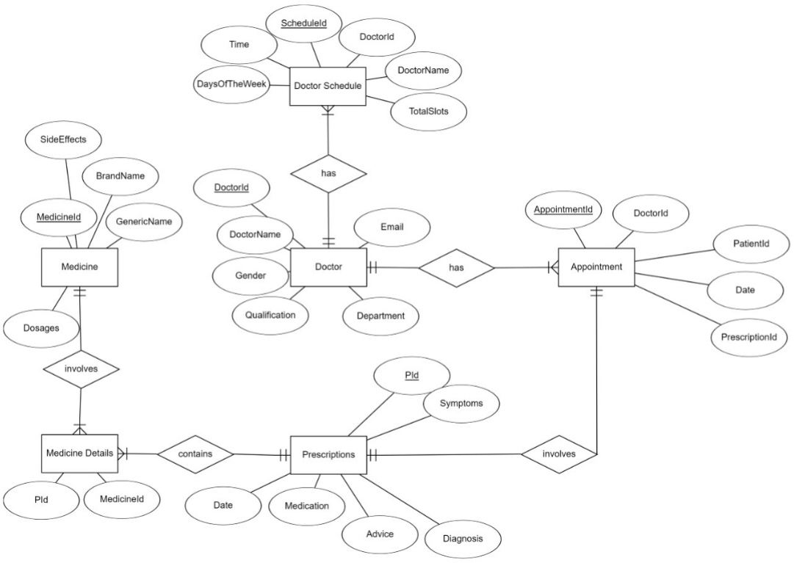

Slide 7
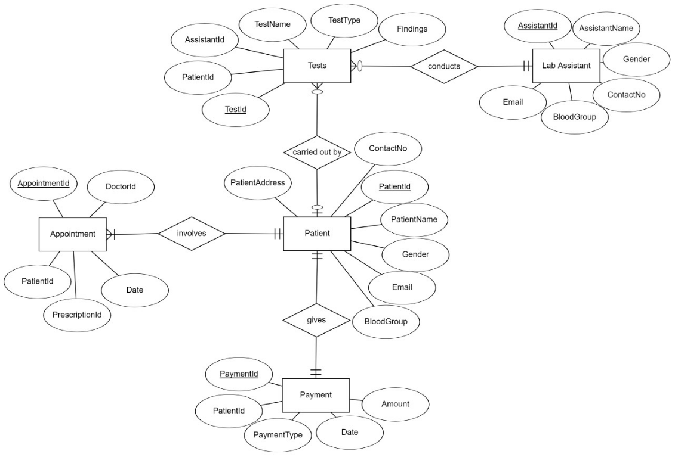

Slide 8
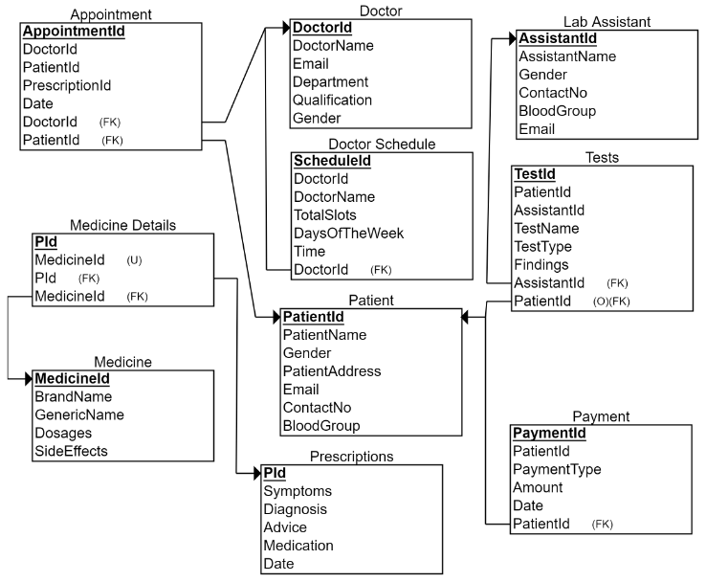
Relational Model

Slide 9
SQL Commands
create table Patient
(
PatientId int primary key identity(1,1),
PatientName varchar(50) not null,
Username varchar(50) unique not null,
Password varchar(50) not null,
Gender varchar(50) not null,
PatientAddress varchar(50) not null,
Email varchar(50) not null,
ContactNo varchar(50) not null,
BloodGroup varchar(50) not null
);
create table Doctor
(
DoctorId int primary key identity(1,1),
DoctorName varchar(50) not null,
Username varchar(50) unique not null,
Password varchar(50) not null,
Email varchar(50) not null,
Department varchar(50) not null,
Qualification varchar(50) not null,
Gender varchar(50) not null
);

Slide 10
SQL Commands (continued)
create table DoctorSchedule
(
ScheduleId int primary key identity(1,1),
DoctorId int foreign key references Doctor(DoctorId),
DoctorName varchar(50) not null,
TotalSlots int not null,
DaysOfTheWeek varchar(255) not null,
Time varchar(255) not null
);
create table Prescription
(
PId int primary key identity(1,1),
Symptoms varchar(255) not null,
Diagnosis varchar(255) not null,
Advice varchar(255) not null,
Medication varchar(255),
Date varchar(255) not null
);

Slide 11
SQL Commands (continued)
CREATE TABLE Test (
TestId INT IDENTITY (1, 1) NOT NULL,
PatientId INT NOT NULL foreign key references Patient(PatientId),
AssistantId INT NOT NULL foreign key references LabAssistant(AssistantId),
TestName VARCHAR (255) NOT NULL,
TestType VARCHAR (255) NOT NULL,
Findings VARCHAR (255) NULL,
);
CREATE TABLE LabAssistant(
AssistantId INT IDENTITY (1, 1) NOT NULL,
AssistantName VARCHAR (50) NOT NULL,
Gender VARCHAR (50) NOT NULL,
ContactNo VARCHAR (50) NOT NULL,
BloodGroup VARCHAR (50) NOT NULL,
Email VARCHAR (255) NOT NULL,
);

Slide 12
SQL Commands (continued)
create table Medicine
(
MedicineId int primary key identity(1,1),
BrandName varchar(50) not null,
GenericName varchar(50) not null,
Dosages varchar(50) not null,
SideEffects varchar(255)
);
CREATE TABLE Payment
(
PaymentId INT NOT NULL IDENTITY(1,1) PRIMARY KEY,
PatientId INT NOT NULL foreign key references Patient(PatientId),
PaymentType VARCHAR(10) NOT NULL,
Amount INT NOT NULL,
Date DATETIME NOT NULL,
)

Slide 13
SQL Commands (continued)
CREATE TABLE Appointment
(
AppointmentId INT NOT NULL PRIMARY KEY,
DoctorId INT NOT NULL foreign key references Doctor(DoctorId),
PatientId INT NOT NULL foreign key references Patient(PatientId) ,
PrescriptionId INT NOT NULL foreign key references Prescription(PrescriptionId),
Date DATETIME NOT NULL,
)
CREATE TABLE MedicineDetails
(
PId INT NOT NULL,
MedicineId INT NOT NULL,
MedicineId INT NOT NULL,
PRIMARY KEY (PId),
FOREIGN KEY (PId) REFERENCES Prescriptions(PId),
FOREIGN KEY (MedicineId) REFERENCES Medicine(MedicineId),
UNIQUE (MedicineId)
);

Slide 14
Dummy Data Patient Doctor
Patient ID | PatientName | Username | Gender | Address | ContactNo | Blood Group
01 | Mehedi Abir | abeer420 | Male | 10/D 30/23 Mirpur 1216 | 015……… | O+
02 | Protiva Juha | projuha | Female | 10/c 5/6 Mirpur 1216 | 017……… | O-
DoctorId | DoctorName | Username | Department | Qualification | Gender
01 | Fakhrul Ahmed | fakhah | Pathology | …….. | Male
02 | MD Johurul | Johurul | Surgeon | ……… | Male

Slide 15
Dummy Data
Doctor Schedule
Prescription
TEST
ScheduleId | DoctorId(FK) | DoctorName | TotalSlots | ……….
1 | 01 | Johurul | 23 | …………
2 | 02 | Johurul | 22 | …………
PId | Symptoms | Diagnosis | Advice | …………
1 | Alergy Coughing | Fever | Paracetamol | ………….
2 | ………. | ………. | ………… | …………
TestId | PatientId | AssistantId | TestName | ………..
1 | 2 | 5 | X-ray

Slide 16
Dummy Data Medicine Payment Appointment
MedicineId | BrandName | GenericName | Dosages | …………..
2 | Metamizole | Homatropine | 2 times a day | ……….
3 | Naproxen | Pantoparazol | 3 times a day | ………..
PaymentId | PaymentType | Amount | Date
3 | Credit Card | 10,000tk | 23-03-2019
4 | Cash | 1000tk | 04-06-2018
AppointmentId | DoctorId | PatientId | PrescriptionId | Date
2 | 5 | 3 | 4 | 23-03-2019
3 | 2 | 7 | 6 | 04-06-2018

Slide 17
Conclusion
The ERD and Relational Model helped us to understand how the database will be implemented. SQL commands allowed us to make data tables according to the model.
Hence, our project has moved further towards completion.

Slide 18
THANK YOU! Any questions?

