Slide 1
Student Task Manager System
CSE-3532: Tools and Technologies for Internet Programming
Spring 2026 — 5th Semester, Section 5CM | International Islamic University Chittagong (IIUC)
Team: Mehedi Hasan Howlader (C241086) | Mohammad Sadman Tahiat (C241100) | Minhaj Hasan Rohan (C241101)
Submitted To: Ahasanul Kalam Akib, Adjunct Lecturer, Dept. of CSE, IIUC

Slide 2
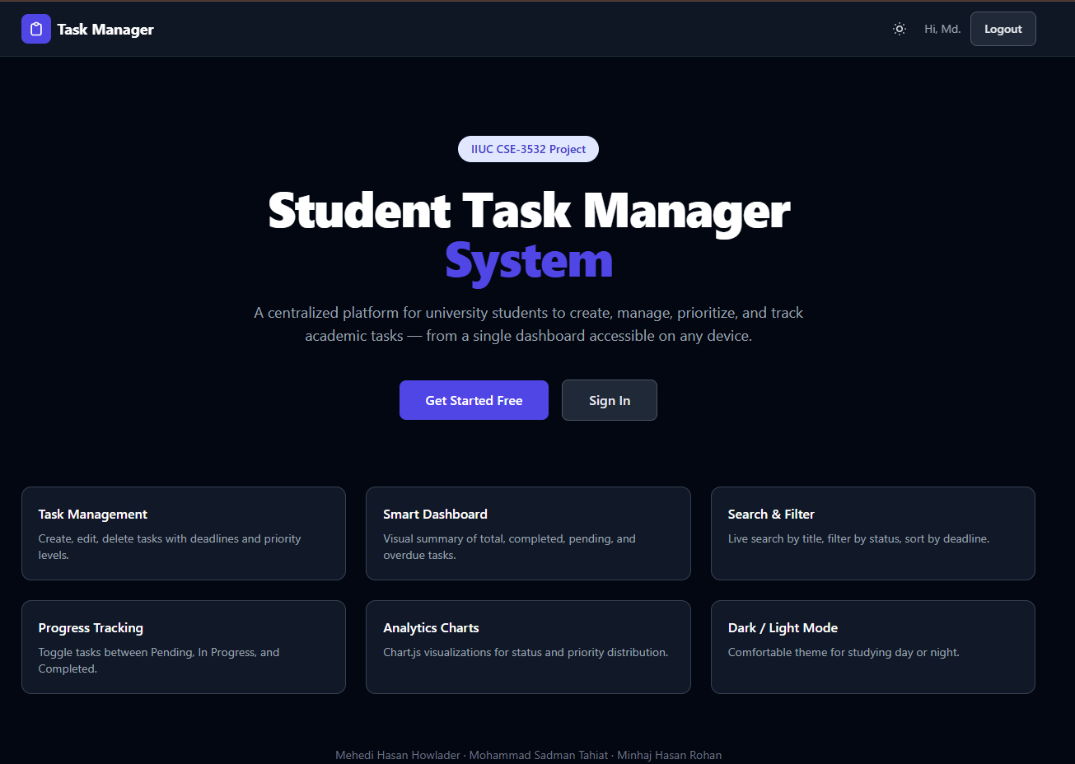
Problem Statement
The Real-Life Problem
University students face demanding academic workloads — juggling multiple courses, assignments, lab reports, presentations, and personal responsibilities.
67% of university students struggle to organize academic tasks effectively, leading to missed deadlines and lower academic performance.
Traditional methods (scattered paper notes, generic reminder apps, simple memory) fail to provide structured priority, deadline tracking, or centralized progress visualization.
Our Solution: A purpose-built, responsive web application providing a centralized, intuitive dashboard to create, manage, prioritize, and track academic tasks on any device.

Slide 3
Objectives of the Project
1. Build a full-stack MERN web application for student task management
2. Implement secure authentication (email/password + Google OAuth via Firebase)
3. Provide full CRUD operations on tasks with title, description, deadline, priority, status
4. Build productivity dashboard with summary statistics and Chart.js visualizations
5. Implement smart search, filtering, and sorting for efficient task retrieval
6. Design responsive UI with dark/light theme support using Tailwind CSS
7. Ensure cross-device compatibility (mobile, tablet, desktop)

Slide 4
Key Features
🔒 Authentication & Security
Email/password signup/login with bcryptjs hashing (salt 12) + JWT stored in localStorage. Google OAuth via Firebase with backend sync.
📝 Full Task CRUD
Create, read, update, delete tasks with title, description, deadline, priority (Low/Medium/High), and status (Pending/In Progress/Completed).
📊 Analytics Dashboard
Summary cards (Total, Completed, Pending, Overdue). Doughnut & bar charts via Chart.js showing status and priority distribution.

Slide 5
Key Features (cont.)
🔍 Smart Search & Filter
Real-time text search by title. Filter by status and priority. Sort by deadline (asc/desc) or creation date.
🌗 Dark / Light Mode
Dynamic theme switcher using CSS variables + React Context API. Persisted in localStorage. Auto-detect system preference.
📱 Responsive Design
Mobile-first layout using Tailwind CSS grid and flexbox. Works seamlessly on mobile (320px+), tablet (768px+), and desktop (1024px+).
🛡️ Protected Routes
React Route guards redirect unauthenticated requests to Login page. JWT attached to every API request via Axios interceptors.

Slide 6
Technology Stack
Layer | Technology | Usage in Project
Frontend | React 18 (Vite) | Declarative UI component architecture
Styling | Tailwind CSS | Utility-first responsive layouts + dark/light themes
State & Auth | React Context API + Axios | Global auth/theme state, JWT interceptors
Analytics | Chart.js + react-chartjs-2 | Doughnut and bar chart visualizations
Backend | Node.js + Express.js | RESTful API server handling business logic
Database | MongoDB + Mongoose | Document DB with ODM for persistent storage
Auth Services | JWT + bcryptjs + Firebase Auth | Email/password + Google OAuth integration
Dev Tools | Git/GitHub, VS Code | Version control and collaborative workspace

Slide 7
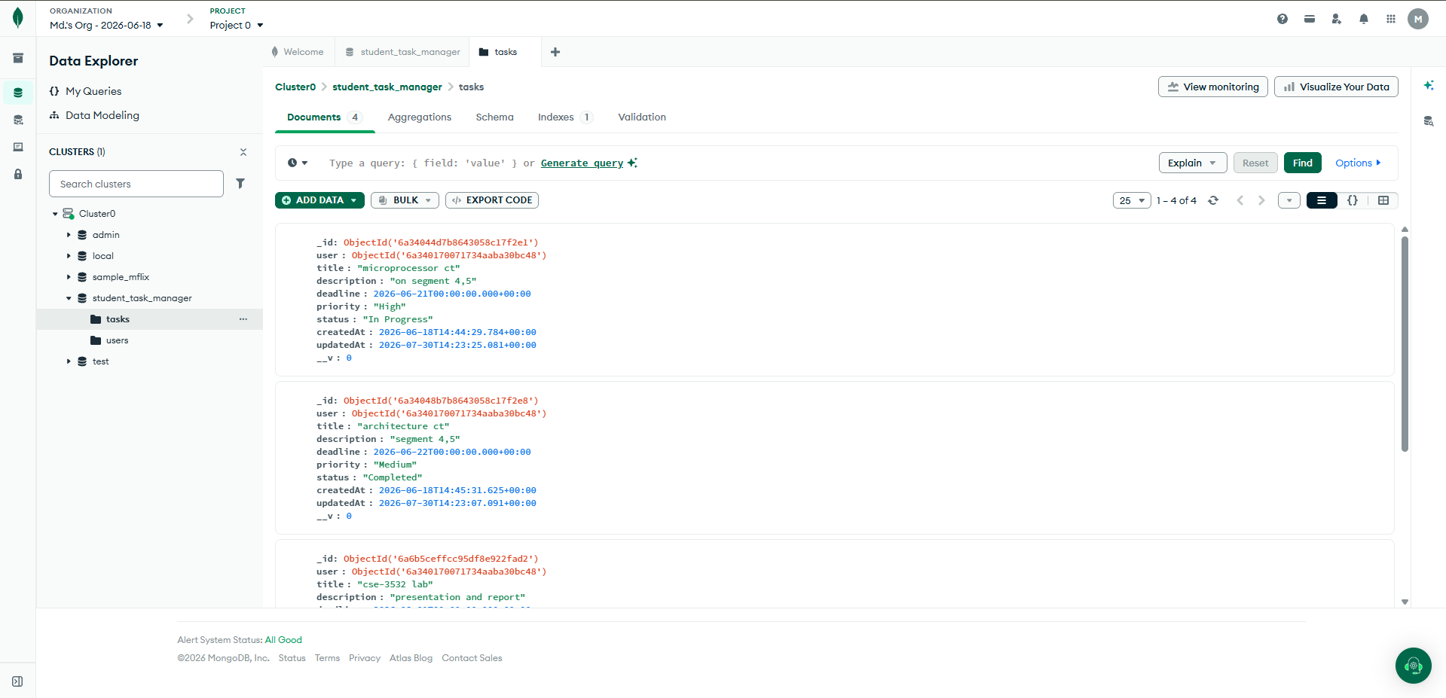
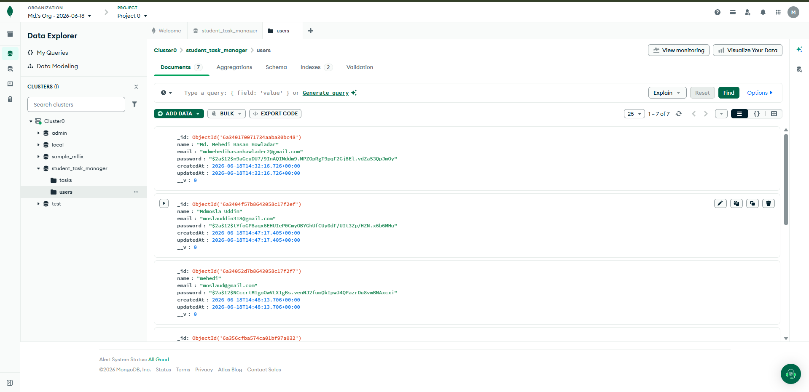
System Architecture
CLIENT (Browser)
React SPA (Vite)
Tailwind CSS
Chart.js + react-chartjs-2
Axios HTTP Client
BACKEND (Node.js + Express)
Auth Routes (/api/auth)
Task Routes (/api/tasks)
JWT Middleware (protect)
Stats Endpoint (/api/tasks/stats)
DATABASE (MongoDB)
User Collection
Task Collection
Mongoose ODM
MongoDB Atlas (Cloud)
→ HTTP/JSON →
→ Queries →
EXTERNAL: Firebase Auth
Google OAuth / Google Sign-In

Slide 8
Database Design
User Collection
Task Collection
Field | Type | Required | Description
name | String | Yes | Full name of the user
email | String | Yes (unique) | Lowercase, unique email
password | String | Yes | bcrypt-hashed (salt 12, min 6 chars)
createdAt | Date | Auto | Account creation timestamp
updatedAt | Date | Auto | Last update timestamp
Field | Type | Req? | Description
user | ObjectId (ref: User) | Yes | Owner of the task
title | String | Yes | Task title (trimmed)
description | String | No | Optional task details (default '')
deadline | Date | Yes | Task due date
priority | enum: Low/Med/High | No | Default: Medium
status | enum: Pending/Prog/Done | No | Default: Pending
createdAt | Date | Auto | Creation timestamp
updatedAt | Date | Auto | Last update timestamp
Relationship: One User → Many Tasks (1:N). Each Task belongs to exactly one User via user ObjectId reference. All task queries are filtered by req.user._id (JWT-authenticated).

Slide 9
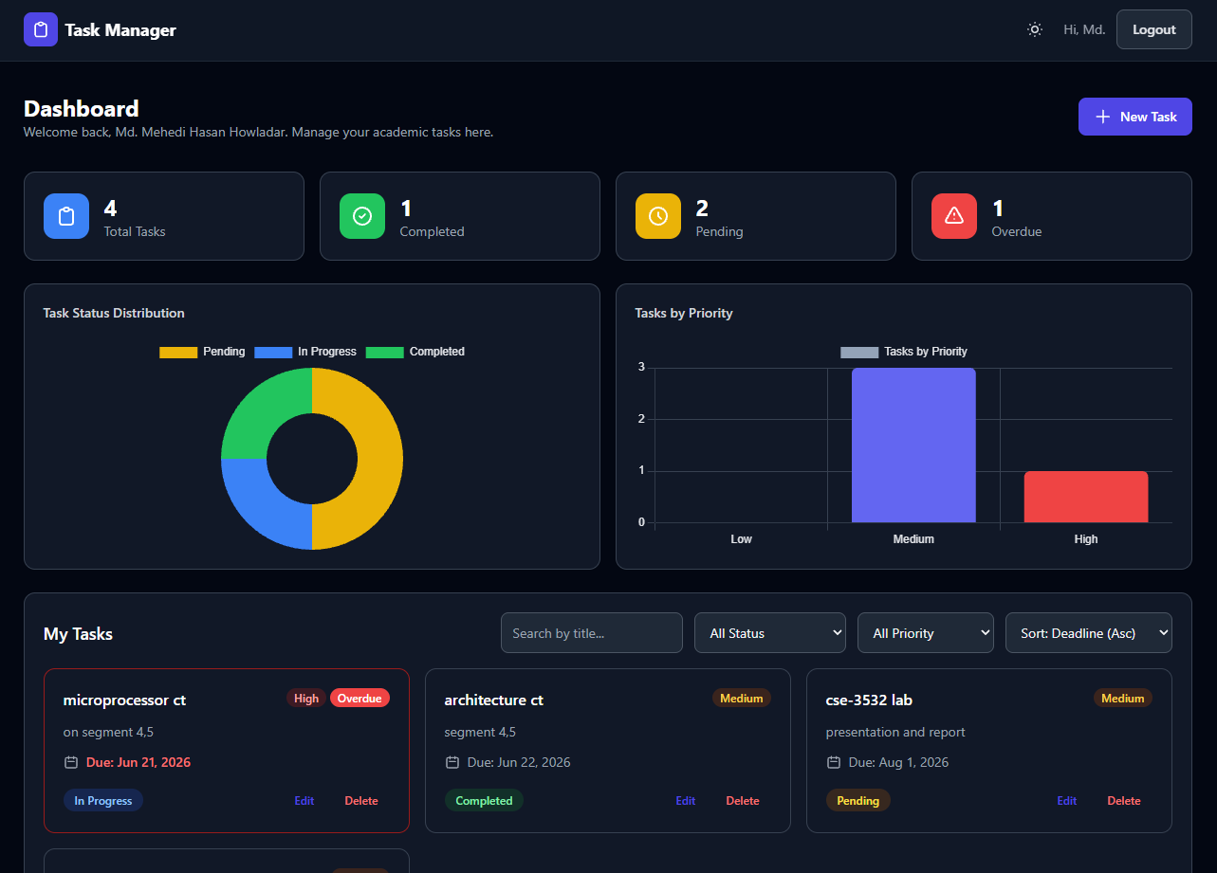
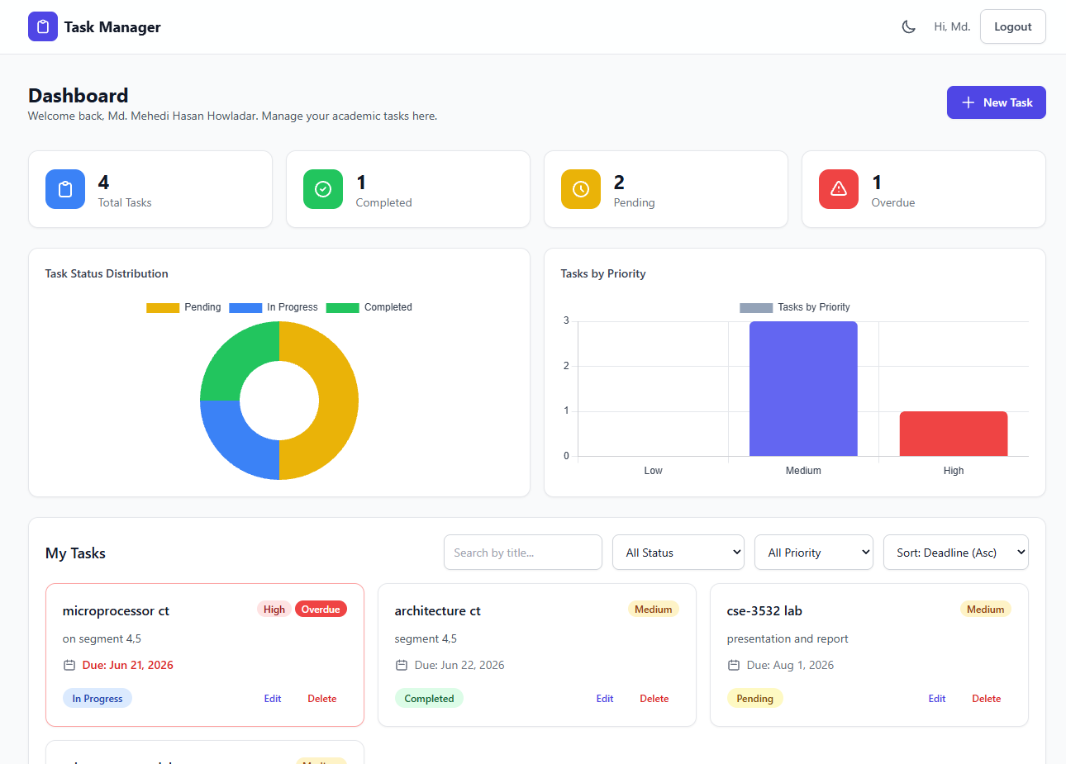
Project Screenshots

Slide 10
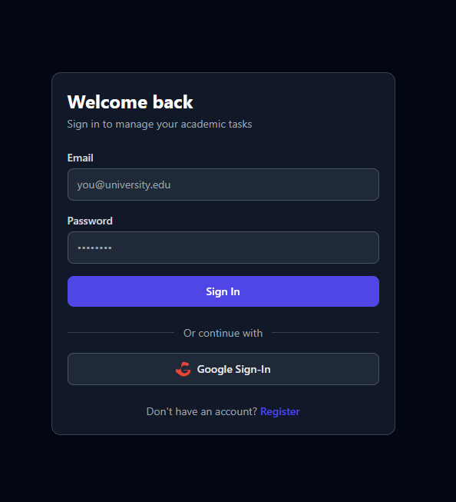
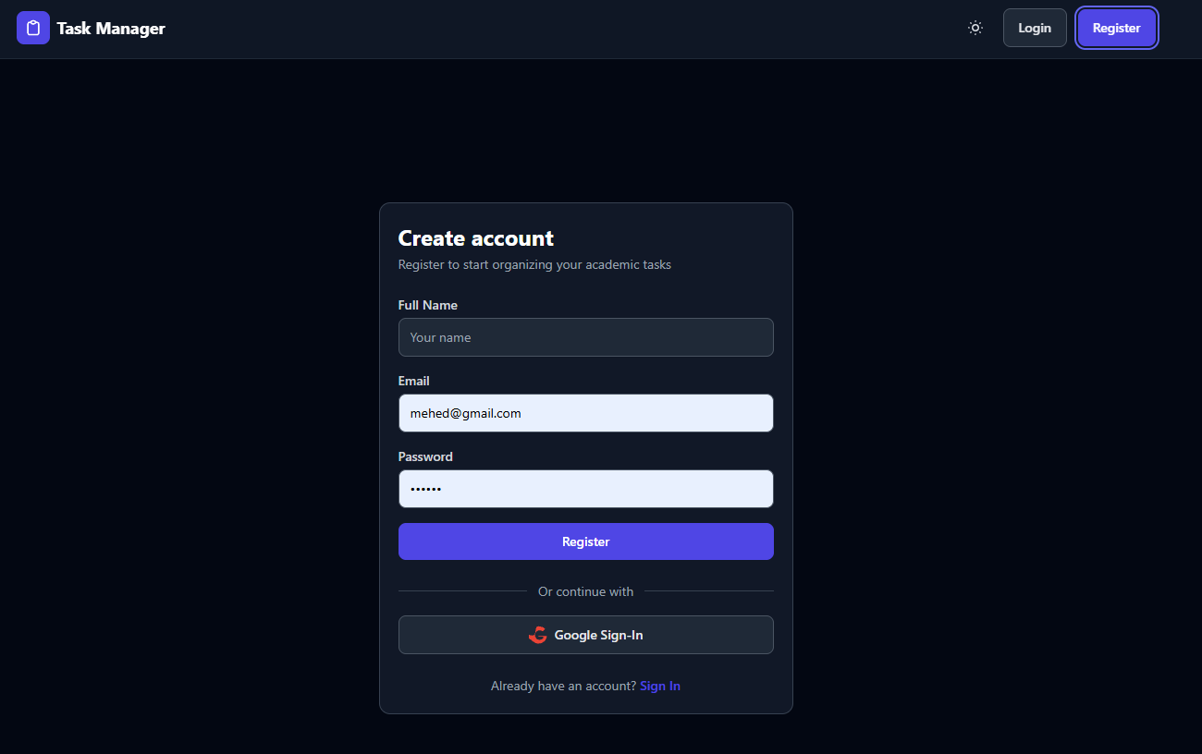
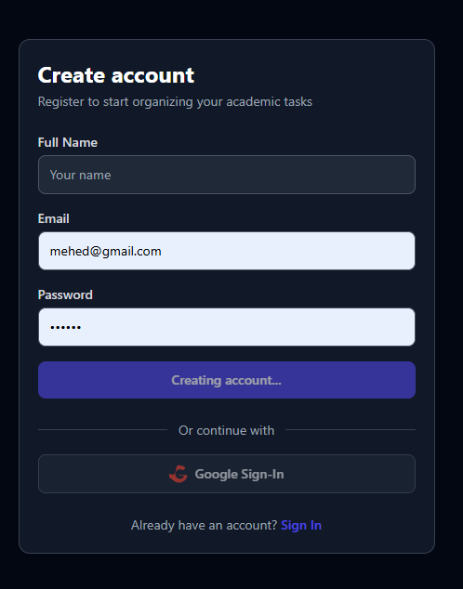
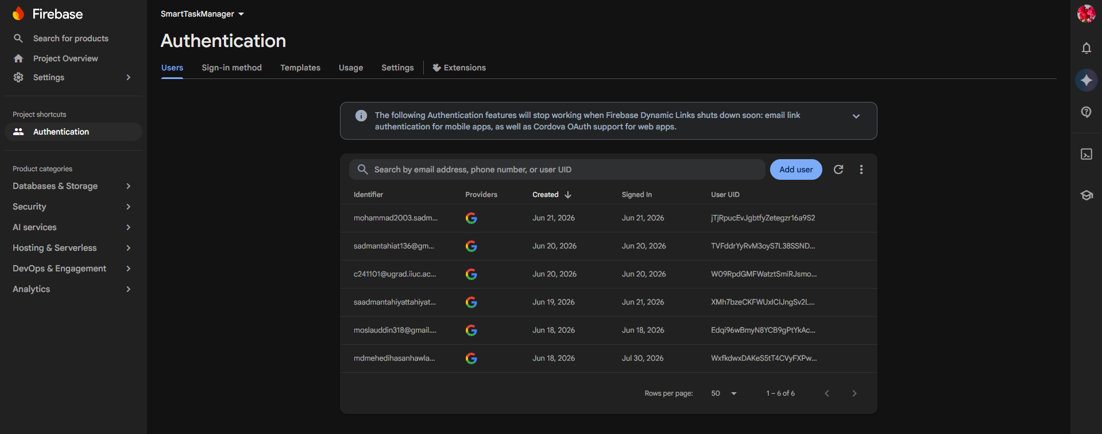
Project Screenshots (cont.)

Slide 11
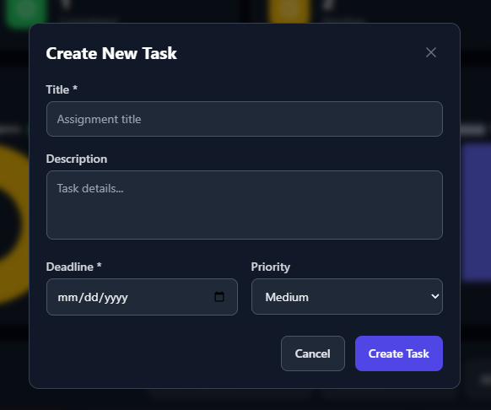
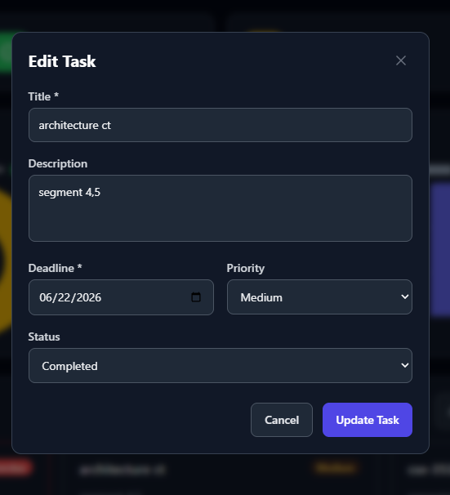
Project Screenshots (cont.)

Slide 12
Challenges Faced
⚠️ Firebase → Backend Sync
Google OAuth users authenticate via Firebase but needed to exist in MongoDB too. Solved with /api/auth/firebase endpoint that creates/finds user and returns JWT.
⚠️ Real-Time Search with Debounce
Live search without excessive API calls required a 300ms debounce timer in the Dashboard component.
⚠️ JWT Token Management
Auto-redirect on 401 responses needed Axios interceptors on both request (attach token) and response (handle 401) sides.
⚠️ Dark/Light Persistence
Theme state persisted across reloads using localStorage + prefers-color-scheme media query with class-level toggling on <html> element.
⚠️ MongoDB Memory Server Fallback
When local MongoDB is unavailable, system falls back to mongodb-memory-server — useful for dev but data resets on restart (trade-off).

Slide 13
Future Improvement
📧 Smart Deadline Alerts
Email + browser push notifications for approaching deadlines (nodemailer, Service Workers)
📅 Calendar View
Interactive monthly/weekly calendar component showing task density and timelines
👥 Collaboration Boards
Multi-user shared boards for group projects with subtask delegation
🤖 AI Priority Assistant
ML model analyzing deadlines, descriptions, and past performance for priority suggestions
📎 Document Attachments
Upload lecture slides, notes, PDFs, screenshots inside task cards (GridFS/Firebase Storage)
📱 React Native Mobile App
Offline-first mobile companion with background sync capabilities
🌐 Localization / i18n
Multi-language support starting with Bengali for IIUC students

Slide 14
Conclusion
The Student Task Manager System successfully delivers a modern, full-stack MERN web application that helps university students organize, prioritize, and track their academic tasks in one centralized platform. It combines secure authentication, full CRUD task management, interactive analytics, and a responsive dark/light UI into a cohesive experience — demonstrating practical application of React, Node.js, Express, MongoDB, and modern web development best practices.
— Strong outcome for CSE-3532 course at IIUC —

