Slide 1
CSE 4513
Lec – 9
Design Pattern

Slide 2
Someone has already solved your problems

Slide 3
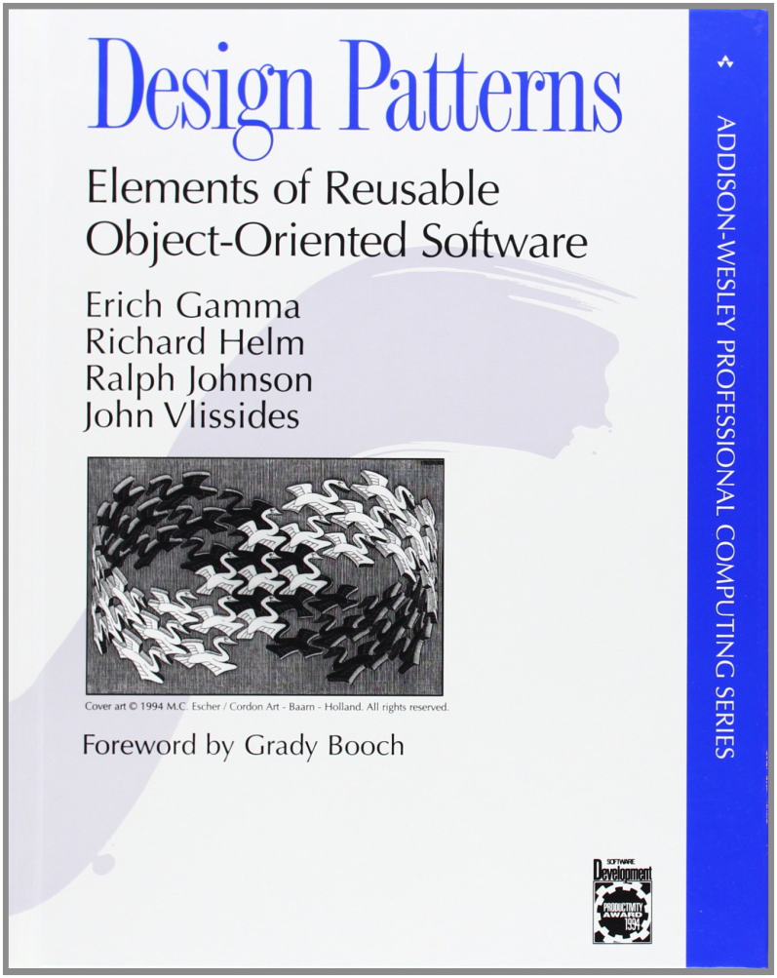
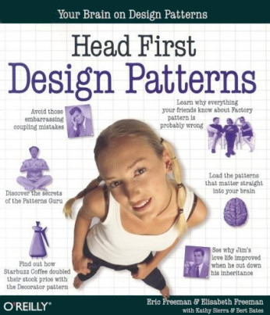
Useful books
The “Gang of Four” book
1994
Head First Design Patterns Book
2004

Slide 4
What you can do
A design pattern is a general solution
to a common problem in a context.
What you want
What you have
Each pattern Describes a problem which occurs over and over again in our environment ,and then describes the core of the problem
“a design pattern is a general repeatable solution to a commonly occurring problem in software design”

Slide 5
Usage of Design Pattern
Design Patterns have two main usages in software development:
Common platform for developers
  Provide a standard terminology and are specific to particular scenario.
Best Practices
  Evolved over a long period of time
  Provide best solutions to certain problems faced during software development.
  helps inexperienced developers to learn software design in an easy and faster way.

Slide 6
Elements of a Pattern
four elements to describe a pattern
    • The name of the pattern
    • The purpose of the pattern: what problem it solves
    • How to solve the problem
    • The constraints we have to consider in our solution

Slide 7
Types of design patterns
There are about 26 Patterns currently discovered …
These 26 can be classified into 3 types:
Creational: These patterns are designed for class instantiation. They can be either class-creation patterns or object-creational patterns.
Structural: These patterns are designed with regard to a class's structure and composition. The main goal of most of these patterns is to increase the functionality of the class(es) involved, without changing much of its composition.
Behavioral: These patterns are designed depending on how one class communicates with others.

Slide 8
Design Pattern Index
Creational | Structural | Behavioural
Factory Method | Adapter | Template
Abstract Factory | Bridge | Strategy
Builder | Composite | Command
Singleton | Decorator | State
Multiton | Facade | Visitor
Object pool | Flyweight | Chain of Responsibility
Prototype | Front controller | Interpreter
 | Proxy | Observer
 |  | Iterator
 |  | Mediator
 |  | Memento

Slide 9
Warning
Always go with the simplest solution that does the job and introduce patterns only where the need emerges.
Overuse of design patterns can lead to code that is downright over-engineered.

Slide 10
Strategy Pattern

Slide 11
Strategy Pattern
it's probably the simplest pattern
it's about using composition rather than inheritance
it's about understanding that inheritance is not intended for code reuse

Slide 12
Definition
Defines a family of algorithms, encapsulates each one, and makes them interchangeable. Strategy lets the algorithm vary independently from clients that use it.

Slide 13
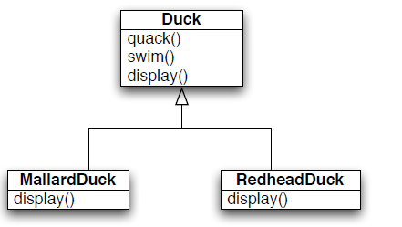
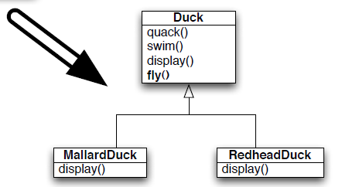
Strategy Pattern
But a request has arrived to allow ducks to also fly.

Slide 14
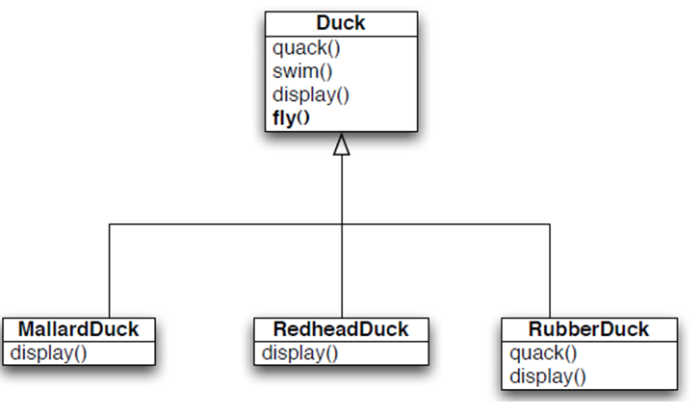
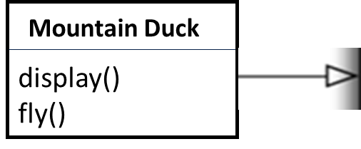
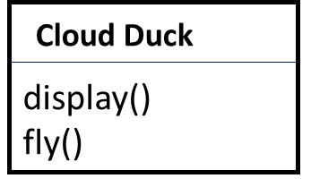

Strategy Pattern
Now we have another duck for example rubber duck which is a fake duck..
Mountain and cloud duck has same flying behavior.
Rubber duck has different flying behavior . We could override fly() in
RubberDuck to make it do
Nothing..

Slide 15
Strategy Pattern
We have algorithm for quacking
We have algorithm for flying…
Defines a family of algorithms, encapsulates each one, and makes them interchangeable. Strategy lets the algorithm vary independently from clients that use it.

Slide 16



Strategy Pattern
IFlyBehavior
IQuackBehavior
fly()
quack()
SimpleFly
fly()
SimpleQuack
quack()
JetFly
NoQuack
fly()
quack()
NoFly
fly()
FlyBehavior and QuackBehavior define a set of behaviors that provide behavior to Duck. Duck delegates to each set of behaviors and can switch among them dynamically, if needed.

Slide 17
Strategy Pattern

Slide 18
Observer Pattern

Slide 19
Observer Pattern
observer: An object that "watches" the state of another object and takes action when the state changes in some way.
Problem: You have a model object with a complex state, and the state may change throughout the life of your program.
You want to update various other parts of the program when the object's state changes.
Solution: Make the complex model object observable.
observable object: An object that allows observers to examine it (notifies its observers when its state changes).
Permits customizable, extensible event-based behavior for data modeling and graphics.

Slide 20
Observer Pattern
Subject/observable
  has a list of observers
  Interfaces for attaching/detaching an observer
Observer
  An updating interface for objects that gets notified of changes in a subject
ConcreteSubject
  Stores “state of interest” to observers
  Sends notification when state changes
ConcreteObserver
  Implements updating interface

Slide 21
Observer Pattern
Defines a one-to-many dependency between objects so that when one object changes state, all of its dependents are notified and updated automatically.

Slide 22

Observer Pattern
observers
ISubject
IObserver
Add(Observer)
Remove(Observer)
Notify()
Update()
ConcreteSubject
ConcreteObserver
Add(Observer)
Remove(Observer)
Notify()
getState()
Update()

Slide 23
Decorator Pattern

Slide 24
Decorator Pattern
The decorator pattern is a pattern where we write wrapper code to let us extend the core code.
We just keep wrapping objects around objects that we want to use so that we keep extending the capabilities of the existing objects by defining new objects that have the capabilities of the existing object.

Slide 25
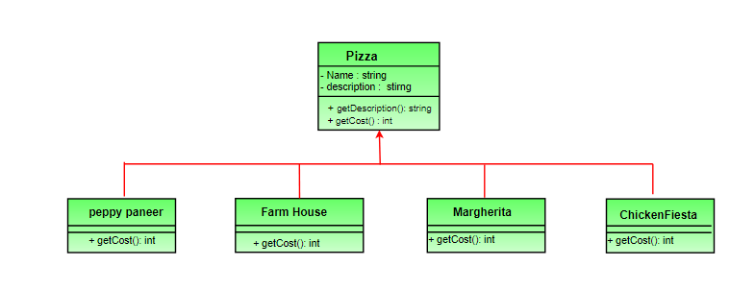
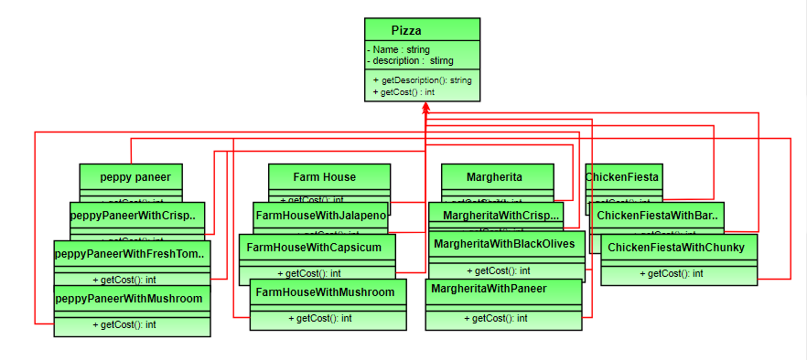
Decorator Pattern
how do we accommodate changes in the below classes so that customer can choose pizza with toppings and we get the total cost of pizza and toppings the customer chooses.
Option 1
Create a new subclass for every topping with a pizza.

Slide 26
Decorator Pattern
Option 1
This looks very complex.
There are way too many classes and is a maintenance nightmare.
Also if we want to add a new topping or pizza we have to add so many classes. This is obviously very bad design.

Slide 27
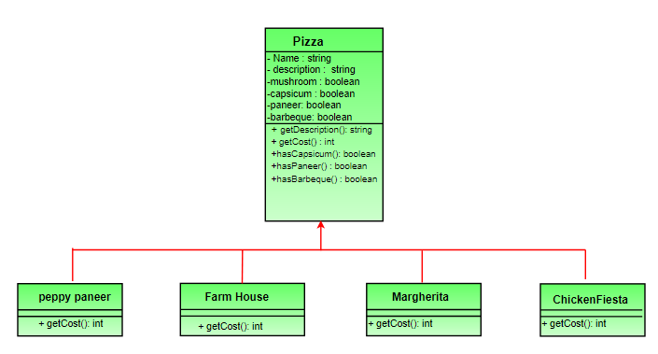
Decorator Pattern
Option 2:
Let’s add instance variables to pizza base class to represent whether or not each pizza has a topping.
The getCost() of superclass calculates the costs for all the toppings while the one in the subclass adds the cost of that specific pizza.

Slide 28
Decorator Pattern
Option 2:
This design looks good at first but problems associated with it are:
Price changes in toppings will lead to alteration in the existing code.
New toppings will force us to add new methods and alter getCost() method in superclass.
For some pizzas, some toppings may not be appropriate yet the subclass inherits them.
This design violates one of the most popular design principle – The Open-Closed Principle

Slide 29
Decorator Pattern
The decorator pattern attaches additional responsibilities to an object dynamically. Decorators provide a flexible alternative to subclassing for extending functionality.

Slide 30
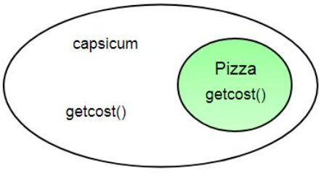
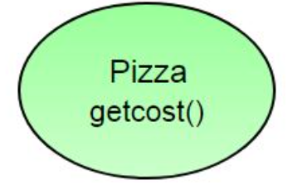
Decorator Pattern
The solution:
Previous designs are not a good one
Now, we will take a pizza and “decorate” it with toppings at runtime
2. “Decorate” it with a Capsicum object.
Take a pizza object.

Slide 31
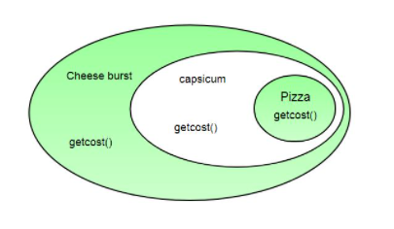
Decorator Pattern
3. “Decorate” it with a CheeseBurst object.

Slide 32
Decorator Pattern
4. Call getCost() and use delegation instead of inheritance to calculate the toppings cost.
800/-
100/-
200/-
1100/-
Now we get a pizza with cheeseburst and capsicum toppings.
Visualize the “decorator” objects like wrappers.

Slide 33
Decorator Pattern
Here are some of the properties of decorators:
Decorators have the same super type as the object they decorate.
You can use multiple decorators to wrap an object.
We can decorate objects at runtime.

Slide 34
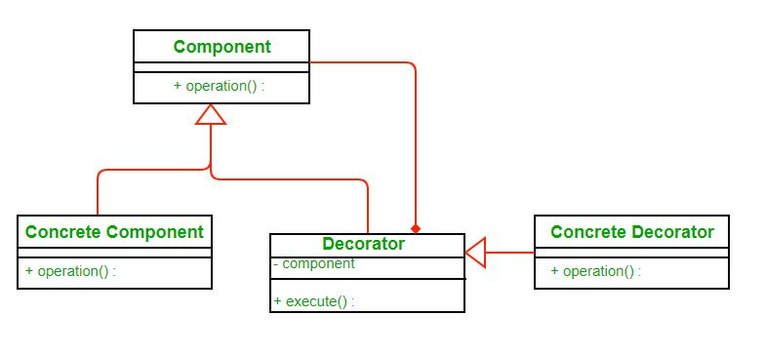
Decorator Pattern
Structure:
The Component declares the common interface for both wrappers and wrapped objects.
Each component can be used on its own or may be wrapped by a decorator.
Concrete Decorators define extra behaviors that can be added to components dynamically. Concrete decorators override methods of the base decorator and execute their behavior either before or after calling the parent method.
Concrete Component is a class of objects being wrapped. It defines the basic behavior, which can be altered by decorators.
The ConcreteComponent is the object we are going to dynamically decorate.
The Decorator class has a field for referencing a wrapped object The decorator delegates all operations to the wrapped object.
Each decorator has an instance variable that holds the reference to component it decorates(HAS-A relationship).

Slide 35
Decorator Pattern
Advantages:
The decorator pattern can be used to make it possible to extend (decorate) the functionality of a certain object at runtime.
The decorator pattern is an alternative to subclassing. Subclassing adds behavior at compile time, and the change affects all instances of the original class; decorating can provide new behavior at runtime for individual objects.

Slide 36

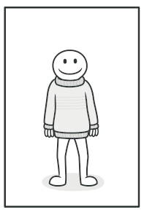
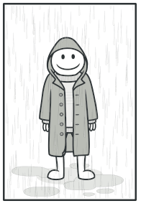
Decorator Pattern
Real-World Analogy
Wearing clothes can be an example of using decorators.
When you’re cold, you wrap yourself in a sweater.
If you’re still cold with a sweater, you can wear a jacket on top.
If it’s raining, you can put on a raincoat.
All of these garments “extend” your basic behavior but aren’t part of you, and you can easily take off any piece of clothing whenever you don’t need it.

Slide 37
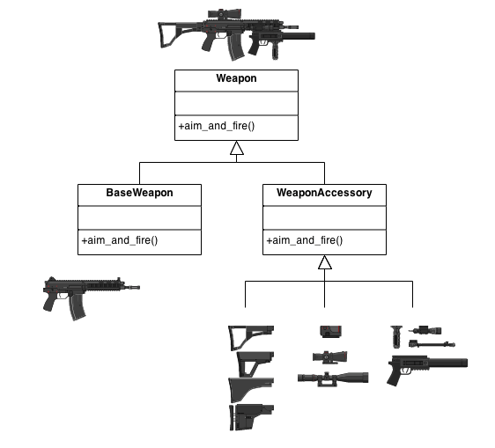
Decorator Pattern
More scenario:
assault gun is a deadly weapon on it's own. But you can apply certain "decorations" to make it more accurate, silent and devastating.

Slide 38
Search the Answer
What is the difference between decorator and strategy?
When should we use each of them?

Slide 39
Additional Quiz
Rules:
Each team will get one topic to present.
Each member should be ready to present . Any one of you can be asked to present the topic.
If you do well , whole team will get good marks. If you failed to perform your team will not get good marks. So, each of you should be well prepared.
Each presentation will be evaluated by me . (70% marks)
Each team will evaluate other teams (30% marks)

Slide 40
Factory Singleton Adapter Bridge Façade Proxy
200041201
200041202
200041203
200041204
200041205
200041214
200041217
200041218
200041219
200041221
200041223
200041224
200041225
200041227
200041228
200041231
200041234
200041235
200041239
200041240
200041242
200041246
200041253
200041254
200041255
200041256
200041257
200041260
200041261
200041262
200041263
200041264
190041250
SEC 2
200041101
200041105
200041106
200041108
200041109
200041113
200041114
200041116
200041119
200041120
200041121
200041122
200041123
200041125
200041126
200041127
200041130
200041131
200041132
200041134
200041138
200041139
200041141
200041142
200041143
200041144
200041147
200041150
200041153
200041155
200041156
200041157
200041158
200041161
200041162
200041163 200041164
SEC 1

