Slide 1
3-BIT BINARY MULTIPLIER CALCULATOR
1
IUT CSE 4206
Prepared By
Radib Bin Kabir Mehedi Ahamed
ID-200041122 ID-200041125

Slide 2
INTRODUCTION
2
This calculator takes two 3-bit binary numbers as input and shows the result after multiplying them in decimal number in a seven segment display.

Slide 3
USED COMPONENTS
3
Seven Segment BCD
4-Bit Adder (4008)
2 Input AND Gate (7408)
3 Input AND Gate (7411)
2 Input OR Gate (7432)
4 Input OR Gate (4072)
NOT Gate (7404)

Slide 4
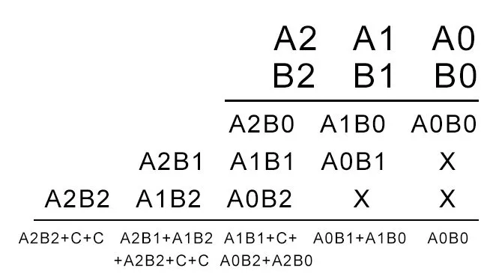
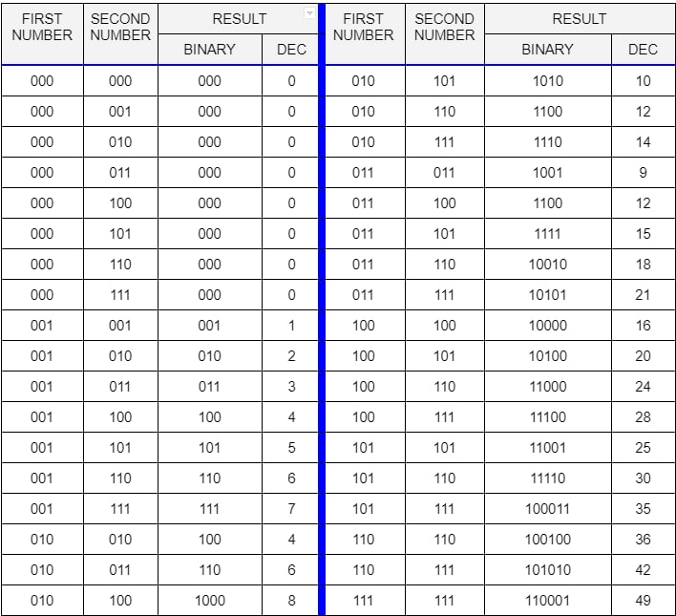
MULTIPLICATION PROCESS AND RESULT TABLE
4

Slide 5
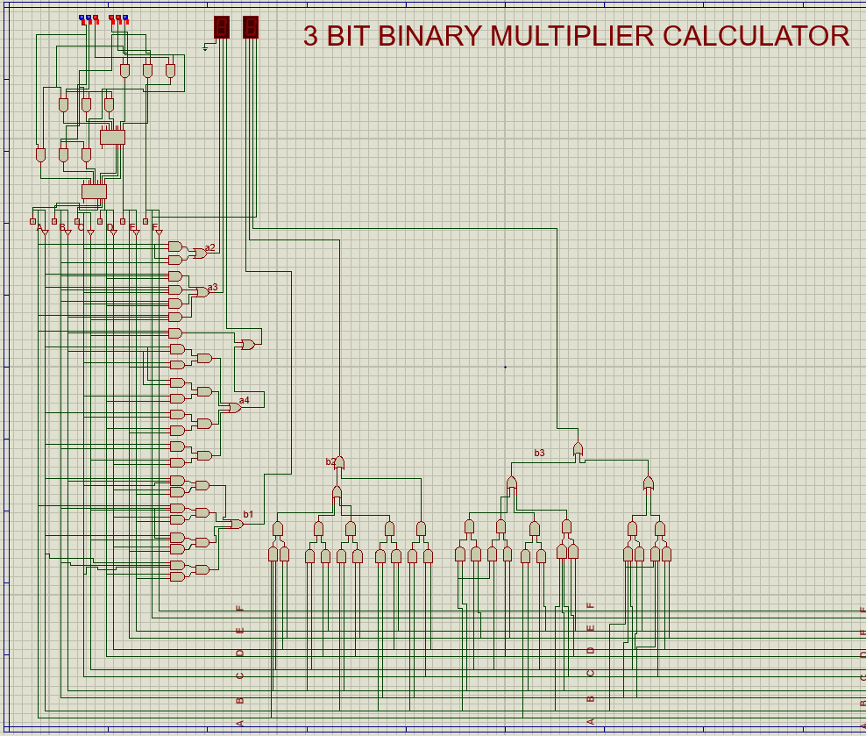
5

Slide 6
6
SEVEN SEGMENT IMPLEMENTATION
Decimal | Binary ABCDEF | BCD a1a2a3b1b2b3b4 | Decimal | Binary ABCDEF | BCD a1a2a3b1b2b3b4 | Decimal | Binary ABCDEF | BCD a1a2a3b1b2b3b4
0 | 000000 | 000 0000 | 11 | 001011 | 001 0001 | 22 | 010110 | 010 0010
1 | 000001 | 000 0001 | 12 | 001100 | 001 0010 | 23 | 010111 | 010 0011
2 | 000010 | 000 0010 | 13 | 001101 | 001 0011 | 24 | 010101 | 010 0100
3 | 000011 | 000 0011 | 14 | 001110 | 001 0100 | 25 | 011001 | 010 0101
4 | 000100 | 000 0100 | 15 | 001111 | 001 0101 | 26 | 011010 | 010 0110
5 | 000101 | 000 0101 | 16 | 010000 | 001 0110 | 27 | 011011 | 010 0111
6 | 000110 | 000 0110 | 17 | 010001 | 001 0111 | 28 | 011100 | 010 1000
7 | 000111 | 000 0111 | 18 | 010010 | 001 1000 | 29 | 011101 | 010 1001
8 | 001000 | 000 1000 | 19 | 010011 | 001 1001 | 30 | 011110 | 011 0000
9 | 001001 | 000 1001 | 20 | 010100 | 010 0000 | 31 | 011111 | 011 0001
10 | 001010 | 001 0000 | 21 | 010100 | 010 0001 | 32 | 100000 | 011 0010

Slide 7
7
Decimal | Binary ABCDEF | BCD a1a2a3b1b2b3b4 | Decimal | Binary ABCDEF | BCD a1a2a3b1b2b3b4 | Decimal | Binary ABCDEF | BCD a1a2a3b1b2b3b4
33 | 100001 | 011 0011 | 44 | 101100 | 100 0100 | 55 | 110111 | 101 0101
34 | 100010 | 011 0100 | 45 | 101101 | 100 0101 | 56 | 110101 | 101 0110
35 | 100011 | 011 0101 | 46 | 101110 | 100 0110 | 57 | 111001 | 101 0100
36 | 100100 | 011 0110 | 47 | 101111 | 100 0111 | 58 | 111010 | 101 1000
37 | 100101 | 011 0111 | 48 | 110000 | 100 1000 | 59 | 111011 | 101 1001
38 | 100110 | 011 1000 | 49 | 110001 | 100 1001 | 60 | 111100 | 110 0000
39 | 100111 | 011 1001 | 50 | 110010 | 101 0000 | 61 | 111101 | 110 0001
40 | 101000 | 100 0000 | 51 | 110011 | 101 0001 | 62 | 111110 | 110 0010
41 | 101001 | 100 0001 | 52 | 110100 | 101 0010 | 63 | 111111 | 110 0011
42 | 101010 | 100 0010 | 53 | 110100 | 101 0011
43 | 101011 | 100 0011 | 54 | 110110 | 101 0100

Slide 8
SOLVING K-MAP
8
After solving K-map we find,
a₁ = AC + AB
a₂ = A’BD + A’BC + BCD + AB’C’
a₃ = AB’C’ + A’B’CE + A’B’CD + A’CDE + A’BC’D’
b₁ = A’B’CD’E’ + ABC’D’E’ + A’BC’D’E + A’BCDE’
b₂ = AB’C’D’E + B’C’DE’ +A’B’DE + ABD’E’ + A’BCD’
b₃ = A’B’C’E + A’C’DE + AB’C’E’ + A’B’CDE’ + A’BC’D’E’ +A’BCD’E
b₄ = F

Slide 9

THANK YOU
9

