Slide 1
Team name: Di-Tech Squad
Daffodil International Professional Training Institute
Lead Teacher: Rajesh Kumar Das
Assistant Teacher: Mr. Shakil

Slide 2
Project IDEA and discussion!
01
Project name: (InstaCore)
Institute Management System
We are, |  | Role
Humaira Akter | : | Design & UI/UX, Ideation
Mehedi Alam | : | Co-Leader, Full-stack Support
Md Khalid Mahmud | : | Team Leader, Backend and APIs
Shakil Ahmed | : | Developer & Quality Assurance

Slide 3
What is InstaCore?
Web-based platform for institute management
Modern, secure, and responsive
Solves problems in outdated systems

Slide 4
Features – Phase 1
Landing page with login & signup
Custom Django authentication
Email verification for signup
OTP verification before account deletion
Individual user dashboards
Profile management (edit, password, delete)
Role-aware navigation bar and footer

Slide 5
How It Works – User Flow
Visit index page → Login or Signup
Signup → Email verification → Login
Dashboard → Profile management
Delete account with OTP
Secure logout

Slide 6
Tech Stack
Frontend: HTML, CSS, JavaScript
Backend: Django (Custom Auth, Email/OTP)
Database: SQLite (dev) → PostgreSQL (prod)
Planned: Django REST Framework for APIs

Slide 7
Project Timeline
11 Aug – Present idea & mockups
17 Aug – Frontend & auth completed
21 Aug – CRUD operations & API integration
24 Aug – Final submission with features

Slide 8
Future Plans
Role-based dashboards (Admin, Teacher, Student)
Institute-wide announcements
Attendance & results module
Public API documentation

Slide 9
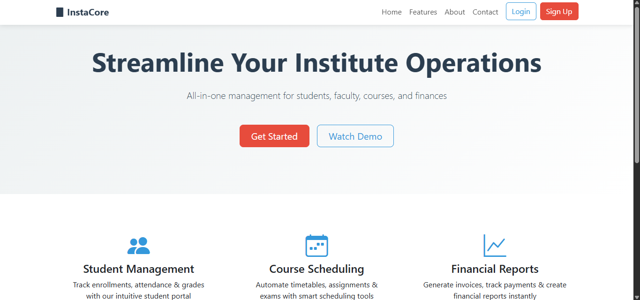
UI Mockups: Landing page

Slide 10
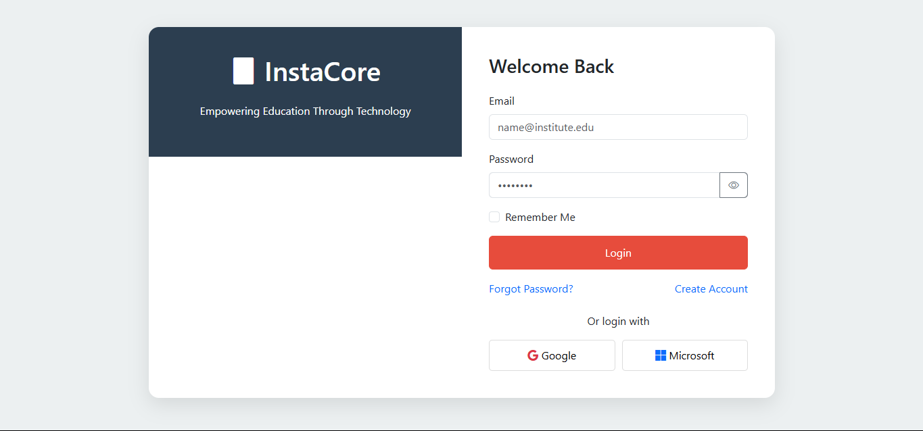
UI Mockups: Login page

Slide 11
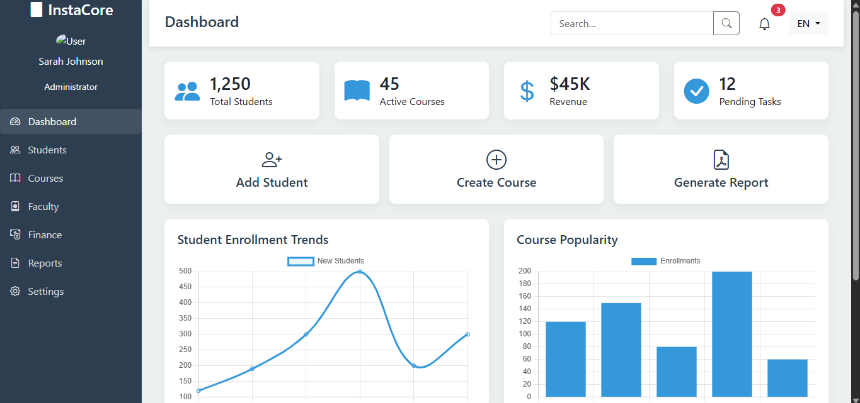
UI Mockups: Dashboard

Slide 12
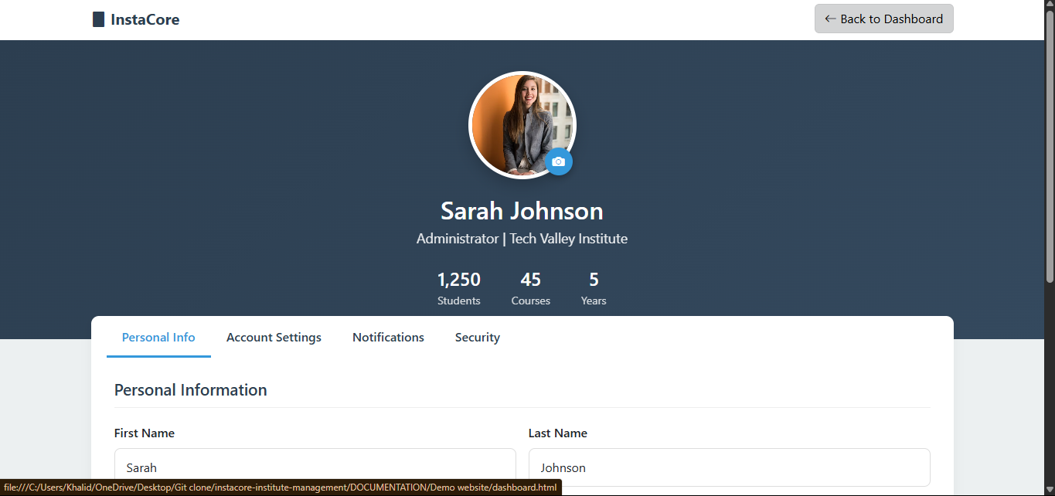
UI Mockups: Profile page

Slide 13
Questions?
We’re happy to answer your questions.

Slide 14
Thank You Everyone

