Slide 1
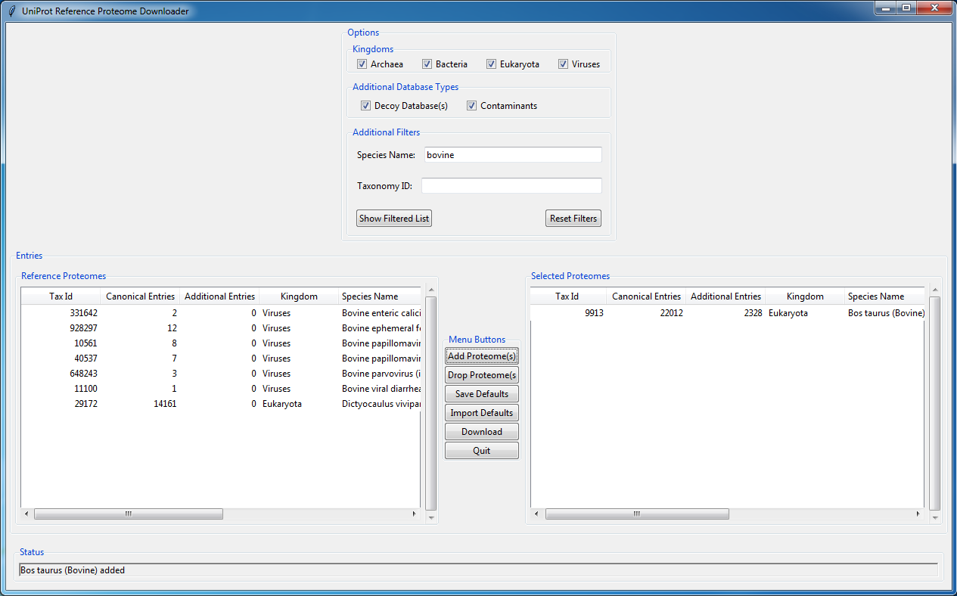
User’s Guide: UniProt_reference_proteome_manager.py August 2017

Slide 2
What is UniProt_reference_proteome_manager?
A GUI Python application to download and manage UniProt reference proteomes
Written by Delan Huang and Phil Wilmarth (wilmarth@ohsu.edu), OHSU
Available at GitHub: (https://github.com/Delan-Huang/Reference_Proteome_Manager)
System requirements: Python 3 (developed and tested with v3.6) and an internet connection

Slide 3
What are UniProt reference proteomes?
High quality, complete proteomes that span the tree of life
See: http://www.uniprot.org/help/reference_proteome
Reference proteome statistics (July 2017):
Phyogenetic Kingdom | Number of proteomes
Archaea | 372
Bacteria | 6521
Eukaryota | 993
Viruses | 506

Slide 4
How to get reference proteomes?
Reference proteomes are available from UniProt main web pages and at the Proteomes page: http://www.uniprot.org/proteomes/
They are available via FTP at: ftp://ftp.uniprot.org/pub/databases/uniprot/current_release/knowledgebase/reference_proteomes/
Designation of canonical sequences and associated isoforms, and annotation of isoforms are superior for the FTP files
Reference proteome naming and multiple files per species make the FTP site challenging to navigate

Slide 5
UniProt_reference_proteome_manager helps
The App presents reference proteomes in an informative graphical user interface (GUI)
Reference proteomes are designated by species names and searching and filtering of the 8000+ proteomes is supported
Sets of user-defined default organisms are support to facilitate frequent downloading of common proteomes
Locating FTP files and downloading is automated
Reference proteome naming and file organization are standardized

Slide 6
Running UniProt_reference_proteome_manager
A few files are needed: UniProt_reference_proteome_manager.py, fasta_lib.py, reverse_fasta.py, and a contaminants FASTA file (configured to use “Thermo_contams_fixed.fasta”)
The files should be in the same folder and that folder can be located anywhere
Python version 3 is required (3.6 is current release)
https://www.python.org/downloads/
https://www.continuum.io/downloads
Application can be ran from command line or integrated programming environment editor windows
There are many online resources for how to run python scripts

Slide 7
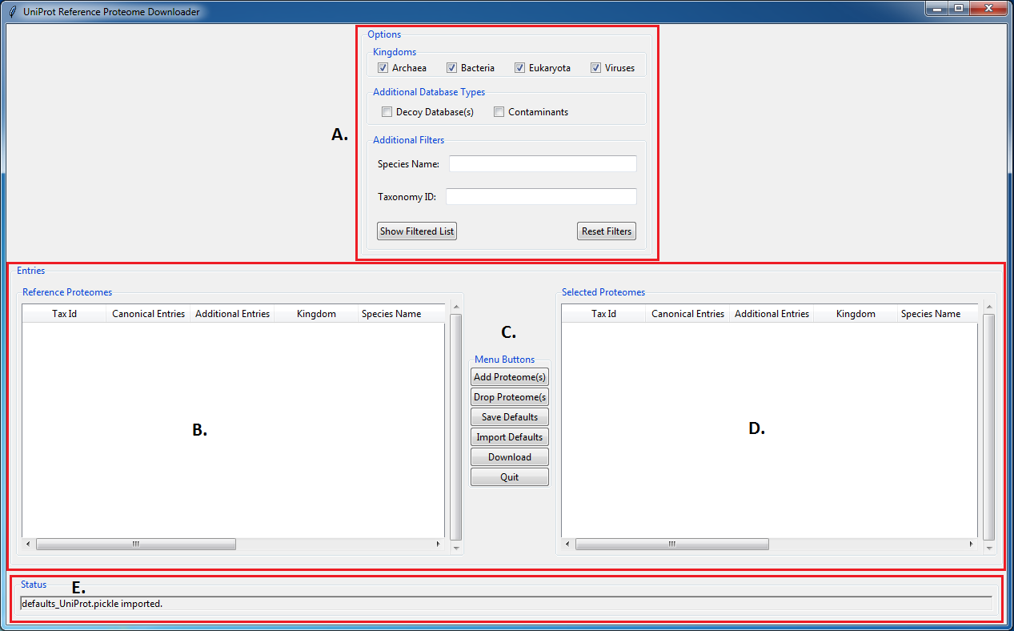
Overview
The general program flow is as follows:
Select kingdom filters and type in any partial word/phrase and taxonomy number into respective search bars and press the “Show Filtered List” button to display all relevant databases into the left display table. You can also select whether or not you want decoy databases and/or common contaminants in your fasta files
Here you can then select databases and using the “Add Proteome(s)” button add databases to the right display table. This table represents all databases that are to be downloaded.
Notable buttons here include the “Save Defaults” and “Import Defaults” buttons. These buttons allow the user to save current selections in the right display table to a defaults file, or import databases from a previously saved defaults file.
This display table shows all selected databases that the user wants to download.
Press “Download Databases” to download all fasta files.
F. This status bar will display any changes made to either display box including adding/dropping proteomes, refiltering the database list, and downloading files.

Slide 8
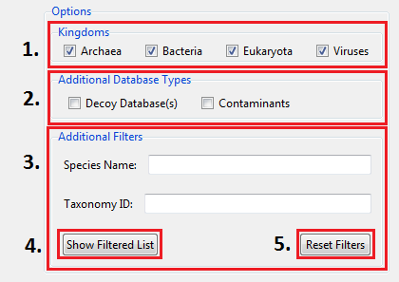
Filter Descriptions
The “Kingdoms” checkboxes allow the user to narrow database list by the kingdom their species belongs to.
The “Additional Database Processing” checkboxes allow the user to decide whether or not downloaded fasta files should include reversed sequences and/or common contaminants.
The “Species Name” search bar allows the user to type in either a partial word/phrase or complete word/phrase that match the name of the desired species. The “Taxonomy ID” search bar allows the user to type in either a full or partial taxon number that matches their desired species.
The “Show Filtered List” button will output all species that match the desired filters.
The “Reset Filters” button will clear all search bars and re-select all kingdoms.
Note: It is valid to have empty search bars including kingdoms. Also, if “Target/Decoy Databases” is selected, “*_both” will be appended to the fasta file name (with or without contams). If only “Add Contaminants” is selected, “*_for” will be appended.

Slide 9
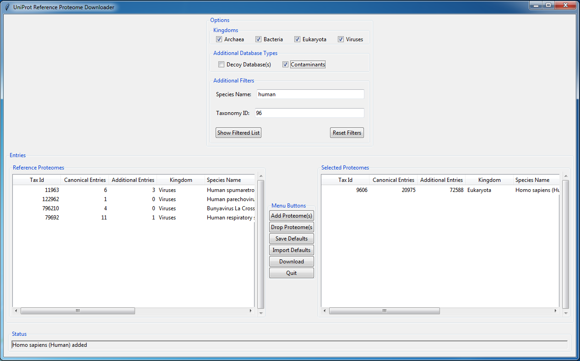
Filters Example
Here, all kingdoms are left selected and searched for and species names containing “human” and with “96” as a partial taxon number. The “Homo sapiens” database has been selected for downloading, and the resulting FASTA file will include common contaminants.

Slide 10
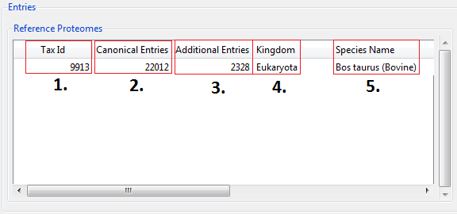
Display Tables Description
“Tax Id”: outputs the taxonomy number of the species.
“Canonical #”: outputs the number of canonical sequences in the database
“Isoform #”: outputs the number of isoform sequences in the database
“Kingdom”: outputs the kingdom the species belongs to
“Species Name”: outputs the species name
Note: All of these headers can be extended. Furthermore, clicking on the header will sort the database list either alphabetically or numerically depending on the header. Also, all of these descriptions are the same for both display tables (Reference Proteomes and Selected Proteomes)

Slide 11
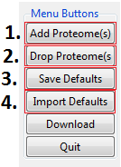
Menu Buttons
“Add Proteome(s)”: moves database(s) from the left display table to the right display table (Reference Proteomes → Selected Proteomes).
“Drop Proteome(s): moves database(s) from the right display table to the left display table (Reference Proteomes ← Selected Proteomes).
“Save Default Species”: saves all databases in the right display table (Selected Proteomes) to a defaults file in the directory the user selects.
“Load Default Species”: imports the databases stored in a defaults file to the right display table (Selected Proteomes)

Slide 12
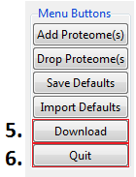
Menu Buttons cont’d
“Download”: downloads all of the databases shown in the Selected Proteomes display table to a user selected general container folder (eg. “uniprot_downloads”). Currently, “reference_proteome_manager.py” is configured to download only *.fasta.gz and *_additional.fasta.gz files from the UniProt FTP download site.
The program will save all selected databases into a common “UniProt_(date)” subfolder (inside general container folder), where “date” is the release date of the databases (ie. 2017.07).
Each reference proteome will have its own folder named in the following convention “(date)_(proteome ID)_(Species Name)”.
The *.gz files are then unzipped to *_all.fasta files and *_canonical.fasta files that are placed in the common “UniProt_(date)” folder.
The naming convention for these files is “(version)_(proteome ID)_(taxonomy ID)_(species name)_all.fasta” or “(version)_(proteome ID)_(taxonomy ID)_(species name)_canonical.fasta”.
*_all.fasta file includes both canonical and isoform sequences. Canonical sequences only are recommended for most use cases.
“Quit”: will quit out of the program. If any changes have been made to the Selected Proteomes display table, the user will be prompted to save the current species list to a new defaults file. Default species lists make it easier to regularly update common reference proteomes.

Slide 13
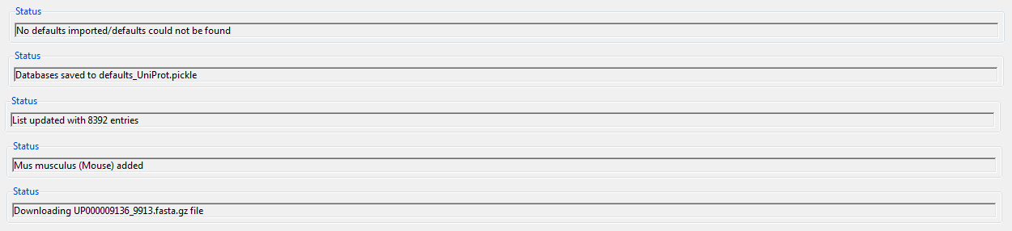
Status Bar Updates
These are some common messages that the status bar will provide as the user interacts with the program.

