Slide 1
WELCOME TO THE PRESENTAION
ONLINE JOB PORTAL

Slide 2
Developed by
Name | ID | Intake
Mehedi Hasan Shovon | 15163103066 | 33
Nazmul Hossain | 15163103064 | 33

Slide 3
SUPERVISED BY
Md.Raisul Alam
Assistance Professor
Dept. of Computer Science and Technology
Bangladesh University of Business and Technology

Slide 4

Are you searching for a job ?
or
Do you have any vacancy in yours companies ?
We have a simple solution
Online Job Portal

Slide 5

Introduction
A job portal, also known as a career portal, is a modern name for an online job board that helps applicants find jobs and aids employers in their quest to locate ideal candidates.

Slide 6

Goals
To act as a middle men connecting job seeker and provider.
To store all information about the employers as well as Jobseekers
Easy to search a job according to requirement
To facilitate company so that it can search for the best candidates available
Providing user friendly interface

Slide 7

Software & Tools we used
Software
Operating System: Windows 10
Application Server: wamp server
Database: MySQL, SQLite Database
Front End: HTML5, CSS3, JavaScript, jQuery
Browser: Chrome or Firefox or Internet Explorer
Hardware
Processor: Intel core i3 or above
Processor speed: 3.40 GHz above
RAM: 4 GB above

Slide 8
Present System’s Features
Employer
Create/edit Profile Information
Post job vacancies
Select employee as per requirement match
Jobseeker
Create/edit Profile Information
Search preferred job as per his area of interest
Apply for a job

Slide 9
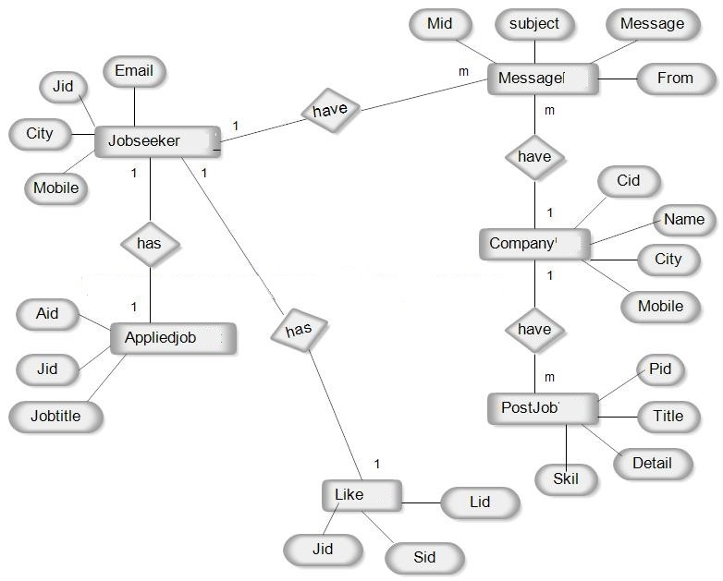
ER Diagram

Slide 10
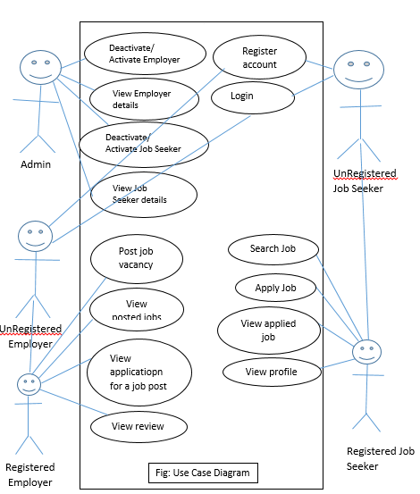
Use Case diagram:

Slide 11
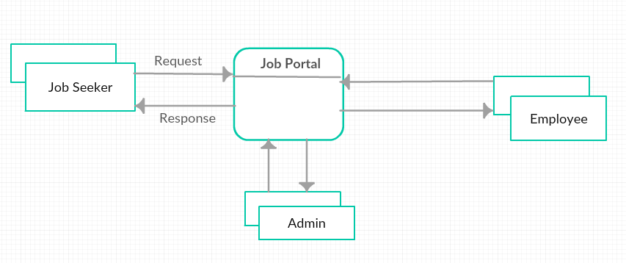
Data Flow Diagram Context level :

Slide 12
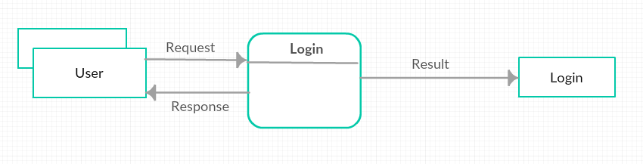
Level-1

Slide 13
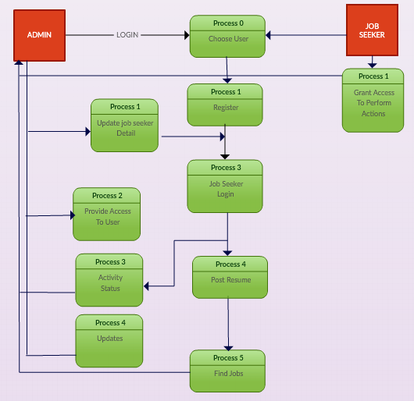
Level-1:

Slide 14
Limitations
Only attract job seekers and not actual difference makers. The best candidates aren’t looking for a job they’re happy doing what they’re doing.
Recruiters waste a lot of time with unqualified candidates.
The barrier to entry is too low and anybody can apply to your job.

Slide 15

Future Inhencement
This project fulfills the primary requirements of the job seekers and employers. It can be extended in several ways
We can provide recommendations and email updates for new job postings based on the job seeker’s search history
Making mobile application
We can also provide templates for building the Resumes which might interest most applicants

Slide 16


