Slide 1




Slide 2
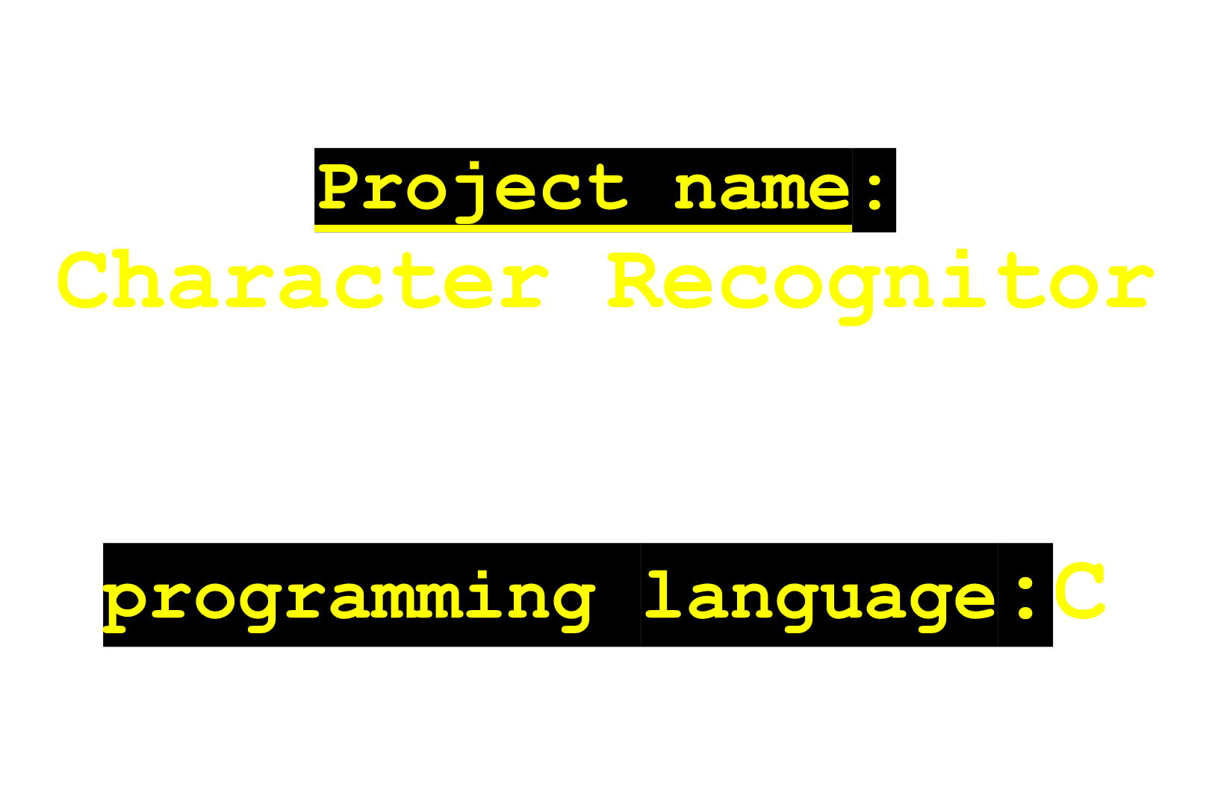

Slide 3

This project takes a handwritten character-image and detect which character has been written in it. For this purpose this project has to be trained first with so many number of handwritten character in a image.

Slide 4


Slide 5
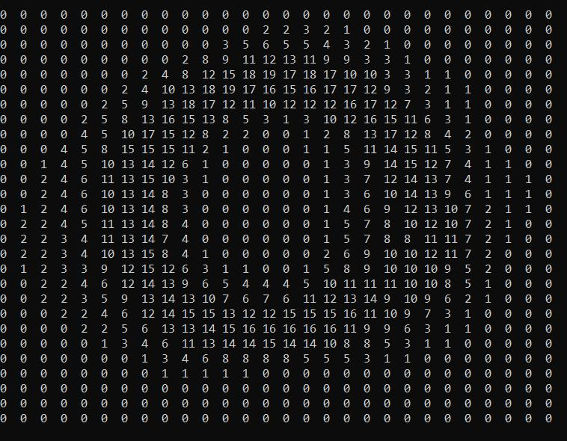
Objectives
Build model from the training character data.

Slide 6
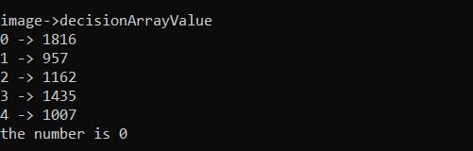
Objectives
Detect the character hand-written in a image.

Slide 7
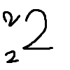
Objectives
Handle the anomalies(difference in size,difrence in position,difference in angularity)

Slide 8


Slide 9
Methodology
Calculate score for training data.
Storing training scores
Calculate pixels and use a 0/1 array to for it.
Calculate matching scores.
Compare test data with previously stored model data.
Choose the most matched data as final data.

Slide 10


Slide 11
Background Study
Basic c programming and some of its functionalities.
Basic structure of an BMP image.
How a BMP image store its pixel value in color mode,grey-scale mode.

Slide 12


Slide 13
Calculate score for training data
For example , “zero”

Slide 14
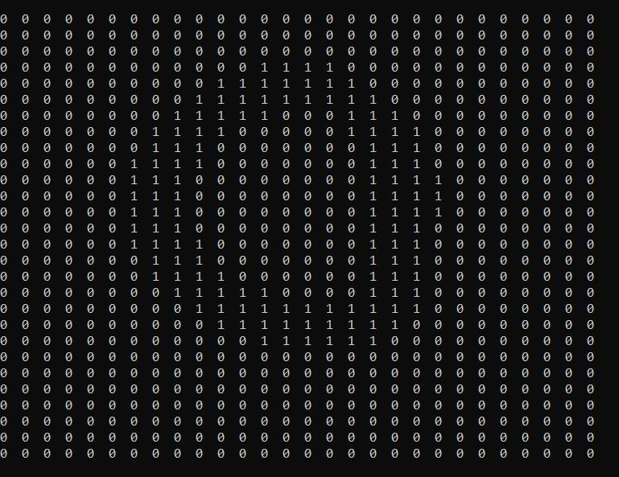

Calculate score for training data
After 1st iteration:

Slide 15
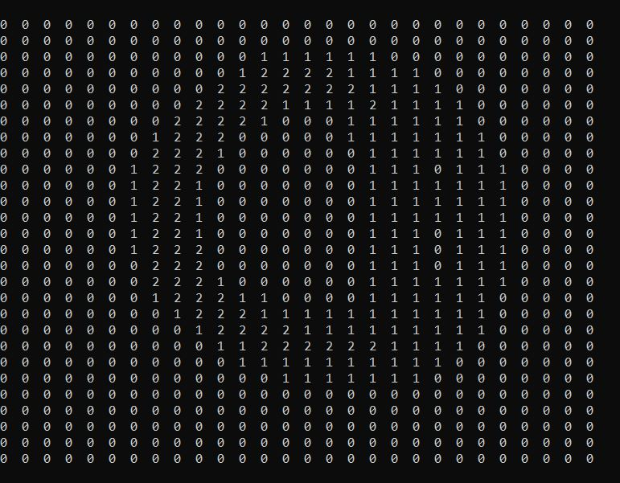

Calculate score for training data
After 2nd iteration:

Slide 16
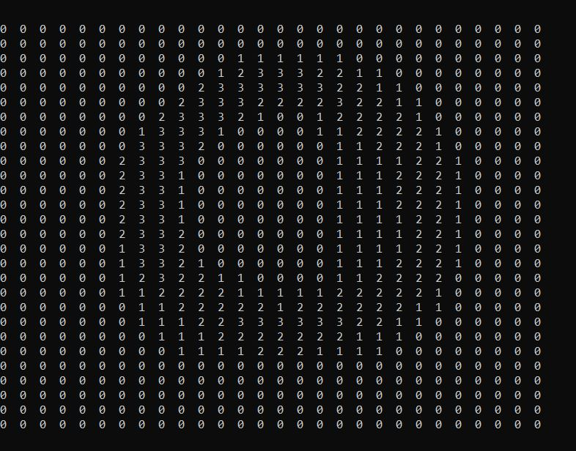

Calculate score for training data
After 3rd iteration:

Slide 17

Calculate score for training data
After 20th iteration:

Slide 18
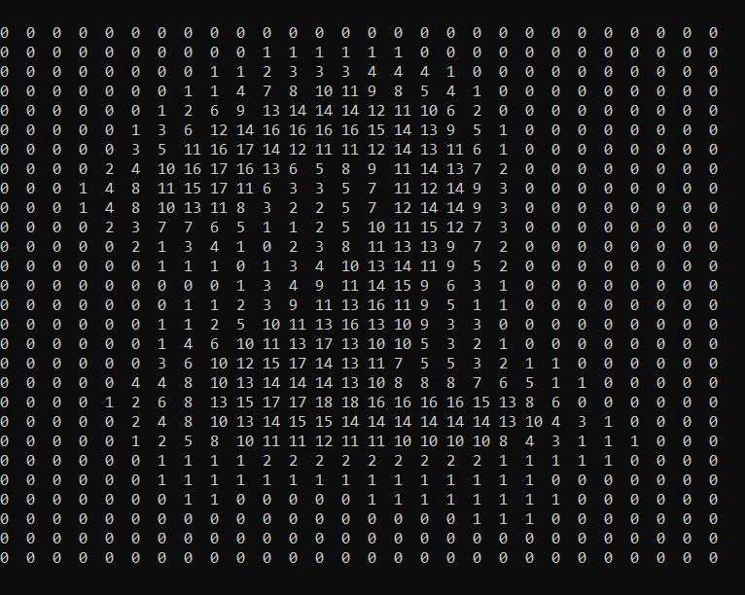
Calculate score for training data
Again For example if we take “two”

Slide 19
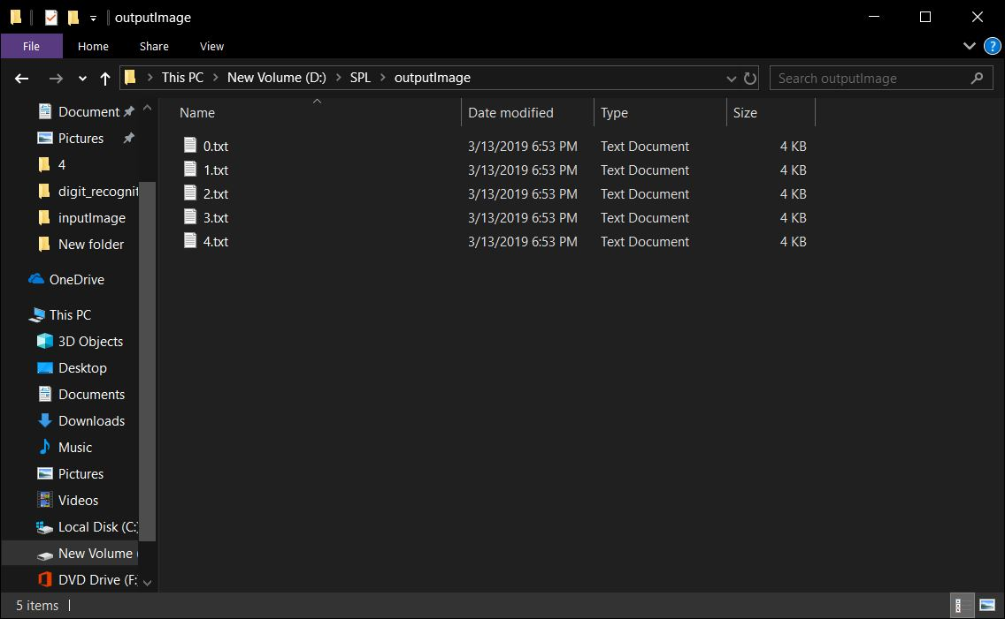
Storing training scores in output data folder

Slide 20
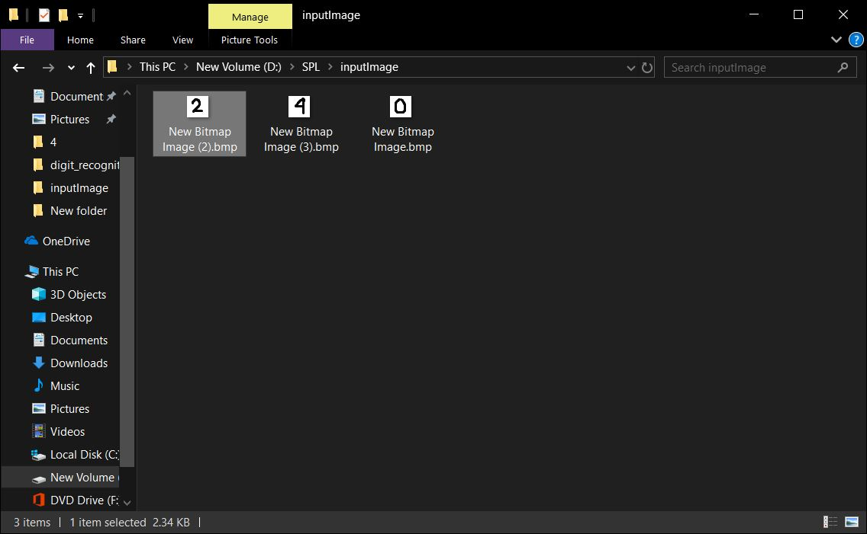
Putting some test images in input data folder

Slide 21
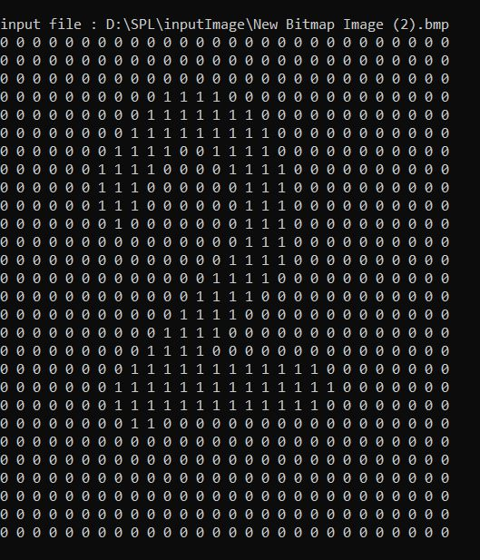
Calculate pixels of a test data and use a 0/1 array to for it
For example ,let’s take a test data “two”

Slide 22
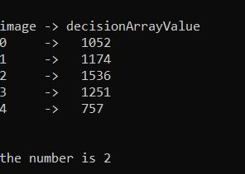
Calculate matching scores of test data
After try to match with all the training models, the number of total matches is shown.As two is has the number of mostly matches,so we can predict that the given input is two.

Slide 23


Slide 24
Accuracy of results
The more training image we use to build the model image,the more accurate the results will be.
consisting more pixels in height and width will have more accurate results.

Slide 25


Slide 26
Future work
Handle the three type of anomalies yet encountered in :
  Size
  Position
  Angularity

Slide 27
Future work
Make a good and user-friendly interface.
Construct model data from not only BMP file but also JPG,PNG.

Slide 28
Github link: https://github.com/MehediHasanSunBSSE1025/SPL-

Slide 29
Thanks for your valuable time

