Slide 1
Advance TypeScript
Let’s Type

Slide 2

Presented By
Mehedi Hasan
SOFTWARE ENGINEER,
AUDIENCE HUB
mehedi.hasan@kinesso.com

Slide 3
Basic Types
1. Common Types
number
string
boolean
2. Interface
Notes:
These are the most common ones, but we have other types which we not going to explain

Slide 4
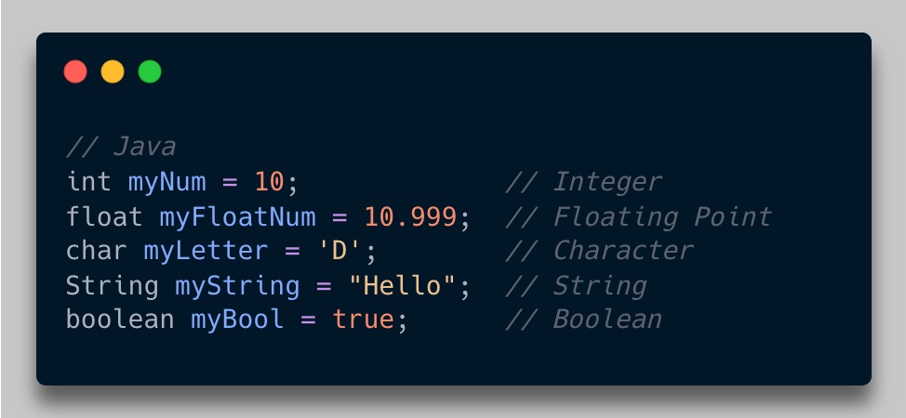
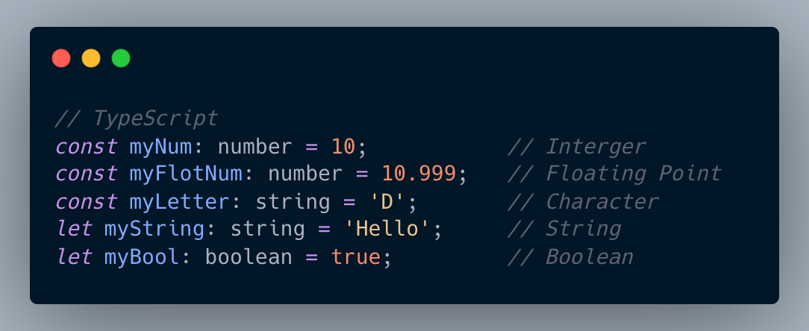
Differences Between Common Types

Slide 5
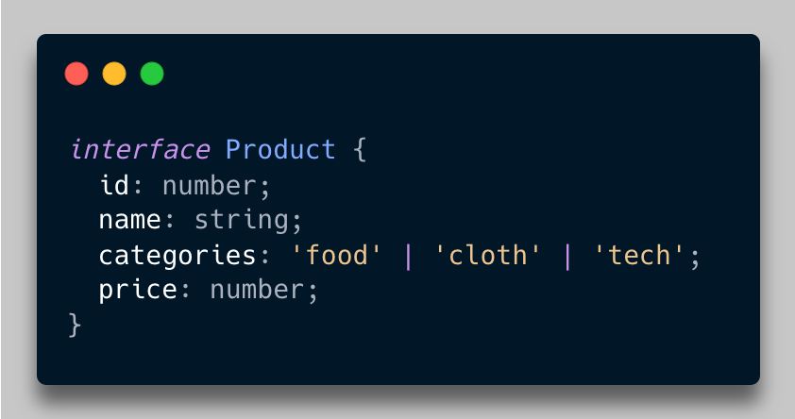
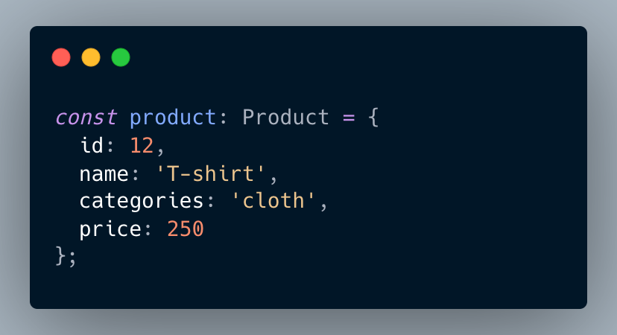
Interface
Notes:
Interface represents data model. Some people call it data modeling, contract, shape, struct – stuck is c++

Slide 6
Topics
General Use Case
Generic Class
Utility
Omit
Pick
Partial
Readonly
ReturnType
Template Literal Type
Type Guard

Slide 7
Questions?

Slide 8
References
Interface
Utility Types
Workshop Repository

Slide 9
Thank You

