Slide 1
Advance TypeScript
Let’s Type

Slide 2

Presented By
Mehedi Hasan
SOFTWARE ENGINEER,
AUDIENCE HUB
mehedi.hasan@kinesso.com

Slide 3
Basic Types
1. Basic Type
number
boolean
string
2. Interface

Slide 4
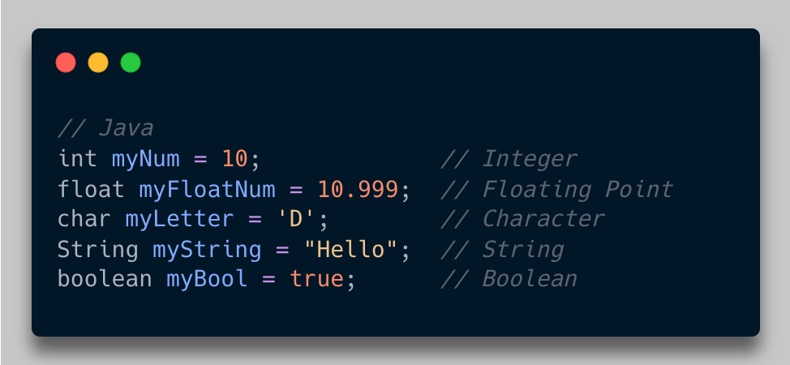
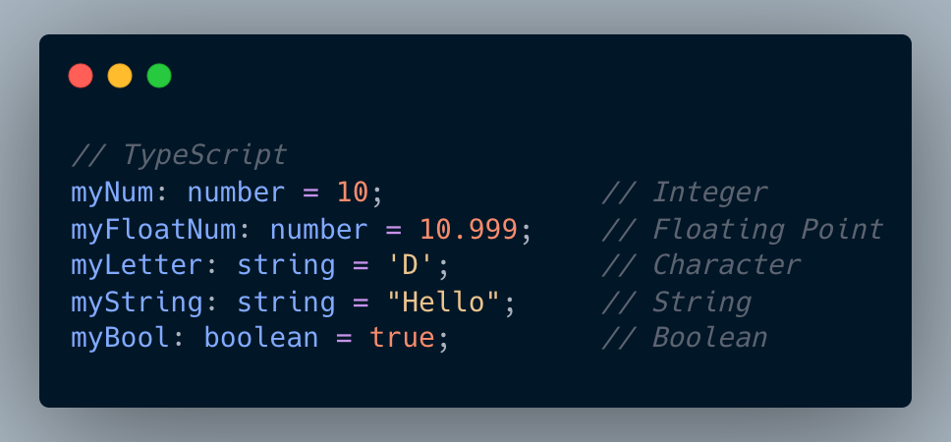
Basic Types

Slide 5
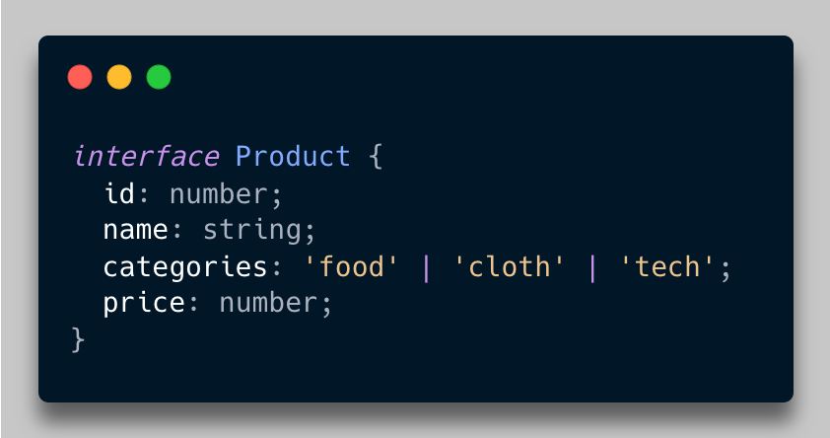
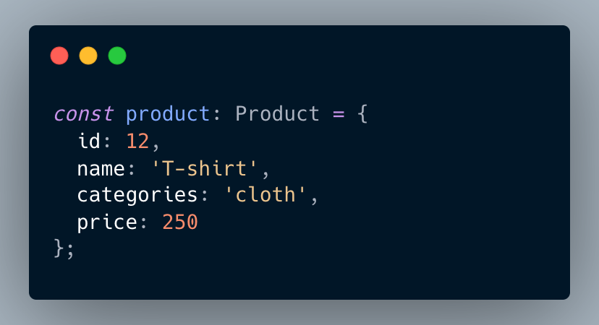
Interface

Slide 6
Topics
General Use
Generic Class
Utility
Omit
Pick
Partial
Readonly
ReturnType
Template Literal Type
Type Guard

Slide 7
Questions?

Slide 8
Thank You

