Slide 1
Medicare

Slide 2
Group members
Md. Mehedi Hasan
Id: 19-41168-2
Sadika Afrin Meen
Id: 19-41178-2
Ashiqur Rahman
Id: 19-41191-2
Md. Ahsan Nayem
Id: 19-41212-2

Slide 3
Requirement planning
This MEDICARE system is basically built for Doctors. This is a virtual helper of a doctor. Besides that it helps the particular patients also who is related with this system user.
This system contains patients details , treatment history , payment and many other facilities that makes the job easy , simple and modern. All information about treatment is stored in this system and user can access easily.
This project attempts have been made to make this project as user friendly as possible. Interfaces are very clear and simple hope that anyone can use it easily.

Slide 4
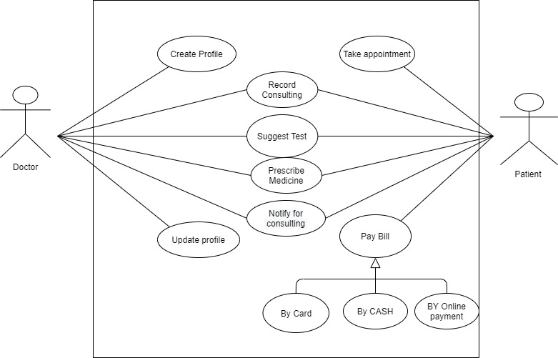
Use case Diagram

Slide 5
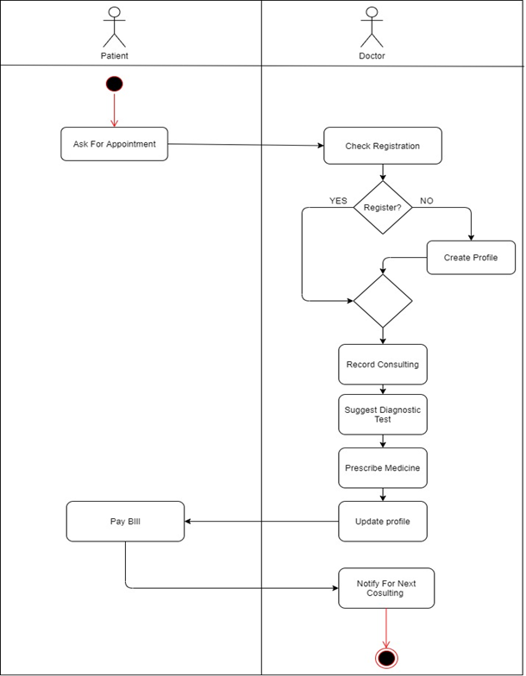
Activity diagram

Slide 6

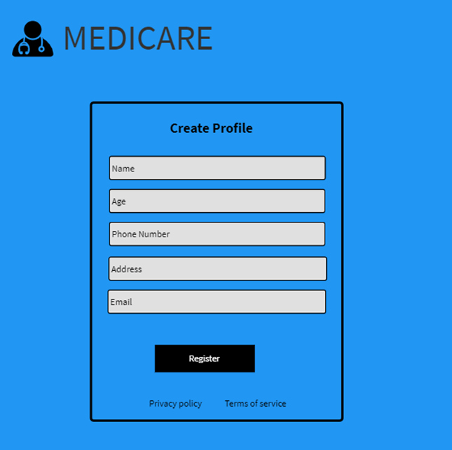
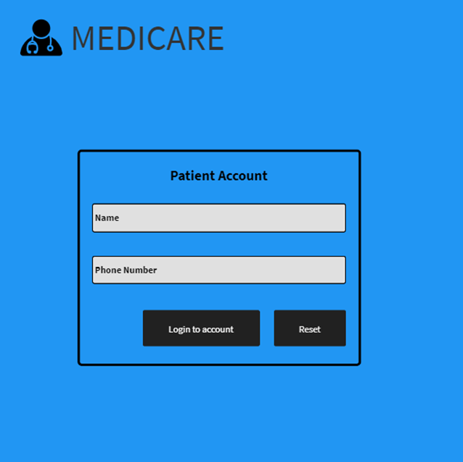
Mock design

Slide 7
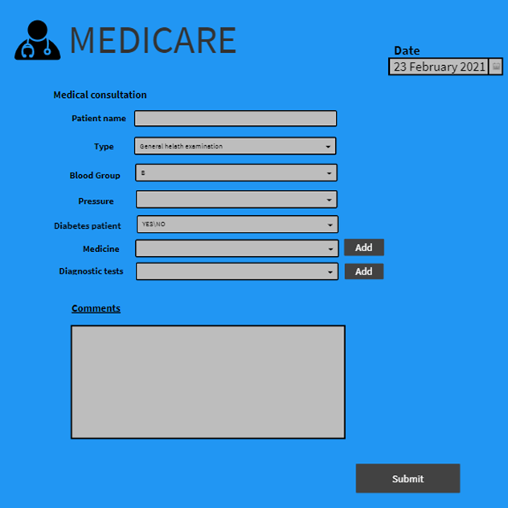
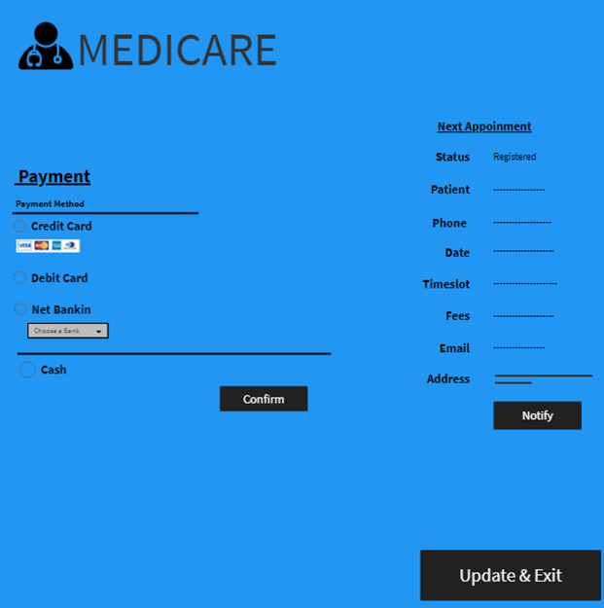
Mock design

Slide 8
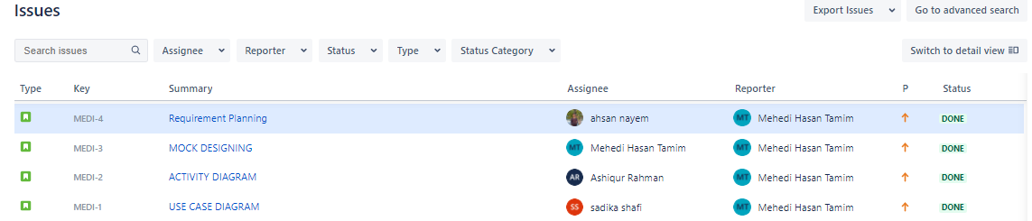
jira IsSues

Slide 9
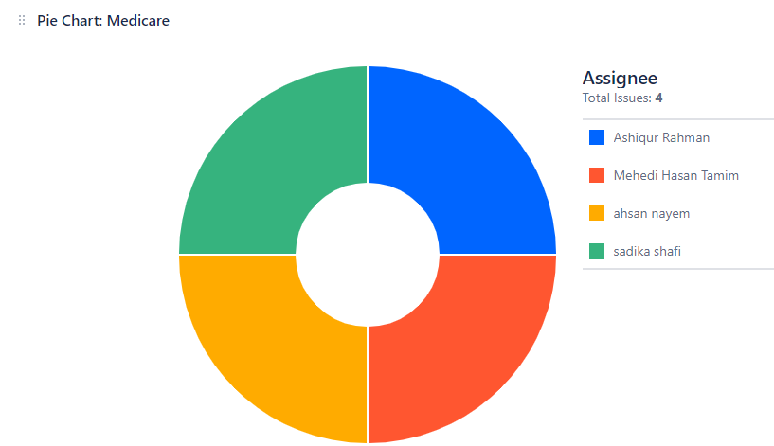
JIRA Contribution Pie Chart
25%
25%
25%
25%

Slide 10
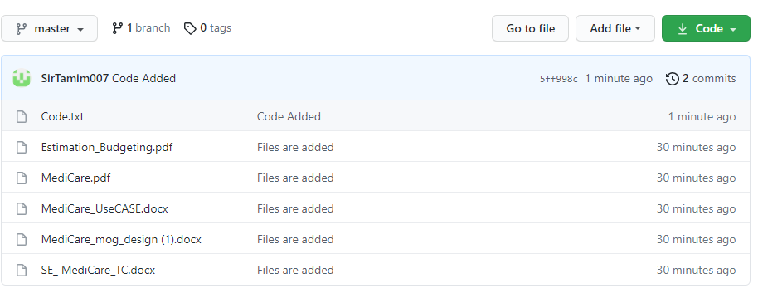
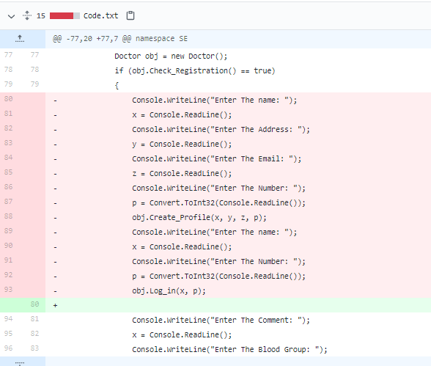
Git

Slide 11
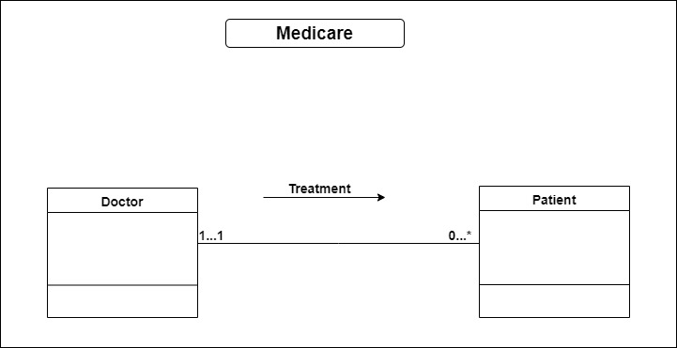
Class diagram

Slide 12
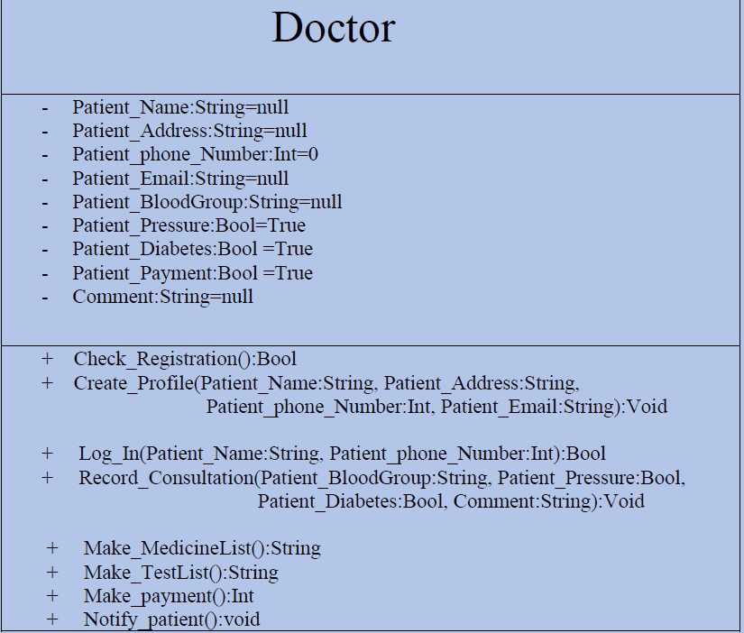
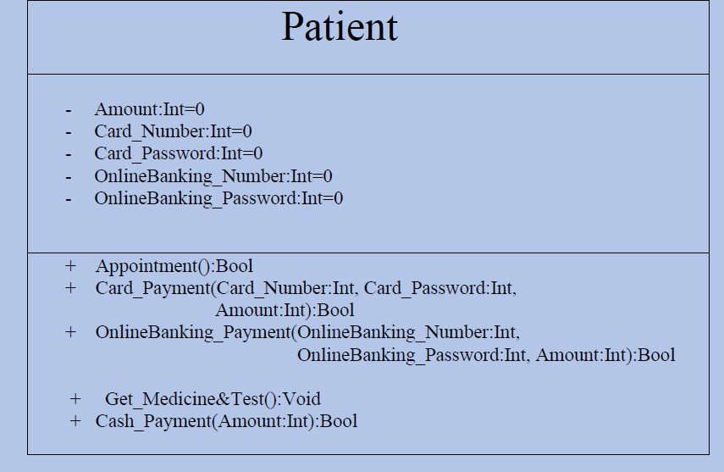
Class compartment

Slide 13
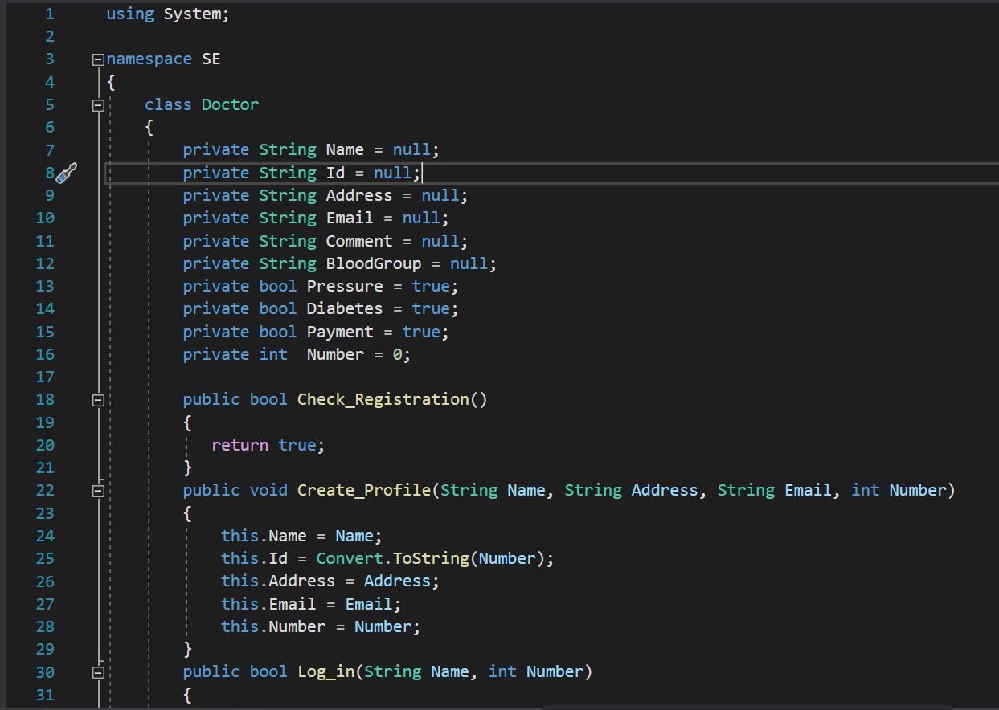
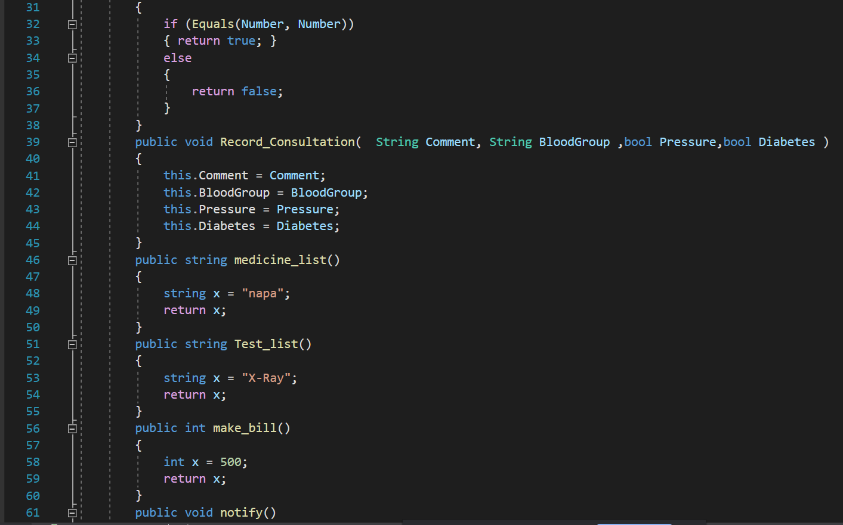
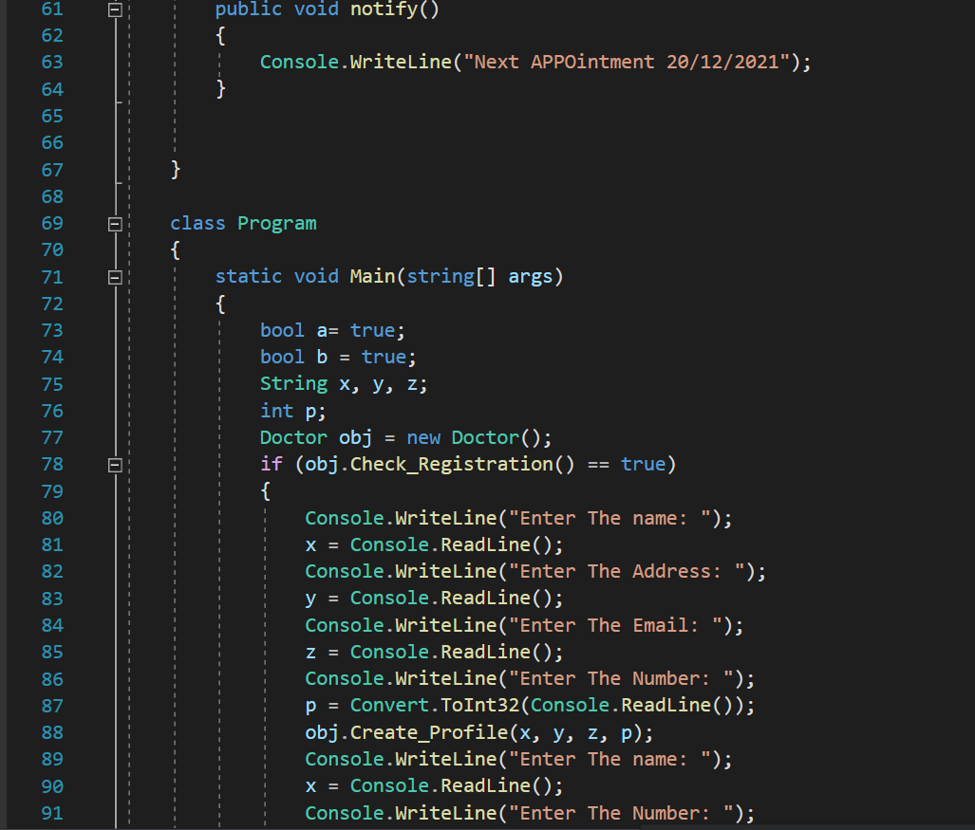
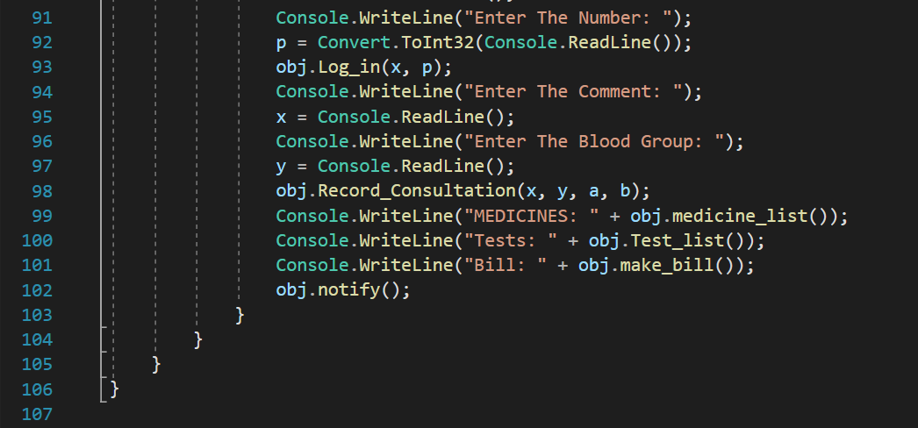
Project Code

Slide 14
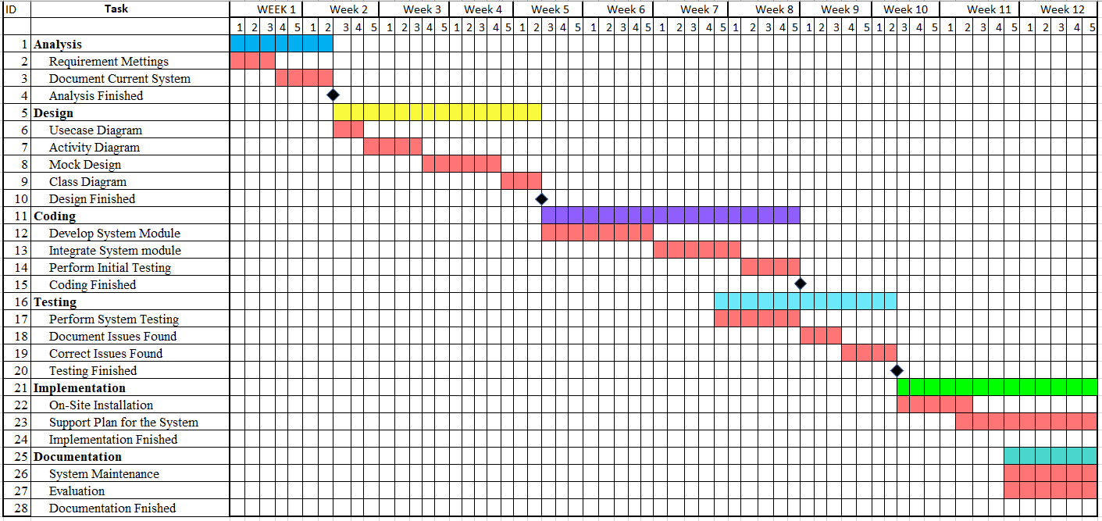
Project scheduling

Slide 15
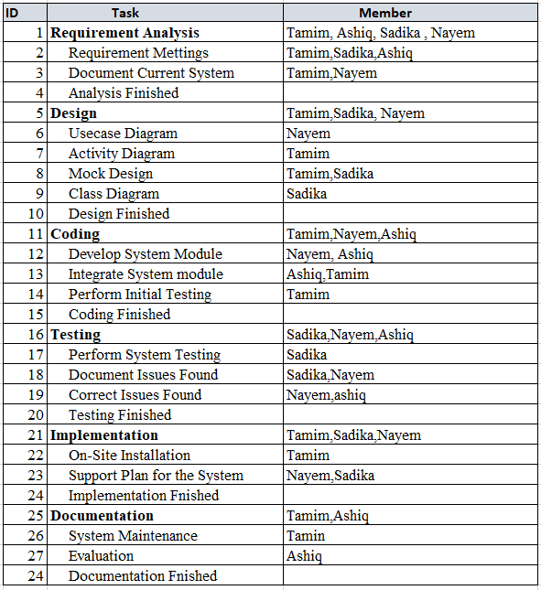
Project scheduling

Slide 16
Constructive Model For Medicare System:
Project type: Semi-detached
SLOC = 10000
Coefficient<effort factor> =3
P= 1.12
Effort= PM= Coefficient<effort factor> *(SLOC/1000)^P
=3*(10000/1000)^1.12 =39.54
Development Time= DM= 2.50*(PM)^T
=2.50*(39.54)^0.35=9.05
Required number of people =ST= PM/DM = 39.54/9.05=4.36

Slide 17
Budgeting
Development salary 9 month : Considering 600 taka per developer
600*1584=950400 taka
Requirement analysis : Hourly=400 taka
Analysis expense=400*176=70400 taka
Transportation cost : 15500 taka
Training and hardware cost : 150000 taka
Rent expense : 18000*9=162000 taka
Total utilities : 60000 taka
Maintenance cost : Expense per hour =1500 taka
Extra hour need for maintenance 80 hours
Total maintenance = 80 * 1500=120000 taka
Other human resource : Project manager = 1* 28000*9=252000 taka
Accountant = 1* 22000*9=198000 taka
Technical staff = 2* 15000*9=270000 taka
Total cost= 252000+198000 +270000=720000 taka
Total estimate expense: 950400+70400+15500+150000+162000+60000+120000+720000=2248300 taka
Profit : 2248300*25%= 562075taka
Final project budget: 2248300+562075=2810375 taka

Slide 18
Conclusion
System Overview.
Problems system will solve.
System relate to modern era.

Slide 19


