Slide 1
⚡
Smart Meter System Logic
BY Cohort-6
Data validation, circuit logic, threshold logic and communication

Slide 2
Data validation
Why validation matters
Input checks
Device states
Voltage is constrained to 220-240 V in the simulator so the demo stays inside a realistic domestic supply range for the project.
Fan, bulb and TV states are validated as ON/OFF inputs before assigning current values, preventing invalid appliance combinations.
Range filtering
Formatted serial data
Current values can be fixed or randomized inside safe ranges, such as fan current varying from 0.09 A to 0.43 A for realistic simulation.
LabVIEW sends clean comma-separated values in the form voltage,current so the ESP32 can parse the packet reliably every cycle.

Slide 3
Data validation
Validation flow
1
2
3
4
Read controls
Apply ranges
Build packet
Check in ESP32
Read voltage knob and appliance switches from LabVIEW front panel.
Limit voltage and assign current only when a load is enabled.
Convert values to %f,%f format and push through VISA Write.
Parse serial data, reject bad values, then compute total power.

Slide 4
Circuit logic
Functional circuit path
LabVIEW side
ESP32 side
Voltage control acts as the supply source.
Fan, bulb and TV switches represent simulated loads.
Select blocks assign current when each load is ON.
Compound Arithmetic adds all branch currents.
Serial port receives voltage and total current.
Controller calculates power using P = V x I.
Latest values are stored for dashboard upload.
Cloud update sends a meter-like reading packet.

Slide 5
Circuit logic
Load model example
🌀
💡
📺
Fan
Bulb
TV
Variable current can be mapped between 0.09 A and 0.43 A to mimic speed and load fluctuation.
A smaller current band can represent steady lighting behavior with slight random variation.
A wider band can simulate real consumption changes based on screen brightness and activity.
Total current = fan current + bulb current + TV current, and total power = voltage × total current.

Slide 6
Threshold logic
Decision rules
Normal
Warning
Critical
Power remains in the safe operating band, so the dashboard shows standard green status.
If total power crosses a preset soft threshold, the system can flag a high-consumption alert.
If the limit is exceeded again, the system can trigger a critical event, notification or cut-off logic.

Slide 7
Threshold logic
Suggested thresholds
Voltage rules
Power rules
Below 220 V: low-voltage condition.
220-240 V: normal operating region.
Above 240 V: over-voltage condition.
Below threshold: normal load profile.
Near limit: send warning notification.
Above limit: mark anomaly or overload event.
These thresholds can later support Telegram alerts, dashboard color changes, or relay-based protection logic.

Slide 8
Communication
End-to-end data flow
🖥️
🔌
📡
☁️
LabVIEW
NI-VISA
ESP32
Dashboard
Displays periodic energy monitoring results every 20sec
Generates validated voltage and load values.
Transfers serial packets over USB to the ESP32.
Parses, computes and prepares cloud-ready data.

Slide 9
📊
Communication extensions
ThingSpeak
Custom dashboard
Quick prototype option for periodic visualization and initial cloud testing.
Streamlit or HTML, CSS and JS can provide a richer live monitoring interface.

Slide 10
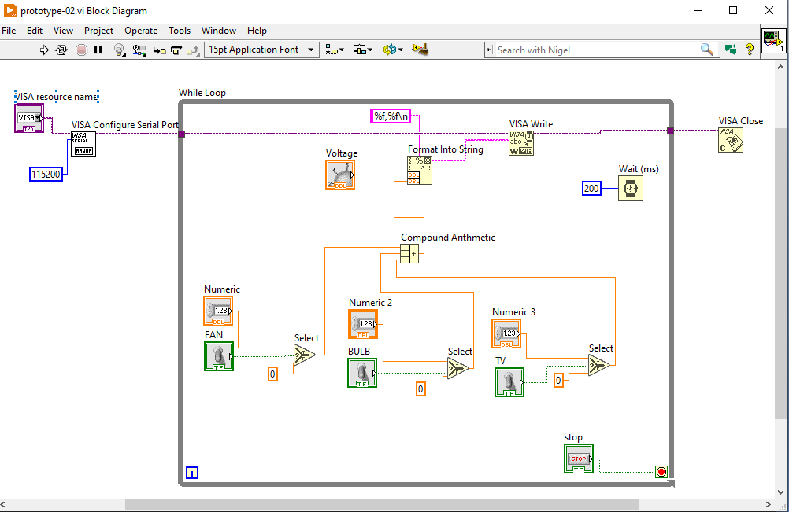

Slide 11
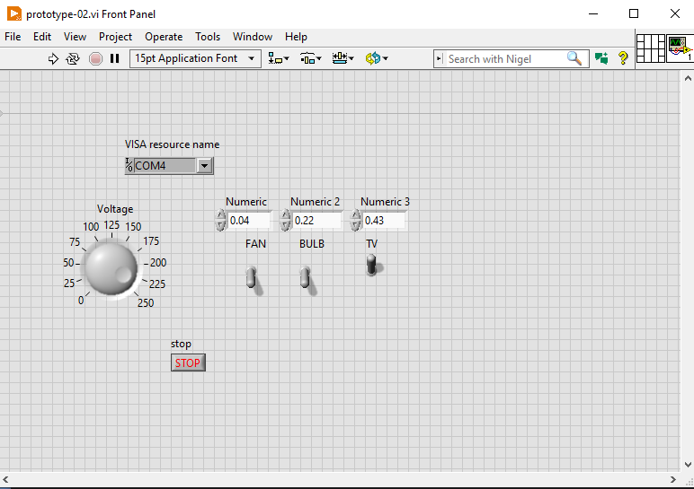

Slide 12
