Slide 1
Automated Investigation of Cyber Attacks Through NetworkTraffic Analysis (PCAPs)
Prepared by: Taghizade Mahammad
Institution: Eötvös Loránd University, Faculty of Informatics
Supervisor: Aya Khedda
Course: Cybersecurity Lab I
Academic Year: 2024-2025
1

Slide 2
1.Introduction
Cybersecurity Landscape:
Rapid increase in cyber threats like PortScan attacks.
Attacks are becoming more sophisticated and harder to detect.
Purpose of This Study:
Automating the detection of PortScan through machine learning.
Improving the effectiveness of anomaly detection systems for network traffic analysis.
2

Slide 3
2.Background – PortScan
What is PortScan?
A PortScan allows attackers to control a compromised system remotely.
Obfuscation techniques help attackers disguise malicious traffic as normal.
Challenges in Detection:
Traditional tools rely on signatures or rules, ineffective for new/zero-day attacks.
Obfuscated traffic hides within normal patterns, evading rule-based systems.
3

Slide 4
2.Background – Why Machine Learning?
Advantages of Machine Learning (ML):
Automatically detects patterns in high-dimensional network traffic data.
Can generalize and identify unseen attack vectors.
Key Approaches:
Supervised Learning (e.g., Random Forest, SVM).
Unsupervised Learning (e.g., Isolation Forest).
4

Slide 5
3.Problem Statement
Key Issue:
Detecting PortScan in complex, obfuscated network traffic.
Research Gap:
Existing methods struggle with precision and scalability.
Goal:
Develop an automated, ML-based anomaly detection framework for obfuscated traffic.
5

Slide 6
3.Problem Statement
Key Issue:
Detecting PortScan in complex, obfuscated network traffic.
Research Gap:
Existing methods struggle with precision and scalability.
Goal:
Develop an automated, ML-based anomaly detection framework for obfuscated traffic.
6

Slide 7
4.Objectives
SECURITY
1.Build an automated anomaly detection system for network traffic.
2.Evaluate machine learning models:
Support Vector Machines (SVM)
Isolation Forest
Random Forest
3.Propose model optimization strategies based on experimental results.
7

Slide 8
5.Dataset Overview
Dataset Details:
Rows: 286,096
Columns: 79 (78 features + 1 target label)
Label Distribution:
Benign traffic: ~158,804 instances
Malicious traffic: ~127,292 instances
Feature Categories:
Flow-based metrics: e.g., flow duration, bytes/sec.
Packet-level attributes: e.g., mean packet size.
Inter-Arrival Times (IAT).
Flag-based features: e.g., ACK, PSH, FIN.
Temporal metrics: e.g., active and idle durations.
8

Slide 9
6.Preprocessing Steps
Normalization:
Scaled feature values between -1 and 1 for compatibility with ML models.
Missing Values:
No missing data, eliminating the need for imputation.
Class Balancing:
Addressed the imbalance using oversampling and weighted loss functions.
Feature Selection:
Identified key features like flow duration and packet length mean.
9

Slide 10
7.Machine Learning Models – Overview
Models Used:
1.Support Vector Machines (SVM):
Effective for high-dimensional data, binary classification.
2.Isolation Forest:
Detects anomalies by isolating observations in the feature space.
3.Random Forest:
An ensemble learning technique combining multiple decision trees.
10

Slide 11
8.Model Training & Evaluation
Training Process:
Dataset split: 80% training, 20% testing.
Hyperparameter tuning for optimal performance.
Evaluation Metrics:
Accuracy, Precision, Recall, and F1-Score.
Confusion matrices used to evaluate true positives, false positives, and false negatives.
11

Slide 12
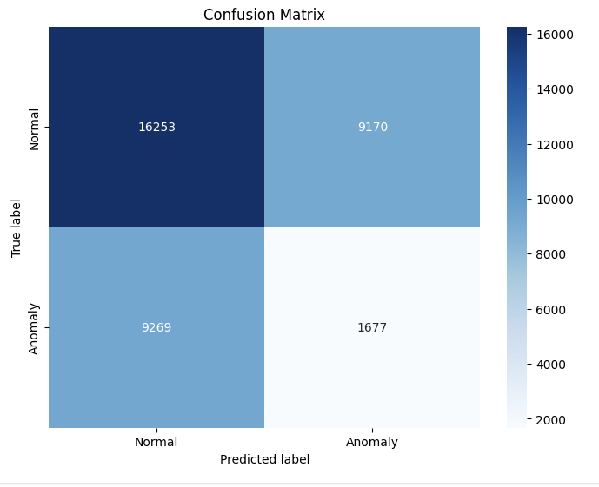
9.1.Results – SVM Performance
Performance Overview:
Accuracy: 49.3%
Precision/Recall/F1: 64%
Key Observations:
Moderate anomaly detection but low accuracy.
Struggled with imbalanced data.
The model has notable issues with both false positives (9,170) and false negatives (9,269), leading to a low accuracy (45.7%) and a moderate F1-score (63.8%). With precision and recall both at around 63.9% and 63.8%, the model struggles to identify the positive class effectively, causing many false positives and false negatives.
12

Slide 13
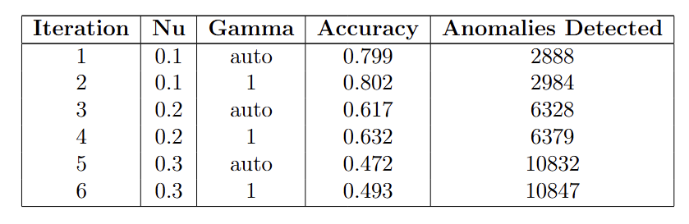
9.1.Results – SVM Performance
Trend: Increasing Nu improves anomaly detection but reduces accuracy.
Key Iteration: Iteration 6 detects the most anomalies (10,847) but has lower accuracy (49.3%).
13

Slide 14
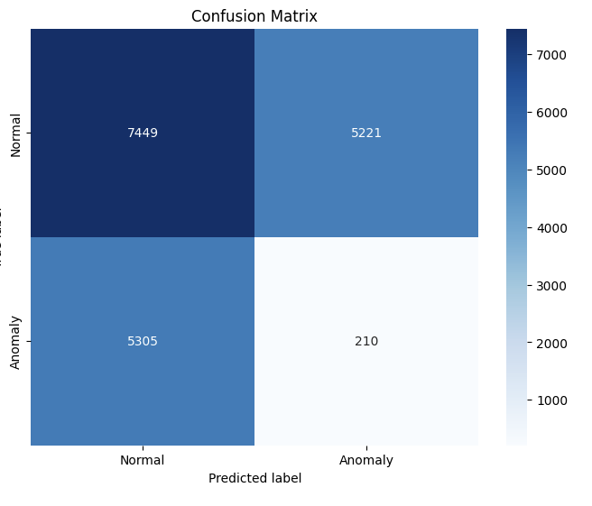
9.2.Results – Isolation Forest Performance
Performance Overview:
Accuracy: 42.1%
Precision: 58%, Recall: 59%.
Key Observations:
Effective for detecting outliers.
High false negatives due to isolation-focused design.
The model has issues with both false positives (5,221) and false negatives (5,305), leading to a low accuracy (42.7%) and a moderate F1-score (58.6%). The precision of 58.8% and recall of 58.4% suggest the model struggles to identify the positive class effectively, with many false positives and false negatives.
14

Slide 15
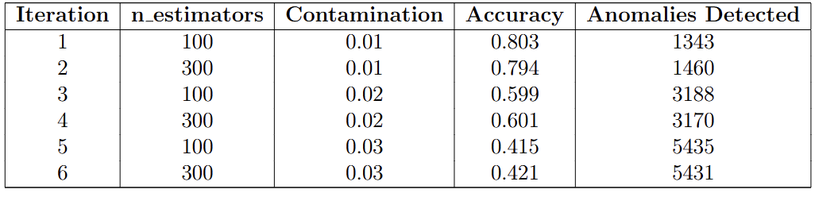
9.2.Results – Isolation Forest Performance
Trend: Increasing contamination raises anomalies detected but reduces accuracy.
Key Iteration: Iteration 6 detects 5,431 anomalies with an accuracy of 42.1%.
15

Slide 16
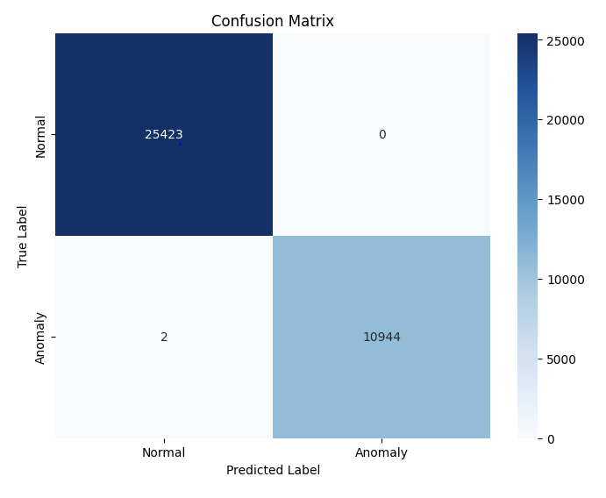
9.3.Results – Random Forest Performance
Performance Overview:
Accuracy: 99.9%
Precision/Recall/F1: 100%
Key Observations:
Near-perfect anomaly detection.
Handles imbalanced datasets effectively.
The model has exceptionally high accuracy (99.9%) with almost perfect precision (100%) and recall (99.98%), making it highly effective at identifying both positive and negative instances. The extremely low number of false positives (0) and false negatives (2) indicate that the model performs nearly flawlessly in distinguishing between the two classes. This makes it one of the most reliable models for this classification task.
16

Slide 17
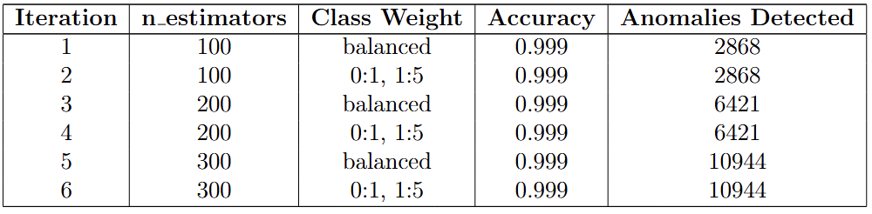
9.3.Results – Random Forest Performance
Trend: Increasing the number of estimators raises the number of anomalies detected but has no effect on accuracy, which remains stable at 0.999 throughout the iterations.
Key Iteration: Iteration 6 detects 10,944 anomalies with an accuracy of 42.1%, marking a significant increase in detected anomalies compared to previous iterations, despite the decrease in accuracy.
17

Slide 18
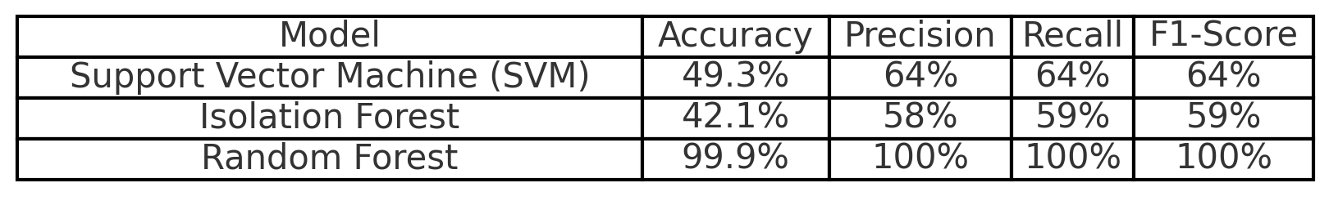
10.Comparison of Models
The Random Forest model excels with 0.999 accuracy and perfect precision, recall, and F1-score. The SVM model shows moderate performance with 0.493 accuracy and 0.64 for precision, recall, and F1-score. The Isolation Forest model has lower accuracy (0.421) and slightly worse metrics than SVM, with precision, recall, and F1-score around 0.58-0.59.
18

Slide 19
11.Key Insights
Random Forest: Most robust and effective model for detecting obfuscated attacks.
Limitations of Other Models: Require better hyperparameter tuning and feature engineering.
Importance of Preprocessing: Feature scaling and class balancing were crucial for model performance.
19

Slide 20
12.Conclusion
Key Takeaways:
Machine learning is critical for automating cyber-attack detection.
Random Forest proved to be the best-performing model for PortScan.
Future Outlook:
Continued optimization and integration of advanced ML techniques will strengthen cybersecurity frameworks.
20

Slide 21
THANKS!
Do you have any questions?
YH0U66@inf.elte.hu
Please keep this slide for attribution.
21

