Slide 1

Comparative Evaluation of Fingerprint-Based Gender Classification (CNN)
1

Slide 2

Supervised by
Prof. Md. Abdul Based
Additional Director of Research & Publications Cell
Dept. of Computer Science & Engineering
Dhaka International University
2

Slide 3
Presented by
 | Roll: | Batch
Md Atiqur Rahman | 03 | 54th(1st Shift)
Md Saymon Islam | 06 | 54th(1st Shift)
Shameul Haque | 07 | 54th(1st Shift)
Lubana Akter | 23 | 54th(1st Shift)
Meher Negar | 25 | 54th(1st Shift)

Slide 4

Introduction
Objective
Background of Research
Methodology
Results and Analysis
Conclusion
References
4

Slide 5
Introduction
This study comprehensively evaluated fingerprint-based gender classification by employing Convolutional Neural Network (CNN) on the SOCOFing dataset comprising 55,273 fingerprint images. Notably, our system achieved an exceptional accuracy rate of 99.23%. This remarkable performance underscores the significant role that fingerprints can play in accurately determining an individual's gender by leveraging critical features inherent in the fingerprint data. This research highlights the promise of fingerprints as a robust biometric trait for gender classification
5

Slide 6
Objective
Accuracy Assessment
Performance Comparison
Robustness Analysis
Feature Extraction Analysis
Computational Efficiency
Comparative Benchmarking
5

Slide 7
Background of Research
The comparative evaluation of fingerprint-based gender classification using CNNs represents a significant step towards improving the accuracy and reliability of gender classification techniques. This research has the potential to enhance the capabilities of biometric systems and contribute to the broader field of computer vision and pattern recognition.
5

Slide 8
RELATED WORK
Research work | Year | Accuracy | Algorithm
Fingerprint gender classification using wavelet transform and singular value decomposition [14] | 2012 | 89.32% | KNN
Gender classification with KNN by extraction of Haar wavelet features from canny shape fingerprints[15] | 2016 | 98% | KNN
Fingerprint-based gender identification using digital image processing and artificial neural network[18] | 2017 | 82% | ANN
Gender classification based on fingerprint analysis[20] | 2021 | 99% | KNN
Research on gender-related fingerprint features[21] | 2022 | 97.48 | CNN
5

Slide 9
Methodology
5

Slide 10
Dataset
In this study, we preprocess the dataset adopted from the Sokoto Coventry Fingerprint (SOCOFing) dataset [22] contains 6,000 fingerprints belonging to 600 African subjects. There are 10 fingerprints per subject; all subjects are 18 or older. SOCOFing contains unique attributes such as labels for gender and hand and finger names.
5

Slide 11
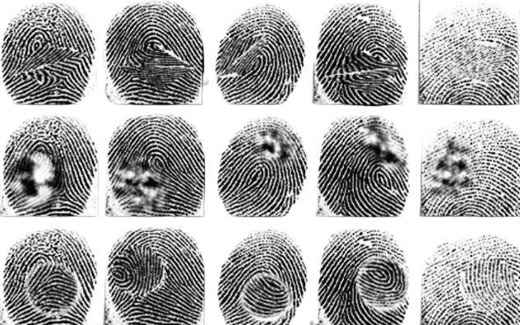
Dataset
Figure 2. Images are altered into z-cut, obliteration, and central rotation.
5

Slide 12
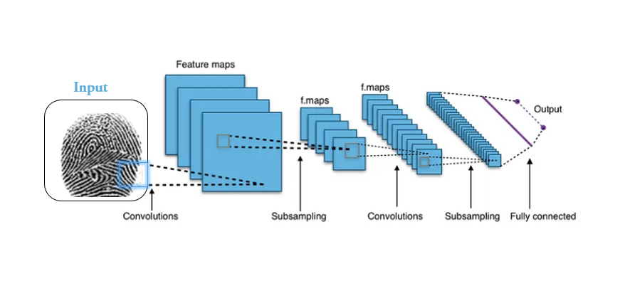
Proposed Model
Figure 3. Convolutional neural network (CNN) Architecture.
5

Slide 13
Experimental Result and Analysis
Convolutional Neural Networks (CNNs) have revolutionized the field of computer vision and achieved remarkable success in various image-related tasks. In this discussion, we focus on a specific CNN model with an impressive accuracy of 99.23%.
5

Slide 14
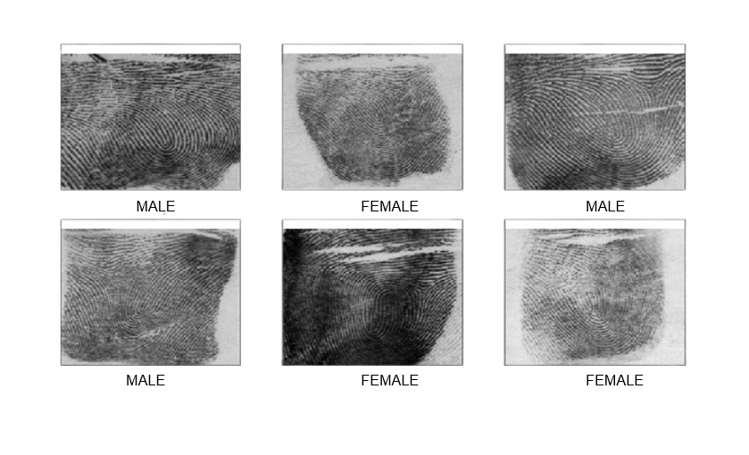
Experimental Result and Analysis
Figure 4. Sample input fingerprint images of male and female.
5

Slide 15
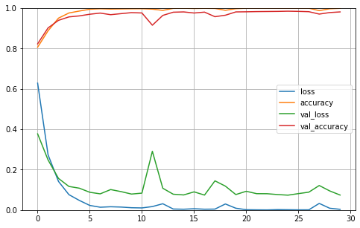
Experimental Result and Analysis
Figure 5. Accuracy and loss curve of the proposed model CNN..
5

Slide 16
Experimental Result and Analysis
Table2. Classifying accuracy, precision, recall, and F1 score.
Deep Learning Algorithm | Accuracy | Precision | Recall | F1-Score
Convolutional Neural Network | 99.23% | 98.39% | 98.88% | 0.978754
K-Nearest Neighbors | 95.28% | 94.91% | 94.91% | 0.889352
Support Vector Machine | 93.45% | 92.43% | 92.94% | 0.876849
5

Slide 17
CONCLUSION
The findings from these evaluations contribute to the advancement of biometric research and may have practical applications in various fields, such as law enforcement, border control, and forensic sciences. It's important to note that while fingerprint-based gender classification shows promise, it is not without limitations. Factors like image quality, variations in fingerprint acquisition devices, and noise can affect the accuracy of gender classification algorithms. Additionally, ethical considerations regarding privacy and potential biases must be considered when deploying such technologies in real-world applications.
5

Slide 18
REFERENCES
[1] S. Alwahaishi and J. Zdralek, “Biometric authentication security: an overview,” in Proceedings of the 2020 IEEE International Conference on Cloud Computing in Emerging Markets CCEM, pp. 87–91, Bengaluru, India, November 2020.
[2] M. Gomez-Barrero, P. Rozdowski, C. Rathgeb, J. Patino, and M. Todisco, “Biometrics in the era of COVID-19: challenges and opportunities,” 2021, http://arxiv.org/abs/2102.09258.
[3] J. Preciozzi, G. Garella, V. Camacho, et al., “Fingerprint biometrics from newborn to adult: a study from a national identity database system,” IEEE Trans Biom Behav Identity Sci, vol. 2, no. 1, pp. 68–79, 2020.
[4] H. Chiroma, “Deep learning algorithms based on fingerprint authentication: systematic literature review,” Journal of Artificial Intelligence and Systems, vol. 3, no. 1, pp. 157–197, 2021.
[5] Y. Liu, T. Zhou, Z. Yue, et al., “Secure and efficient online fingerprint authentication scheme based on cloud computing,” IEEE Transactions on Cloud Computing, p. 1, 2021.
5

Slide 19
REFERENCES
[[6] C. Militello, V. Conti, S. Vitabile, and F. Sorbello, “Embedded access points for trusted data and resources access in HPC systems,”: e-Journal of Supercomputing, vol. 55, no. 1, pp. 4–27, 2010, https://www.academia.edu/80212156/ Embedded_access_points_for_trusted_data_and_resources_access_in_HPC_systems.
[7] W. Xu, Y. Zhuang, X. Long, Y. Wu, and F. Lin, “Human gender classification: a review,” International Journal of Biometrics, vol. 8, no. 3/4, p. 275, 2016.
[8] M. Linortner and A. Uhl, “Towards match-on-card .nger vein recognition,” in Proceedings of the IH and MMSec 2021 - Proceedings of the 2021 ACM Workshop on Information Hiding and Multimedia Security, pp. 87–92, New York, NY, United States, June 2021. [9]Butler, J. (1990). Gender Trouble: Feminism and the Subversion of Identity.
[10]Fausto-Sterling, A. (2000). Sexing the Body: Gender Politics and the Construction of Sexuality.
5

Slide 20
REFERENCES
[11]Laqueur, T. (1992). Making Sex: Body and Gender from the Greeks to Freud.
[12]Raz, O. (2018). Islam and Gender: The Religious Debate in Contemporary Iran.
[13]Serano, J. (2007). Whipping Girl: A Transsexual Woman on Sexism and the Scapegoating of Femininity.
[14] P. Gnanasivam and Dr. S. Muttan, “Fingerprint gender classification using wavelet transform and singular value decomposition,” 2012, https://arxiv.org/abs/1205.6745v1.
[15] S. R. Shinde and S. D. ) Spade, “Gender classification with KNN by extraction of Haar wavelet features from canny shape fingerprints,” in Proceedings of the 2015 International Conference on Information Processing (ICIP), pp. 702–707, Pune, India, June 2016.
[16] M. K. Shinde and S. A. Annadate, “Analysis of fingerprint image for gender classification or identification: using wavelet transform and singular value decomposition,” in Proceedings of the 1st International Conference on Computing, Communication, Control and Automation, ICCUBEA, pp. 650–654, Pune, India, February 2015.
5

Slide 21
REFERENCES
[17] S. F. Abdullah, A. F. N. A. Rahman, Z. A. Abas, and W. H. M. Saad, “Development of a fngerprint gender classification algorithm using fingerprint global features,” International Journal of Advanced Computer Science and Applications, vol. 7, no. 6, 2016.
[18] M. Kanojia, N. Gandhi, L. J. Armstrong, and C. Suthar, “Fingerprint-based gender identification using digital image processing and artificial neural network,” Advances in Intelligent Systems and Computing, vol. 736, pp. 1018–1027, 2017.
[19] O. N. Iloanusi and U. C. Ejiogu, “Information security journal: a global perspective ISSN: (print),” Gender classi5- cation from fused multi-fngerprint types Gender classifcation from fused multi-5ngerprint types, vol. 29, no. 5, 2020.
[20] G. Jayakala, L. Sudha, and A. Professor, “Gender classification
based on fingerprint analysis,” Turkish Journal of Computer and Mathematics Education (TURCOMAT), vol. 12, no. 10, pp. 1249–1256, 2021.
[21] Y. Qi, M. Qiu, H. Lin, J. Chen, Y. Li, and H. Lei, “Research on gender-related fingerprint features,” Extracting Fingerprint Features Using Autoencoder Networks for Gender Classification, vol. 12, no. 19, 2022.
[22].Shehu, Y.I., Ruiz-Garcia, A., Palade, V., James, A. (2018) “Detection of Fingerprint Alterations Using Deep Convolutional Neural Networks” in Proceedings of the International Conference on Artificial Neural Networks (ICANN 2018), Rhodes – Greece, 5th- 7th October 2018. Springer-Verlag Lecture Notes in Computer Science.
5

Slide 22
Thank You
.
5

