Slide 1
A Simple, Efficient Method for Realistic Animation of Clouds
Yoshinori Dobashi Kazufumi Kaneda
Hideo Yamashita Tsuyoshi Okita Tomoyuki Nishita
SIGGRAPH 2000

Slide 2
Main Idea
Simulation method
The cloud evolution is simulated using cellular automation which can simulate the motion by simple Boolean operations.
Rendering method
Hardware-accelerated rendering method based on OpenGL, thus quickly calculate shadows and shafts of light through clouds, as well as cloud color.

Slide 3
Introduction
The density distribution of clouds can be defined in 3D space to create realistic images.
Static clouds
Cloud animation in movies.
Nagel use cellular automation to simulate by transition rules.
Based on Nagel’s work, we generate cloud shadows, light shafts using graphics API and OpenGL.

Slide 4
Introduction
Our method display the following effects:
1) cloud color considering the single scattering of light
2) shadows of the clouds cast on the ground
3) shafts of light through light.
Not for the physically exact cloud motion.

Slide 5
Previous work
Simulation
Two categories to simulate the gaseous motion like cloud.
1) simulate the physical process of field dynamics – time consuming
2) heuristic approach – search parameters by trial and error
Our method reflect the physical formation process of cloud and is easy to control the shape and motion.

Slide 6
Previous work
Rendering
1. To display photo-realistic images, scattering/absorption (due to particles) should be considered.
2. Multiple scattering the skylight are important for realistic image synthesis but is time-consuming. Our method use it as ambient term.
3. Use 3D texture to render volume density, yet the 3D texture mapping hardware is expensive. So, we use 2D texture.
4. Ray-tracing is time-consuming. We use hardware color blending and texture mapping functions.

Slide 7
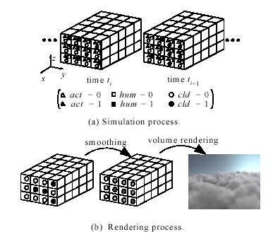
Basic Idea

Slide 8
Basic idea
Each variable can be stored in one bit to save the memory cost and the simulation process is accelerated by using bit field manipulation function.
From the simulation process, what we get is no more than whether there is cloud (cld=1/0). So a density at each point is calculated by smoothing the binary distribulation.

Slide 9
Basic idea
Use volume rendering algorithm
1. calculate the intensity of light reaching the center of each voxel. Also calculate the cloud shadows which are got as texture.
2. generate.
Clouds are rendered with a splatting method.
Shafts of light are rendered with multi spherical shells with their center at the viewpoint.
Shell then are drawn from back to front using the hardware alpha-blending function.
Shafts of light are rendered by mapping the shadow texture on the shells.

Slide 10
Simulation method
We extend the following four points to Nagels methods:
Extinction of clouds
Wind effects
Speeding up of the simulation
Controlling cloud motion

Slide 11
Physical process of cloud formation
Clouds are formed as a bubble of air is heated by underlying terrain heat, causing the bubble to become less dense, and to rise into regions of lower pressure in which the bubble expands. Expansion cools the bubble, increasing the relative humidity inside the bubble.
Phase transition then occurs ( water vapor in the bubble becomes water droplets, or clouds).

Slide 12
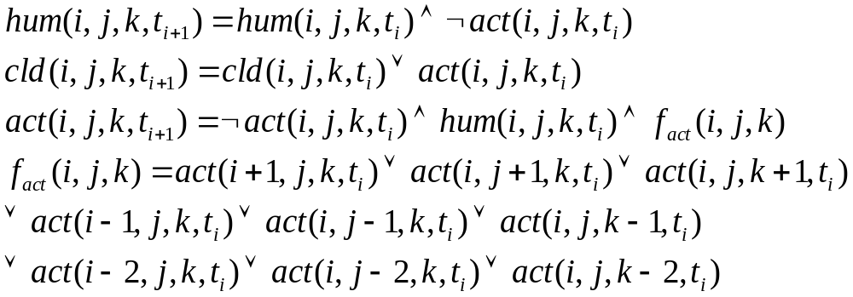
Nagel’s method
Use the cellular automation to simulate.
Three logical variables: hum, act, cld.

Slide 13
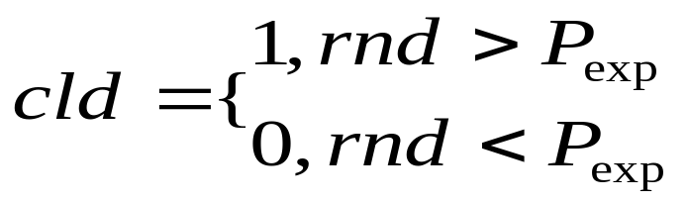
Cloud extinction
One disadvantages of Nagel’s method is that cloud extinction never occurs once it become 1.
In reality, cloud extinction is caused by gradual transition of water droplets to vapor.
Our method:
cloud extinction probability Pext, at each cell whose cld=1, generate a rand( 0<=rnd<=1)

Slide 14
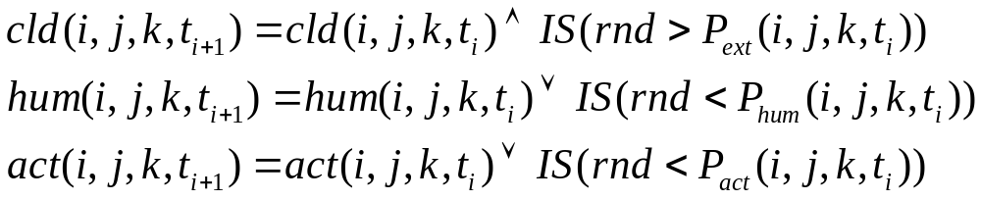
Cloud Extinction
Another problem, clouds are never generated after the extinction at the cell.
With the help of vapor (hum) and phase transition factors (act) which are supplied at specified time intervals.

Slide 15
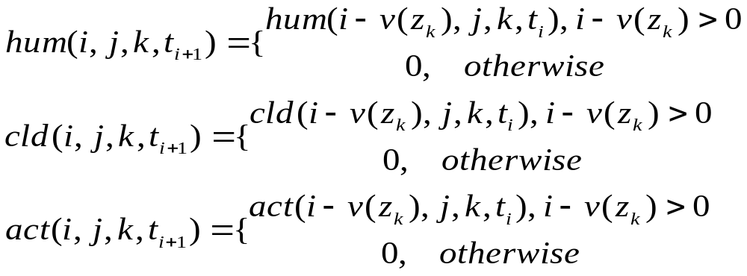
Advection by wind
Clouds move in one direction blown by wind
-shift all the variables towards the wind effect.
Wind velocity depends on the height from the ground - specify it is the function of z.

Slide 16
Fast Simulation Using Bit Field Manipulation Functions
Each variable can be stored in 1 bit since its state is 0/1. Thus simulation with large numbers of cells can be executed in a small amount of memory –store the variables in an array of unsigned integers. Let m be the bit length of the unsigned integer variable, transitions of m cells can be computed at the same time.
Yet random numbers generation at each cell (in cloud extinction) cost large computation time—use look-up table!

Slide 17
Controlling cloud motion using ellipsoids
Cloud motion can be controlled by Phum, Pact and Pcld.
When wet air parcels move upwards and reach the height of the dew point, clouds are gradually formed. Ellipsoids-air parcels!
By controlling ellipsoid parameters (size and position) different kinds of clouds can be simulated.

Slide 18
Rendering
The density distribution of clouds is obtained from simulation.
Images are then rendering with OpenGL.

Slide 19
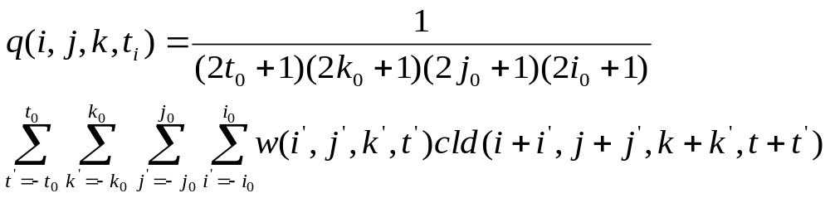
Continuous Density Distribution Calculation
The density distribution of clouds in real world is continuous from 0 to 1. Yet the simulated one only has two values 0/1.
--calculate continuous distribution by smoothing the binary distribution.

Slide 20
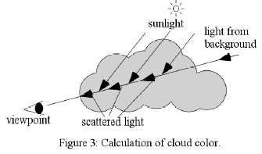
Hardware-accelerated Rendering Using OpenGL
Light reaching the viewpoint = the sum of the scattered light reaching from the sun on the viewing ray + the attenuated light reaching from behind the clouds
The voxel’s color depends on the scattered color of the sun, the transmitted color of the sky, and the attenuated due to cloud particles.

Slide 21
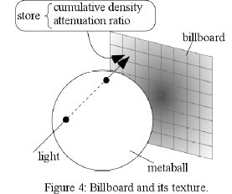
Rendering clouds
Textures for billboards are precalculated. Since the attenuation is not proportional to it, the texture has to be prepared for all metaballs when their center densities are different.—memory-consuming!—discretize the density into nq level and prepare nq textures. Here, nq=64.
The texture corresponding to the nearest density of each metaball is mapped onto the corresponding billboard.
An image is calculated in two steps: 1.calcualte the intensity of light from the sun at each metaball; the clouds’ shadow are also calculated. 2. the image viewed from the viewpoint is generated.

Slide 22
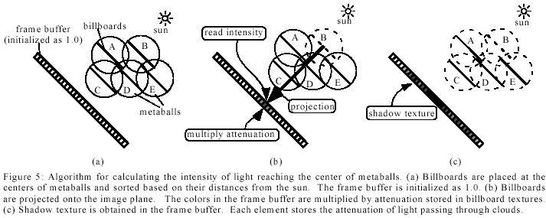
Rendering clouds
Calculate the image viewed from the sun direction to obtain the intensity of light reaching the metaball.

Slide 23
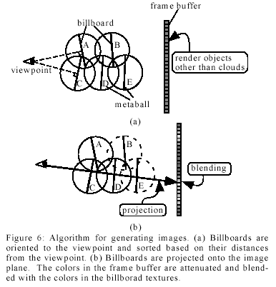
Generate the image using the color of the metaball obtained in first step.
Colors in the frame buffer are multiplied by the attenuation radio of the billboard texture and then the colors in the texture are added.

Slide 24
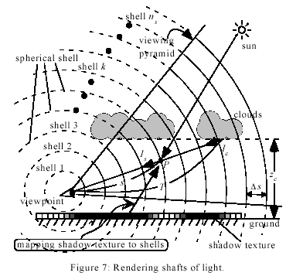
Rendering shafts of Light

Slide 25
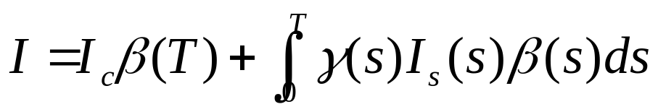
Rendering Shafts of Light
Shafts of light are caused by particles in the atmosphere. The sunlight passing through the gaps in clouds is scattered by the particles at P. The scattered light, Is, reaching the viewpoint is recognized as shafts of light. So the scattering/absorption due to the atmospheric particles must be taken into account.
Ic is the cloud color. B(s) is the attenuation ratio due to atmospheric part, r(s) is the attenuation radio due to cloud particles from the sun to P, and Is(s) is the intensity of the light scattered at P due to atmospheric particles.

Slide 26
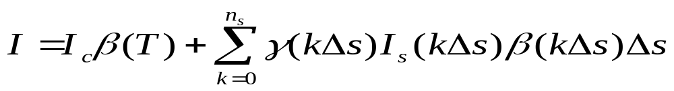
Rendering shafts of light together with clouds
Both the billboard and the shells are transparent objects, they have to be rendered in back-to-front order.
Calculate the colors of vertices of the polygons of the shells in the viewing pyramid.
Repeat the following steps for k=ns, ns-1, ….,1
2.1 Render the shell k with additive blending function. Map the shadow texture for polygons under the cloud bottom.
2.2 Render billboards for displaying clouds between the shell k-1 and the shell k.

Slide 27
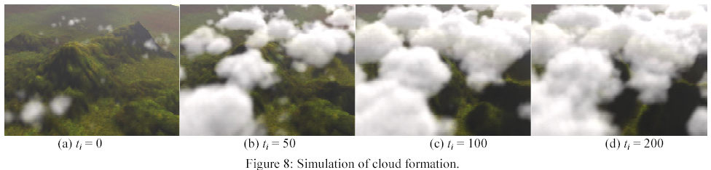
Results

Slide 28
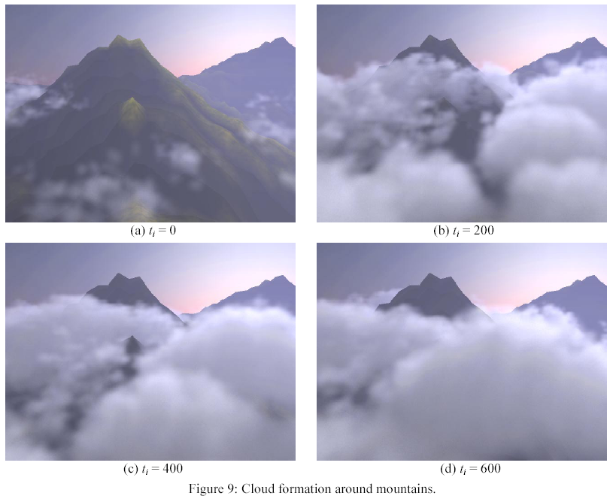

Slide 29
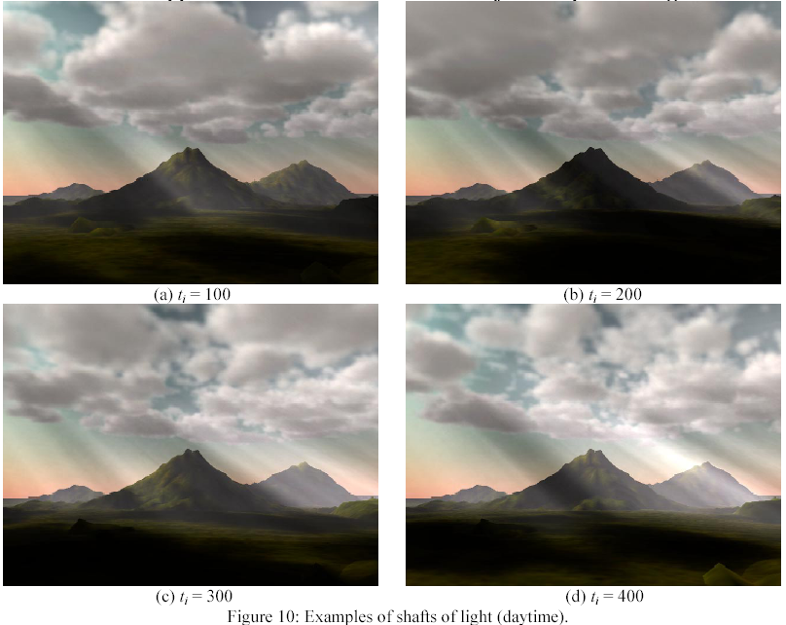

Slide 30
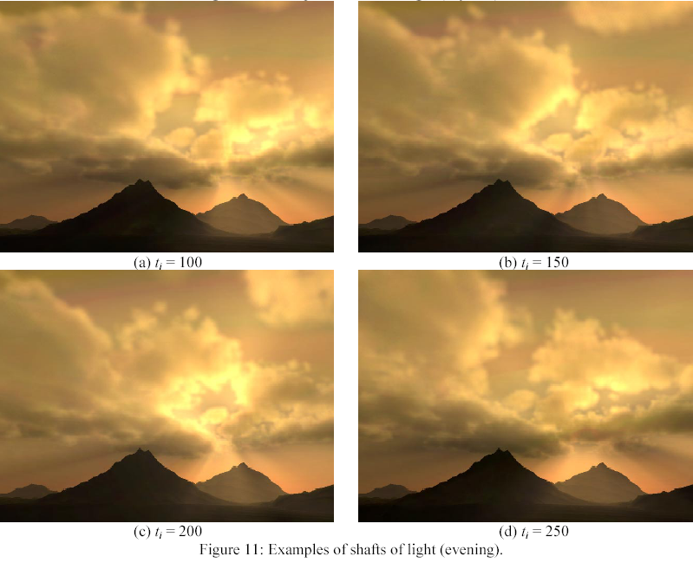
http://www.eml.hiroshima-u.ac.jp/~doba/anim.html

Slide 31
Conclusion
A realistic animation method for clouds
  Cloud motion is simulated using the cellular automation. Shadows and shafts of light are generated by OpenGL.
  Advantages:
  Simulation of the cloud evolution requires small amount of computation--executed by Boolean operations.
  The memory requirement of the simulation is small.
  Images can be rendered quickly with graphics hardware.
  shadows of clouds and shafts of light rendered.
  -- Further work
  Considered the effect of terrain under clouds—multiple wind directions/velocity fields;
  Level of details—hierarchical voxels & coarser voxels faraway->less metaballs ->less computation time

Slide 32
Thank you!

