Slide 1
✈
AI - ASSISTED CODING - Project
SkyWay
Flight Booking System
AI-Powered Full-Stack Web Application
Details
Name : MEHER NAAZ Hall Ticket Number : 2303A51902
Department : CSE
Course Instructor : SALLAUDDIN MOHAMMAD
Institution : SR University
Year : 2026

Slide 2
Introduction
What is SkyWay and why does it matter?
About SkyWay
12
SkyWay is a full-stack, AI-assisted flight booking web application built entirely in Python (stdlib) + vanilla JavaScript — no external web framework required. It simulates a production-grade airline ticketing portal supporting:
Flight search across 12 airports & 6 airlines
Dynamic user registration & OTP-based login
Interactive seat map with exit-row pricing
Pre-book meals (Economy paid, Business free)
Mock payment — Card, UPI/QR, Netbanking, Wallet
PDF boarding-pass ticket download
Web check-in, reschedule, cancellation rules
Full Admin Panel — revenue, users, notifications
Airports
6
Airlines
50+
Routes
100%
AI-Built

Slide 3
Objectives
Goals this project aims to achieve
🎯 Real-World Booking Flow
🔐 Secure Authentication
Simulate end-to-end flight booking: search → seat → meal → pay → ticket — exactly like production airline portals.
Implement email+password login, 6-digit OTP verification, and Google OAuth 2.0 sign-in with session cookies.
🤖 AI-Assisted Development
🛡️ Server-Side Business Rules
Leverage GitHub Copilot prompts embedded in every file to generate, extend, and document code intelligently.
Enforce cancellation windows (<2h blocked, 10%/50%/90% refund tiers), check-in windows, and reschedule restrictions.
💳 Mock Payment Gateway
⚙️ Admin Operations Panel
Support Card (CVV/expiry), UPI QR, Netbanking, and Wallet flows with validation — ready to swap for Razorpay/Stripe.
Let airline staff declare delays, cancellations, gate changes, view revenue, user profiles, and seat occupancy maps.

Slide 4
Stakeholders
Who interacts with SkyWay and what do they need?
✈ Passenger / User
⚙️ Airline Admin
💻 Developer
🏫 Evaluator
Search & compare flights
Book, reschedule, cancel
Web check-in
Download PDF ticket
Track booking status
OTP / Google sign-in
View all bookings & revenue
Declare delays & cancellations
Send passenger notifications
View seat occupancy maps
Manage user accounts
Monitor payment transactions
Copilot prompts in every file
JSON file-based DB
Pure stdlib Python backend
SPA frontend
PDF tickets via ReportLab
Extend via clear API routes
AI-generated code demonstrated
Full prompt history included
Live running demo
10-slide structured PPT
Source code with comments
Functional end product

Slide 5
Technologies, Tools & Software
The full tech stack powering SkyWay
🐍 Backend
🌐 Frontend
🤖 AI & Dev Tools
Python 3.11+
Vanilla JS (ES6+)
GitHub Copilot
Core language — no framework
SPA — no React / Vue / Angular
Primary code generation
http.server
CSS Custom Props
VS Code
Built-in HTTP server (stdlib)
Full design-token theme system
IDE with Copilot extension
Google OAuth 2.0
hashlib / hmac
Google Fonts
Social sign-in integration
SHA-256 auth + sessions
Sora + DM Sans + DM Mono
ReportLab 4.x
HTML5 Modals
PDF boarding-pass generation
Cancel / Reschedule / Payment
JSON flat-file
Fetch API
Zero-dependency database
All async API communication
urllib.request
LocalStorage
Google OAuth token exchange
Client-side state (seat / meal)

Slide 6
GitHub Copilot Prompts
Prompts embedded in app.py
app.py
#create a app.py for flight ticket booking system with below features:
# - Search flights between airports on specific dates and round trips with proper pricing with different classes (economy, business, first). take some static data for airports, airlines, route times, meal menus and special services.
# - View flight details, seat map, meal options, and special services
# - Book flights with passenger details, seat selection, meal preferences, and additional services of extra baggage, wheeelchair requirement ,veg meal,infant in lap, priority boarding, lounge access
# - Manage bookings: view, cancel (with refund rules), reschedule (with fee rules), and check-in (with time restrictions) and mock payment with card or upi
# - Admin panel: view all bookings, manage flight status updates, send notifications to users, and view revenue reports.
-------------------------
# implement booking flow with passenger details, seat selection, meal preferences, and additional services of extra baggage, wheelchair requirement, veg meal, infant in lap, priority boarding, lounge access etc. also implement manage bookings features like view, cancel (with refund rules), reschedule (with fee rules), and check-in (with time restrictions). and also for the admin panel, implement features to view all bookings, manage flight status updates, send notifications to users, and view revenue reports. ensure all business rules are enforced and edge cases handled properly.
--------------------------
# Generate mock flight data based on origin, destination, and date with realistic departure times, durations, prices for different classes, seat availability, and other details while ensuring consistency for the same inputs and incorporating any admin-set status or delays.
# Generate a seat map for a given flight and cabin class with realistic occupancy rates, exit rows, window/aisle seats, and price additions while ensuring consistency for the same flight and cabin inputs.
--------------------------
# Implement business rules for cancellation, rescheduling, and check-in based on booking status, time to departure, fare conditions, and other factors while providing appropriate messages and refund/fee percentages.
# Implement rules for rescheduling based on booking status, time to departure, fare conditions, and other factors while providing appropriate messages and fee percentages.
# Implement business rules for check-in based on booking status, time to departure, and other factors while providing appropriate messages about check-in availability and restrictions.
--------------------------
# Implement user authentication with OTP login, secure password handling, session management with expiration, and input validation for registration and login while providing appropriate feedback messages for success and failure cases.
--------------------------
#add a download ticket and boarding pass button that generates a PDF with the booking details and a QR code for check-in.
# include proper api calls:get,post,put,delete for admin panel,revenue collection,delays,searching flights, viewing details, booking, managing bookings, and generating tickets. ensure all business rules are enforced and edge cases handled..
#include otp login for user authentication and session management. implement secure password handling and session expiration. also add input validation and error handling for all API endpoints.
#include profile details of user and allow them to update their information and view their booking history.

Slide 7
Prompts embedded in app.js
app.js
//Generate a complete frontend JavaScript code for a flight booking management system called "SkyWay". The code should include the following features:
//1. booking details page that displays comprehensive information about a specific flight booking, including route details, passenger information, fare breakdown, and booking status.
//2. web check-in page that allows users to check in for their flight online, providing necessary details and generating a boarding pass upon successful check-in and also mock payment with upi or card.
//3. user profile page where users can view and update their personal information, change their password, and access quick links to their bookings and the home page.
//4. Authentication functionality with login and registration pages, including OTP-based login and registration options.
//5. dialogs for confirming booking cancellations and rescheduling, with appropriate messages and actions.
// 6. Admin panel with features to view all bookings, manage flight status updates, send notifications to users, and view revenue reports.
---
// Display list of available flights with pricing, duration, and cabin selection options. Also handles flight selection and navigation to booking page.
----
//Render booking page with passenger details, seat selection, meals, and price summary
//Handle meal selection and update total price accordingly by recalculating the price breakdown based on selected meal and service options, and update the UI to reflect the current selections and total price.
//Handle special service selection and update pricing based on the selected service, also visually indicate the selected service in the UI and recalculate the total price to reflect any additional fees associated with the chosen service.
//Calculate total booking cost including base fare, taxes, seat, meal, and services, and update the price breakdown display in the UI to show the current total price based on user selections.
//Initiate payment process by creating a payment order, displaying payment modal with options, and handling user interactions for payment method selection and submission.
//Fetch and display detailed information for a specific booking, including flight details, passenger info, timeline, fare breakdown, and payment status, with options to cancel or reschedule if applicable.
//Handle web check-in process by validating booking eligibility, displaying flight and passenger details, allowing users to declare baggage and accept terms, and submitting check-in information to the server.
----
//Handle booking cancellation by confirming user intent, sending cancellation request to the server, and updating the UI based on the response, including refund information if applicable.
//Fetch and display admin dashboard with key statistics, charts, and tables for managing flights, bookings, users, notifications, and revenue, with tabbed navigation for different sections.
// Filter admin bookings table based on search input, matching against PNR, passenger names, route, and airline, and update the display of rows accordingly.
// Fetch and display all admin notifications, allowing admins to view details of each notification, including type, message, affected flight (if any), creation time, and providing the ability to delete notifications or create new ones.
// Handle user login by collecting email and password input values, sending them to the server for authentication, and providing feedback on success or failure while also updating the UI and navigating to the appropriate page based on user role . SingUP page and login with otp and google signin

Slide 8
System Workflow
End-to-end flow from landing page to boarded flight
User Visits
http://localhost:8765
Login / Register
(Email + OTP)
Search Flights
(Route + Date)
Select Flight
+ Cabin
Seat Map +
Meal + Services
▶
▶
▶
▶
▼
Admin: Notify /
Delay / Revenue
Web Check-In
(48h window)
PDF Ticket
Download
Booking
Confirmed + PNR
Payment
(Card/UPI/QR)
◀
◀
◀
◀
Unauthenticated
Booking steps
Post-payment
Admin actions

Slide 9
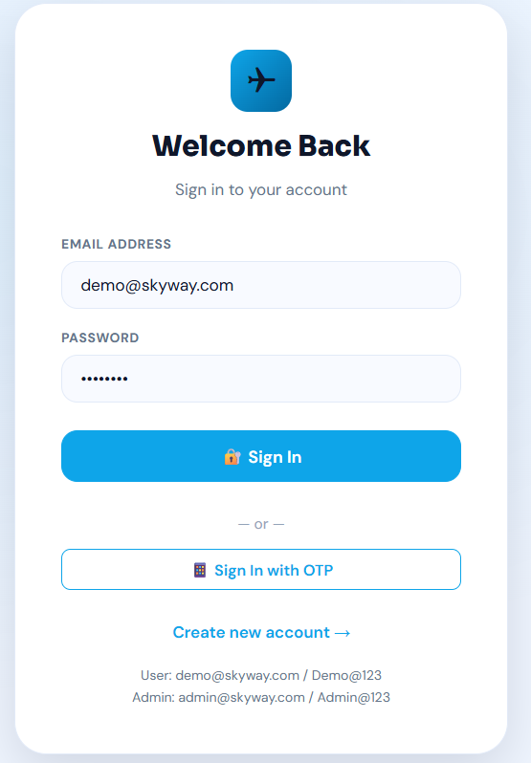
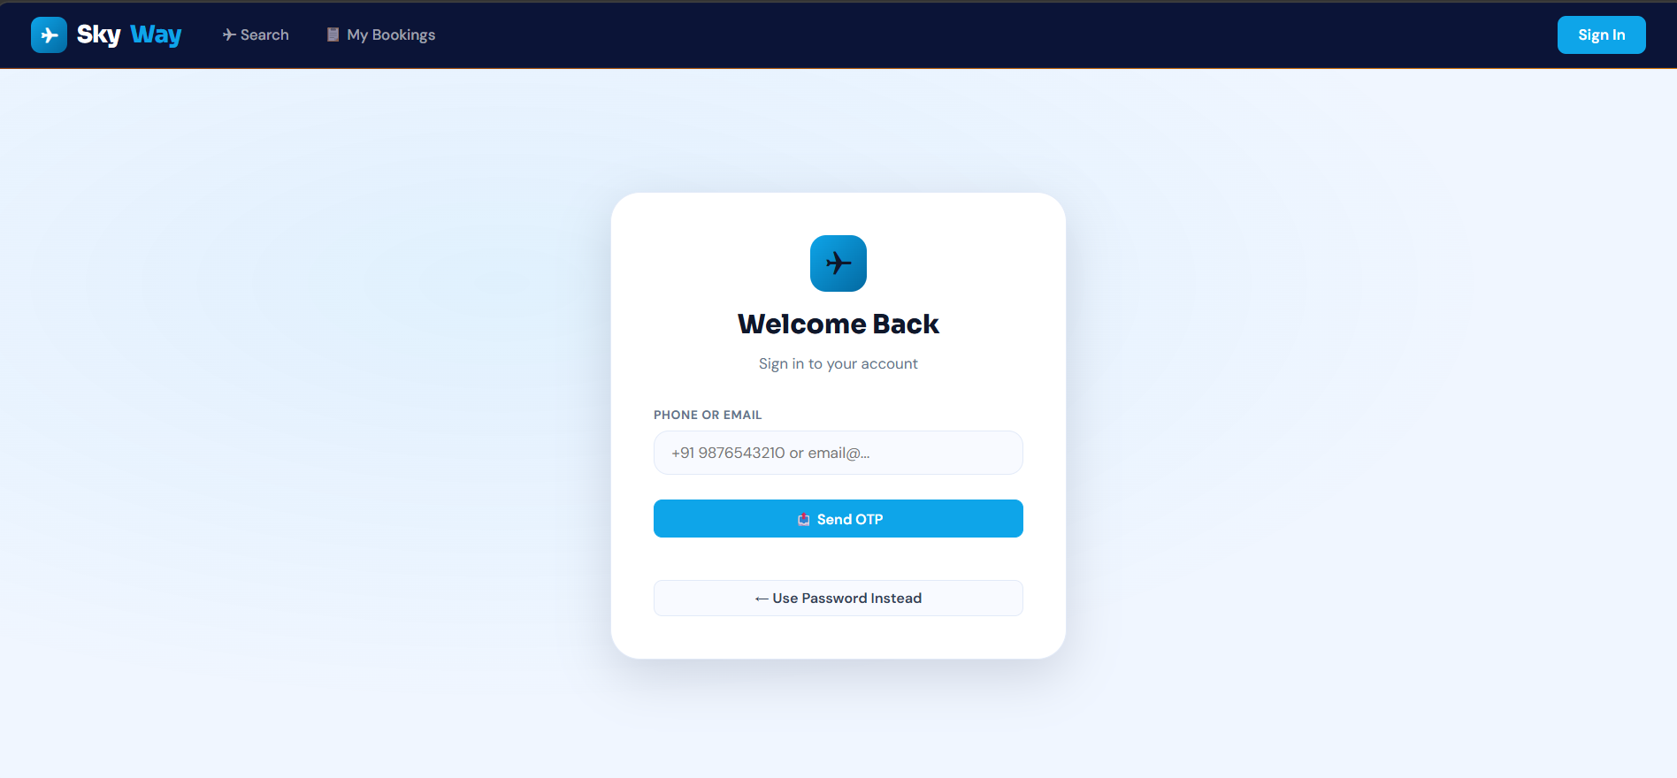
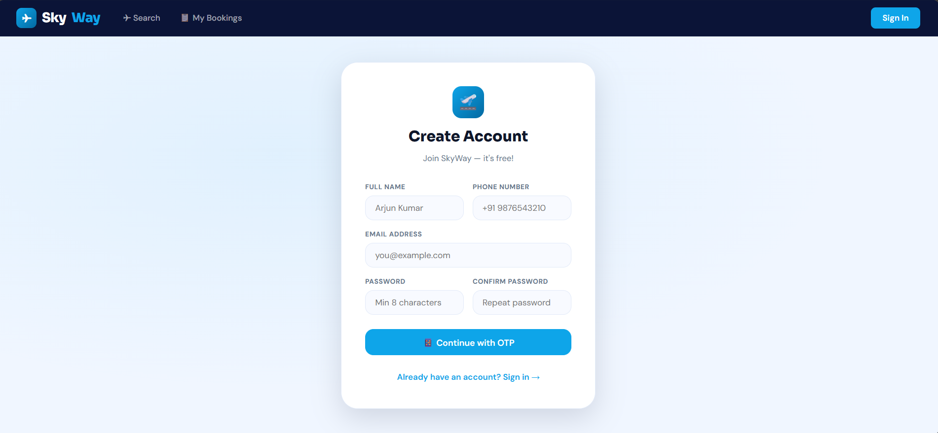
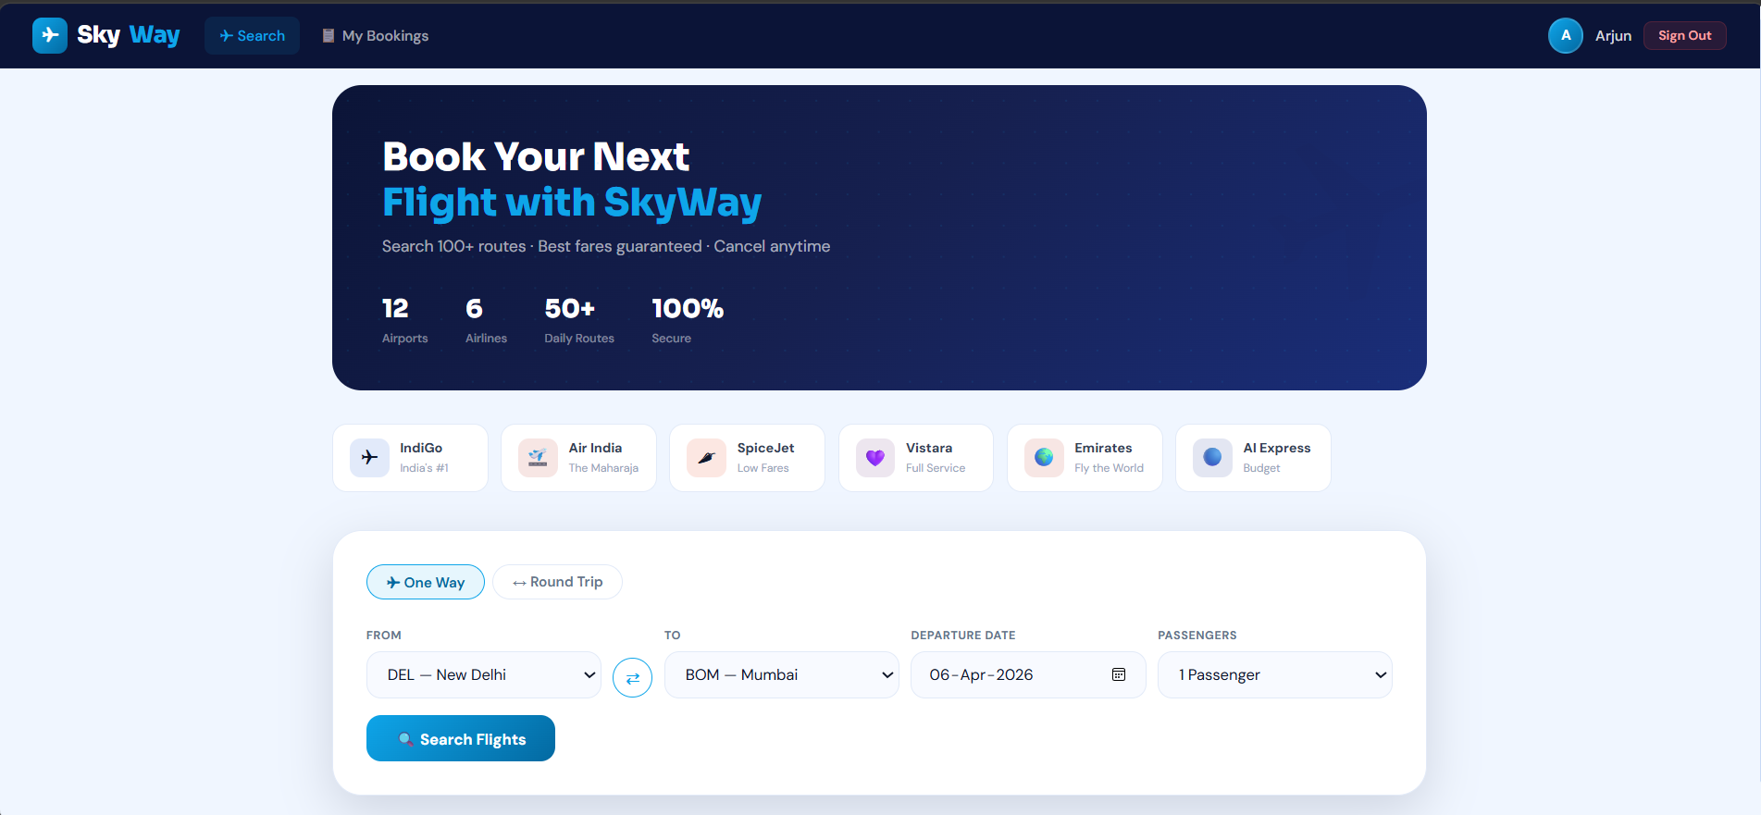
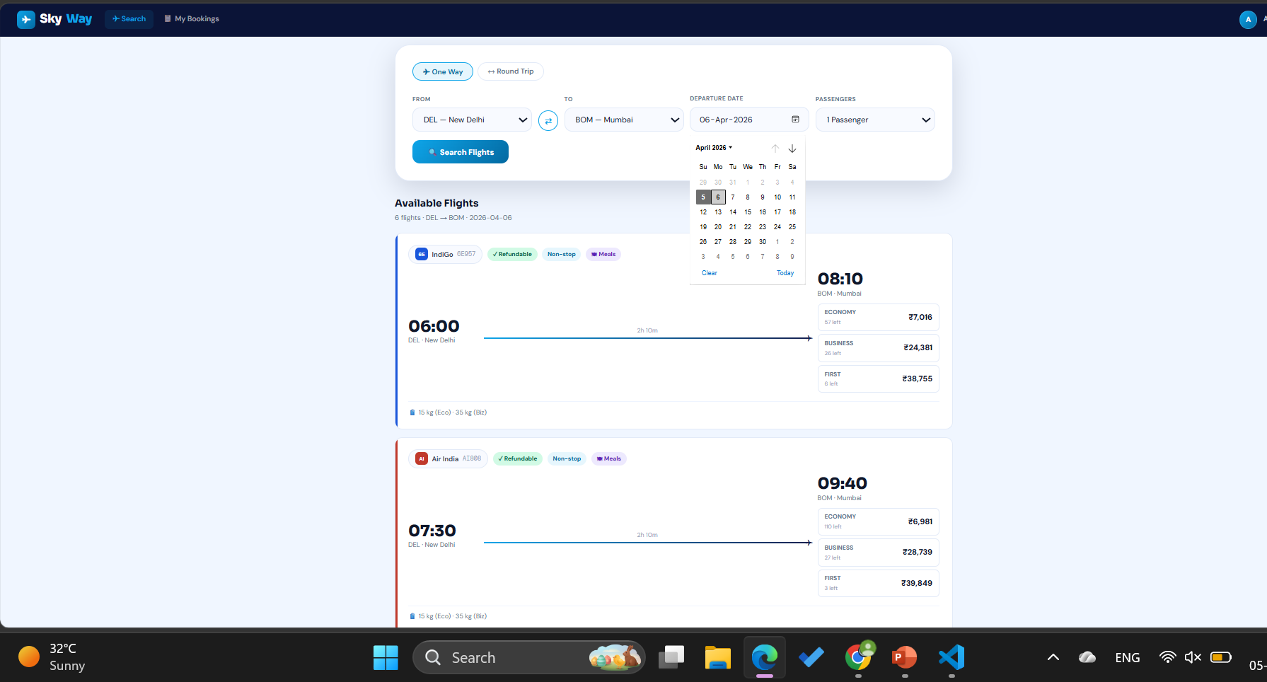
Frontend Views
localhost:8765
Key screens of the SkyWay web application
🔐 Login / SignUp
Login via email + password
OTP login (phone or email)
Register with name, phone, OTP
Admin: admin@skyway.com / Admin@123
Demo: demo@skyway.com / Demo@123
🏠 Home — Flight Search
Hero banner with 6 airline cards
One Way / Round Trip tabs
12 airports · 6 airlines
Search returns real flight results
Economy / Business / First pricing

Slide 10
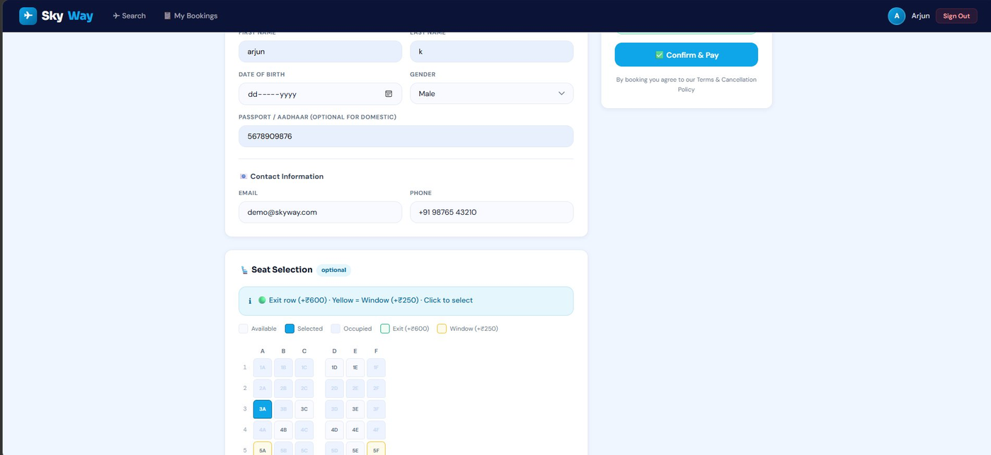
Frontend Views
localhost:8765
Key screens of the SkyWay web application
💺 Passenger Details & Seat Selection
Fill passenger name, DOB, gender, Aadhaar
Contact email and phone number
Interactive 30-row seat map (A–F grid)
Green border = Emergency Exit (+₹600)
Yellow = Window seat (+₹250)
Seat 3A selected — price updates live
Confirm & Pay button on sticky sidebar
Slide 9 · Passenger Details + Seat Map

Slide 11
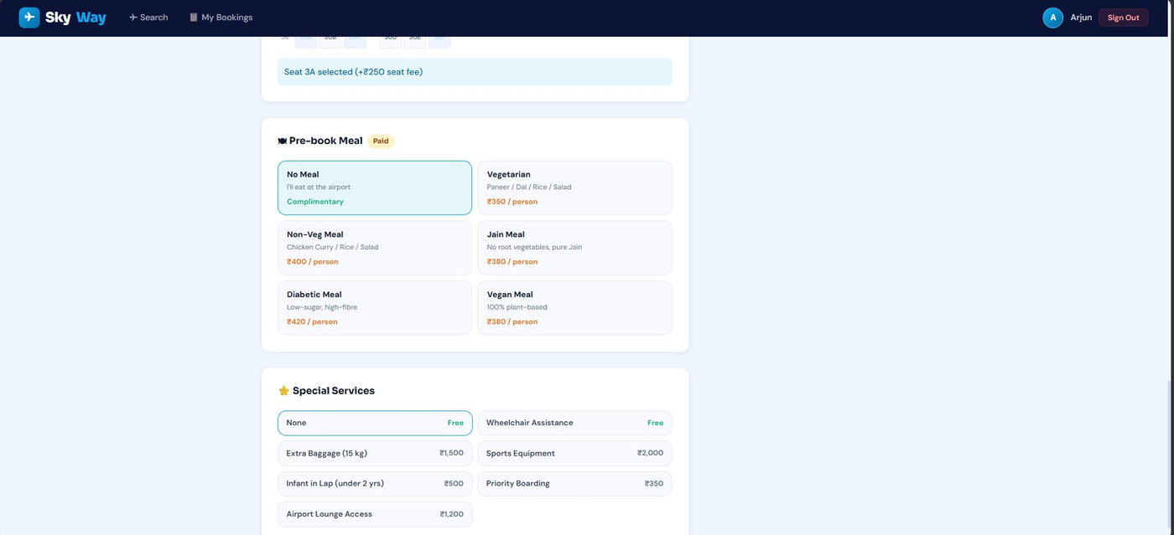
Frontend Views
localhost:8765
Key screens of the SkyWay web application
🍽 Pre-book Meal & Special Services
Economy: 6 meal options (₹350–₹420)
No Meal (free) · Vegetarian · Non-Veg
Jain Meal · Diabetic · Vegan Meal
Special Services grid below meals
Wheelchair (Free) · Extra Baggage ₹1,500
Sports Equipment ₹2,000 · Infant ₹500
Priority Boarding ₹350 · Lounge ₹1,200
Slide 10 · Meal + Special Services

Slide 12
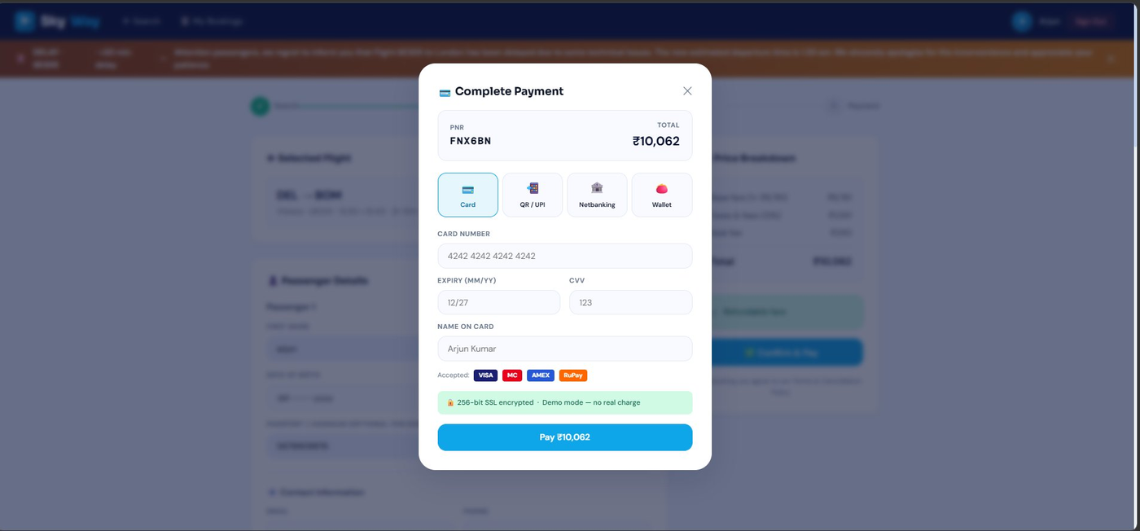
Frontend Views
localhost:8765
Key screens of the SkyWay web application
💳 Complete Payment Modal
4-tab payment interface in a modal
Card tab: Card number, Expiry, CVV, Name
Accepted: VISA · MasterCard · AMEX · RuPay
QR / UPI tab: PhonePe, GPay, Paytm, BHIM
Netbanking: 12 Indian banks listed
Wallet: Paytm, Amazon Pay, Mobikwik, Ola
PNR FNX6BN · Total ₹10,062 shown clearly
Slide 11 · Payment Gateway

Slide 13
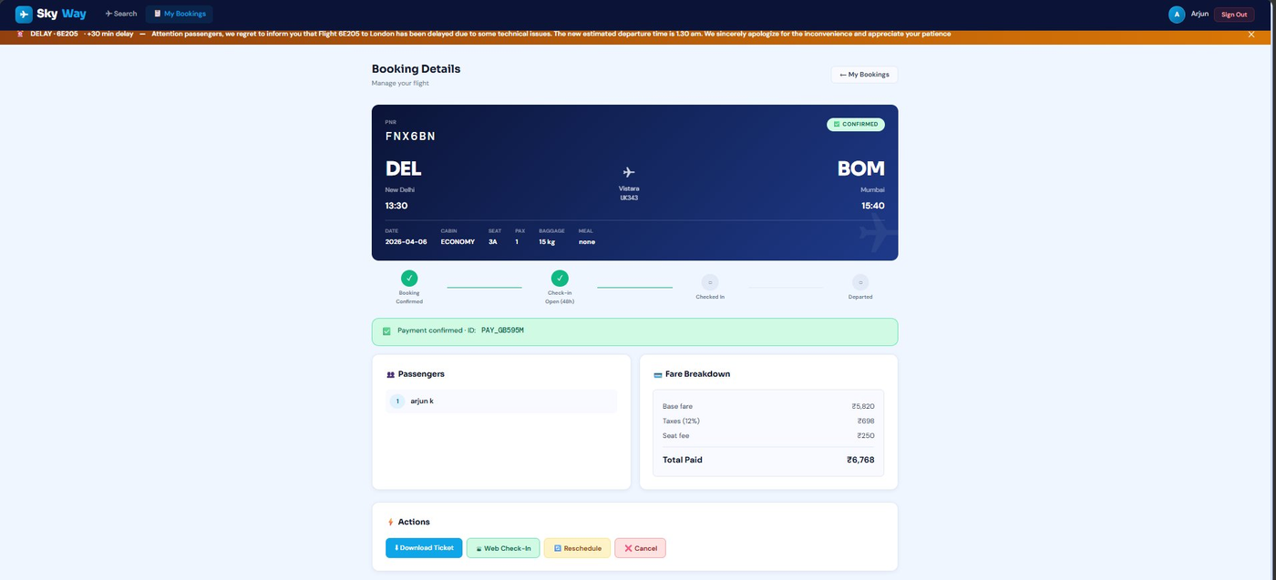
Frontend Views
localhost:8765
Key screens of the SkyWay web application
📋 Booking Details Page
PNR FNX6BN · Status: CONFIRMED badge
DEL → BOM route hero card (navy bg)
Vistara UK343 · 13:30 → 15:40
Progress timeline: Confirmed → Check-in Open
Payment confirmed: PAY_GB595M shown
Passengers + Fare Breakdown cards
Actions: Download Ticket · Check-In · Reschedule · Cancel
Slide 12 · Booking Details

Slide 14
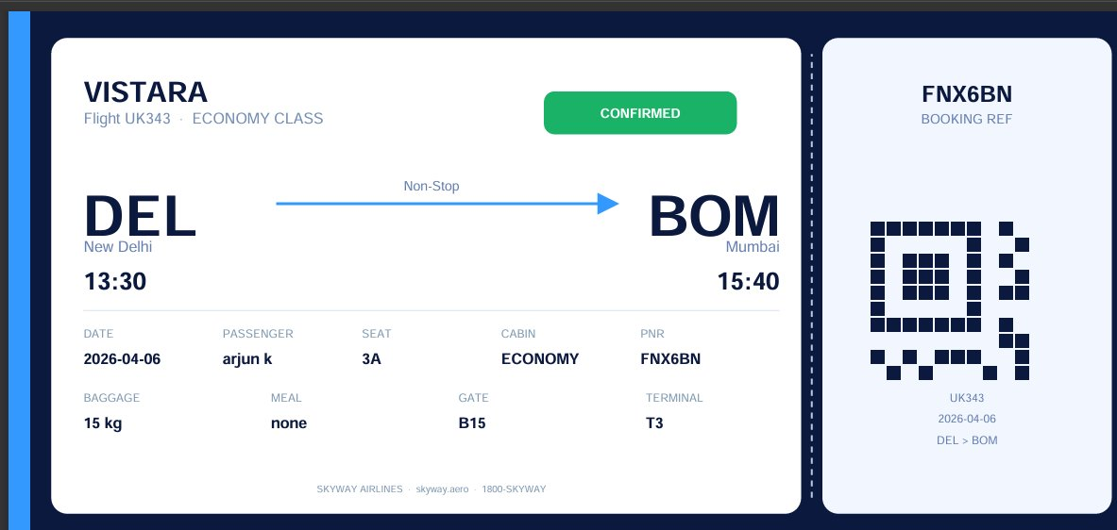
Frontend Views
localhost:8765
Key screens of the SkyWay web application
📄 PDF Boarding Pass Ticket
ReportLab-generated PDF download
Dark navy boarding-pass layout
VISTARA · Flight UK343 · ECONOMY CLASS
DEL → BOM · Non-Stop arrow
13:30 departure · 15:40 arrival
Passenger: arjun k · Seat: 3A
QR code pattern on stub · Gate B15 · T3
Slide 13 · PDF Boarding Pass

Slide 15
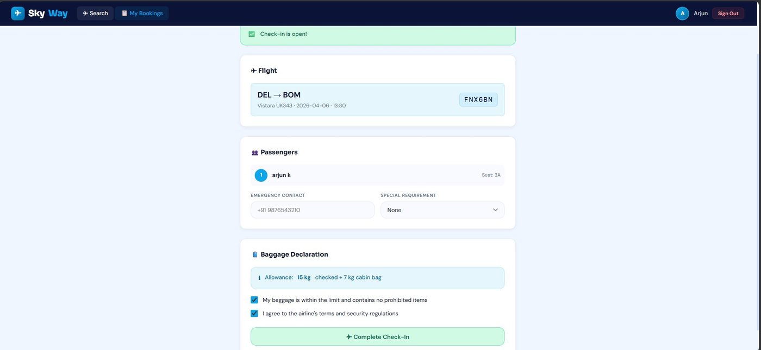
Frontend Views
localhost:8765
Key screens of the SkyWay web application
🛎 Web Check-In Page
Check-in is open! green banner shown
DEL → BOM · Vistara UK343 · PNR FNX6BN
Passenger arjun k · Seat 3A displayed
Emergency Contact + Special Requirement fields
Baggage Declaration: 15 kg + 7 kg cabin
Two checkboxes: baggage + terms confirm
Complete Check-In green button at bottom
Slide 14 · Web Check-In

Slide 16
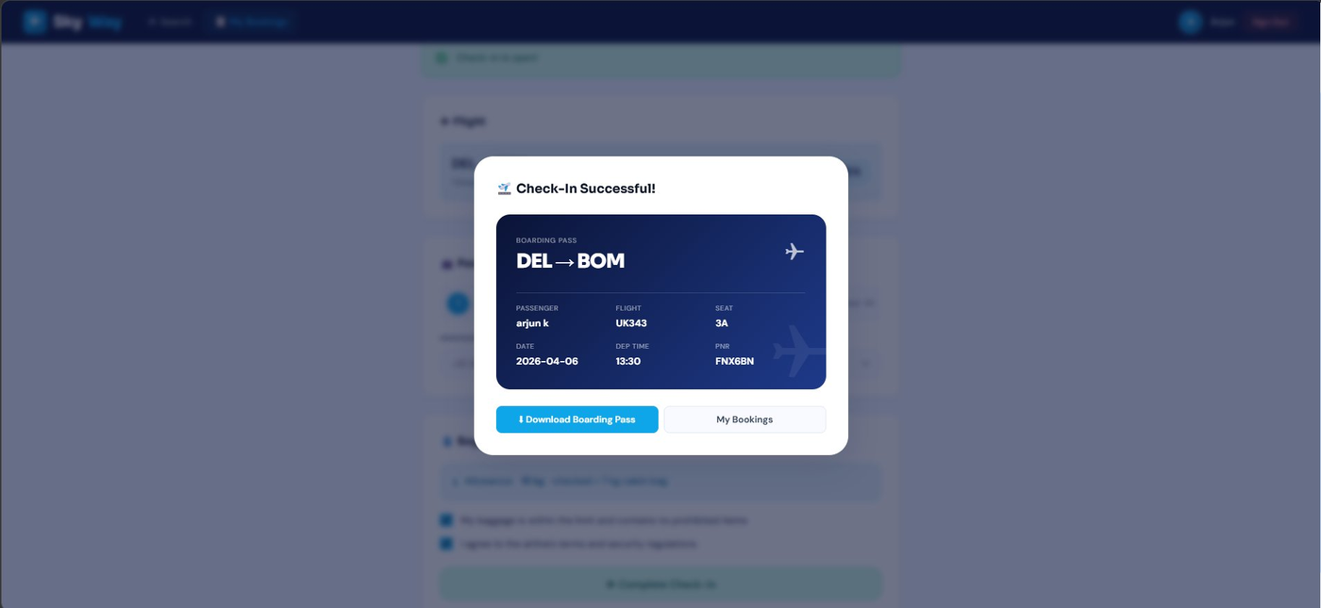
Frontend Views
localhost:8765
Key screens of the SkyWay web application
✈ Check-In Successful — Boarding Pass
Modal popup: Check-In Successful!
Dark navy boarding pass card in modal
DEL → BOM route shown large
Passenger: arjun k · Flight: UK343
Seat: 3A · Date: 2026-04-06 · 13:30
PNR: FNX6BN displayed in mono font
Download Boarding Pass + My Bookings buttons
Slide 15 · Boarding Pass Modal

Slide 17
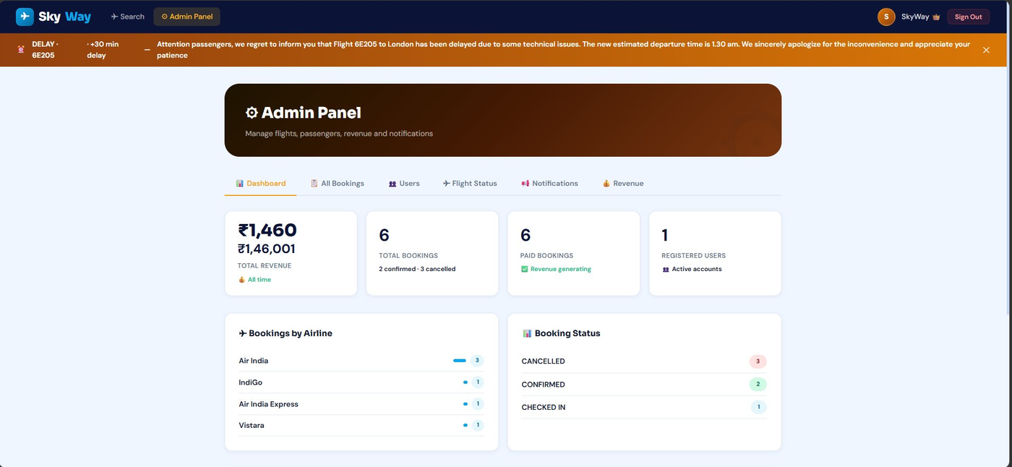
Frontend Views
localhost:8765
Key screens of the SkyWay web application
⚙️ Admin Dashboard
Admin Panel header (dark brown gradient)
6 tabs: Dashboard · All Bookings · Users
Flight Status · Notifications · Revenue
4 stat cards: Revenue ₹1,46,001 · 6 bookings
6 paid bookings · 1 registered user
Bookings by Airline bar chart (Air India 3)
Booking Status: Cancelled 3, Confirmed 2
Slide 16 · Admin Dashboard

Slide 18
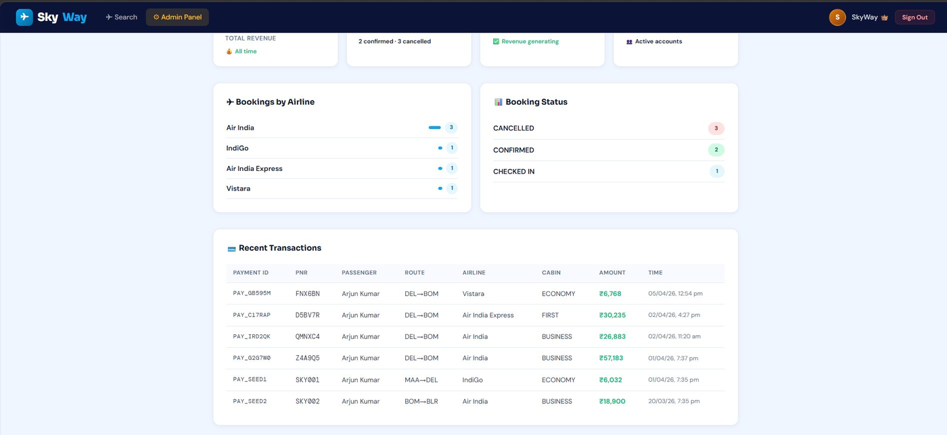
Frontend Views
localhost:8765
Key screens of the SkyWay web application
💰 Admin — Recent Transactions
Dashboard scrolled to Recent Transactions
Bookings by Airline + Booking Status cards
Full transaction table with 6 rows
Columns: Payment ID · PNR · Passenger
Route · Airline · Cabin · Amount · Time
PAY_GB595M · FNX6BN · DEL→BOM · ₹6,768
Amounts in green · sortable by time
Slide 17 · Admin Transactions

Slide 19
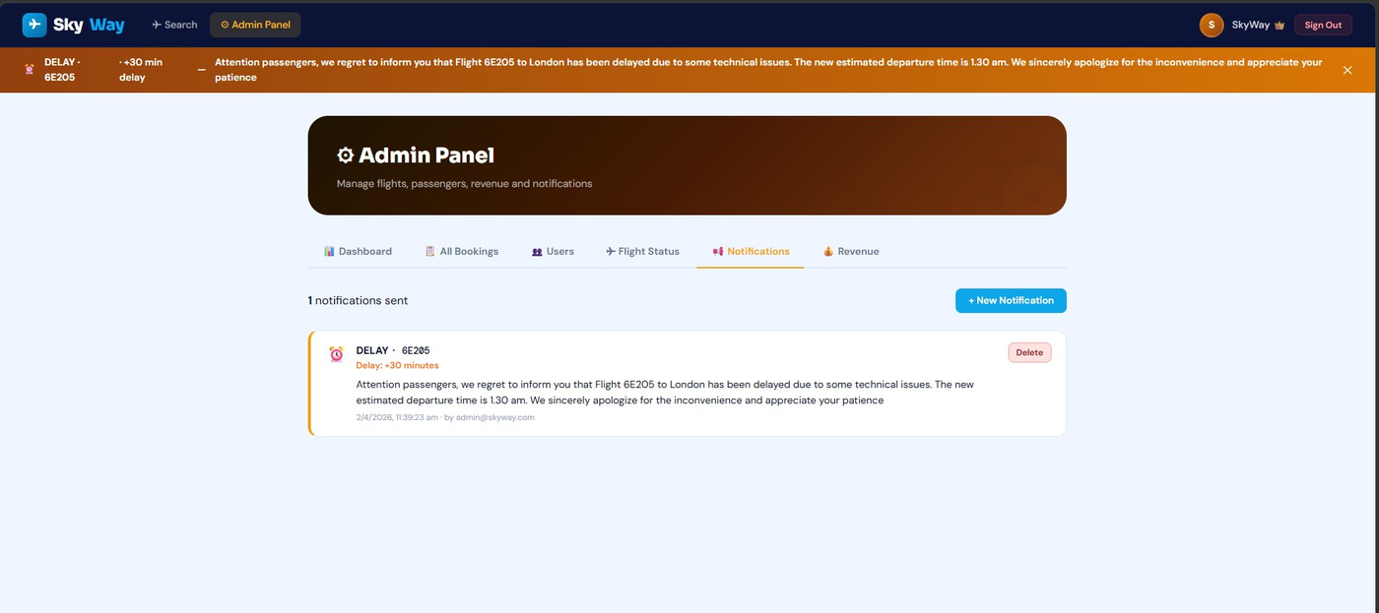
Frontend Views
localhost:8765
Key screens of the SkyWay web application
📢 Admin — Notifications Panel
Notifications tab selected in admin panel
Orange delay banner at top of screen
1 notifications sent counter shown
New Notification button (blue) top-right
DELAY · 6E205 card with orange header
Delay: +30 minutes shown in orange
Full message text · timestamp · admin email
Delete button to remove notification
Slide 18 · Admin Notifications

Slide 20
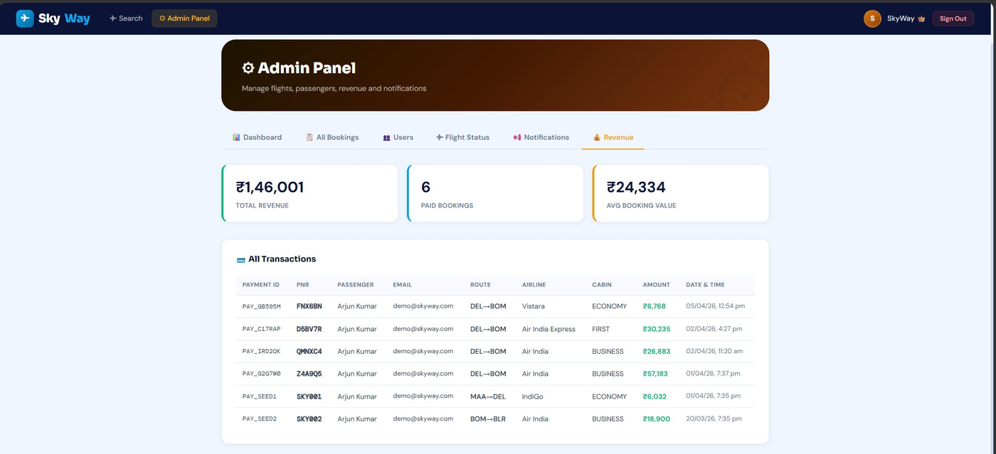
Frontend Views
localhost:8765
Key screens of the SkyWay web application
📊 Admin — Revenue Analytics
Revenue tab selected in admin panel
3 stat cards at top row
Total Revenue: ₹1,46,001 (green border)
Paid Bookings: 6 (blue border)
Avg Booking Value: ₹24,334 (gold border)
All Transactions table with 6 entries
Payment ID · PNR · Email · Route · Amount
Amounts highlighted in green font
Slide 19 · Admin Revenue

Slide 21
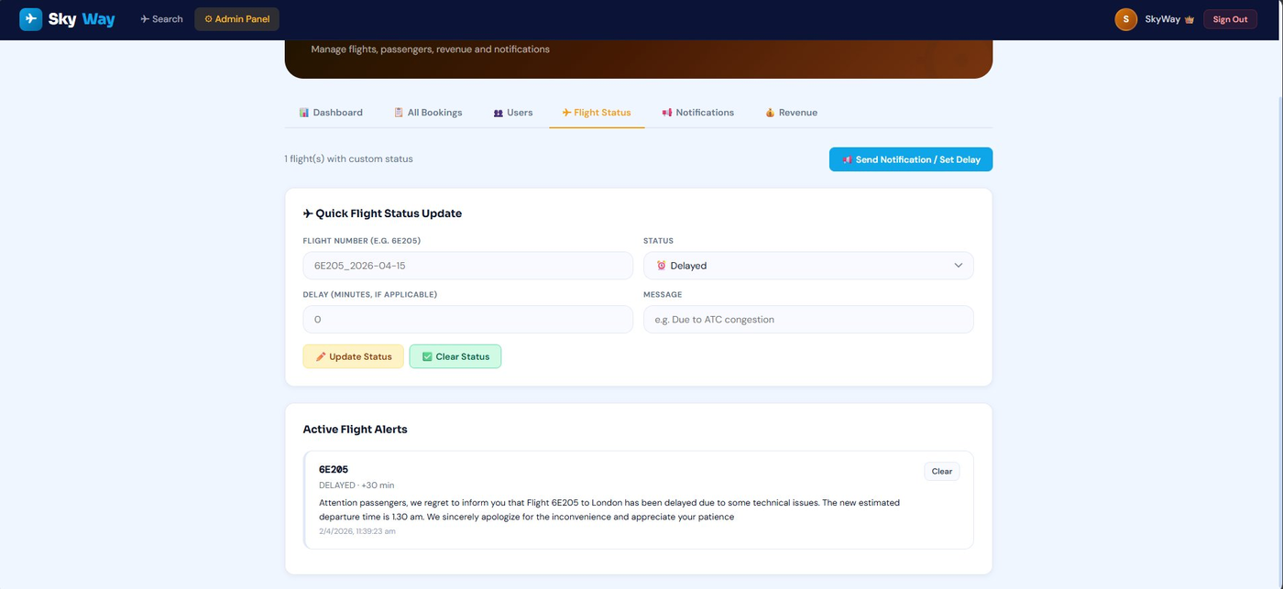
Frontend Views
localhost:8765
Key screens of the SkyWay web application
✈ Admin — Flight Status Control
Flight Status tab · 1 flight with custom status
Send Notification / Set Delay button
Quick Flight Status Update form
Flight Number · Status dropdown · Delay min
Message text field · Update Status button
Active Flight Alerts section below
6E205 · DELAYED · +30 min delay card
Clear button to remove active alert
Slide 20 · Admin Flight Status

Slide 22
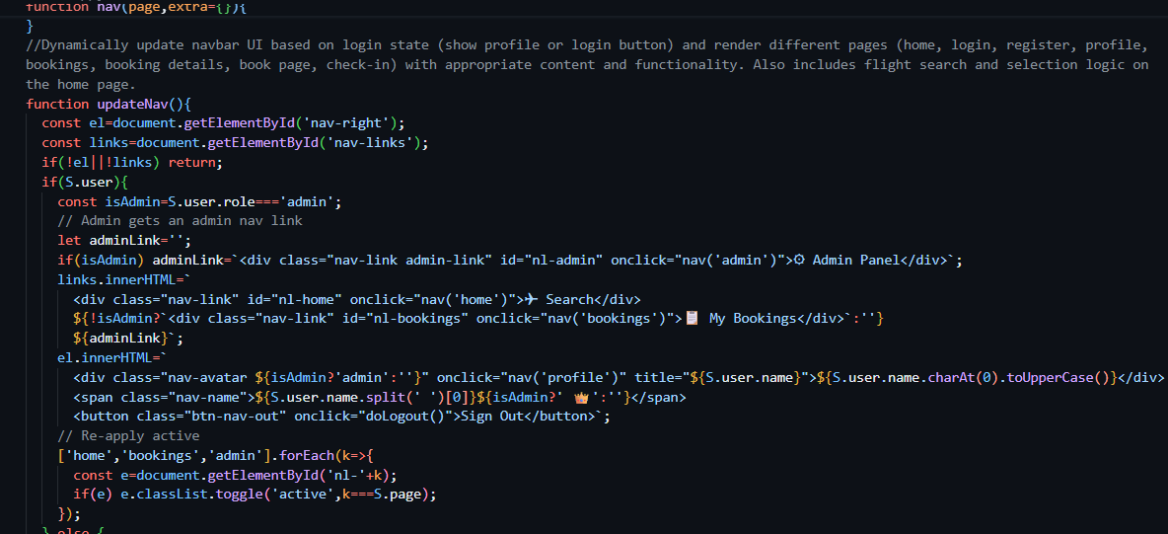
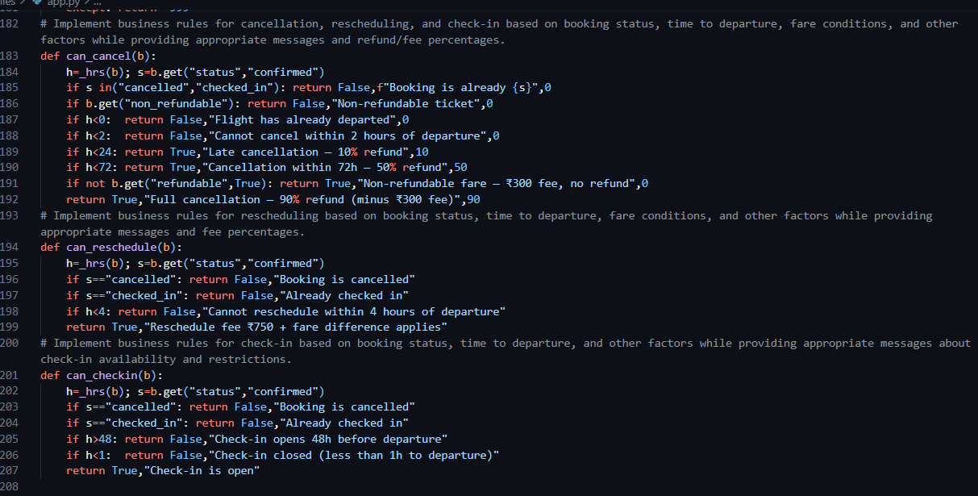
Proof of Prompts Generating Code

Slide 23
References
Documentation, libraries, and tools used
Python Documentation
▸ Python 3.11 Standard Library — http.server, hashlib, json, io, os — docs.python.org
▸ ReportLab 4.x User Guide — PDF generation library — docs.reportlab.com
Frontend & Design
▸ Google Fonts — Sora, DM Sans, DM Mono — fonts.google.com
▸ CSS Custom Properties (MDN) — developer.mozilla.org/en-US/docs/Web/CSS/--*
AI Tools Used
▸ GitHub Copilot — AI code completion — github.com/features/copilot
Airline Industry Standards
▸ IATA Airport Codes Reference — iata.org/en/publications/directories/code-search
▸ Cancellation & Refund Policy Reference — DGCA India Passenger Charter — dgca.gov.in

