Slide 1

IILM UNIVERSITY
Greater Noida, Uttar Pradesh · School of Computer Science and Engineering
INTERNSHIP PRESENTATION
Meher.dev — Web Developer Intern Portfolio
A Web Development internship project, submitted in partial fulfilment of the degree of B.Tech (CSE)
STUDENT NAME
ENROLLMENT NUMBER
Meher Prateek
25SCS1003002642
PROGRAM & SEMESTER
ORGANIZATION
B.Tech CSE — 3rd Semester
Codec Technologies Pvt. Ltd.

Slide 2
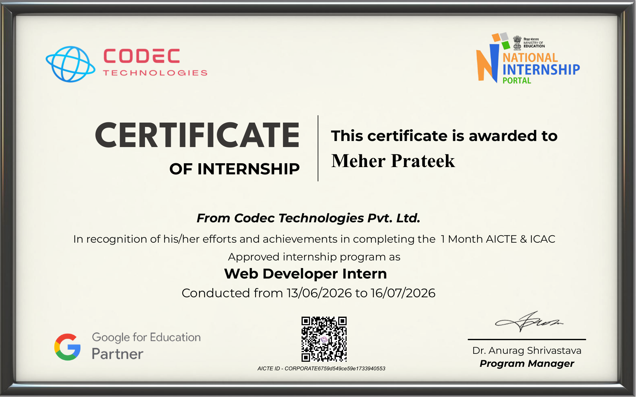
PROOF OF COMPLETION
Internship Completion Certificate
Issued by Codec Technologies Pvt. Ltd. · 13 June 2026 – 16 July 2026 · Role: Web Developer Intern
MEHER.DEV · INTERNSHIP PRESENTATION
2 / 10

Slide 3
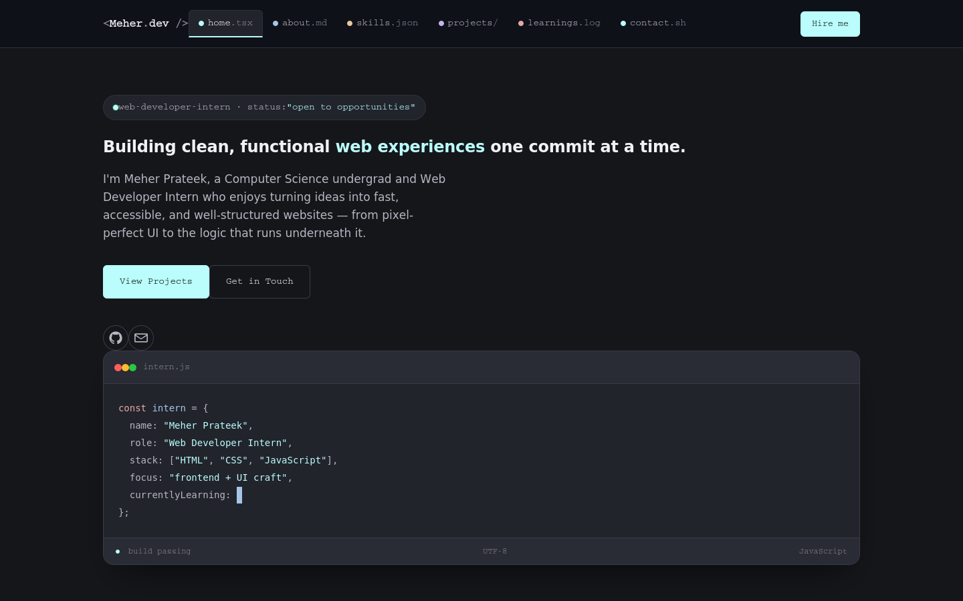
PROJECT OVERVIEW
A personal site, built like a code editor
The portfolio is the internship's project component — a single-page personal website that presents Meher's profile, skills, and internship projects. Its visual identity borrows from the tools developers use every day: the navigation looks like open editor tabs, and projects are shown as repo-style cards — implemented with HTML, CSS and vanilla JavaScript, with no backend or build step.
Client-side app
HTML · CSS · JS
GitHub Pages
The layout adapts across desktop, tablet, and mobile, with smooth-scroll navigation, an active-tab indicator, and reveal animations throughout.
Meher.dev — homepage hero
MEHER.DEV · INTERNSHIP PRESENTATION
3 / 10

Slide 4
ORGANIZATION PROFILE
Codec Technologies Pvt. Ltd.
A global platform connecting learners and talent to meaningful career opportunities, delivering IT and business-consultancy services across 27+ countries with a focus on global innovation and strategic growth.
🌎
GLOBAL REACH
👩‍💻
INTERNSHIP MODE
IT & business consultancy across 27+ countries
Hybrid, Pan-India engagement
🛠️
ASSIGNED ROLE
📅
DURATION
Web Developer Intern
13 June 2026 – 16 July 2026
MEHER.DEV · INTERNSHIP PRESENTATION
4 / 10

Slide 5
THE BRIEF
Problem statement & objectives
KEY OBJECTIVES
PROBLEM STATEMENT
Design a distinctive, code-editor-inspired visual identity instead of a generic template
Many student portfolios lean on generic templates that don't reflect the person who built them, or clearly show what was actually learned and shipped during an internship. This project addresses that by building a single-page personal website that documents the internship experience — skills, projects, and takeaways — using a design language borrowed from the tools developers use every day: code editors and GitHub.
Present skills, internship projects, and learnings in dedicated, well-structured sections
Build fully responsive layouts with a working mobile navigation menu
Implement smooth scrolling, scroll-triggered reveal animations, and an active nav-tab indicator
Apply accessibility practices: semantic markup, visible focus states, reduced-motion support
Deploy the finished static site through GitHub Pages
MEHER.DEV · INTERNSHIP PRESENTATION
5 / 10

Slide 6
SCOPE & TOOLKIT
What's in scope, and what it's built with
IN SCOPE
OUT OF SCOPE
Hero, About, Skills, Projects, Learnings, and Contact sections, plus a responsive nav and footer — entirely client-side.
Backend email delivery, a CMS, user accounts, or database-backed project data — noted as future extensions.
TECHNOLOGIES & TOOLS USED
HTML5
CSS3
JavaScript
VS Code
Structure & semantics
Responsive design system
Interactivity & animation
Development environment
Live Server
Git & GitHub
GitHub Pages
Google Fonts
Local testing
Version control
Public deployment
Typography
MEHER.DEV · INTERNSHIP PRESENTATION
6 / 10

Slide 7
UNDER THE HOOD
A simple, static client-side architecture
The browser loads the HTML document, applies the CSS design system, and runs the JavaScript for navigation, animation, and form handling. There is no application server or database — everything happens directly in the browser, then the static files are served by GitHub Pages.
Figure 1 — Site Architecture of Meher.dev
JavaScript Layer
Scroll reveal + typing
Mobile menu logic
Form validation
User Interface
GitHub Pages
HTML5 structure
Tab-style navigation
Responsive sections
Static file hosting
No server / database
Public live URL
CSS Layer
GitHub-dark design system
Grid & Flexbox layout
Transitions & animation
MEHER.DEV · INTERNSHIP PRESENTATION
7 / 10

Slide 8
METHODOLOGY
From planning to public deployment
1
2
3
4
5
6
Requirements
UI Planning
HTML & CSS
JS Logic
Testing
Deployment
Mapped out the sections needed: hero, about, skills, projects, learnings and contact.
Sketched a code-editor-inspired layout with tab navigation and repo-style cards.
Built semantic structure with a GitHub-dark design system and responsive breakpoints.
Implemented scroll reveal, a typing effect, mobile menu, and form validation.
Manually tested every section across screen sizes and browsers.
Published the static site to GitHub Pages from the repository.
MEHER.DEV · INTERNSHIP PRESENTATION
8 / 10

Slide 9
RESULTS
Outcomes of the internship project
EXPECTED OUTCOMES
LEARNING OUTCOMES
A fully responsive, single-page portfolio site reflecting the internship
Practical experience in semantic HTML, responsive CSS layout (Grid & Flexbox), JavaScript DOM manipulation and event handling, IntersectionObserver-based scroll animation, accessibility fundamentals, Git/GitHub workflows, and static-site deployment. The internship also built experience turning a real internship experience into a clear, well-organized personal narrative for a portfolio.
Working mobile navigation and smooth-scroll section links
Categorized skills and internship-project sections with real write-ups
A commit-log-styled “What I Learned” timeline
A front-end-validated contact form with direct contact links
Live, public deployment on GitHub Pages
MEHER.DEV · INTERNSHIP PRESENTATION
9 / 10

Slide 10
CONCLUSION
Meher.dev shows a complete front-end workflow — from planning and visual identity to a live, deployed website.
Built without frameworks or a backend, the project demonstrates that thoughtful HTML, CSS and JavaScript alone can produce a distinctive, responsive, and genuinely useful personal portfolio.
6
100%
Live
Feature modules
Client-side, no backend
Deployed on GitHub Pages
Thank you
Meher Prateek · B.Tech CSE, 3rd Semester · IILM University, Greater Noida

