Slide 1
JavaScript Introduction
Course Code: CSC 3222
Course Title: Web Technologies
Dept. of Computer Science
Faculty of Science and Technology
Lecture No: | 10 | Week No: | 10 | Semester: | Fall 2024-2025
Lecturer: | MD.AL-AMIN (alamin@aiub.edu)

Slide 2
Lecture Outline
Introduction to JavaScript
Usage of JavaScript and How to Use JavaScript
JS Variables and Data Types
JS Syntax, Output, Statements
JS Operators and Arithmetic operations
JS Events
JS Functions
JS Control flow (If else, loops)

Slide 3
Introduction to JavaScript
JavaScript is a client side programming language which was designed to add
Interactivity to static HTML pages.
JavaScript is a scripting Language
A scripting language is lightweight programming language
JavaScript is interpreted not compiled (means that script execute without preliminary compilation )
JavaScript is also known as ECMASCRIPT
Developed by Brandan Eich in September 1995.
JavaScript and Java have almost nothing in common.

Slide 4
Usage of JavaScript
Topic sub heading..
Great thing about JavaScript is that you will find tons of frameworks and Libraries already developed which can be used.
JavaScript usage has now extended to mobile app development, desktop app development, and game development.
Application of JavaScript is also very easy as it is pre installed in every modern web browsers.
Once you learn about JS it can help you in front-end development as well as back-end development.

Slide 5
Where and How to Use JS
Where to Use
In HTML JavaScript code can be inserted in between <script></script> tags
<script>
Some JS Codes
</script>
In some old examples you may see <script type= "text/javascript" ></script>. Where type is not required as JavaScript is the default scripting language ins HTML.
Scripts can be placed in the <body>, or in the <head> section of an HTML page, or in both.
Placing scripts at the bottom of the <body> element improves the display speed, because script interpretation slows down the display.

Slide 6
Where and How to Use JS
Where to Use
JavaScript can also be placed in external files.
Its better to put JavaScript codes in an external files.
You can place any number of scripts in an HTML document.
External script files are also useful when same code is used in many different web pages.
External files must have the extension .js
To use external js file you need to add a src attribute in the <script> tag. Where the value of src will be the path of the external JS file.
<script src="myScript.js"></script>
The external file can be added both in <head> and <body> section.
This will behave as if the codes are located in the <script> tag.
Remember external scripts cannot contain <script> tag only the JS codes.

Slide 7
Benefits of External JS
It separates the HTML and JavaScript so increased modularity.
Many HTML pages can use same codes so increased reusability.
Modification of code is easier so increased maintainability.
Modern browsers cached JS files so speed up the page loads.
JS files residing in another server can also be used.
Note: As browsers cached up the external JS files to speed up the execution you need to clear cache (ctrl +f5) of the page to reflect the change during development.

Slide 8
How to use JS
JavaScript in <head>
<html>
<head> <script> </script> </head> <body>
<h1>A Web Page</h1> </body>
</html>
JavaScript in <body>
<html>
<head> </head> <body>
<h1>A Web Page</h1>
<script> </script> </body>
</html>
External JavaScript
Can also be put in both head and body
<html>
<head> <script src="myScript.js"></script> </head> <body>
<h1>A Web Page</h1> </body>
</html>
External JavaScript residing in another server
Put the URL of the file
<html>
<head> <script src="https://www.w3schools.com/js/myScript1.js"></script> </head> <body>
<h1>A Web Page</h1> </body>
</html>

Slide 9
JS Variables and Data Types
JS Variables
JavaScript is a loosely typed language.
Loosely typed means the variable is not bound to store a specific type of data like strongly typed languages. If x is a variable it can hold 10 (integer) and "ten" (string).
Creating variable in JavaScript is called declaring a variable.
JavaScript variables are can be declared using var keyword. You can also create variable without var.
Declared variable has the default value undefined
Like other languages variable value can be assigned at the time of declaration using (=) assignment operator.

Slide 10
JavaScript Variable Naming Rules
All variables in a must be identified by a unique name.
These unique names can be called as variables or identifiers.
Variables can be declared with or without var keyword.
var name="AIUB";
var number=10;
Name can contain letters, digits, underscore(_) and dollar($) sign.
Name must begin with a letter or underscore or dollar sign.
Names are case sensitive.
Reserved keyword can not be used as a variable name.
Variable values can be initialized with = operator.
String values are written with double quotation ("") or single quotation (').
Numbers are written without quotation.
Re-declaration of variable will not loss the value.
var name="AIUB";
var name;
//This will not lose the value of name. In next instructions //value of name will remain "AIUB";
var name="AIUB";
var name ="BUET";
What Will Happen?

Slide 11
JavaScript Data Types
As discussed earlier JavaScript is a loosely typed language, this can hold many data types.
JavaScript has 4 primitive data types and 2 complex data type
Boolean (Can have only 2 values true or false)
Number
String
Undefined
Object
Function
JavaScript has dynamic types.
var x; // Now x is undefined x = 5; // Now x is a Number x = "John"; // Now x is a String
typeof keyword returns the type of a variable.

Slide 12
Data Type Number
JavaScript has only one type of number that is float.
JavaScript numbers can be written with or without decimals.
var x = 3.14; // A number with decimals var y = 3; // A number without decimals
JavaScript numbers are always stored as 64-bit floating point.
Integers (numbers without a period or exponent notation) are accurate up to 15 digits.
The maximum number of decimals is 17, but floating point arithmetic is not always 100% accurate.
var x = 0.2 + 0.1; // x will be 0.30000000000000004
This can be solved by multiply and divide.
var x = (0.2 * 10 + 0.1 * 10) / 10; // x will be 0.3
NaN is a JavaScript reserved word indicating that a number is not a legal number. Trying to do arithmetic with a non-numeric string will result in NaN (Not a Number)
Must Read: https://www.w3schools.com/js/js_numbers.asp

Slide 13
Data Type String
Strings are used for storing texts
Strings can be written with single and double quotation.
var carName1 = "Volvo"; // Double quotes var carName2 = 'Volvo'; // Single quotes
To write string with quotations like My name is ‘Jon’ you can write as below
var name= "My name is 'Jon'";
In other case of My name is My name is “Jon” you can do as follows
var name= 'My name is "Jon"';
By default string acts an object. So it has some properties and methods by default.
(.) dot operator is used to access its properties and methods.
Length of the string can be get by length property.
var txt = "ABCDEFGHIJKLMNOPQRSTUVWXYZ"; var sln = txt.length;
Must Read: https://www.w3schools.com/js/js_string_methods.asp

Slide 14
Data Type NULL VS Undefined
Both of them means nothing.
Both of them are same in terms of value but different in type.
When a variable in JavaScript is declared its value is undefined
Null value must be assigned programmatically otherwise its undefined
var a = null; //this one is null
var b; //this one is undefined
You can also explicitly set a variable to equal undefined.

Slide 15
JS Syntax, Output, Statements
JS Syntax
Fixed values are called literals and others are called variables.
Sum = x + y * 8 Literals
Variables
Each instruction is called a statement. Each statement is ended with a semi colon.
var x = 10.5; //this a statement
var x = 10.4; var y = 7; // 2 statements
JavaScript ignores multiple spaces. You can add white space to your script to make it more readable.
var person = "Hege"; var person="Hege";
//both are same
An expression is a combination of values, variables, and operators, which computes to a value.
Sum = x + y * 8 //expression

Slide 16
JS Syntax
Comments are those line of codes which are not interpreted by the interpreter.
In JavaScript the comments are of 2 types.
Single line
var x = 10;
//var y = 12; Single line comment
Multi line
var z = 12;
/*
this lines
Will not be
Executed
*/
We will be learning more about syntaxes day by day.

Slide 17
JS Output
JavaScript can display values in 4 different ways
Into HTML element (inside tags)
In HTML Document
In alert box (Like a pop up message)
In console (usually for developers)
We are about to write our first program using JavaScript. Some points to remember
Each HTML element should be uniquely identified by a id or name.
We will use id attribute to use JavaScript.
name can also be used.
JavaScript operates with a document object which works in a object oriented way.
There are some built in functions and attributes of document object we will use them.

Slide 18
JS Output [InnerHTML]
1. <html> 2. <body> 3. <h1>My First Web Page</h1> 4. <p>My First Paragraph</p> 5. <p id="demo"></p> 6. <script> 7. var para1 = document.getElementById("demo");
8. para1.innerHTML = "Hello World"; 9. </script> 10. </body> 11. </html>
Output of the code:
My First Web Page
My First Paragraph.
Hello World
Lets observe the code. In line 5 the <p> tag has id attribute. The value of id attribute must be unique in a web page.
Now to uniquely identify a particular HTML element JavaScript document object has a predefined method getElementById() which receives the id value as a parameter.
This method returns the HTML element as a object.
In line 7 para1 variable holds the reference of <p> element as a object.
innerHTML is an attribute of HTML element which has starting and closing tag.
There are others attributes of document object we will be covering in further topics.

Slide 19
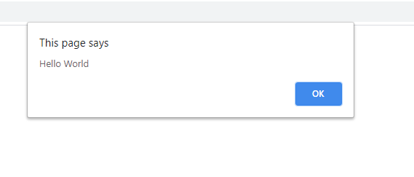
JS Output [document]
1. <html> 2. <body> 3. <h1>My First Web Page</h1> 4. <p>My First Paragraph</p> 5. <script> 6. document.write("Hello World"); 7. </script> 8. </body> 9. </html>
Output of the code:
My First Web Page
My First Paragraph.
Hello World
Lets observe line 6, document object has a method named write() which writes directly in the HTML page. Where ever you put the script it will execute there.
JS Output [alert]
1. <html> 2. <body> 3. <h1>My First Web Page</h1> 4. <p>My First Paragraph</p> 5. <script> 6. alert("Hello World"); 7. </script> 8. </body> 9. </html>
Output of the code:

Slide 20
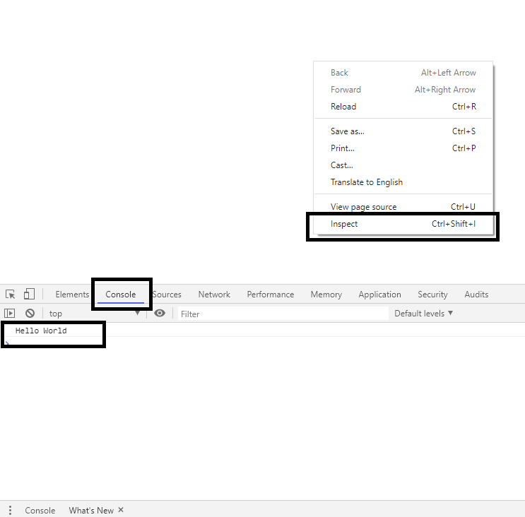
JS Output [console]
1. <html> 2. <body> 3. <h1>My First Web Page</h1> 4. <p>My First Paragraph</p> 5. <script> 6. console.log("Hello World"); 7. </script> 8. </body> 9. </html>
Lets observe line 6, console.log() function which writes directly developer console.
Right click on the HTML page →inspect

Slide 21
JS Operators and Arithmetic operations
Operators
Arithmetic Operator
Assignment Operator
Operator | Description
+ | Addition
- | Subtraction
* | Multiplication
** | Exponentiation
/ | Division
% | Modulus (Division Remainder)
++ | Increment
-- | Decrement
Operator | Example | Same As
= | x = y | x = y
+= | x += y | x = x + y
-= | x -= y | x = x - y
*= | x *= y | x = x * y
/= | x /= y | x = x / y
%= | x %= y | x = x % y
**= | x **= y | x = x ** y
The + operator can also be used to add (concatenate) strings.
The += assignment operator can also be used to add (concatenate) strings.

Slide 22
JS Operators
Comparison Operator
Logical Operator
Operator | Description
== | equal to
=== | equal value and equal type
!= | not equal
!== | not equal value or not equal type
> | greater than
< | less than
>= | greater than or equal to
<= | less than or equal to
? | ternary operator
Operator | Description
&& | logical and
|| | logical or
! | logical not
=== Operator is used for checking both the value and type
var a = 10;
var b = "10";
Both a and b holds the value of 10 but a is of number type and b is of string type.
a==b will result true as both the value are same.
a===b will check value and type. This will return false.

Slide 23
Arithmetic Operations
Arithmetic operations are like other programming languages.
var a = 10;
var c = a + b * 10;
As in traditional school mathematics, the multiplication is done first.
Multiplication (*) and division (/) have higher precedence than addition (+) and subtraction (-).
And (as in school mathematics) the precedence can be changed by using parentheses
var c = a + b * 10;
When many operations have the same precedence (like addition and subtraction), they are computed from left to right.
var c = a + b – 10;
Must Read: https://www.w3schools.com/js/js_arithmetic.asp

Slide 24
Books
1. W3Schools Online Web Tutorials; URL: http://www.w3schools.com
2. PHP Documentation; URL: http://www.php.net/docs.php
3. Sams Teach Yourself Ajax JavaScript and PHP All in One; Phil Ballard and Michael Moncur;
Sams Publishing; 2010
4. JavaScript Phrasebook; Christian Wenz; Sams Publishing; 2007
5. PHP and MySQL Web Development, 4/E; Luke Welling and Laura Thomson; AddisonWesley
Professional; 2009
6. JavaScript for Programmers Paul J. Deitel and Harvey M. Deitel; Prentice Hall; 2009
7. Beginning PHP5, Apache, and MySQL Web Development; Elizabeth Naramore, Jason
Gerner, Yann Le Scouarnec, Jeremy Stolz and Michael K. Glass; Wiley Publishing; 2005
8. XML in a Nutshell, 3/E; Elliotte Rusty Harold and W. Scott Means; O'Reilly Media; 2004

Slide 25
References
https://www.w3schools.com/js/
https://www.springboard.com/blog/history-of-javascript/

