Slide 1
MVC
Course Code: CSC 3222
Course Title: Web Technologies
Dept. of Computer Science
Faculty of Science and Technology
Lecturer No: | 13 | Week No: | 13 | Semester: | Fall 2024-2025
Lecturer: | MD.AL-AMIN (alamin@aiub.edu)

Slide 2
Lecture Outline
Introduction to MVC
MVC Architecture
Features of MVC
Course mapping and Project Discussion

Slide 3
Introduction to MVC
MVC is an application design pattern that separates the application data and business logic (model) from the presentation (view). MVC stands for Model, View & Controller.
The controller mediates between the models and views.
Think of the MVC design pattern as a car and the driver.
The car has the windscreens (view) which the driver (controller) uses to monitor traffic ahead then speed or brake (model) depending on what he sees ahead.

Slide 4
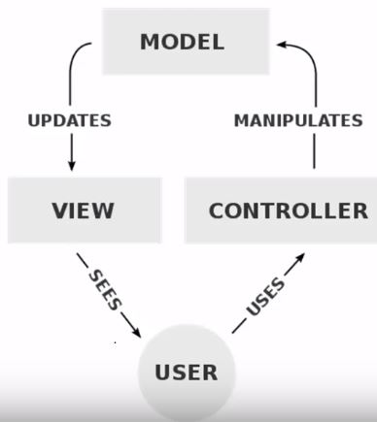
MVC Architecture

Slide 5
MVC Architecture
Model: Database operation such as fetch data or update data etc.
View: End-user GUI through which user can interact with system, i.e., HTML, CSS.
Controller: Contain Business logic and provide a link between model and view.
Model:
The Model object knows all about all the data that need to be displayed.
The Model represents the application data and business rules that govern to an update of data.
Model is not aware about the presentation of data and How the data will be display to the browser.
View:
The View represents the presentation of the application.
View object refers to the model remains same if there are any modifications in the Business logic.
In other words, we can say that it is the responsibility of view to maintain consistency in its presentation and the model changes.

Slide 6
MVC Architecture
Controller:
Whenever the user sends a request for something, it always goes through Controller.
A controller is responsible for intercepting the request from view and passes to the model for appropriate action.
After the action has been taken on the data, the controller is responsible for directly passes the appropriate view to the user.
In graphical user interfaces, controller and view work very closely together.

Slide 7
Features of MVC
Advantages of MVC architecture:
Development of the application becomes fast.
Easy for multiple developers to collaborate and work together.
Easier to Update the application.
Easier to Debug as we have multiple levels properly written in the application.
Disadvantages of MVC architecture:
It is hard to understand the MVC architecture.
Must have strict rules on methods.

Slide 8
Popular MVC
Laravel
CodeIgniter
Symfony
CakePHP
Yii
Zend Framework

Slide 9
Course Mapping
HTML, CSS, PHP, JS, MySQL
Web Technology
ATP 3
Express JS, Laravel
ATP 1
ATP 2
ASP.Net and .Net Framework
J2EE, Spring, Hibernate

Slide 10
References
MySQL - www.mysql.com
W3Schools Online Web Tutorials- www.w3schools.com
PHP Manual - www.php.net
Javatpoint - www.javatpoint.com

Slide 11
Books
Sams Teach Yourself Ajax JavaScript and PHP All in One; Phil Ballard and Michael Moncur;
Sams Publishing; 2010
JavaScript Phrasebook; Christian Wenz; Sams Publishing; 2007
PHP and MySQL Web Development, 4/E; Luke Welling and Laura Thomson; AddisonWesley Professional; 2009
JavaScript for Programmers Paul J. Deitel and Harvey M. Deitel; Prentice Hall; 2009

