Slide 1







#LiveCodeNow
How to build a Live-Broadcasting Social Media App on Flutter
By - Meherdeep Thakur
Built for mobile, web and desktop apps.
Serving over 20 billion Global minutes per month
Voice Chat. Video Chat.
Live Audio/Video Interactive Streaming.

Slide 2



About me
Full stack developer
ML/AI
Flutter Developer
github.com/Meherdeep
linkedin.com/in/meherdeep/

Slide 3





What's Agora?
Companies turn to Agora for our industry leading voice, video chat, and live interactive streaming platform, which is powered by Agora’s real-time engagement network.
WHAT
SETS
AGORA
APART
Video Calling
Audio Calling
RTM
A/V Broadcasting

Slide 4

What are we gonna build today?
Using Agora's Flutter SDK we will be making a live interactive broadcasting app

Slide 5

Pre-requisites
1. Android Studio or VS Code
Android studio 3.0 or later
2. Flutter SDK
https://flutter.dev/docs/get-started/install
3. Android/iOS device or emulator
For testing the app that we built
4. Agora Flutter SDK
https://pub.dev/packages/agora_rtc_engine
5. Agora Developer account
Go to console.agora.io/ and generate an APP ID

Slide 6


Steps
* Broadcaster View * Audience View * RTM
LIVE INTERACTIVE AUDIO/VIDEO STREAMING
Serving over 20 billion Global minutes per month

Slide 7

Get Started
Clone the repo given below
https://github.com/Meherdeep/Interactive-Broadcasting
The repo contains the template for the
broadcasting app that we will be using.

Slide 8
Let's jump to coding
Serving over 19 billion Global minutes per month

Slide 9
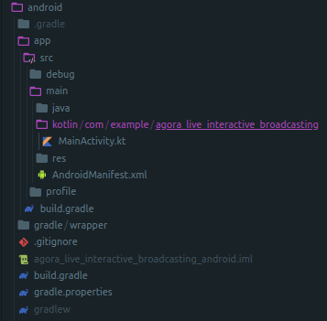
FAQ
Black Screen while initiating a call
Go to your project directory and redirect to MainActivity.kt
And remove this GeneratedPluginRegistrant.registerWith(flutterEngine)

Slide 10
FAQ
Adding watermark to your stream
Use addVideoWatermark() api to add a watermark on top of your stream
addVideoWatermark(String url, WatermarkOptions options)

Slide 11
Thank You

